Slide 1
DIRAC 4 EGI
March 13th 2014

Slide 2
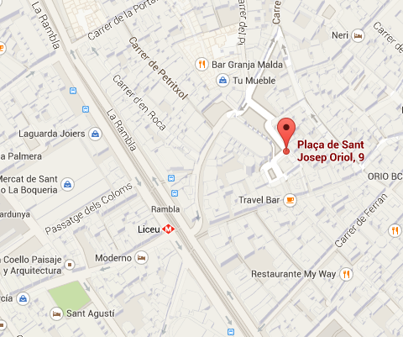
Agenda
10:00 – 11:30 F2F
11:30 – 12:00 Coffee Break
12:00 – 13:00 Pilot Status (I)
Installation and Configuration Status
Resource Provision Plans
13:00 – 14:30 Lunch
14:30 – 16:30 Pilot Status (II)
Pilot Users
Production Planning
16:30 – 17:00 Coffee Break
17:00 – 19:00 Towards H2020
21:00 – 00:00 Dinner
Taller de Tapas
Plaza Sant Josep Oriol 9 (Plaza del Pí) (L3 Liceu)

Slide 3
Towards H2020
Fast Presentation round
Explanation of the main idea of the proposal:
Viability (H2020) and sustaintability (beyond H2020
Developing: DIRAC VRE commonity, VRE specific, other VRE
Training and outreach
Business planning
Expression of interest in contribution
Work Plan proposal from Spanish potential partnership:
https://docs.google.com/document/d/16RAxM8PoQ4EFt-RYrYUw-JAau0nKHD9FEHGF0SBu9ZM
Consensus of the Working Packages and Activities
Matrix of potential contributors and activities

