Slide 1
UMD 2 / EMI 2 Decommissioning Status
Cristina Aiftimiei
EGI.eu

Slide 2
Overview
UMD 2:
Decommissioning Calendar
Status Update

Slide 3
Decommissioning Calendar
EMI 2 EOL– April 2014
Since Nov. 2013 – raise the awareness of the approaching End of Security Support of UMD(EMI) 2 services and the need to plan a massive decommissioning/migration process:
Official Calendar
https://wiki.egi.eu/wiki/Software_Retirement_Calendar%23EMI_2
end of Jan 2014
05/02/2014 - broadcast was sentto sites
https://operations-portal.egi.eu/broadcast/archive/id/1080
ROD alarm template was provided:
https://wiki.egi.eu/wiki/ROD_MW_alarm_template%23EMI_2_retirement_campaign
And the list of affected middleware versions
end of Feb. 2014
12/03/2014 – started to raise alarms for UMD 2 services
https://ggus.eu/?mode=ticket_info&ticket_id=101888
description of SAM probes was provided
https://wiki.egi.eu/wiki/MW_Nagios_tests%23EMI-2_tests
end of May 2014 - possible suspension of sites providing unsupported services

Slide 4
Status Update
Number of instances to be decommissioned:
Service Type | As of March 7th | As of April 7th
ARC-CE | 11* | 0
BDII_site | 159 | 68
CREAM | 220 | 87
DPM | 127 | 67
StoRM | 4 | 2
VOMS | 9 | 7
WMS | 7 | 6
Sites with WNs | 130 | 94

Slide 5
UMD2 Relevant Services
Relevant services:
using specific SAM probes
ARC, DPM, STORM, WN
using generic SAM probe (MiddlewareVersion=2.*)
ARGUS, BDII, CREAM, LB, LFC, MyProxy, VOMS, WMS
Exception:
dCache 2.2.x supported until July 2014

Slide 6
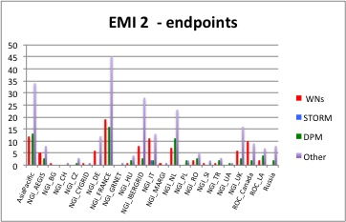
No of endpoints per NGI
Ref:
http://bit.ly/EMI2_NGI_07042014

Slide 7
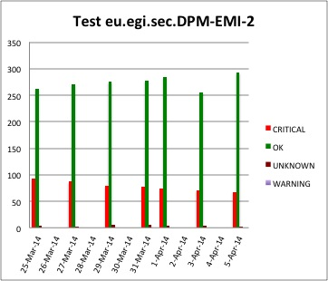
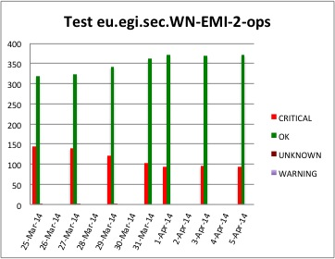
Trends (I)

Slide 8
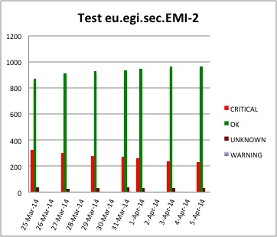
Trends (II)

Slide 9
Conclusions
ON schedule
Sites are responsive and no blocking issues were reported

