Slide 1
EUDAT AAI in a nutshell
“Keep the [first] S in SSO”
EGI singalong in Amsterdam, 24 Sep ’14
Jens Jensen, STFC
Shiraz Memon, FZJ

Slide 2
EUDAT Data Services
(Research) data e-Infrastructure
B2SAFE – deposit data into infrastructure
Based on iRODS
B2SHARE – share data with other researchers
Based on Invenio
B2FIND – discover stuff, based on CKAN
B2DROP – like dropbox, based on ownCloud
B2STAGE – move data into and out of other e-Infra (PRACE, EGI, …)

Slide 3
Requirements
Work with existing community IdPs
CLARIN (linguistics) – SAML ☺
ENES (Climate) – OpenID 😐
EPOS (Earth obs) – any EUDAT IdP
VPH (Physiology) – passwords ☹
In discussion with more…

Slide 4
Outline architecture
Use federated login
Internally, portal requests X.509 certificate
Central CA signs it, adding fed-level attributes
Users normally use cert via portal
They can obtain the certificate-and-key for command line
Based on Contrail and Unity
http://contrail-project.eu/
http://unity-idm.eu/
Code open source, in ow2, and github, and bitbucket ☺
(Contrail has ended, EUDAT “embraced and extended” ☺)

Slide 5
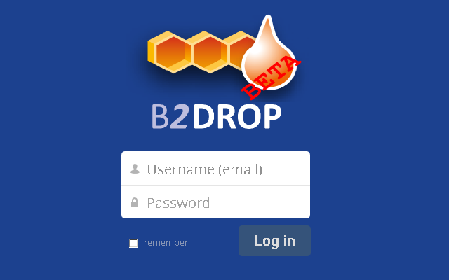
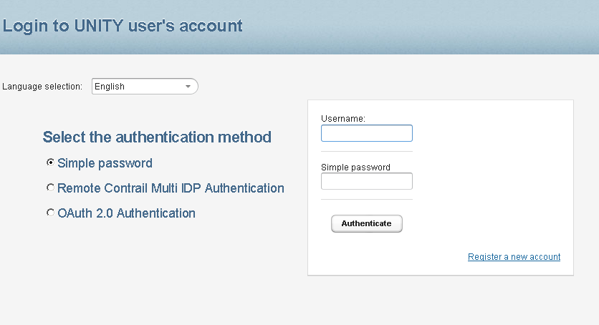
Status
Services exist but are not yet using federated login
Federation exists but needs more (pre)production IdPs
Community integration effort is essential!

Slide 6
Phases of Delivery
Within EUDAT1 (till ~Feb 2015)
Services in preproduction (running at FZJ)
IGTF certificates
Browser friendly certificates on browser-facing hosts
“Real” (not (only) test) identities from communities
First communities: CLARIN, EPOS, ENES (in this order)
Services: B2SHARE, then B2DROP(?)
Authentication to services (but coarse grained authorisation)
Basic support for LoA of IdP (as in Contrail)

Slide 7
Authorisation
Expect to achieve partially now (coarse grained or special cases)
Future: AARC – Proposal (submitted 2 Sept. 2014)
Future: EUDAT2020 – Proposal (submitted 2 Sept. 2014)
Integrate community (non-IdP) authorisation sources
Can we work with what they already have?
REMS, YAVOM/PERUN, VOMS, HEXAA, VAPOR, COmanage, …
Unify role naming
admin → urn:eu:clarin:mpi:role:admin
Consistent management across federation
Thinking of importing and converting to common format
Experimented with common policy format in XACML already

Slide 8
Future Directions?
Expecting AARC to deliver production AAI
Role of eduGain and GEANT 3+/4?
Following Moonshot closely (see next slide)
Promises SSO out of the box
Potential to deliver authorisation attributes?

Slide 9
Moonshot – www.project-moonshot.org
Like eduRoam, but for higher level services
Also non-browser-based services, like ssh
Carries attributes
Based on IETF standards
RADIUS
EAP
And OASIS
SAML
Is itself a standard in IETF
ABFAB-WG

Slide 10
Thank you!

