Slide 1
Towards a Structural Biology Work Bench
Chris Morris, STFC / CCISB

Slide 2
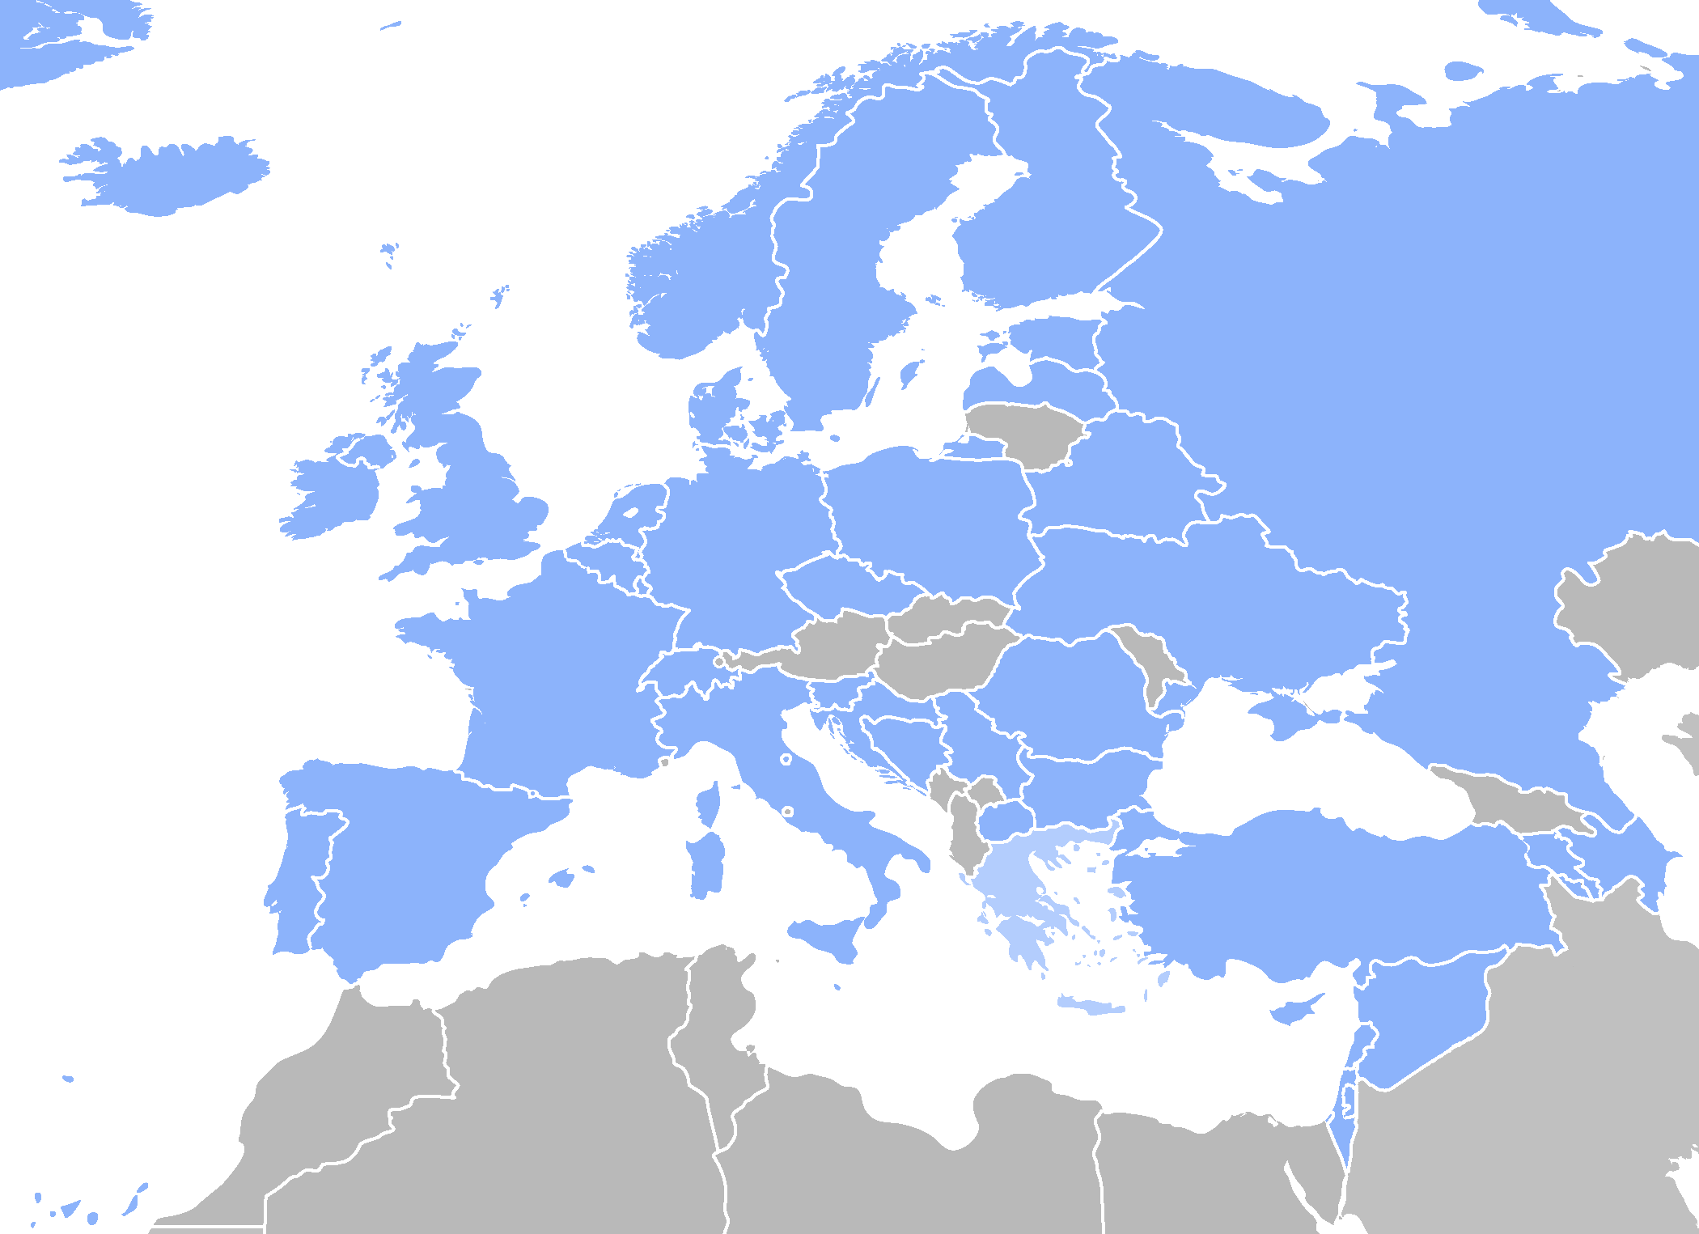
INSTRUCT & Structural Biology
Instruct is a distributed Research Infrastructure serving a large user community (including NMR (WeNMR), X-ray, SAXS, cryo-EM)
129 infrastructure platforms, 11 networks hosted on the hub, 10 countries full Instruct members, 2 affiliate, 4 in progress
Providing large scale and cutting edge technologies for structural biology beyond the reach of many national resources
Moving toward ERIC (expected 2015)
www.structuralbiology.eu

Slide 3
Structural Biologists are mature computer users
Protein Data Bank
Log new entries by year
First use of digital computers in 1940s

Slide 4
New scientific goals
Larger macromolecular machines
Membrane association
4D
Transient interactions

Slide 5
Confirmed by survey
73% at Instruct AGM working on eukaryotic rather than prokaryotic systems
84% working on complexes rather than single gene products
Each research team routinely uses three-four different techniques
73% found it hard to combine software tools for different techniques in integrated workflows
306/324 agree " If a web portal offers integrated access to data archives and to processing software, I will use it".

Slide 6
New experimental methods
Combined techniques
not always an expert
Small samples
Data noisy and incomplete
Deliver results to other life scientists

Slide 7
New data challenges
Data volume:
Combined output of European SB facilities > LHC
XFEL will double it
Some datasets too big to move economically
Improve archiving of data and metadata
Improve automated pipelines for MX
… create pipelines for other techniques
Provenance
Keywords, version numbers
Combined algorithms
Quality indications

Slide 8
Crowdsourcing from the middle tier
Community includes:
Life scientists who use computers
End user programmers
Algorithm developers
Must be easier to compose existing services to make a new web page
Google widgets / BioJS / Web Components
Semantic web

Slide 9
Cost of user management
 | ALBA | BER II | DESY | DLS | ELETTRA |  | ESRF | FRM-II | ILL | ISIS | LLB | SINQ | SLS | SOLEIL | neutron | photon | all
ALBA | 773 | 7 | 61 | 58 | 51 |  | 281 | 2 | 51 | 13 | 5 | 10 | 77 | 105 | 69 | 400 | 773
BER II | 7 | 1563 | 115 | 46 | 27 |  | 179 | 157 | 383 | 198 | 98 | 191 | 62 | 36 | 580 | 329 | 1563
DESY | 61 | 115 | 4197 | 137 | 222 |  | 851 | 116 | 255 | 113 | 62 | 95 | 315 | 188 | 469 | 1294 | 4197
DLS | 58 | 46 | 137 | 4407 | 102 |  | 810 | 30 | 267 | 399 | 33 | 52 | 229 | 192 | 546 | 1130 | 4407
ELETTRA | 51 | 27 | 222 | 102 | 3167 |  | 433 | 11 | 77 | 35 | 20 | 18 | 179 | 367 | 141 | 900 | 3167
ESRF | 281 | 179 | 851 | 810 | 433 |  | 10287 | 139 | 900 | 369 | 190 | 174 | 963 | 1286 | 1313 | 3586 | 10287
FRM-II | 2 | 157 | 116 | 30 | 11 |  | 139 | 1095 | 347 | 137 | 89 | 161 | 33 | 29 | 509 | 259 | 1095
ILL | 51 | 383 | 255 | 267 | 77 |  | 900 | 347 | 4649 | 731 | 301 | 395 | 156 | 222 | 1518 | 1347 | 4649
ISIS | 13 | 198 | 113 | 399 | 35 |  | 369 | 137 | 731 | 2880 | 89 | 233 | 94 | 56 | 936 | 745 | 2880
LLB | 5 | 98 | 62 | 33 | 20 |  | 190 | 89 | 301 | 89 | 1235 | 74 | 39 | 151 | 391 | 323 | 1235
SINQ | 10 | 191 | 95 | 52 | 18 |  | 174 | 161 | 395 | 233 | 74 | 1219 | 224 | 31 | 590 | 415 | 1219
SLS | 77 | 62 | 315 | 229 | 179 |  | 963 | 33 | 156 | 94 | 39 | 224 | 3827 | 399 | 371 | 1470 | 3827
SOLEIL | 105 | 36 | 188 | 192 | 367 |  | 1286 | 29 | 222 | 56 | 151 | 31 | 399 | 4568 | 394 | 1817 | 4568
neutron | 69 | 1563 | 469 | 546 |  | 141 | 1313 | 1095 | 4649 | 2880 | 1235 | 1219 | 371 | 394 | 10023 | 2334 | 10023
photon | 773 | 329 | 4197 | 4407 |  | 3167 | 10287 | 259 | 1347 | 745 | 323 | 415 | 3827 | 4568 | 2334 | 25336 | 25336
all | 773 | 1563 | 4197 | 4407 |  | 3167 | 10287 | 1095 | 4649 | 2880 | 1235 | 1219 | 3827 | 4568 | 10023 | 25336 | 33025

Slide 10
Reinvent nothing
Existing best practise includes:
weNMR
PaNData
Diamond: pipelines and archives
Scipion
Data Life Cycle Lab
Integration, not competition

Slide 11
Structural Biology Work Bench
Seamless data transfer between stages
Accumulate metadata without user intervention
No installation effort
Extensible
Project view, not visit view
Data management should be combined with data processing

Slide 12
Work packages
a distributed file system
a rigid body docking service that can use a variety of experimental evidence
an atomistic structure solution service that can use a variety of experimental evidence
a toolkit for making new active web pages that address new scientific questions
a construct design service
scientific collaborations, which validate the work in progress by putting it to use

Slide 13
Developing infrastructures
Understand context of use
Detailed requirements
User experience design
Service architecture
Develop
… hand in hand with pilot research projects
Seek feedback
users need to become much more directly involved in strategy, coordination and innovation in each of the e-Infrastructure components. This implies that users also need to be empowered to drive the direction of e-Infrastructure service. To this end, the funding for service delivery should be channelled through the users, rather than directly to the service delivery organisations.
e-IRG White Paper 2013

Slide 14
VRE for Instruct?
Participants welcome

Slide 15
References
Biasini et al. (2013). Acta Cryst. D69, 701-709.
Gutmanas et al. (2013). Acta Cryst. D69, 710-721.
Karaca, E. & Bonvin, A. M. J. J. (2013). Acta Cryst. D69, 683-694.
Marabini, et al. (2013). Acta Cryst. D69, 695-700.
Morris, C. & Segal, J. (2012). IEEE Software, 29, 9-12.
Perrakis et al. J. Struct. Biol. 175, 106-112.
DiMaio et al., Nature Methods, Improved protein crystal structures at low resolution by integrated refinement with Phenix and Rosetta, in press
https://www.structuralbiology.eu/sites/default/files/Instruct_Software_Survey.pdf

Slide 16
Part of life of structure data
CCP4GUI2
PDB
Local
Store
Xia2
PiMS
End user
MrBump

