Slide 1
IRIS: Enabling Research Consortiums
EGI Conference on Challenges and Solutions for Big Data Processing on Cloud
September 26, 2014
Dean Flanders (FMI/SystemsX) /
Peter Kunszt (UZH/SIB/SystemsX)

Slide 2
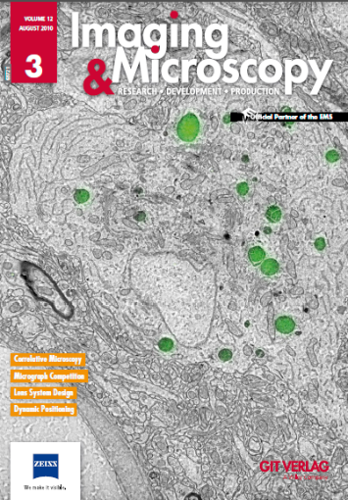
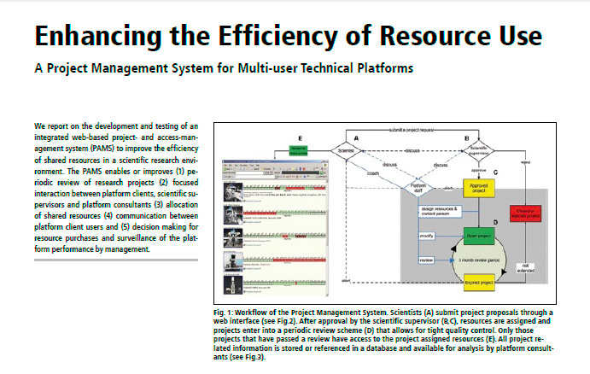
Resource Sharing System

Slide 3
IRIS enables science as a service
Empowers researchers to share resources within and across institutions.
Supports: instruments, service requests, and applications
Creates a virtual pool of resources for collaborations and communities.
Usage restrictions and metering/billing can be enforced on resources.
Directory of resources, people, groups, communities, and organizations.
Supports multiple affiliations of individuals, social identities, and federated identities.

Slide 4
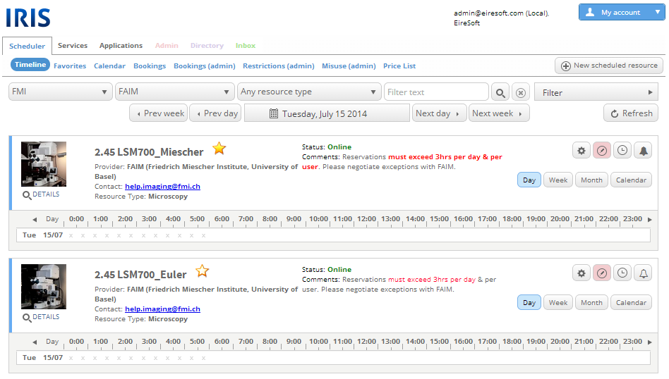
IRIS: Resource Scheduler

Slide 5
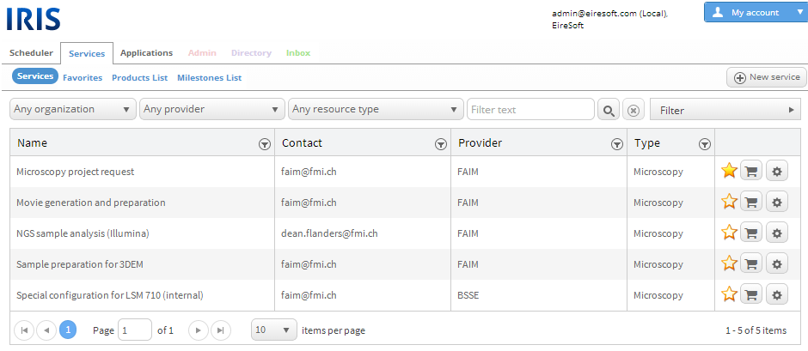
IRIS: Service Requests

Slide 6
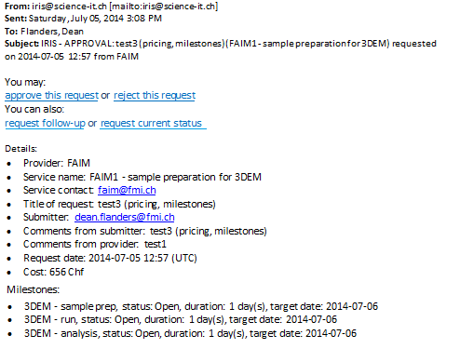
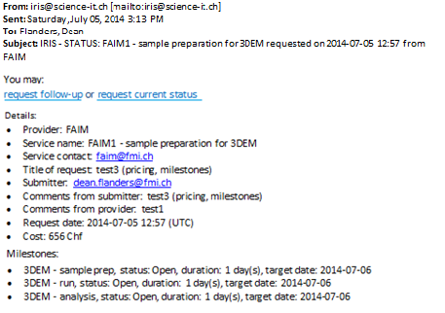
IRIS: Request Workflow
Request "test3 (pricing, milestones)" of service FAIM1 - sample preparation for 3DEM (FAIM): APPROVED
Click here to navigate to IRIS
Request "test3 (pricing, milestones)" of service FAIM1 - sample preparation for 3DEM (FAIM): REJECTED
Click here to navigate to IRIS
Request "test3 (pricing, milestones)" of service FAIM1 - sample preparation for 3DEM (FAIM): STATUS REQUESTED
Click here to navigate to IRIS
Request "test3 (pricing, milestones)" of service FAIM1 - sample preparation for 3DEM (FAIM): FOLLOW-UP REQUESTED
Click here to navigate to IRIS

Slide 7
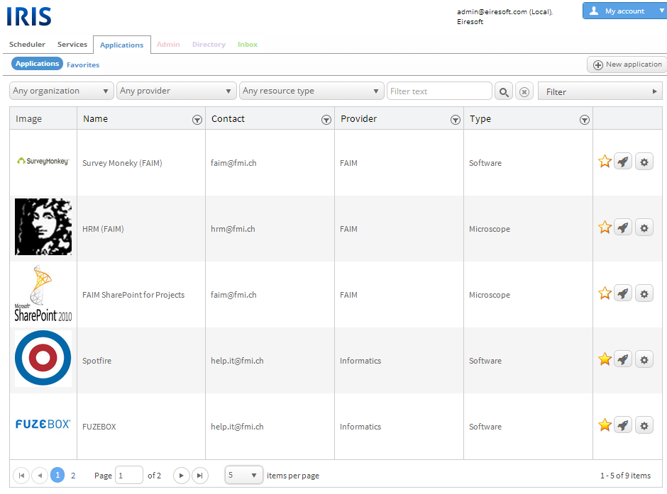
IRIS: App Store

