Slide 1
Cloud Security Session: Introduction
David Kelsey (STFC-RAL)
EGI-Geant Symposium Amsterdam 25 Sep 2014

Slide 2
Cloud Security
Aim of this session
Consider Operational Security
For Distributed, Collaborative, Federated Cloud infrastructures
EGI, GEANT, others
There is LOADs of activity on Cloud Security in many projects, organisations
Much of this concentrates on single providers or technology
We should avoid duplication
Consider the Challenges and Solutions
But mainly the challenges with ideas how to move forward!
Identify those who wish to collaborate

Slide 3
Why Operational Security?
Collaborate with local security teams to provide a distributed capability
Risk Management
Protect assets
Not just services
Also intangibles such as Reputation
Maintain Availability, Confidentiality and Integrity
An open, collaborative multi-domain environment
we have to build and maintain TRUST
We do not have the resources nor mandate for full technical & operational controls
Unlike some commercial Cloud providers

Slide 4
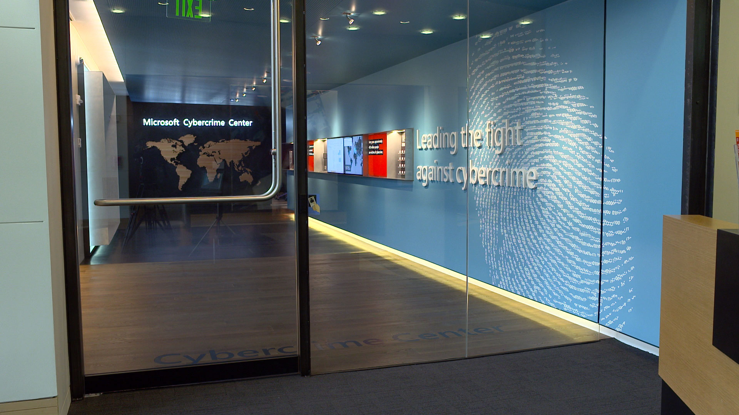
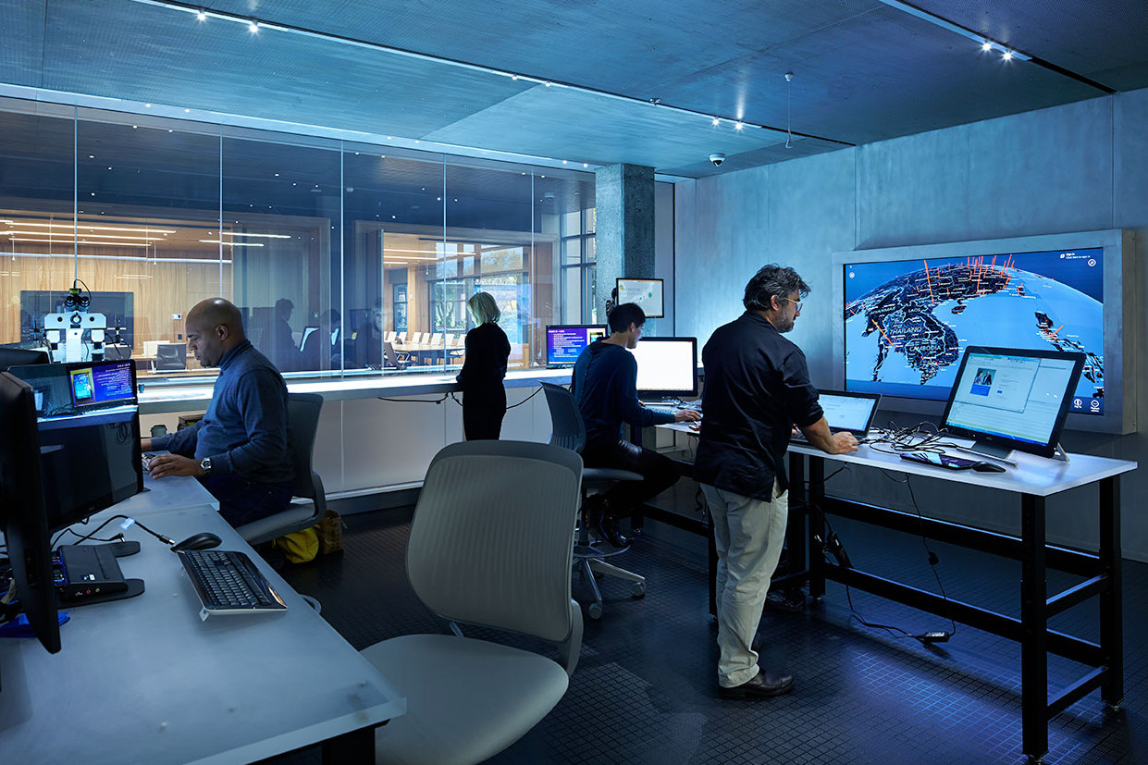
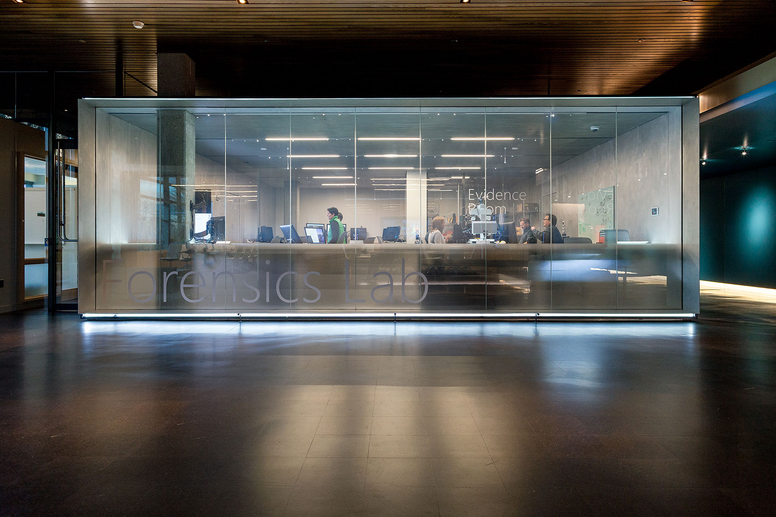
Microsoft Cybercrime Centre

Slide 5
Google security team
https://cloud.google.com/files/Google-CommonSecurity-WhitePaper-v1.4.pdf
Google employs a full-time Information Security Team that is composed of over 250 experts in information, application, and network security.

Slide 6
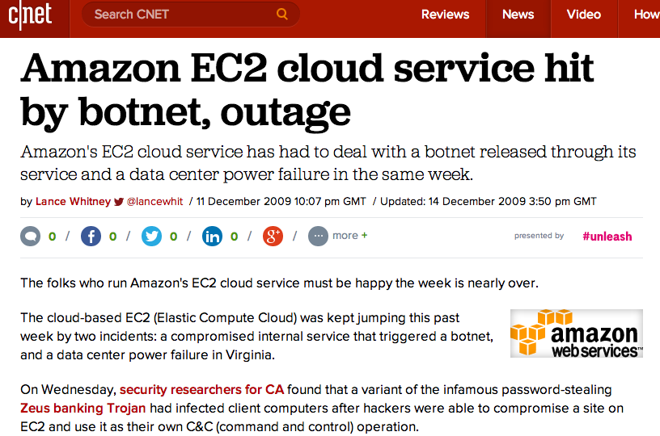
http://www.cnet.com/uk/news/amazon-ec2-cloud-service-hit-by-botnet-outage/

Slide 7
Experience of EGI Security
Security Operations (more details next slides)
Prevent Security Incidents
Handle Security Incidents
Identity Management (IGTF/EUGridPMA) & AAI, VOMS
Moving to more general use of national federated identities
Build TRUST (internal/external) and best practices
Security Policy, Operational Security collaboration
Training and dissemination
Collaborate with others
Shared threats, incidents and users - but also more efficient
TERENA TI/TF-CSIRT, GRID-SEC, WLCG, OSG, PRACE, EUDAT, GEANT, XSEDE, OGF,…

Slide 8
Security Operations
Prevent Security Incidents
Security monitoring
Security intelligence
Assessment of reported vulnerabilities with Software Vulnerability Group (SVG)
Preparation and distribution of advisories and alerts
Perform security drills
Monitor progress of patching for Critical vulnerabilities. E.g. OpenSSL Heartbleed
Training (users, admins, developers, VO managers …)
Application and code security analysis and review (looking for vulnerabilities)
Assessing new technology before deployment

Slide 9
Security Operations (2)
Handle Security Incidents
Incident handling
Incident investigation
Audit logs (traceability)
Emergency user suspension
Communication with sites, services and management
Coordination with site/national CSIRTs, law enforcement, non-R&E CSIRTs
Forensic analysis
Technical support
Incident reports

Slide 10
Challenges: new deployments
New technologies and infrastructure deployments introduce new threats, risks and trust models
Assessment of requirements, risks and security architecture
May require new policies and procedures
Developing new techniques for detecting vulnerabilities
Training to avoid introduction of vulnerabilities in new areas

Slide 11
New Trust models
TRUST is an important part of our security model
To date we had a single Grid trust model (~14 years)
Central Ops, NGIs, Sites, VOs, Users
Now moving to more complex trust!
VRCs now run services
Many virtual environments
Heterogeneous technologies
Federated services/providers who are not direct members of the trust domain
Lower levels of assurance in Identity Management
We need to develop best practices, policies, procedures and tools that will work in this environment
IaaS under community control
Moving towards support of the Long-tail of Science
Need to address legal requirements from EU Data Protection

Slide 12
Today’s agenda
Traceability (David Groep)
Vulnerability handling (Linda Cornwall)
Security Monitoring (Daniel Kouril)
Cloud Resource Providers (Sven Gabriel)
Plans and discussion (Ian Collier)

Slide 13
Questions?

