Slide 1
Storage Management Overview
Andrea Manzi
CERN
EGI Conference on Challenges and Solutions for Big Data Processing on cloud
24/09/2014

Slide 2
Outline
DPM
LFC
Dynamic Federations
EOS

Slide 3
Disk Pool Manager (DPM)
The Disk Pool Manager (DPM) is a lightweight storage solution for grid sites. It offers a simple way to create a disk-based grid storage element and supports relevant protocols (SRM, gridFTP, Xroot, WebDav, RFIO) for file management and access.
It focus on manageability (ease of installation, configuration, low effort of maintenance), while providing all required functionality for a grid storage solution:
support for multiple disk server nodes
multiple file replicas in disk pools
multi VO support

Slide 4
DPM Architecture
Separation between metadata and data access
Direct data access to/from Disk Nodes
Strong authentication/authorization
Multiple access protocols
NFS
HTTP/DAV
XROOT
CLIENT
NS
DPM
GRIDFTP
HEAD NODE
NFS
HTTP/DAV
XROOT
DISK NODE
GRIDFTP
DISK NODE
RFIO
DISK NODE
DISK NODE

Slide 5
LCG File Catalog (LFC)
Shares most of the codebase with DPM
Offers a hierarchical view of files to users, with a UNIX-like client interface. It provides:
Logical File Name (LFN) to Storage URL (SURL) mappings;
Authorization on its logical namespace;

Slide 6
Deployment statistics
DPM is the most widely deployed grid storage system in EGI
Over 200 sites in 50 regions
Over 300 VOs
~36 PB (10 sites with > 1PB)
LFC enjoys wide deployment too
50 instances at 48 sites
Over 300 VOs

Slide 7
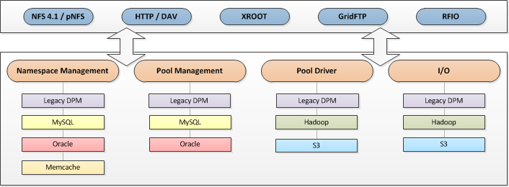
New core library
New plugin based library (dmlite)
Refactoring of the existing code
Single library used by all frontends
Extensible, open to external contributions
Easy integration of standard building blocks
Apache, HDFS, S3, Memcache

Slide 8
Latest DPM release
Version 1.8.9 RC
Many performance improvements
Memcache adoption, in-memory caching, etc.
Realtime Monitoring
Transition to Puppet configuration

Slide 9
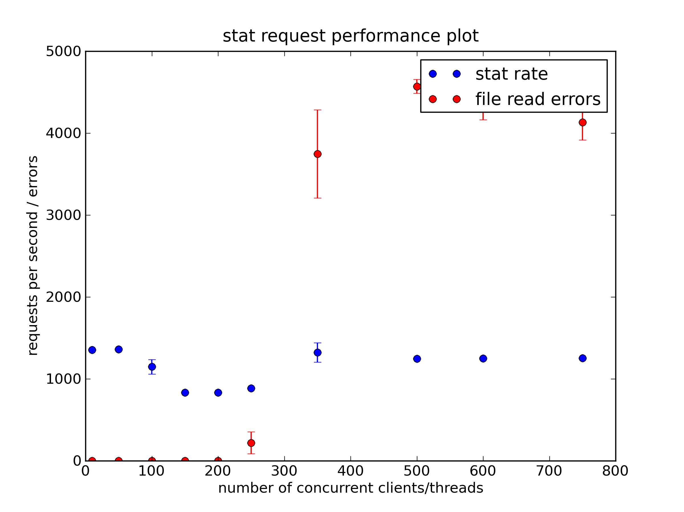
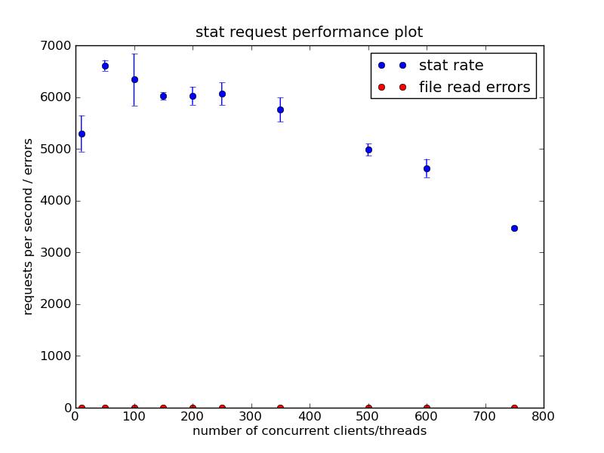
Performance Boost
RC DPM 1.8.9 compare to 1.8.8
WebDav File Stat/s: 5X boost!

Slide 10
DPM Collaboration
Started in 2013 in order to maintain, develop and support the DPM/LFC Software stack for the benefit of the user communities members of the collaboration:
CERN, CESNET, GridPP, Japan, France, Italy and ASGC.
DPM Community Workshop
Naples 09-10 October 2014

Slide 11
Dynamic Federations (DynaFeds)
A set of components that can aggregate on-the-fly storage and metadata farms exposing standard protocols, supporting redirections and WAN data access:
Browse and access a huge repository made of many sites without requiring a static index
Features:
No “registration”, no maintenance of catalogues
Redirect intelligently clients asking for replica
Automatically detects and avoid sites that go offline
Can make client-dependent choices on the fly
Accommodates algorithmic name translations (e.g. SRM TURL to HTTP)
Accommodates client-geography-based redirection choice

Slide 12
Aggregation
This is what
we want to see as users
Sites remain independent
and participate to a global
view
All the metadata interactions
are hidden and done on the
fly
NO metadata persistency
needed here, just efficiency
and parallelism
With 2 replicas
/dir1
/dir1/file1
/dir1/file2
/dir1/file3
.../dir1/file1
.../dir1/file2
.../dir1/file2
.../dir1/file3
Storage/MD endpoint 1
Storage/MD endpoint 2

Slide 13
Demo Testbed
We have a stable demo testbed, using HTTP/DAV http://federation.desy.de
It is actually various demos in one
A fully dynamic catalogue-free demo between DESY, CERN and other sites ( DPM and dCache)
A small ATLAS demo, federating 8 sites, plus LFC as name translator and listing provider
The feeling it gives is surprising and (un)impressively normal
Browsing performance is in avg much higher than contacting the endpoints
We see the directories as merged, as if it were only one system

Slide 14
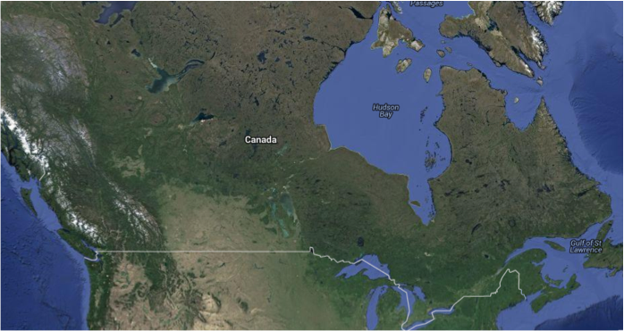
Deployments: NEP-101 and FERMILAB
NEP-101 is a project to enable data-intensive applications to run on distributed clouds
Batch services, Software distribution, Storage Federation, Image Distribution
Need to use standard protocols, open-source components, avoid anything HEP-specific
Have multiple clouds and SEs in various locations; cloud jobs need to find SEs
Use the Dynamic Federations!
News: The intensity Frontier group at FNAL are also evaluating the Dynamic Federations
Storage Element +
Web servers
Web server

Slide 15
EOS: the next storage generation
Disk based file storage system built on top of the XRootD framework.
Open Source project started in May 2010
Designed for Massive storage with high performances ( > 50PB, 500 M files and Khz metadata operations)
RAIN (Redundant Array of independent nodes)
Used in S3, Hdfs, Azure
Master/slave namespace layout
Http/Webdav
Geo-Scheduling
Quota monitoring

Slide 16
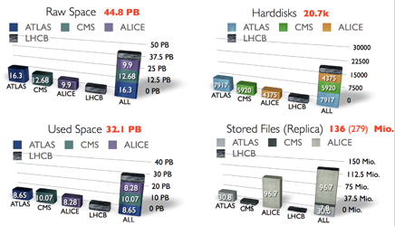
Deployment and support
5 instances at CERN (WLCG Tier 0) and one at FNAL
~20k hard disks
~45 PB
Currently no effort to support other communities but an EOS Collaboration is under discussion

Slide 17
Summary
DPM and LFC are in very good shape
Even more lightweight, much easier code maintenance
Open, extensible to new technologies and contributions
DynaFeds is very promising
EOS is an important storage project at CERN
Could be further deployed if the collaboration will be setup

Slide 18
DPM/LFC/DynaFeds wiki https://svnweb.cern.ch/trac/lcgdm EOS http://eos.cern.ch questions?
Notes:
Terminology:
Module: holds the instructions how a software component can be configured. Has manifests and templates, sometimes ruby functions, and files
Manifest: recipe how to put modules together for a system configuration
The puppetmaster compiles a manifest for a machine into an execution plan
Class: everything with class before its name
Resources: Classes, and specialized resources like file, service, package, … can be only declared once
Defines: functions, can be called multiple times with different arguments
Define a class: specify it in the modules
Declare a class: instantiate it in the modules or manifest, can be only done once globally!

