Slide 1
E-ScienceTalk PMB
E-ScienceTalk PMB Meeting Q2
4 November 2010
CERN

Slide 2
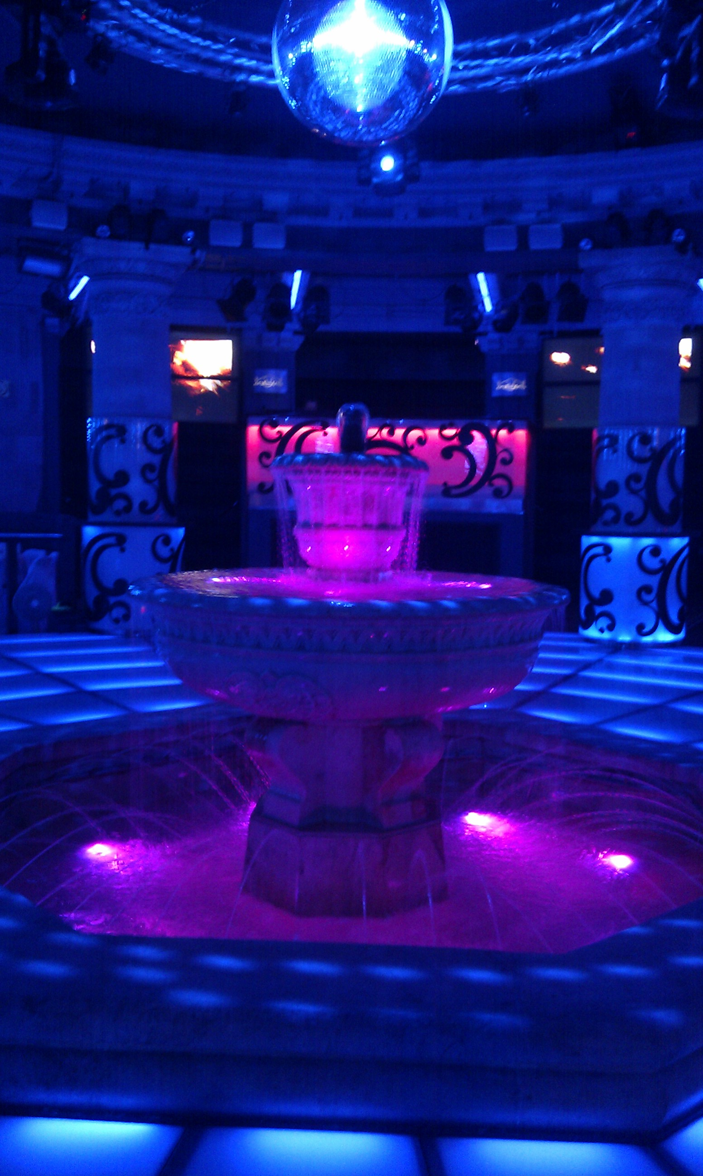
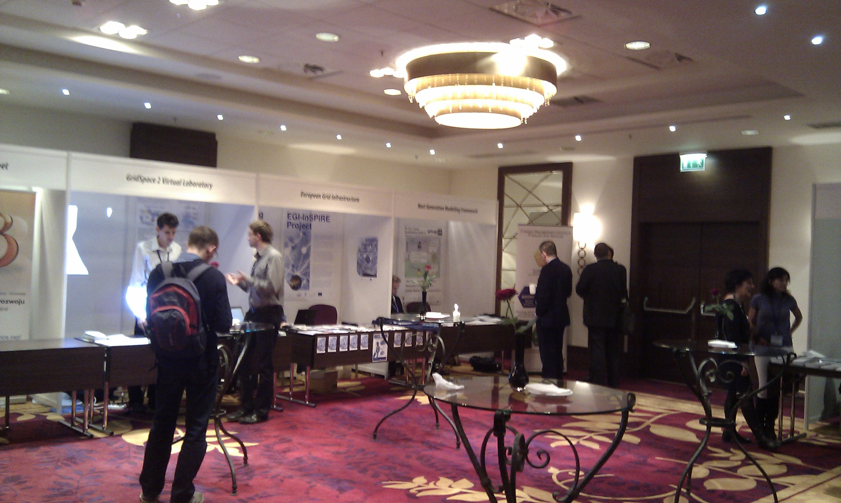
WP1: Grid policy outreach
Progress
New template developed for GridBriefings
GridBriefing on e-Infrastructure Landscape launched at in 8th e-Infrastructure Concertation Meeting
Second GridBriefing annual report circulated at events attended by e-ScienceTalk eg EGITF2010, ICT2010, e-Concertation, eChallenges
Policy advisory group for e-ScienceTalk will in future be the e-IRG Board with additional advisors eg from EGI, EMI
MoU in final draft with e-IRGSP2/3
Sought feedback on GridBriefings from eIRG and EC
Booth proposal accepted for eChallenges, 27-29 October, Warsaw, booth successful
e-Concertation meeting at CERN, 4-5 November – in progress!

Slide 3
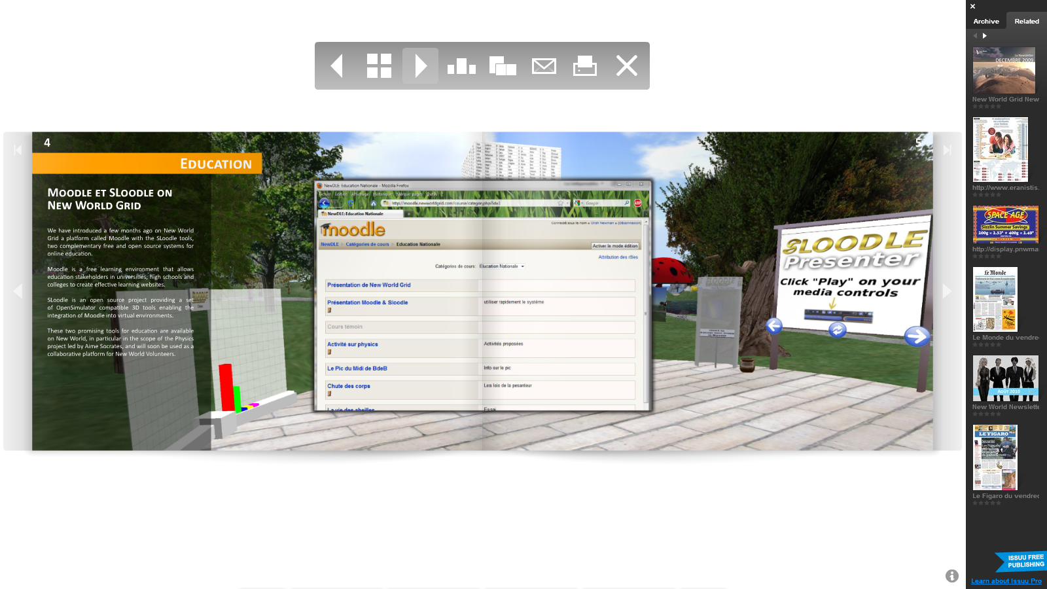
WP1: Grid policy outreach
Long term
New name for the GridBriefings in 2011?
How to innovate on the content?
Give out at more events eg ECRI
Make them easier to read and to find online
Other formats eg video, longer publications
Future topic ideas
Exascale computing
International dimension of grids
eGovernment
Impact indicators
Digital Agenda for Europe
Next Framework programme

Slide 4
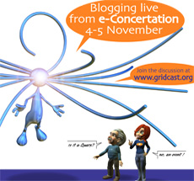
WP2: GridCafé, GridCast, GridGuide
Progress
e-ScienceTalk
New website populated with up to date content, new logos and templates created
GridCafé
French version of GridCafé now 90% translated, will be online by the end of November
Work progressing on a content structure for the cloud lounge, possible launch by February 2011 (Cloudscape-III), plus other areas
Cleaning up references to old projects
GridCast
Mini GridCast at CCC summit, 2-3 Sep, London (+poster)
Major GridCast at EGITF2010, 14-17 Sep, Amsterdam (+ poster)
Mini GridCast at ICT2010, 27-29 Sep, Brussels
Mini GridCast at eChallenges, 27-29 Oct, Warsaw, (+ poster)
Major GridCast at eConcertation, 4-5 November, Geneva, (+poster)
GridGuide
Webstart version up and running, new logos added, server upgrade

Slide 5
WP2: GridCafé, GridCast, GridGuide
Long term
e-ScienceTalk
New leaflet and promotional materials eg pens, banner
Copyright notices – apply by the end of the first period
GridCafé
New translations for the GridCafé eg Russian, Chinese – changes to CMS needed for this?
Timelines for other areas eg data garden, networking, volunteer computing – every 6 months?
New separate identities for these areas or not?
3-D version by 12 month review – working with Virtus / New World Grid
How to use the GridCafé forum
GridCast
Longer, more editorial posts
Celebrity bloggers – who?
Experiment with longer videos, a ‘day in the life’, a conference overview, vox pops
GridGuide
Work on the USP – who is it for?
Should we also include projects as well as individual sites?
Integration with RTM – smart phone platforms

Slide 6
WP3: iSGTW
Progress
Recruitment underway in the Fellows programme for a new writer at CERN, starting April 2011
New logo agreed by the Board – presented here to PMB for input
Publicity: teaser campaign at eConcertation, prototype website will be unveiled at SC10
Launch schedule proposed: final iSGTW issue on 22 December (short issue), first Digital Scientist on 12 January (fully featured)
Fully functioning prototype available to show the EC by the end of November

Slide 7
WP3: iSGTW
Long term
Beta site launched with: - Site with new design/layout - All legacy content ported - Site taxonomies (types of content) defined - Search and advanced search capabilities - Content tagging (legacy, new, and Calais, if desired) - Apture contextual search - Registration, comment, rate - Sample slide/video galleries - Polling - Calendar - ShareThis
Things that may be in flux: - Mobile theme specifics - Some search details - Layout tweaks to ported legacy content - Workflows for contributed content - Contributor profile pages - Related content sidebars
Other things: - Marketing plan – social media?
- More ‘meet the experts’ sessions

Slide 8
WP4: Management
Progress
All paperwork complete and sent to EC and partners: GA, CA, bank account details
Pre-financing paid to EGI.eu, bank payments being set up this week
Dissemination Plan ready for submission PM2 – process of submitting Deliverables and Milestones to be confirmed with EC, and format of the QR
Risk register updated
Presentations given at EGITF2010, eChallenges2010, 8th e-Infrastructure Concertation Meeting
Costings for e-Concertation meetings now clearer, will need to discuss an amendment to the DoW
Weekly meetings established with the project team
Travel: invitations to Taiwan (ASGC), Latin America (GISELA)
MoU with e-IRGSP2/3 – should now work on more of these

Slide 9
Budget
Partner | WP1 | WP2 | WP3 | WP4 | Total | 1st Year
EGI.eu |  |  |  | 187,694 | 187,694 | 68,252
QMUL | 223,513 | 56,858 | 40,627 |  | 320,998 | 116,727
APO | 28,088 | 154,882 | 28,088 |  | 211,057 | 76,748
Imperial |  | 114,181 |  |  | 114,181 | 41,520
CERN | 69,164 | 77,562 | 319,344 |  | 466,070 | 169,480
Total | 320,764 | 403,485 | 388,057 | 187,694 | 1,300,000 | 472,727
Overall EC contribution is 1.3million Euros

Slide 10
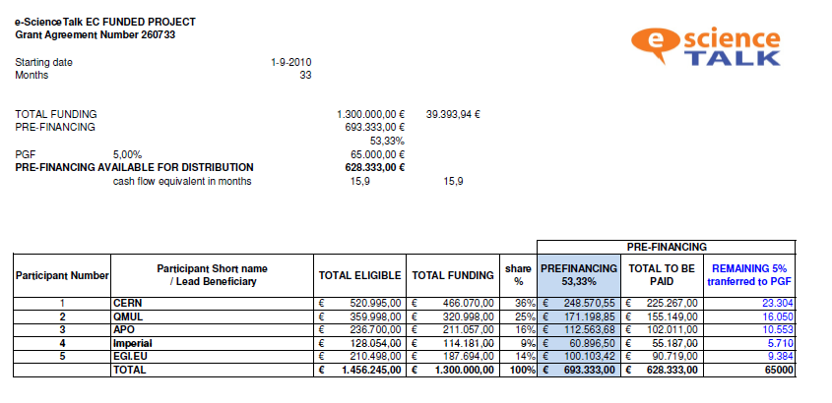
Pre-financing

Slide 11
Deliverables and milestones tracking
Months | 1 | 2 | 3 | 4 | 5 | 6 | 7 | 8 | 9 | 10 | 11 | 12
WP1 Policy
T1.1 Policy |  | D1.2.1 | D1.1 |  | D1.2.2 |  |  | D1.2.3 |  |  | D1.2.4
T1.2 Impact |  |  |  |  |  |  |  |  |  |  | D1.3
T1.3 Events |  |  | MS1
WP2 GridCafé
T2.1 GridCafé
T2.2 GridGuide |  |  |  |  |  |  |  |  |  |  |  | D2.1
T2.3 GridCast |  | MS4 |  |  |  | MS4 |  |  |  | MS4
WP3 iSGTW
T3.1 Weekly | D3.1 cont. |  | D3.2 |  |  |  |  |  |  |  |  | D3.4.
T3.2 New media |  |  |  |  | MS7 |  |  |  | D3.3 |  | MS7
WP4 Mgmt
T4.1 | MS10 | D4.1 | D4.2 | MS10 |  | MS11 | MS10 |  |  | MS10 |  | D4.3 MS12
Complete
In preparation
Overdue

