Slide 1
Follow up meeting
16th April 2014
R. Graciani

Slide 2
Introduction
Welcome newcomers
Service started
Operation team being formed
Other tasks

Slide 3
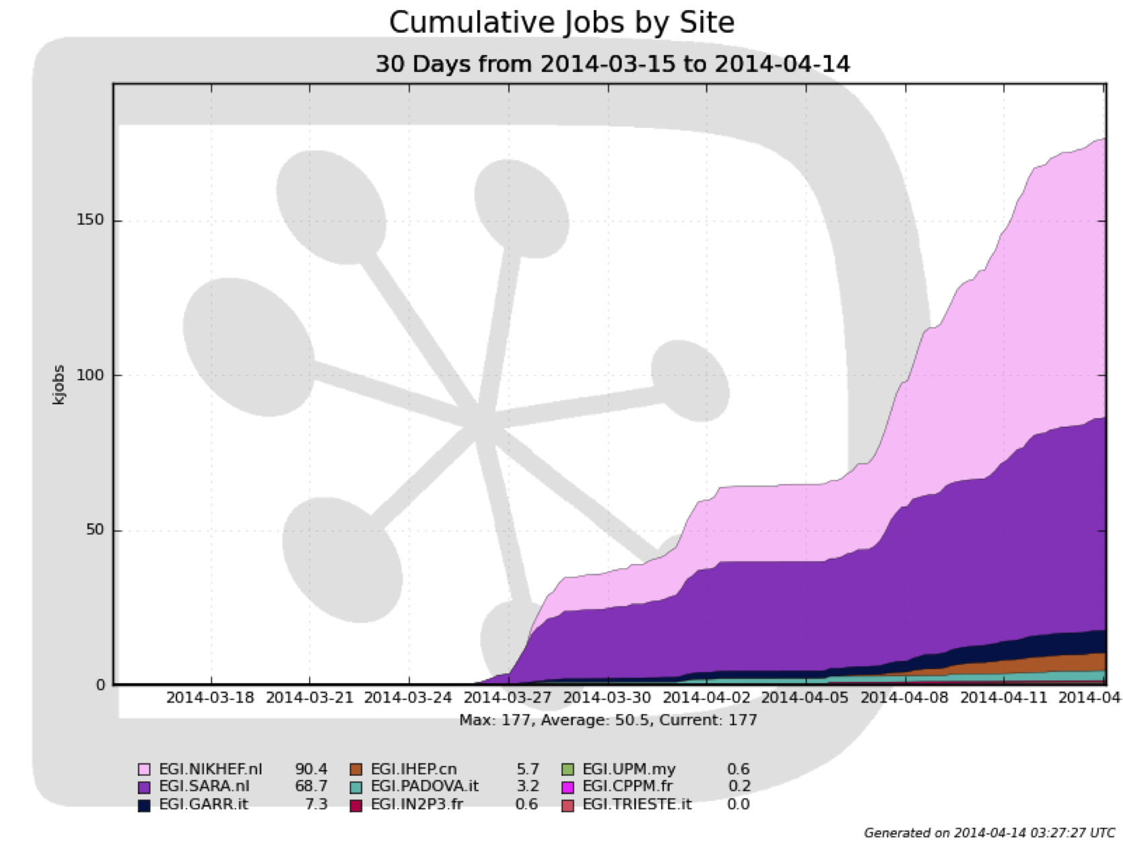
WeNMR: Executed Jobs

Slide 4
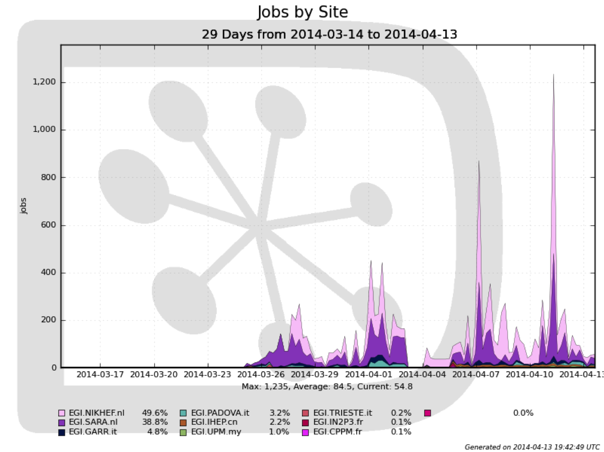
WeNMR: Running Jobs

Slide 5
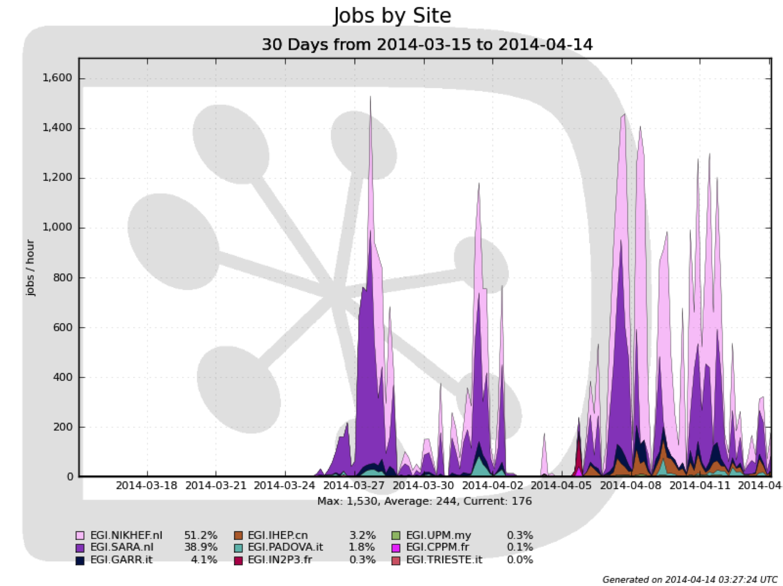
WeNMR: Job Rate

Slide 6
Starting Service
Some issues to be addressed
  Attached disk (Sandbox space got full)
    Expandable disk connected now
  Now Romania has provided 10 TB
OpenSSL
  Web Portal has been updated
  DIRAC services, binaries being recompiled.
New communities being added
  vlemed
  eng.vo.ibergrid.eu

Slide 7
Operations

Slide 8
Identified Tasks
Integrate into EGI Accounting
  Report multi user usage inside pilots and VMs
  CESGA/RAL will provide support
  1-2 month, 25-50 %
Monitoring
  Service End points/Full chain Probes
  EGI will provide support (?)
  1-2 month, 25-50 %
Software Assurance
  Vulnerability
  UAB will provide support
  6-12 month, 50-100 %
Collaborate with communities
  User support / contact with Resource Providers
  TBD
Run the DIRAC services
  Monitoring shifts/contact
  France-Grilles / DIRAC will provide support
  Team of 5-6 people with 25 %

Slide 9
AOB
Who will be the next communities?

