Slide 1
NGI_CZ Ivana Krenkova

Slide 2
Disclaimer
This presentation template is meant to provide NILs with an instrument to discuss ideas for user-support and service innovation in H2020 that could become part of the activity of an EGI-Engage Competence Centre (https://documents.egi.eu/document/2187)
User support activities include
Training and education
Technical support and consultancy to existing and prospective user communities
Innovation and pre-production
of new capabilities to the EGI services portfolio (infrastructure platform, cloud and grid platforms), the integration of new ICT technologies
of Virtual Research Environments to be integrated with existing and new EGI capabilities

Slide 3
Main relevant communities
User community | User support project
Life Science (Biological and medical sciences) | NGI_CZ (CESNET) is an official member of The Czech Republic ELIXIR Node http://www.elixircz.cz/ = joint project of 13 Czech institutions NGI has long history of cooperation with the Central European Institute of Technology, a large national facility (www.ceitec.cz), with focus on its 3 research projects (from many): Structural biology – extends beyond ELIXIR, encompasses Czech part of INSTRUCT and EuroBioImaging Genomics and proteomics Brain and mind research – connected to The Virtual Brain Project (http://www.thevirtualbrain.org/)
Physics, Astrophysics | NGI_CZ cooperates with Institute of Physics of the AS CR Laser physics - Extreme Light Infrastructure (ELI) http://www.eli-beams.eu/, the unique laser centre located in the Czech Republic. Elementary Particle Physics – 2 experiments ATLAS at the LHC collider at CERN and NOVA at Fermilab Astroparticle physics – the Pierre Auger Observatory Masaryk University, department of Theoretical Physics and Astrophysics –mirror of the large NASA Exoplanet Archive for SuperWASP Charles University, Faculty of Mathematics and Physics: Belle II experiment at KEK (Japan) (and also ATLAS and PAO)
Environmental Sciences | NGI_CZ cooperates with the national centre for studying the impact of global climate changes CzechGlobe AS CR. The centre became the Czech node for ICOS, EUFAR, and LIFEWATCH ESFRI projects.

Slide 4
Common objectives
Support objectives (common for all communities)
Advanced training courses (focus on specific application or HW), hands-on practically oriented meetings (for small groups), community workshops, etc.
Technical support and consultancy – SW application porting to grid/cloud (in total hundreds of application from tens research areas, mostly available on the national grid resources)
Close collaboration with the user community on continuous improvement of services, methods and tools, new algorithms development, code optimization, etc. Collaboration is based on close, mostly long-term cooperation of NGI researchers with ITC know-how + pre/post graduate ICT university students + users community researchers (often from non-ICT areas).
Joint team - collaboration
NGI_CZ +
CERIT-SC centre (ICS Masaryk university)
= ICT researchers
Pre/post graduate ICT students
Users community researchers (non-ICT areas)

Slide 5
Life Science
Development projects that could bring benefits to this community
ELIXIR (International level)
We (NGI_CZ staff) are members of many of ELIXIR taskforces (cloud, website, storage, AAI, etc.), in some we act as leaders.
We plan to be member of „ELIXIR Pilot Project(s)“ – single goal oriented communities from min. 2 ELIXIR Nodes, with scalable technical aim (focus on: life-science data access, high-performance computing and clouds, data security, etc.). Discussion with ELIXIR community will be held in Helsinki CF2014.
National level
We developed and maintain several application specific web portals, e.g. interface to large collection of pathological images, were also involved in a proposal of the Carbon Portal of ICOS (one of its central facilities), recently we provided Galaxy framework (task management and workflow engine targeting the bioinformatics community) with significant extensions to run its jobs in the national grid environment.
We have common research collaborations with life-science communities from many research fields:
Example how we help the community to solve problems: DNA sequencing (clover,Trifolium)– improvements in robustness and scalability of the Echo corrector of sequencing errors. The original implementation was very robust (it required 1TB of RAM, 1 CPU, 30+days). We re-implemented it to deal with large data and massive parallelism – result: speed up to 40x and 10x memory reduction.
Other collaborations: analyze of protein structure using complex mathematical methods, reconstruction of molecular structures, implementation of computational methods in human brain simulator, etc.

Slide 6
Physics, Astrophysics
Development projects that could bring benefits to this community
VOs support: atlas, belle, alice, auger, voce, eli-beams, mpi, supernemo, etc.
Porting of generic software/middleware solutions and domain specific software for the community
MPI and parallel application support
Recently we started with astrophysicists from the Masaryk University
NGI hosts mirror of the large NASA Exoplanet Archive for SuperWASP project
(3 TBs of data (expected ↑ + web interface development)

Slide 7
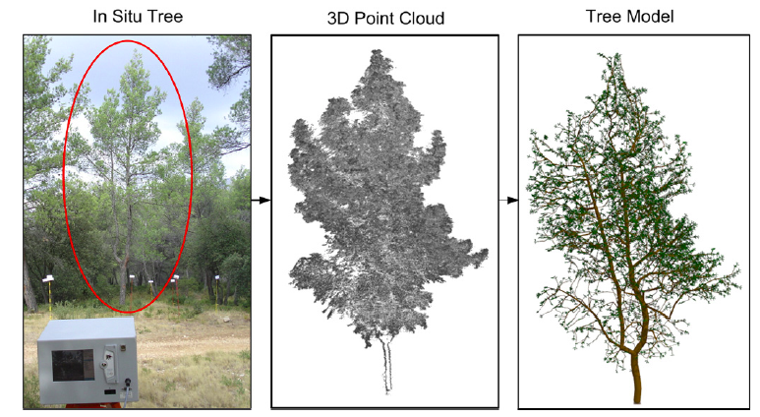
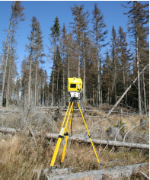
Environmental Sciences
Development projects that could bring benefits to this community
We cooperate with CzechCOS/ICOS project (Global Change Research Centre AS CR) – the national centre for studying the impact of global climate changes.
Success collaboration running (example)
Algorithm of a reconstruction of a tree from LiDaR scans. The program takes a cloud of 3D points (the tree scan) as input and produces structure consisting of the trunk, branches, and foliage. The process was not automated before, fully-automated approach improves quality of further forest studies.

