Slide 1
UMD 2 Decommissioning Status
Cristina Aiftimiei
EGI.eu

Slide 2
Overview
UMD 2:
Decommissioning Calendar
Status Update

Slide 3
Decommissioning Calendar
UMD 2 EOL– April 2014
Since Nov. 2013 – raise the awareness of the approaching End of Security Support of UMD(EMI) 2 services and the need to plan a massive decommissioning/migration process:
Official Calendar
https://wiki.egi.eu/wiki/Software_Retirement_Calendar%23EMI_2
end of Jan 2014
05/02/2014 - broadcast was sentto sites
https://operations-portal.egi.eu/broadcast/archive/id/1080
ROD alarm template was provided:
https://wiki.egi.eu/wiki/ROD_MW_alarm_template%23EMI_2_retirement_campaign
And the list of affected middleware versions
end of Feb. 2014
12/03/2014 – started to raise alarms for UMD 2 services
https://ggus.eu/?mode=ticket_info&ticket_id=101888
description of SAM probes was provided
https://wiki.egi.eu/wiki/MW_Nagios_tests%23EMI-2_tests
end of May 2014
Sites must open a downtime for the UMD-2 services (excluding dCache) still deployed. Sites who fail to do so are eligible for suspension
All sites should have reported upgrade or decommission plans for UMD-2 services in their tickets,

Slide 4
UMD2 Relevant Services
Relevant services:
using specific SAM probes
ARC, DPM, STORM, WN
using generic SAM probe (MiddlewareVersion=2.*)
APEL, ARGUS, BDII(site, top), CREAM, LB, LFC(local,central), MyProxy, VOMS, WMS
Exception:
dCache 2.2.x supported until July 2014

Slide 5
APEL migration
Critical step for the migration of CEs is the update of the APEL clients
The same site *cannot* have APEL clients from UMD-3 and UMD-2 publishing in parallel accounting data
Possible options:
Upgrade every CE with the APEL clients together
Upgrade APEL first, EMI2 CREAM has been successfully tested with EMI3 APEL clients
Deploy EMI3 CREAM with EMI2 APEL
Theoretically it works, it has been tested by SA2 and the results are available in a wiki page
We don’t really recommend it, AND APEL EMI 2 IS NO MORE SUPPORTED
Tutorial on APEL migration at EGI CF 2014:
Migrating from the EMI2 to EMI3 APEL Client
PROBLEM:
We still have ~49 sites publishing accounting data using APEL 2 clients
See http://goc-accounting.grid-support.ac.uk/consumer/

Slide 6
Status Update
Number of instances to be decommissioned:
Service Type | As of March 7th | As of April 23th | As of May 14th | As of May 27th | As of June 2nd
ARC-CE | 11* | 0 | 0 | 0 | 0
BDII_site | 159 | 41 | 29 | 16 | 11
CREAM | 220 | 55 | 45 | 32 | 14
DPM | 127 | 38 | 22 | 11 | 8
StoRM | 4 | 2 | 2 | 0 | 0
VOMS | 9 | 4 | 3 | 2 | 0
WMS | 7 | 5 | 4 | 3 | 3
Sites with WNs | 130 | 52 | 35 | 24 | 7
Reference:
http://bit.ly/UMD2_nodes
Other numbers:
ARGUS – 3
APEL - 18
BDII top – 1
LFC – 1 (local)

Slide 7
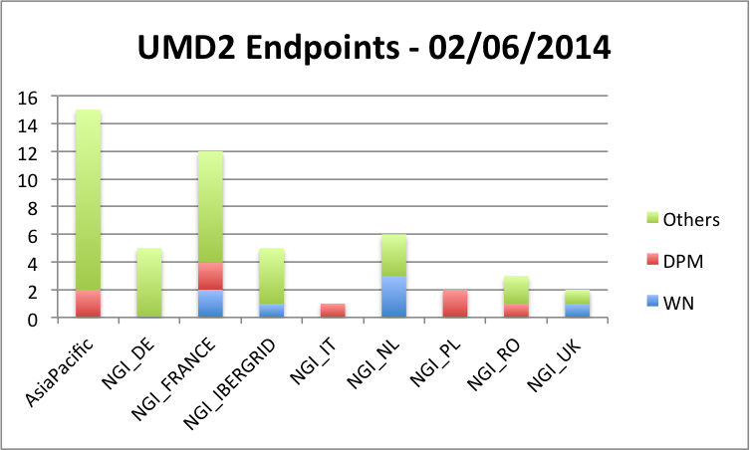
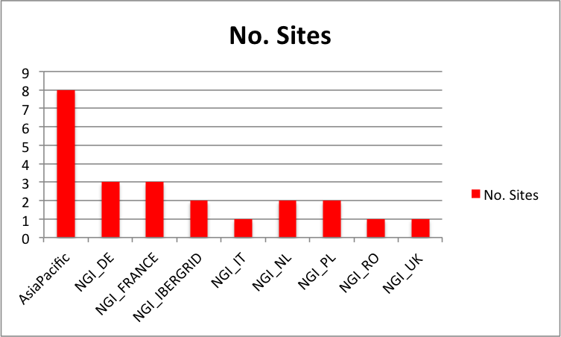
Statistics per NGI

Slide 8
Conclusions
Reports received:
NGI_AEGIS
all sites upgraded
Due to a special setup - 1 central APEL instance publishing accounting for all sites – the migration to EMI 3 was followed with APEL team
NGI_UK
site is finishing with the last EMI 2 service (APEL)
Following up through GGUS – RHUL, Manchester, UCL – EMI 2 APEL clients update
NGI_NL (BEgrid-ULB-VUB)
update this week – CE, APEL client, WNs
Update next week – ARGUS, BDII-site, SE
Will put site in downtime
Waiting for other reports
ALL UMD 2/EMI 2 sites should be in DOWNTIME

