Slide 1
EGI-Engage Competence Centres
http://www.egi.eu/news-and-media/newsfeed/news_2014_026.html
Gergely Sipos
EGI.eu

Slide 2
Our goals and agenda
Inform EGI networks about CC opportunity
Problem solving
Discuss potential CCs
Agenda:
Gergely: CC concept and call for EGI-Engage
Q&A
Voluntary CC presentations
Kostas/Eleni - Atmospheric Modelling CC (Amos-CC)
Ricardo - DIRAC technology oriented CC
Franck – Life Science/ELIXIR

Slide 3
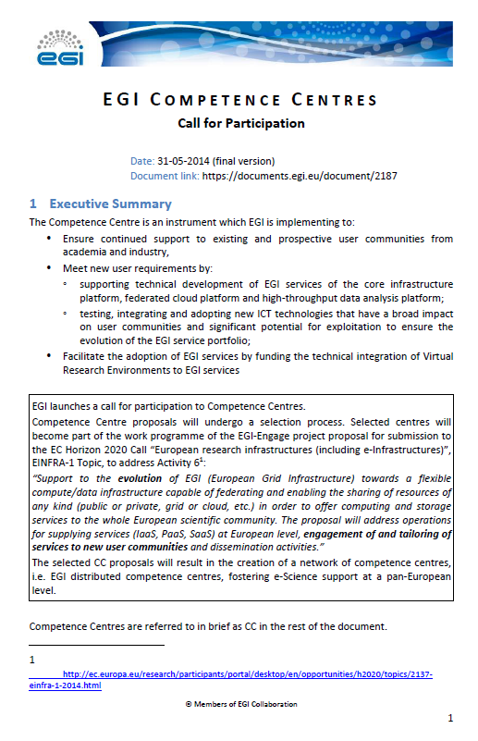
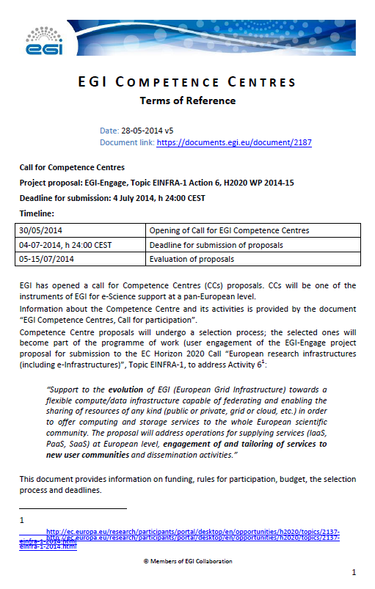
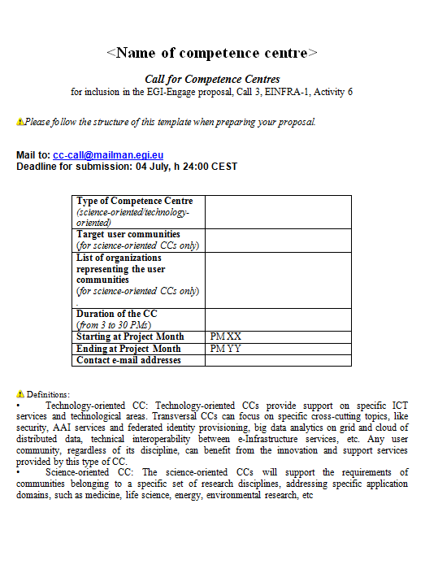
https://documents.egi.eu/document/2187
call
ToR
template

Slide 4
EGI-Engage
Project proposal name: EGI-Engage
Duration: 2.5 years (30 months)
Call:
WP 2014-2015, EINFRA-1 topic, activity 6
Expected start: 1. January 2015.
Maximum EC contribution: 8 mEuro
For Competence Centres: approx. 2mEuro
CCs selected with an open call (DCC – the network of CCs selected for Engage)

Slide 5
EINFRA1, action (6)
“Support to the evolution of EGI (European Grid Infrastructure) towards a flexible compute/data infrastructure capable of federating and enabling the sharing of resources of any kind (public or private, grid or cloud, etc.) in order to offer computing and storage services to the whole European scientific community. The proposal will address operations for supplying services (IaaS, PaaS, SaaS) at European level, engagement of and tailoring of services to new user communities and dissemination activities.“

Slide 6
Competence Centres - goals
Ensure continued support to existing and prospective user communities
FET flagships and large-scale science-driven initiatives
RIs, such as from the ESFRI roadmap and their ERICs
International DCI user communities
Industrial user communities (with European footprint)
Long-tail of science → No! (They will be reached by NGI teams)
Meet new user requirements by
Supporting technical development of EGI platforms (core and/or cloud and/or HTC)
testing, integrating and adopting new ICT technologies
Facilitate the adoption of EGI services by
Integration of Virtual Research Environments
Training and specialised support
Close links to the users, work with the users.
Notes:
FET flagships: http://cordis.europa.eu/fp7/ict/programme/fet/flagship/ Flagship pilots:
FuturICT - The FuturICT Knowledge Accelerator and Crisis-Relief System: Unleashing the Power of Information for a Sustainable Future
Guardian Angels — Guardian Angels for a Smarter Life
ITFoM — The Medicine of the Future: Molecular Modelling in Medicine, Aging, and Drug safety
Graphene — Science and technology for ICT and beyond
HBP — PS — The Human Brain Project — Preparatory Study
CA Robocom — Flagship Candidate Robot Companions for Citizens

Slide 7
Activities of a CC
Capture and define ICT requirements of research communities, and address them by using and/or extending EGI technologies (mandatory)
Test new technical solutions in testbeds (mandatory)
Test new technical solutions in pre-production (if applicable)
Define production requirements such as service levels, reporting, SLAs, etc. (if applicable)
Provide support and training (mandatory)
Production operation and sustainability of services: outside of the CC

Slide 8
Types of CC
Science-oriented CC:
Works with one specific scientific discipline
Develops, provides custom services for bridging EGI and the community
Technology-oriented CC:
Works with multiple user communities from different scientific domains
Develops solutions that are applicable to all

Slide 9
CC workplans
Must consists of projects
3-12 month project (pathfinder)
13-24 month project (lighthouse)
(Note: the CC itself can run for 30month!)
Review of the CC, review of the projects
Size
Funding per project:
60kE for pathfinder; 120kE for lighthouse
+20% of projects total for training and support
At least 2 pathfinder OR 1 lighthouse per CC
In-kind contributions are also expected from ‘associated partners’ (e.g. testbed providers)
60kE/year: same size as mini-projects in EGI-InSPIRE:
https://wiki.egi.eu/wiki/Overview_of_Funded_Virtual_Team_projects

Slide 10
Rules of participation
Eligibility and admissibility rules of H2020 EINFRA1 apply
Users
Represented by 1/more organisations (e.g. ERIC)
Service providers (existing/prospective)
must be associated to a JRU (NGI) and participate in the council. (→ fee applies)
Technology providers
must have at least an MoU with EGI
Associated partners
Self-funded

Slide 11
Review of CCs
Review of the CC and its individual projects
Criteria:
Excellence
Impact
Quality and efficiency of implementation

Slide 12
Preparation of CC proposals

Slide 13
Available for CCs
Infrastructure resources through e-GRANT
Wiki, email list, document server, webex
Request through ucst@egi.eu
1-on-1 CC proposal consultancy:
Gergely Sipos
Tiziana Ferrari

Slide 14
Known interests
Shared Excel sheet https://docs.google.com/spreadsheets/d/1u37snPBuPJF-ZdfOa9MCoSDm9Y4B_b2V2d8F585IL2M/edit?usp=sharing
Presentations in Helsinki: https://indico.egi.eu/indico/conferenceDisplay.py?confId=2125
CMMST, EISCAT-3D, LifeWatch, Structural Biology and INSTRUCT, EPOS, ELIXIR, Regional atmospheric models and observations + interest presentations from OSG, AP, Dutch eSC
Notes:
Helsinki:
- Chemistry Molecular and Materials Science, A. Lagana - EISCAT-3D, M. Nylen - LifeWatch, I. Campos - Structural Biology and INSTRUCT, A. Bonvin, A. van Rijn - EPOS, M.Sterzel - ELIXIR, Fotis E. Psomopoulos - Regional atmospheric models and observations, E. Katragkou - User engagement with OSG, R. Quick - User engagement with Asia Pacific, E. Yen - Platform of eScience and Data Research Centers in Europe, P. Aerts

Slide 15
Timeline
4th of July:
Deadline for submitting CC proposals
July:
Review by an EGI.eu committee
Selection of CCs and their projects
August:
Finalise the accepted CC proposals
Merge into the EGI-Engage proposal
2nd of September:
EINFRA1 deadline

Slide 16
New: ESFRIs prioritised
26th May, 2014:
http://ec.europa.eu/research/infrastructures/index_en.cfm?pg=esfri
Priorities & ready for immediate action for member states:
EPOS, ELIXIR and the European Spallation Source
Additional project recommended for support to member states:
ECCSEL, EISCAT-3D, EMSO, BBMRI, ELI, CTA, SKA, CLARIN and DARIAH
Implemented projects that require additional support
CESSDA, SHARE and the European Social Survey
Potential for distributed RIs that can be linked together to deliver integrated services for greater scientific impact:
in biomedical research: INFRAFRONTIER, EATRIS and ECRIN - 2
in environmental research EURO-ARGO, IAGOS, ICOS and LIFEWATCH
These priorities should be considered by EGI when engaging with ESFRIs

Slide 17
Q & A

