Slide 1
News from UMD
Cristina Aiftimiei (EGI.eu/INFN)
Joao Pina (EGI/LIP)

Slide 2
Overview
UMD2 decommissioning
News on gfal2-util
New products entering UMD
Status of the UMD Software Provisioning Queue
EarlyAdopters - status

Slide 3
UMD2 decommissioning (I)
Timeline:
April 2014 - UMD 2 EOL
May 2014:
Downtimes for Sites deploying UMD-2 services (excluding dCache)
Sites who fail to do so are eligible for suspension
Status:
All monitored services are upgraded, except:
Asia/Pacific
1 site suspended
3 sites with 4 UMD2 services
UMD2 repositories will be “frozen”

Slide 4
UMD2 decommissioning (II)
APEL clients migration:
Status:
http://bit.ly/umd2_apel
12 NGIs
14 sites using old clients - http://goc-accounting.grid-support.ac.uk/consumer/
unresponsive sites/NGIs:
NGI_CYGRID - CY-01-KIMON/
Asia/Pacific - MY-UPM-BIRUNI-01, TW-FTT
Migration closely follow-up by the APEL team

Slide 5
APEL clients migration – Common Issues thanks to APEL team (J. Gordon)
As documented, EMI3 APEL requires a fresh install, not an rpm upgrade.
In sender.cfg define
a TopLevel BDII;
network:PROD and
destination:/queue/global.accounting.cpu.central
No need to migrate old data. Just migrate the current month.
Make sure the parser.cfg is pointing at the correct batch and blah directories.
If you haven’t installed a clean CREAM and Batch system then EMI3 APEL will pick up all the jobs you already published and publish them again in EMI3. This need not be a problem but it may result in duplicate jobs which need removing.
Remove the records created by the migration script.
If you have multiple CREAM-CEs pointing at the same batch system with shared batch logs then you only need to run the parser with [batch] enabled=true on one of them. You should use [blah] enabled=true on every CREAM.
Wait 4 hours after adding hostDN to glite-APEL endpoint in GOCDB. This allows the Message Brokers time to update their ACL.

Slide 6
UMD2 decommissioning (III)
dCache
Support statement:
“dCache 2.2.X is supported until July 2014, when the new golden release will be made available”
UMD 3 – provides dCache 2.6.28
Status – 18.09.2014
V. 2.6.X => 56 services
V. 2.2.X => 11 services
Timeline:
Start monitoring 22nd of September
To be upgraded by the 31st of October

Slide 7
Gfal2-util - status
End-of-life mode of gfal and lcgutil - Fri, 05/09/2014
“gfal and lcg-util are in end-of-life mode, which means no new features, nor new bug fixes will be done, excepting very critical ones if needed.
Support for both will defintitely end the 1st of November 2014 , so we recommend to all our users to switch to the newer gfal2 and gfal2-utils.”
Presented in OMB – 27.05.2014
Issues identified:
No replacement for: lcg-aa, lcg-la, lcg-ra, lcg-uf
Solution for lcg-uf - new gfal-legacy-replicas, gfal-legacy-register and gfal-legacy-unregister
document gfal-util commands as replacement of lcg-util ones
No progress
New version of UI & WN – 3.1.0
Added dependency on gfal2-util

Slide 8
Gfal2-util – status (II)
References:
http://dmc.web.cern.ch/projects/gfal2-utils
https://svnweb.cern.ch/trac/lcgutil/wiki/gfaltogfal2/MediumTermProposal
https://svnweb.cern.ch/trac/lcgutil/wiki/gfaltogfal2

Slide 9
New products “for” UMD
FTS 3:
“FTS3 is now the production FTS service for all the LHC experiments”
https://wiki.egi.eu/wiki/URT:UMD_products_ID_cards#FTS3
Frontier Squid
https://wiki.egi.eu/wiki/URT:UMD_products_ID_cards#Frontier-Squid
CVFMS-client
http://cernvm.cern.ch/portal/filesystem
FedCloud middleware – wish-list:
OCCI-os : https://github.com/IFCA/occi-os
Keystone-VOMS : https://github.com/IFCA/keystone-voms
ceilometer2ssm: https://github.com/schwicke/ceilometer2ssm
rOCCI-server: https://github.com/EGI-FCTF/rOCCI-server
rOCCI-client: https://github.com/EGI-FCTF/rOCCI-cli
glancepush - https://github.com/EGI-FCTF/glancepush
Vmcatcher2 - https://github.com/EGI-FCTF/glancepush-vmcatcher2
vmcatcher_eventHndlExpl_ON: https://github.com/grid-admin/vmcatcher_eventHndlExpl_ON
cloud-info-provider: https://github.com/EGI-FCTF/BDIIscripts
Short summary of the UMD software provisioning process:
https://wiki.egi.eu/wiki/File:UMD_Software_Provisioning_Process_summary.pdf

Slide 10
Software Provisioning Queue
New CREAM flavours:
LFS v. 2.0.4, SLURM v. 1.0.2, Torque v. 2.1.4 and GE v. 2.3.0 :
update of the info-dynamic-scheduler improving the Glue2 support and provides some bug fixes.
ARC v. 13.11.2:
This version introduces a fix for a number of bugs and introducing several new features like extending ADL with Rerun option allowing to write/delete to xrootd DMC.
APEL v. 1.2.2:
Fix for being unable to parse uncompressed accounting introduced in 1.2.1 – version not released in UMD

Slide 11
Software Provisioning Queue
Bdii-core v. 1.6.0:
Minor release containing a set of new features and minor fixes to the following packages: bdii, glue-validator, glue-schema and glite-info-provider-service.
WMS v. 3.6.6
Bug fix when setting umask 0077 breaks glite-wms-job-submit and WMProxy deletes a user delegated proxy on list-match operation.
It also solve the issue when a given CE with problems causes a WMS to become very slow dealing with all other jobs.
UI/WN v. 3.1.0 : new dependencies on gfal2-util & ginfo
caNl v. 2.2.4: bug fix in the caNl-java package in order to solve some OCSP handling

Slide 12
Software Provisioning Queue
CERN Data Management Clients:
gfal2 v. 2.6.8:
Important release with many bug fix, improvements and new functionalities like enabling tests for xrootd, http and dCache.
gfal2-util v. 1.0: Some importante bug fixes like gfal-copy force not working and gfal-ls hanging.
Davix v. 0.3.6
Other clients like CGSI-gSOAP v. 1.3.6, srm-ifce v. 1.20.1, gfal2-python 1.5.0.
dCache server v. 2.6.31 and dCache srmclient v. 2.2.27

Slide 13
Early Adopter status
At the moment we have 67 different products from different PT's:
https://www.egi.eu/earlyAdopters/teams
Main PT's are ex-EMI, QCG, IGE, UNICORE and some others with only one component.
Currently there are 76 EA teams registered:
https://www.egi.eu/earlyAdopters/table
Many teams are acting as EA for more than one product.

Slide 14
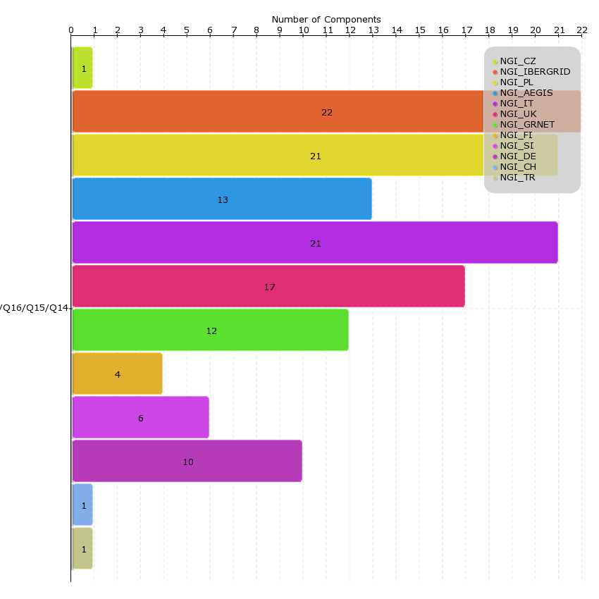
Early Adopter in numbers
A total of 129 reports achieved during last year
29 sites contributed with reports spread over 12 NGI's
79 components passed staged- rollout with a total of 0 rejections
12 months (QR15 to QR17)

Slide 15
Early Adopter Conclusions
Critical components with good coverage (with > 5 teams) like CREAM, VOMS, DPM, WMS, SAM-Nagios
but many teams not responding
BUT majority of components with 1 team (QCG, Unicore, Globus) – normally very active
New products needing EA: FTS3, CVFMS, SQUID

Slide 16
Early Adopter Conclusions
Number of active teams slight dropping over time.
Some teams increased activity compensating the drop in total number of active teams.
Also a drop in the number of release per component
Collaboration between PT's and EGI improved, under URT, allowing a faster introduction of new releases into UMD:
Data Management Clients group, ARC, dCache

