Slide 1
Operations Management Board October 30
Agenda: https://indico.egi.eu/indico/conferenceDisplay.py?confId=2282
Start: 1o:oo CEST

Slide 2
Agenda

Slide 3
Operations Update October
Cristina Aiftimiei, Małgorzata Krakowian, Peter Solagna

Slide 4
Actions

Slide 5
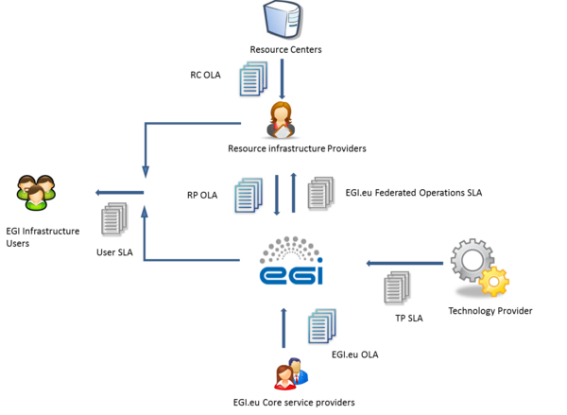
OLA/SLA framework
https://wiki.egi.eu/wiki/Performance
RP and RC OLA
https://documents.egi.eu/public/ShowDocument?docid=31
https://documents.egi.eu/public/ShowDocument?docid=463
Approval: 29 September
EGI.eu SLA
https://documents.egi.eu/public/ShowDocument?docid=2166
Approval: October OMB

Slide 6
OLA/SLA framework
RC and RP OLA reporting since November
RP
Availability/Reliability
Unknown
NGI
Availability/Reliability
Top BDII
SAM
Quality of Support
ROD performance index
Proposal: One ticket per NGI about all issues

Slide 7
QR18
Period: August, September, October
http://metrics.egi.eu/

Slide 8
Operations Centre Decommission
NGI AL (Albania)
Start: 13.10.2014
Never in production
removing entries from the operations tools

Slide 9
Argus
Problem: how to list all NGI Argus instances? Separate service type?
Solution: service group
Authoritative source of NGI argus instances
https://goc.egi.eu/portal/index.php?Page_Type=Service_Group&id=1184
Managed by EGI Operations
Contact EGI Operations if you want to change it
Service group will be also used for SAM and Top BDII instances

Slide 10
Operations Campaigns
UMD2 decommissioning
APEL clients
NGI_DE – GoeGrid, BMRZ-FRANKFURT, UNI-DORTMUND
NGI_HR – egee.irb.hr, egee.fesb.hr
NGI_UA – UA-ISMA, Kharkov-KIPT-LCG2
ROC_Asia/Pacific – TW-NCUHEP, TW-FTT, MY-UPM-BIRUNI-01
ROC_Canada – issue under investigation by APEL team
ROC_LA – UCN-INAM
dCache v.2.2
NGI_DE – GoeGrid (not prod. SE, but monitored), UNI-FREIBURG – alarms not followed by ROD
NGI_NL - BEgrid-ULB-VUB – upgrade plan: end of the month
ROC_Russia - JINR-T1 – upgrade plan:12-11-2014

Slide 11
Production=True + Monitored=False
Goal: All production resources MUST be monitored
Problem: It is allowed in GOC DB to set a service in Production=True + Monitored=False status.
Meeting: Emir Imamagic, Malgorzata Krakowian, David Meredith, Stuart Pullinger
Action: NGIs should check with theirs sites if there is a genuine requirement for such configuration and report to Operations@egi.eu
Deadline: 17 November
If there is no real requirement, then;
A new GOCDB rule will be introduced that will enforce Mon=True when Prod=True.
All existing production services will be updated to conform to this rule.

Slide 12
Operations Portal
ROD dashboard training
Recording and slides: https://documents.egi.eu/public/ShowDocument?docid=301
Ava Rel probe
Problem: Availabilty and reliability probe is taking into account last 30 days. Even if problem fixed ROD teams need to wait „annoying” period of time to close the alarm
Solutions:
Create a ticket and put expiration date till the end of the month
Shorten the period to last 2 weeks

Slide 13
Optimize communications to sites
Problem: broadcasts are sometime ignored by site administrators
One of the causes of this is the excessive amount of communications distributed to site administrators, from different sources:
EGI central operations, VOs, NGIs, …
About 30 Broadcasts in the last 6 months
Mitigation: reduce all the broadcasts about operational issues to one every month with a summary of:
Important actions to be performed clearly listed
Information about UMD releases/Ops tools changes
Keep unscheduled broadcast for urgent actions/communications
Pros: Less broadcast, site admins will need to follow up with only one communication from EGI every month
Cons: Messages could be overloaded. Some broadcasts must remain (e.g. the release of new CAs)

Slide 14
Federated Cloud
Update of Procedures
Resource Centre Registration and Certification (PROC09) and Temporary Cloud Resource Centre Registration and Certification (PROC18) have been merged
Operations and Operations Support is working on Introducing new cloud stack and grid middleware in EGI Production Infrastructure procedure
Documentation for Site admins
Plans: Manual for Site Admins how to set up Cloud site
Help from: Alvaro Lopez and Pablo Orviz, NGI Ibergrid (Thank you!)

Slide 15
Federated Cloud
Availability and Reliability reporting
Data since May 2014 in place
https://wiki.egi.eu/wiki/Availability_and_reliability_monthly_statistics
Phase1: Investigating with Monitoring team if probes are wroking ok
Phase2: Since December cover cloud sites with Quality verification of monthly availability and reliability statistics (PROC04)

