Slide 1
Technology provider feedback: NorduGrid Collaboration TCB (21?), Amsterdam, September 2014
Balázs Kónya, Lund University
NorduGrid Technical Coordinator

Slide 2
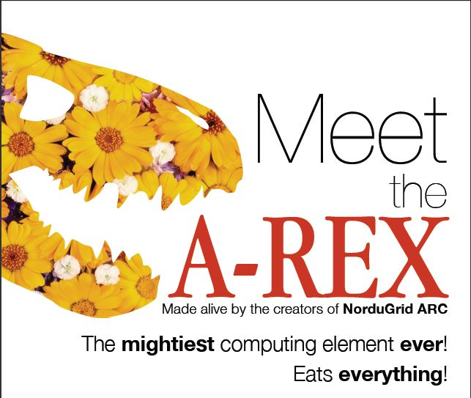
Nordugrid Collaboration & ARC: a long history
We are developing and maintaining the
Advanced Resource Connector (ARC)
including the flagship product,
the A-REX Computing Element

Slide 3
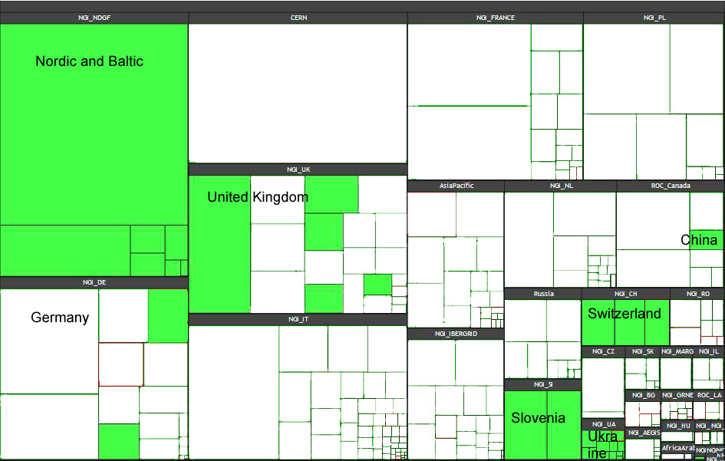
Heavy usage by ”big science”
Increasing ARC-based contribution to WLCG
Was interesting to see increased ARC deployments after the end of EMI
Missing out on the ”long tail scientists”

Slide 4
Plans: towards exascale HPC and the longtail
HPC:
LCG started to investigate utilization of HPC resources
Massive systems with serious restrictions
ARC CE has been successfully used in pilots
Initially in backfill mode
Technical challenges
Scalability (millions of jobs on millions of cores)
Data injection/extraction problem
Software provisioning
Job aggregation
Long Tail:
put usability in the center, offer high quality ARC SDK
European Spallation Source (prioritized ESFRI being built in Lund, Sweden)

Slide 5
Thoughts regarding TCB
Does the TCB still exist?
Who are the members?
Only tech providers or the user-side as well?
Where are the ”non-grid” technologies (”core”, cloud, AAI, so on...)
What is the membership criteria? Expected commitment level?
Any formal (still valid) document?
What is the mandate of TCB?
Is it technology coordination for EGI?
or ”meeting place” for tech providers, EGI.eu and ”the users”?
How should TCB operate?
What is the relation with UMD (Release Team)?

Slide 6
Some expectations from Nordugrid
The ”external interfaces” of ARC towards EGI need to be based on ”agreements”
Accounting, monitoring, discovery
Provide clear operation/deployment/certification requirements
Technology coordination based on strong commitment
Success: accounting records
Failure: GLUE1 retirement, EMI-ES adoption, info index
The ”long tail” requires coordination
Roadmap sharing of software teams would be very nice...

