Slide 1
User Engagement in EGI (With focus on the cloud)
Gergely Sipos, EGI.eu Technical Outreach Manager

Slide 2
EGI Cloud Infrastructure
EGI Collaboration Tools
EGI Cloud Infrastructure Platform
Open Action:
FCTF: Clarify the status of Storage Management and the timeline for production operation
Instance Mgmt
Storage Management
Image Repository
OCCI
CDMI
EGI Cloud Service Marketplace
Cloud Management Stacks
(OpenStack, OpenNebula, Synnefo, …)
OVF
EGI Application DB
EGI Core Platform
GLUE2
GSI
SAM
UR
Service
Registry
Information Discovery
Federated AAI
Monitoring
Accounting
Security Co-ordination
Help and Support
Training and Outreach
Sustainable Business Models
FCUS

Slide 3
Federated Cloud pillars
Innovation, R&D (FC Task Force)
David Wallom
Usage statistics Usage trends
Capability roadmaps (for users)
Requirements Feedback Usage models and trends
Service roadmaps
Service candidates (for early adopters)
Service releases (for deployment)
Operations
Malgorzata Krakowian
User support & engagement
Gergely Sipos
New services in operation
Applications ready for production
Requirements & Feedback
Usage models and trends
Overall responsibility with EGI Technical Director

Slide 4
Outline
Self-servicing
Guides and documentations
VM Marketplace & ready-to-use Virtual Appliances
High level tools (~Paas, SaaS), for example CSGF
Consultancy and support
NGI and other cloud user teams
Webinars, events
Engagement
Focussed initiatives
Impact
Plans

Slide 5
Motivating user workflows
OCCI API
rOCCI cmd line tool
High level tools
(+ CDMI tools)
Cloud sites
End users:
Access services running in VMs
Site: Supports the VO
perform OCCI (+CDMI) cmds
Download VM images for supported VOs
Open Action:
FCTF + Operations: Develop and put in place the monitor probes to check that VMCatcher is correctly deployed at the sites
AppDB
Cloud Marketplace
EGI Applications Database
Download VM image and use ‘locally’
Publish VA
Include VA in VO set
Technical developer: Prepares VM Images
VO Manager: Endorses suitable VM images

Slide 6
Existing infrastructure resources
List of resource providers: https://wiki.egi.eu/wiki/Fedcloud-tf:ResourceProviders#Current_Resource_Providers
20 certified sites
3 under integration & certification
Many interested
Fedcloud.egi.eu VO
All certified sites are (must be) member of
Recommended incubator and test field for new use cases
Generic VAs
e.g. CentOS, Ubuntu Server, SC Linux, etc.
Production VOs
Peachnote, physiome, Highthroughputseq, eiscat, Biomed, pl-grid
Open Action:
For everyone with a cloud site: Certify your site in EGI FedCloud

Slide 7
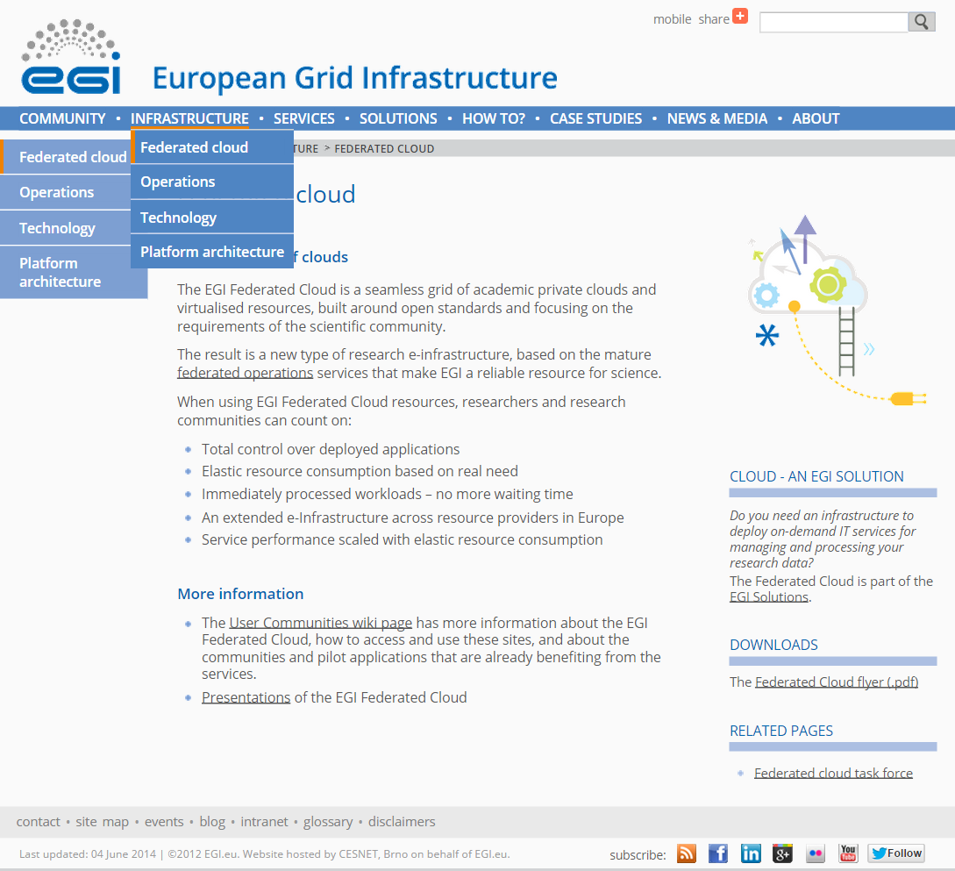
Guides, documentations
http://go.egi.eu/cloud

Slide 8
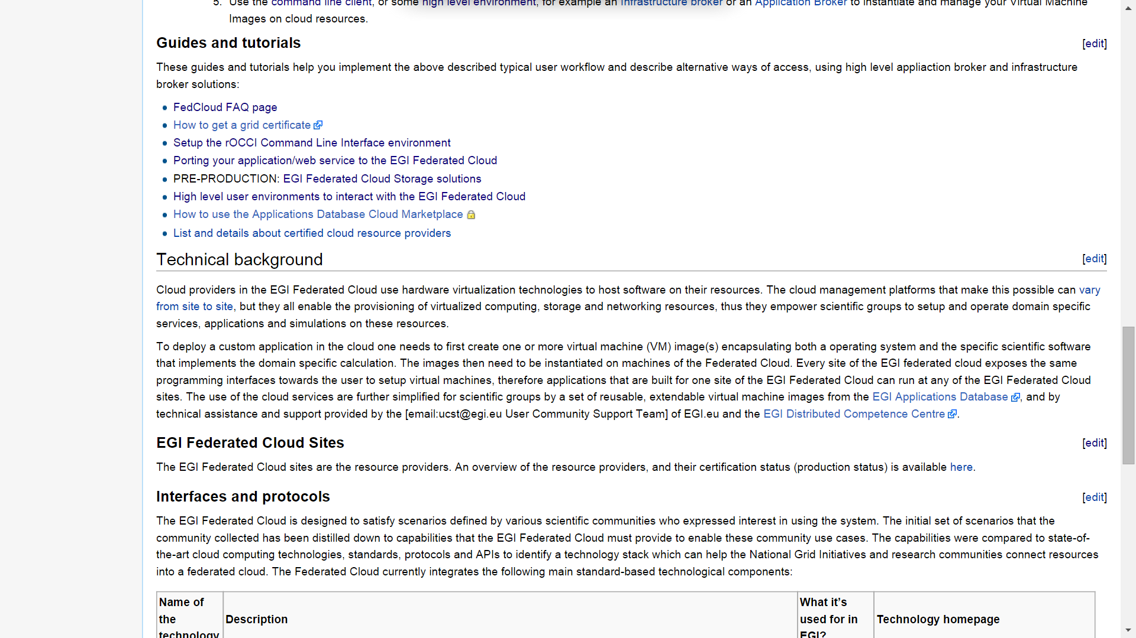
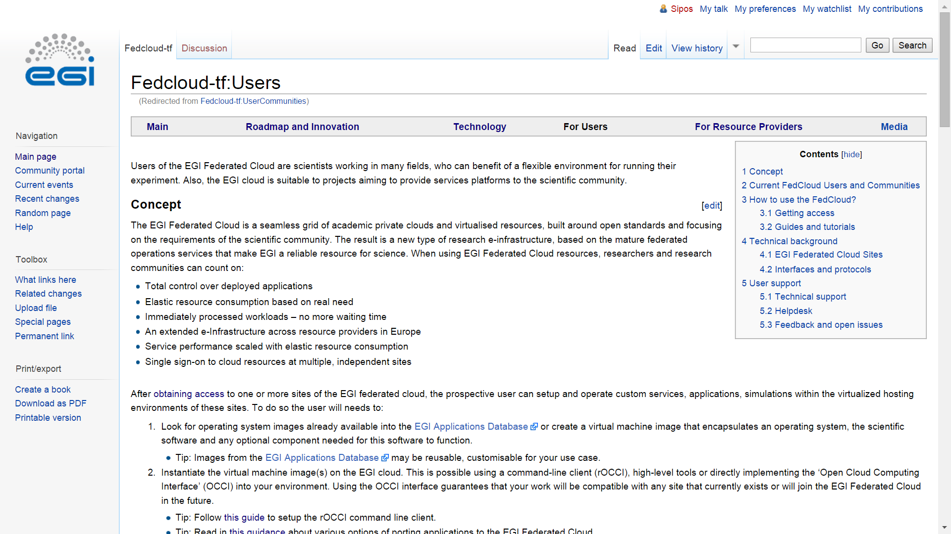
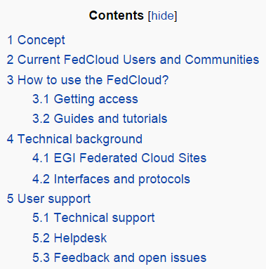
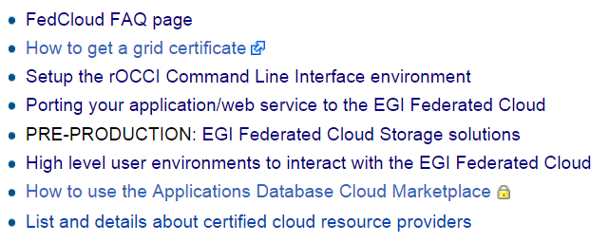
Guides, documentations
Open Action:
Enol to break this into two sections:
Use existing VAs from AppDB (quickstart)
Create and use custom VAs
Add figure(s) about the user workflow (~slide 5)

Slide 9
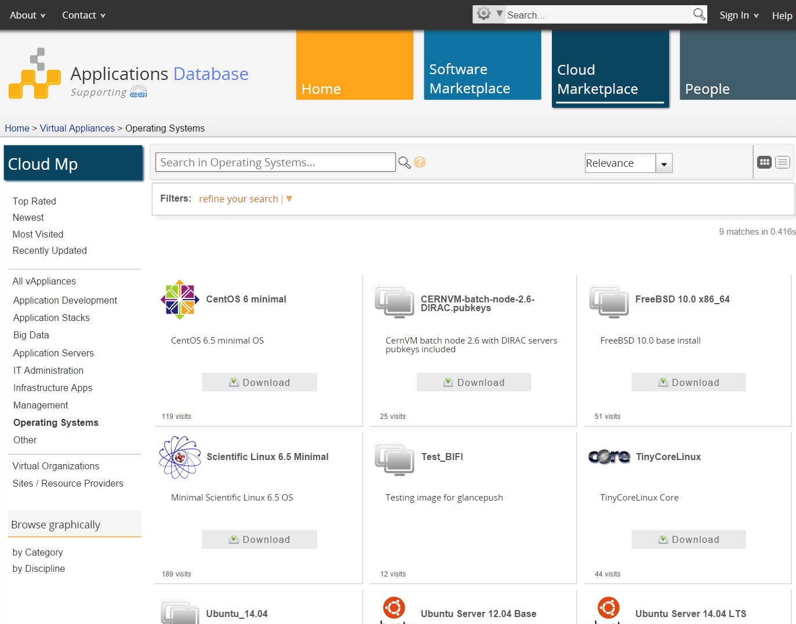
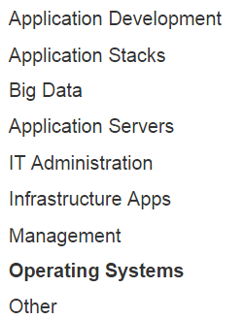
Ready-to-use Virtual Appliances in EGI AppDB
Open Action:
Operations: Correctness checks should be implemented for the data published by sites in BDII about VMIs
(E.g. https://appdb.egi.eu/store/software/centos.6.minimal --> CESNET: The data for Memory and Logical/Physical CPUs are swapped)

Slide 10
High-level tools to use the EGI Federated Cloud
Recognised as generic and useful
Extend the IaaS capabilities of the EGI cloud
‘Alternatives’ of the OCCI client and API
More than OCCI
External contributions (→ support many other clouds too)
Infrastructure brokers and Application brokers
Catania Science Gateway Framework – SaaS with ID federations
SlipStream – PaaS for automating deployments; Helix Nebula
COMPs – programming framework for auto-parallelisation
VMDIRAC – abstraction on top of various HPC/HTC/cloud
WS-PGRADE – workflow development and enactment
Open Actions for Tool developers
User documentation/guide must be available about every tool in the Wiki
Setup an EGI Webinar about your FedCloud tool
Open action for FCTF (from WSPGRADE):
Publish private-public IP and firewall control processes about the sites. Uniformise these as much as possible.

Slide 11
Consultancy support

Slide 12
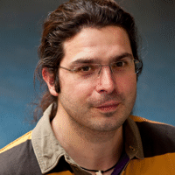
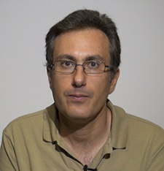
User support teams
support@egi.eu
Nuno Ferreira
Diego Scardaci
Enol Fernández del Castillo
with a growing number of NGIs:
ES, PT, FR, CZ, DE, IT, HU, ….
Mostly from EGI-InSPIRE SA5.1 and SA5.2
Bi-weekly teleconferences for the support teams
Fc-usersupport@mailman.egi.eu
Weekly updates to/from FC-Task Force by Diego

Slide 13
Support workflow
F2F / teleconference
Initial requirements
Allocation of technical experts
Milestones
Continuous tracking with appropriate support
Registration of use case on https://wiki.egi.eu/wiki/Fedcloud-tf:Users:Communities
Technical integration support from NGI / EGI.eu
On the incubator VO or in a dedicated VO
Service further-development support from Federated Cloud Task Force
Community support through Virtual Team projects
Migration into production
Resource provider commitments

Slide 14
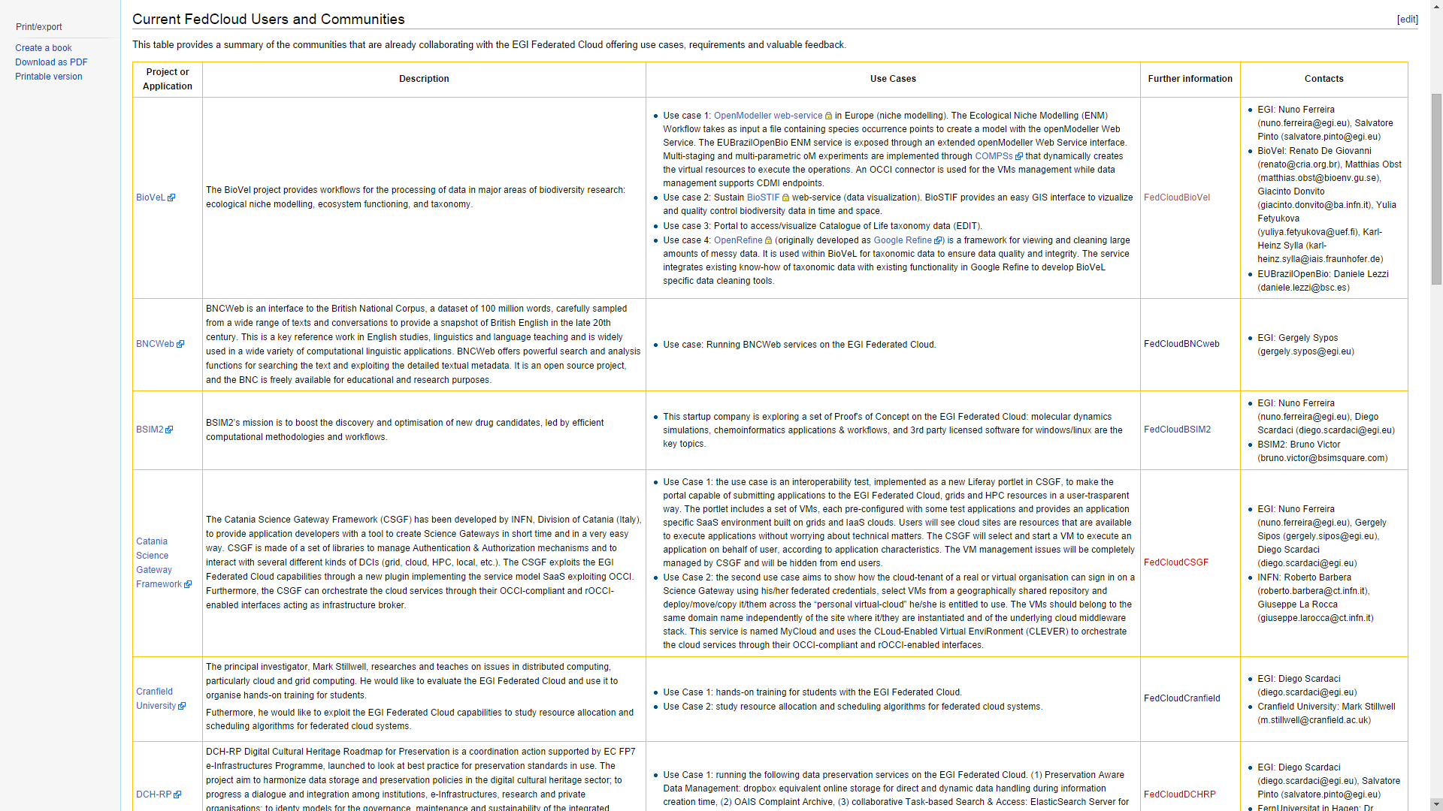
Use cases / user communities: https://wiki.egi.eu/wiki/Fedcloud-tf:Users:Communities
TODO:
Nuno to simplify the table to encourage registrations from the NGIs
Diego to investigate how to better monitor use cases at the infrastructure level
How to associate use cases and VM instances?
What info does the accounting system already collects about VM instances?

Slide 15
Webinars, events
EGI Webinar Programme
http://go.egi.eu/webinars
Porting applications to the EGI Federated Cloud (April 2). Video recording online
Topics and contributions welcome!
Growing number of related EGI and NGI events
Several during EGI Community Forum 2014 May, Helsinki
Joint user forums with EUDAT & GEANT in H2020
TODO:
NGIs to consider organising national cloud event with EGI.eu’s support

Slide 16
Engagement projects in EGI: Virtual Teams
National engagement activities, linked at European level
NGI International Liaisons
‘Virtual Team’ projects, based on NGI contributions
6-18 month projects with focussed activities and goals
Example: Support for genome analysis and protein folding
Identify relevant, reusable tools already available in EGI (Applications Database, NGIs)
Identify relevant tools not yet supported by EGI
Make these available on EGI (cloud/grid)
Work ongoing: READemption, Trufa, Chipster, RSAT
Develop materials to disseminate relevant applications & services for domain researchers
Through “knowledge networks” within the ERA
https://wiki.egi.eu/wiki/VT_GAPF
TODO:
NGIs to volunteer providing support for new use cases

Slide 17
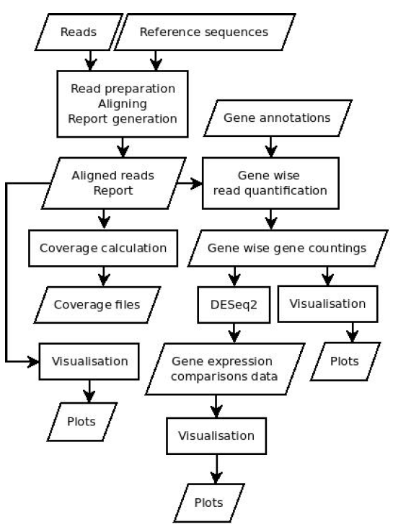
READemption
Implemented in Python 3
Needs:
Third-Party libraries (numpy, scipy, matplotlib, pysam)
Short Read mapper segemehl
R
Usual runtime on a multi-core machine several hours to some days
Implementation on EGI Federated Cloud
GWDG site in the fedcloud.egi.eu VO
VM with 24 cores and 128 GB of RAM
Block storage up to 3TB
To move into production
To serve peak loads
Dedicated resources with a new VO
GWDG and CESNET + more
Source: Konrad U. Förstner

Slide 18
Impact
25 communities and 44 use cases currently supported
19 use cases access the FedCloud through the rOCCI client
9 use cases adopted an high level brokering tool:
4 CSGF, 2 Slipstream, 2 WS-PGRADE, 1 DIRAC
7 use cases from private companies
Use case classification according to the new scientific discipline classification:
http://www.egi.eu/news-and-media/newsletters/Inspired_Issue_11/VT-SDC.html
Details on hidden slides next

Slide 19
EGI FedCloud Use Cases Discipline Classification (1° tier)
Natural Science: 35
Engineering and Technology: 4
Medical and Health Sciences : 2
Humanities: 3

Slide 20
EGI FedCloud Use Cases Discipline Classification (2° tier)

Slide 21
Have a new use case? Contact support@egi.eu
Thank you!

