Slide 1
EGI Federated Cloud
Diego Scardaci
User Community Support Team
EGI.eu

Slide 2
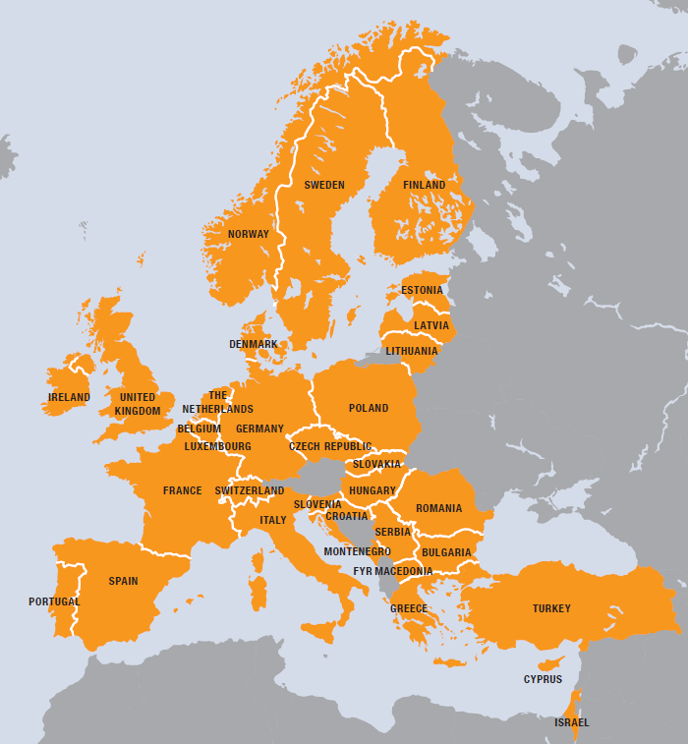
What is the EGI Federated Cloud
The EGI Federated Cloud is federation of institutional private Clouds, offering Cloud Infrastructure as a Service to scientists in Europe and worldwide.
EGI Federated Cloud is based on:
Standards and validation: federation is based on common Open-Standards – OCCI, CDMI, OVF, GLUE, etc...
Heterogeneous implementation: no mandate on the cloud technology, the only condition is to expose the chosen interfaces and services.
Our user communities:

Slide 3
The EGI Federated Cloud
12 countries provide certified resources
Czech Republic, Germany, Greece, Hungary, Italy, Finland, Poland, Slovakia, Spain, Sweden, Turkey, United Kingdom
20 resource providers
5 countries interested
Bulgaria, France, Israel*, The Netherlands, Switzerland
Worldwide interest
South Africa* (SAGrid)
South Korea* (KISTI)
United States* (NIST, NSF Centres)
October 2014

Slide 4
Cloud Infrastructure Platform
EGI Collaboration Platform
EGI Federated IaaS Cloud Infrastructure
OCCI
CDMI
GLUE2+
Cloud Compute
Cloud Storage
Information Discovery
Image Repository
Cloud Management Stacks
(OpenStack, OpenNebula, CloudStack, Stratuslab, …)
OVF
HEPiX
EGI
Application Database
EGI Core Infrastructure Platform
GLUE2
GSI
SAM
APEL
Service
Registry
Information Discovery
Federated AAI
Monitoring
Accounting

Slide 5
Federated Cloud service tiers
Tier 4:
Zero ICT
Infrastructures
VRE
VRE
VRE
Virtual
eLaboratory
Secure storage
Tier 3:
Professional research infrastructure platforms
Tier 2:
General-purpose platform services
DB aaS
Hadoop
aaS
Key Mgmt
Encryption
ACL mgmt
Tier 1:
Reliable
Infrastructure Cloud
Federated IaaS and STaaS Cloud

Slide 6
Value proposition
Open standards, open technologies
Use of Open Standards is key to the establishment of an effective, fair and transparent cloud market in Europe
Open Source components raise the barrier for hidden backdoors, thus lead to more trusted services
Firmly rooted in Europe
Strong public sector involvement through NRENs, NGIs, EIROs are EGI’s members
European commercial Cloud resource providers, including SME
A single cross-border market
Reaching out for research, government & business sectors
Level playing field for innovation and services on multi-service tiers

Slide 7
User workflows
OCCI API
rOCCI cmd line tool
High level tools
(+ CDMI tools)
Cloud sites
End users:
Access services running in VMs
Site: Supports the VO
perform OCCI (+CDMI) cmds
Download VM images for supported VOs
AppDB
Cloud Marketplace
EGI Applications Database
Download VM image and use ‘locally’
Publish VA
Include VA in VO set
Technical developer: Prepares VM Images
VO Manager: Endorses suitable VM images

Slide 8
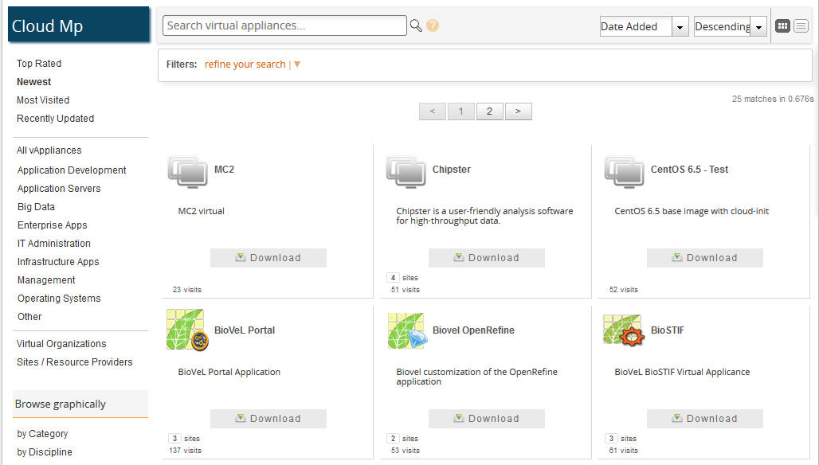
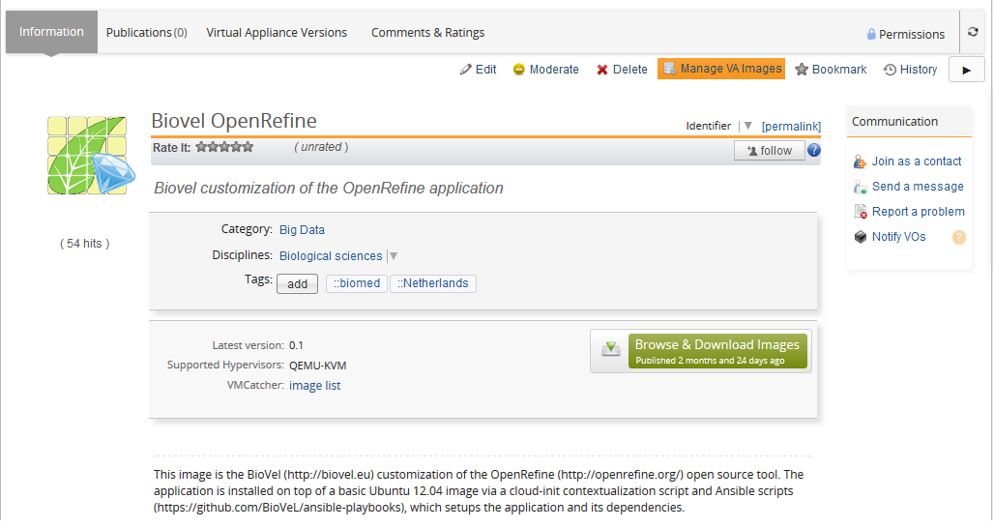
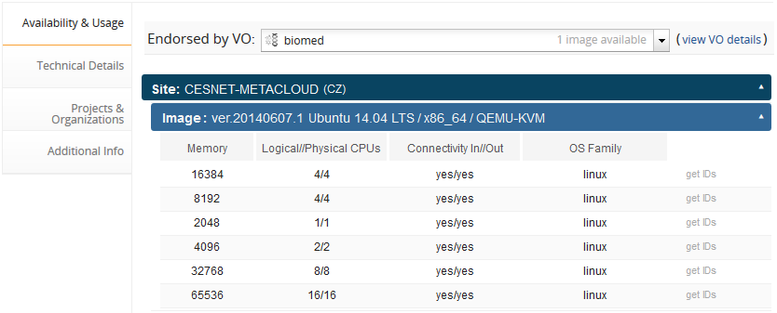
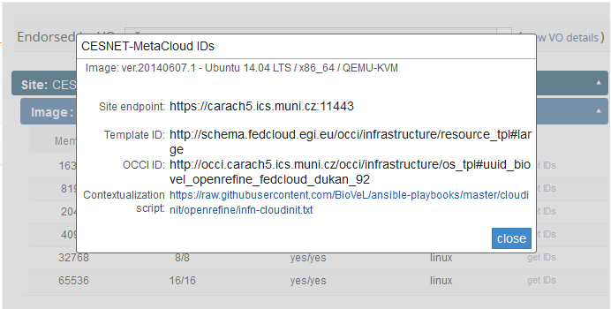
The Cloud Marketplace VM images

Slide 9
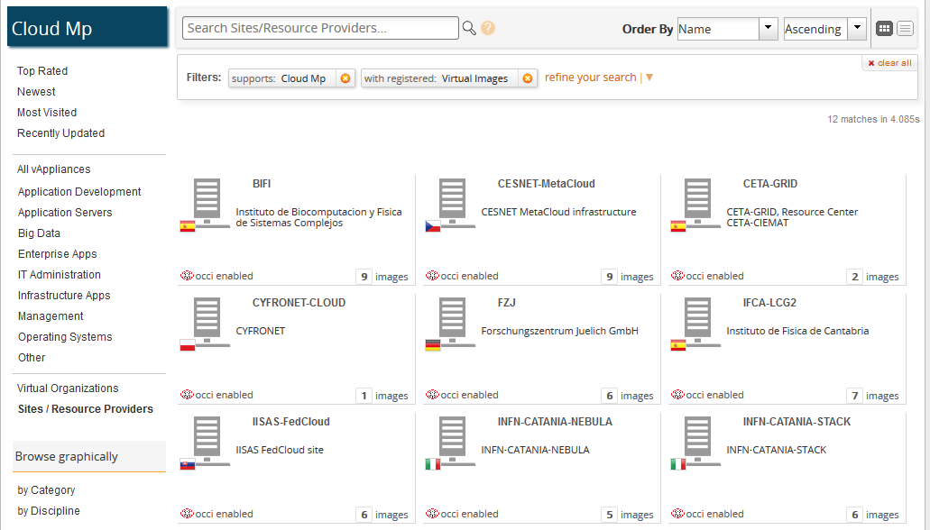
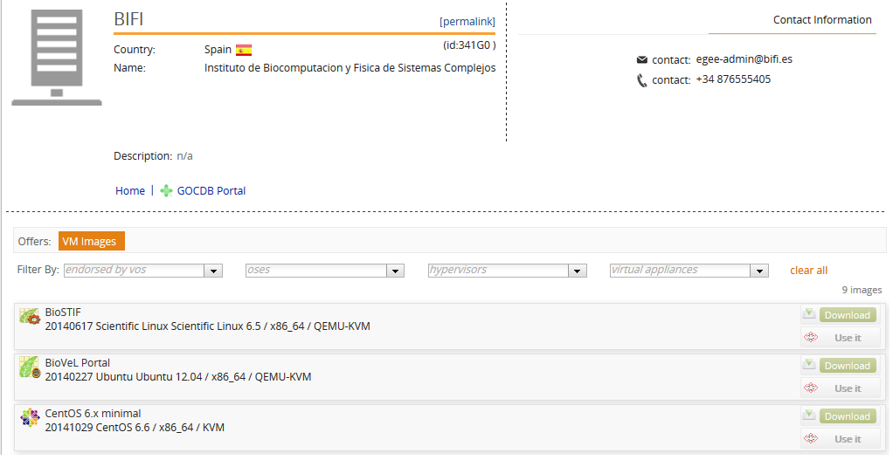
The Cloud Marketplace Resource Providers

Slide 10
High-level tools to use the EGI Federated Cloud
Recognised as generic and useful
Extend the IaaS capabilities of the EGI cloud
‘Alternatives’ of the OCCI client and API
More than OCCI
External contributions (→ support many other clouds too)
Infrastructure brokers and Application brokers
Catania Science Gateway Framework – SaaS with ID federations
SlipStream – PaaS for automating deployments; Helix Nebula
COMPs – programming framework for auto-parallelisation
VMDIRAC – abstraction on top of various HPC/HTC/cloud
WS-PGRADE – workflow development and enactment

Slide 11
User support teams
support@egi.eu
Nuno Ferreira
Diego Scardaci
Enol Fernández del Castillo
with a growing number of NGIs:
ES, PT, FR, CZ, DE, IT, HU, ….
Bi-weekly teleconferences for the support teams (Contact us us to be involved!)
Weekly updates to/from FC-Task Force

Slide 12
Summary
EGI: Community of resource providers with long-term tradition in providing federated ICT services for research
EGI Federated Cloud: Paving the way for a federated cloud in Europe
Open standards, open technology
Open membership, open processes
Driver for innovation in Europe
International perspective: Although EGI activity, a global federation is in scope, with global concrete interest
Korea, South Africa, Canada, Taiwan, Australia
large public Cloud providers

Slide 13
Thank you
EGI Federated Cloud resources
Wiki site: http://go.egi.eu/fedcloud
User support: https://wiki.egi.eu/wiki/Federated_Cloud_user_support
User support e-mail: support@egi.eu
Cloud Marketplace: https://appdb.egi.eu/browse/cloud
GitHub: https://github.com/EGI-FCTF

