Slide 1
SLAs in the EGI Federated Cloud
Małgorzata Krakowian
EGI.eu

Slide 2
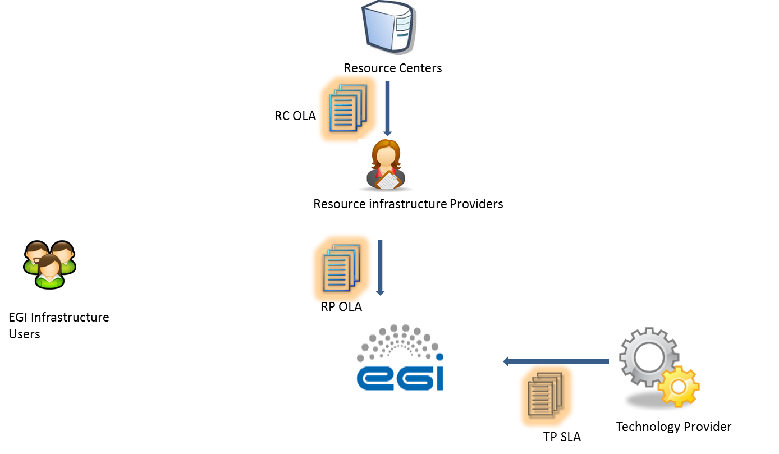
Phase 1

Slide 3
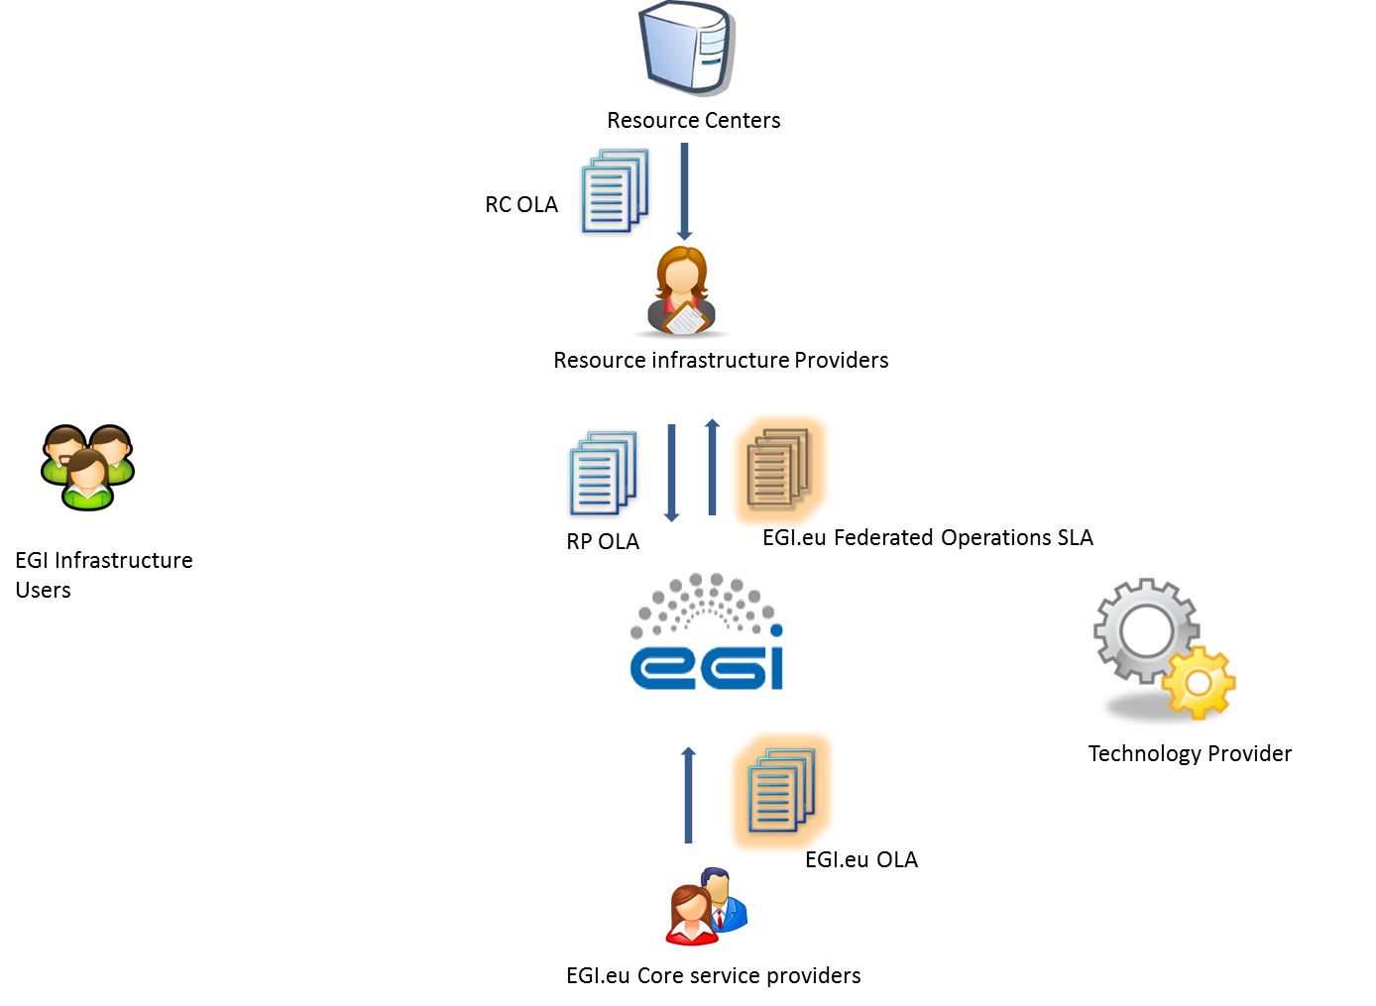
Phase 2

Slide 4
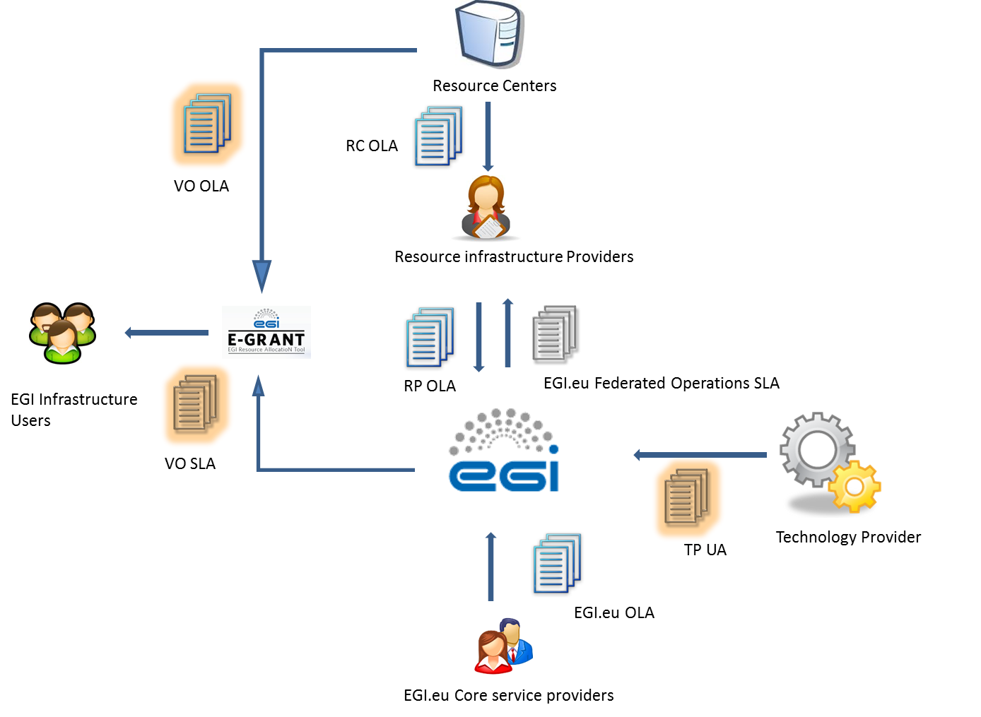
Phase 3

Slide 5
RC OLA
RP OLA
EGI.eu OLA/SLA
TP UA
VO OLA/SLA

Slide 6
EGI VO SLA
https://documents.egi.eu/document/2371
It is all about expectations clarity!
Not a legal contract, No penalties
Agreement between EGI and VO
Negotiated and agreed via e-GRANT
Supported by VO OLA
between EGI and RPs
subset of what is offered to VO

Slide 7
Content
Scope
High-Throughput Computing Platform/Cloud Computing Platform
Parameters
Service hours and exceptions
Exceptions: planned maintenance
Services components and dependencies
Cloud/grid computing/storage, accounting, monitoring (Ops VO), ?
VO monitoring out of EGI scope
Support
Incidents and service requests handling

Slide 8
Content
Service level targets
Availability, Reliability (based on Ops VO results)
Quality of support in GGUS
Limitations
Eg. Downtimes caused due to upgrades for fixing critical security issues are not considered SLA violations.
Communication, reporting & escalation
Contact points
SLA violations communication
Escalation & complaints

Slide 9
Content
Information security & data protection
Additional responsibilities of the provider
Can be extended during negotiation process
Customer responsibilities
Can be extended during negotiation process
Review

Slide 10
Next actions
Finalize VO SLA/OLA
Discuss with P4U how they will be integrated
Finalize TP UA

Slide 11
VMI endorsement (TF)
EGI.eu Operations
(C. Aiftimiei)

Slide 12
VMI endorsement – setting the scene (1) -
Issues (raised by user communities or user communities support)
one of the main issues - is maintenance of production applications on the cloud available as VMIs registered in AppDB and deployed as instances on sites through some production VO
the VM images get outdated and the software inside these must be upgraded when new OS version comes out, when new version of the scientific software or datasets of the images come out.
we also have basic OS VM images in AppDB., used as basis of many other images.
must be also maintained by someone, moreover and after each upgrade the changes should be propagated to the other images that have been built from such a basic OS image.
need some sort of SLAs for the VM images (for individual images, or for groups of VM images) that defines who maintaines the images in AppDB and on the production VO, and what's the protocol for propagating changes to other mages that depend on some image. “

Slide 13
VMI endorsement – setting the scene (2) -
OS VM images in AppDB
created by the EGI FedCloud should be endorsed and properly updated by EGI.
should create a group/board of appointed people in charge of keeping always updated these images, decide to add new images in the set or remove obsolete ones, etc.
Until now this job has been done by volunteers – this is not sustainable.
The basic images are part of the EGI FedCloud offer and we should guarantee an adequate quality level.

Slide 14
VMI Endorsement -proposed solution-
EGI VMI Endorsement (TF) – team:
EGI endorses base VM images
EGI is providing a well-defined small set of base VM images, and takes responsibility for maintaining these.
A well-defined group of people within EGI will be responsible for this duty.
EGI.eu Operations - coordinate the group of people maintaining EGI VM images
we’ll contact experts but please feel free to contact us if you want to take part
Define quality criteria (security policies), upgrade procedures, etc
(VO SLA) takes care that Appdb is making it clear to VO managers that they are responsible for keeping VM images up to date
VO images
A VO manager *may* decide to include EGI base images in their VO set and will receive notifications of updates of entries.
For other VO images, it is the explicit responsibility of the VO Manager to ensure that the VM images endorsed into their own image list are properly maintained and updated.

