Slide 1
EGI Federated Cloud Use Cases Current status and open requirements
Diego Scardaci, EGI.eu/INFN Technical Outreach Expert
EGI Federated Cloud F2F meeting
19 January 2015, Amsterdam

Slide 2
Outline
EGI Federated Cloud user support
Guides and documentations
VM Marketplace & ready-to-use Virtual Appliances
High level tools (~Paas, SaaS)
NGI and other cloud user teams
Impact and use cases status
Requirements for the FedCloud TF
Conclusions

Slide 3
Motivating user workflows
OCCI API
rOCCI cmd line tool
High level tools
(+ CDMI tools)
Cloud sites
End users:
Access services running in VMs
Site: Supports the VO
perform OCCI (+CDMI) cmds
Download VM images for supported VOs
AppDB
Cloud Marketplace
Fedcloud.egi.eu VO : recommended incubator for new users
EGI Applications Database
Download VM image and use ‘locally’
Publish VA
Include VA in VO set
Technical developer: Prepares VM Images
VO Manager: Endorses suitable VM images

Slide 4
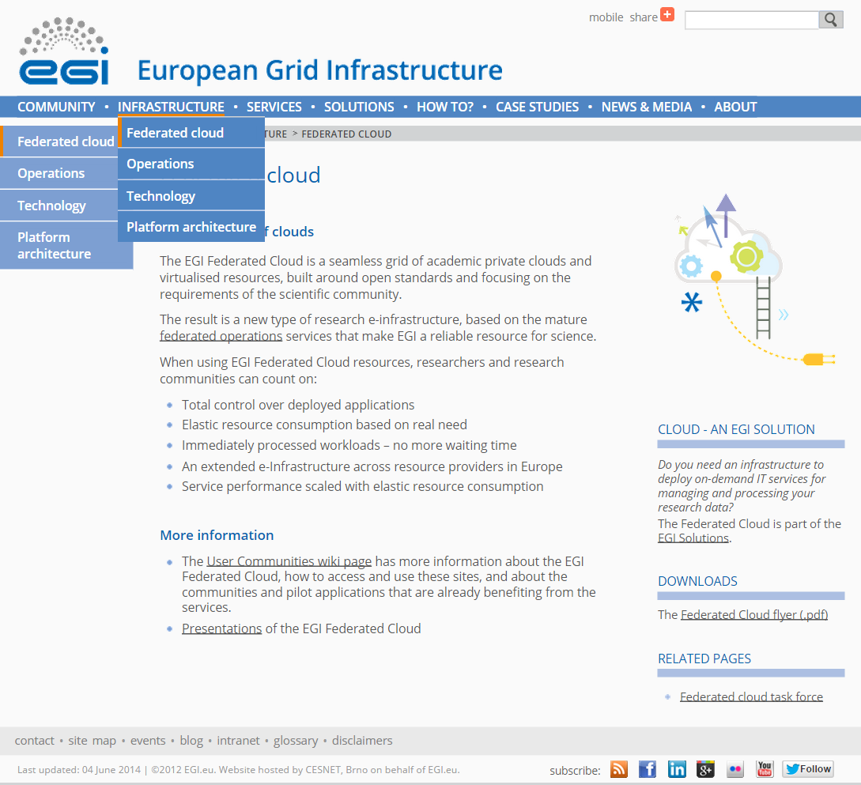
Guides, documentations
http://go.egi.eu/cloud

Slide 5
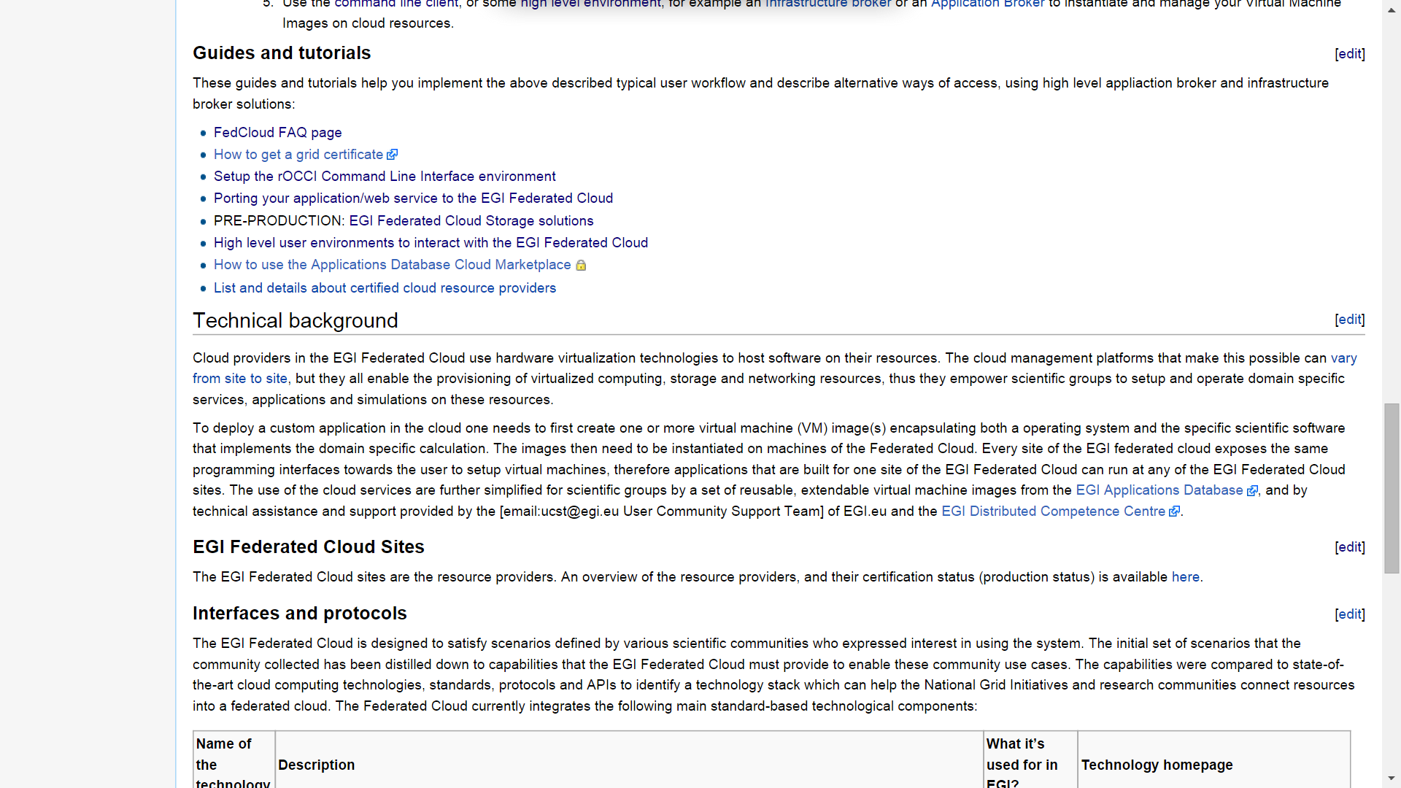
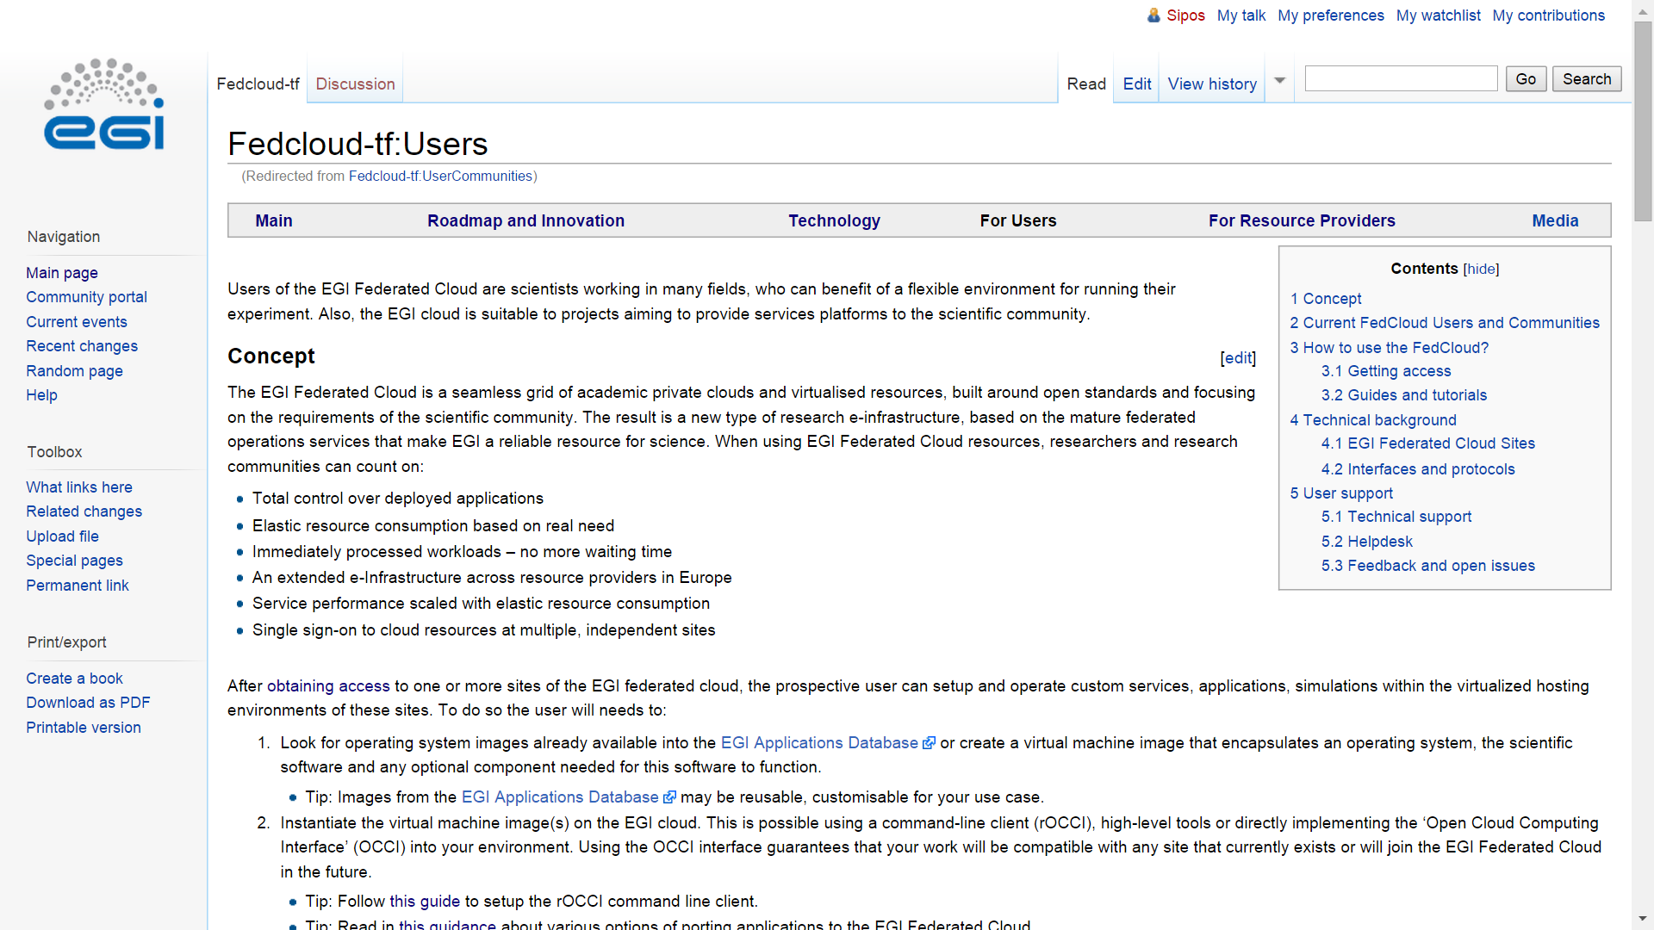
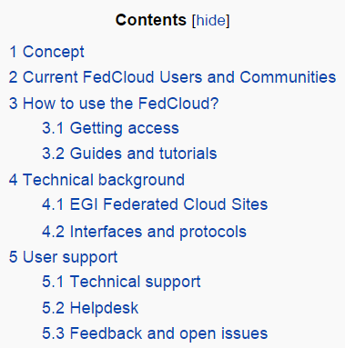
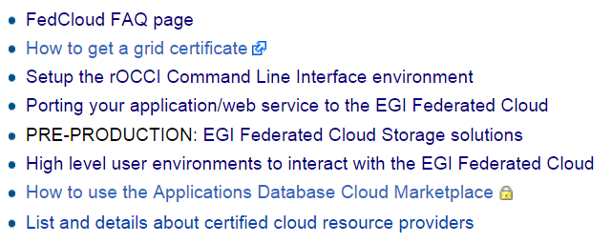
Guides, documentations

Slide 6
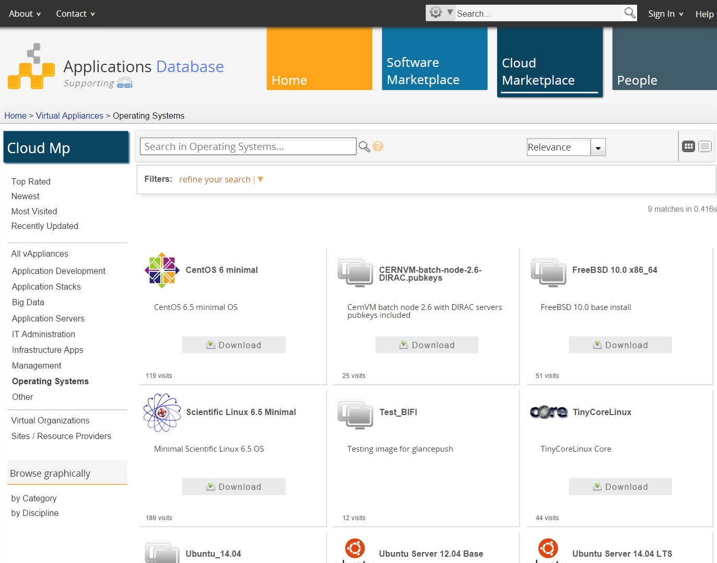
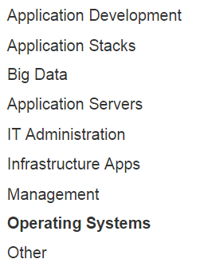
Ready-to-use Virtual Appliances in EGI AppDB

Slide 7
High-level tools to use the EGI Federated Cloud
Recognised as generic and useful
Extend the IaaS capabilities of the EGI cloud
‘Alternatives’ of the OCCI client and API
More than OCCI
External contributions (→ support many other clouds too)
Infrastructure brokers and Application brokers
Catania Science Gateway Framework – SaaS with ID federations
SlipStream – PaaS for automating deployments; Helix Nebula
COMPSs – programming framework for auto-parallelisation
VMDIRAC – abstraction on top of various HPC/HTC/cloud
WS-PGRADE – workflow development and enactment
Vcycle - a VM lifecycle manager that implements the vacuum model on IaaS Cloud services

Slide 8
Consultancy support

Slide 9
User support teams
Support given by EGI in collaboration with NGIs:
ES, PT, FR, CZ, DE, IT, HU, ….
Specific consultancy for each use case
User requirements discussed with the EGI Federated Cloud TF
support@egi.eu

Slide 10
Support workflow
F2F / teleconference
Initial requirements
Allocation of technical experts
Milestones
Continuous tracking with appropriate support
Technical integration support from EGI/NGI team
On the incubator VO or setup of new VO
Service development support from EGI FedCloud Task Force
Community support through Virtual Team projects
Migration into production
Resource provider commitments

Slide 11
Webinars, events
EGI Webinar Programme
http://go.egi.eu/webinars
Porting applications to the EGI Federated Cloud (April 2). Video recording online
RNA-Seq analysis with READemption - Setup and usage in the EGI Federated Cloud (November 27). Video available soon.
Cloud-Init (December 15). Video available soon.
Growing number of related EGI and NGI events
Several during EGI Community Forum 2014 May, Helsinki
Joint user forums with EUDAT & GEANT in H2020

Slide 12
EGI FedCloud use cases
Full list available at:
https://wiki.egi.eu/wiki/Federated_Cloud_Communities
detailed wiki page for each use case
8 different phases

Slide 13
Impact
26 communities and 50 use cases currently supported
29 use cases access the FedCloud through the rOCCI client
12 use cases adopted an high level brokering tool: 6 CSGF, 3 COMPSs, 2 Slipstream, 2 WS-PGRADE, 1 DIRAC, 3 VCYCLE
4 use cases from private companies
Use case classification according to the new scientific discipline classification:
http://www.egi.eu/news-and-media/newsletters/Inspired_Issue_11/VT-SDC.html
see next slides

Slide 14
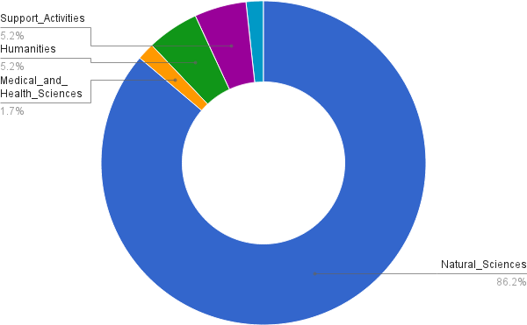
EGI FedCloud Use Cases Discipline Classification (1° tier)
Engineering and technology 1.7%

Slide 15
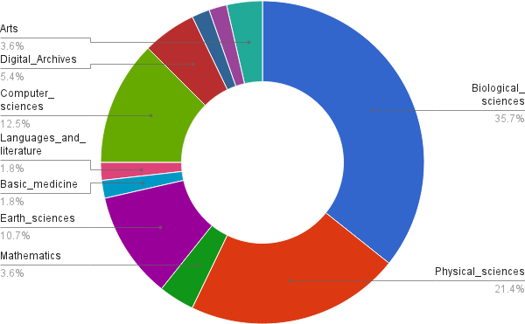
EGI FedCloud Use Cases Discipline Classification (2° tier)

Slide 16
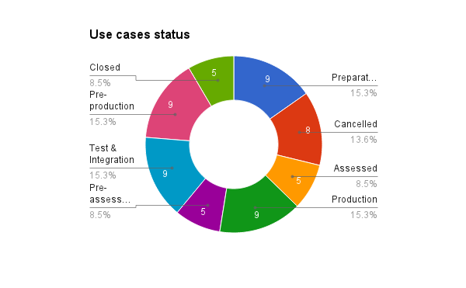
EGI FedCloud Use cases status

Slide 17
Use Cases in production
Community | Description | Scientific discipline | Sites
BioVeL | BioVeL Portal | Biodiversity conservation | BIFI, CESNET-MetaCloud, PRISMA-INFN-BARI
BioVeL | OpenRefine | Biodiversity conservation | BIFI, CESNET-MetaCloud, PRISMA-INFN-BARI
BioVeL | OpenModeller | Biodiversity conservation | CESNET-MetaCloud
BioVeL | BioSTIF | Biodiversity conservation | BIFI, CESNET-MetaCloud, PRISMA-INFN-BARI
CUSM, Würzburg University | READemption | Bioinformatics | GoeGrid, IFCA
Peachnote | OCR analysis in music scores | Musicology | CESNET-MetaCloud, FZJ
Next step
MoU to agree a SLA between communities and sites

Slide 18
Use Cases in pre-production
Community | Use cases | Next steps
CHAIN-REDS | R, Octave, Aleph, WRF, Tthreader | Almost ready to move to production Sites: INFN-Catania-Stack, INFN-Catania-Nebula, PRISMA-INFN-BARI, Okeanos, CESNET, CESGA
CERN | Run ATLAS/LHCb/CMS jobs on the EGI FedCloud through Vac/Vcycle | Complete last tests (accounting validation) To be internally discussed at CERN
CERN | CERN@School | Looking for resources (100%IT ? )

Slide 19
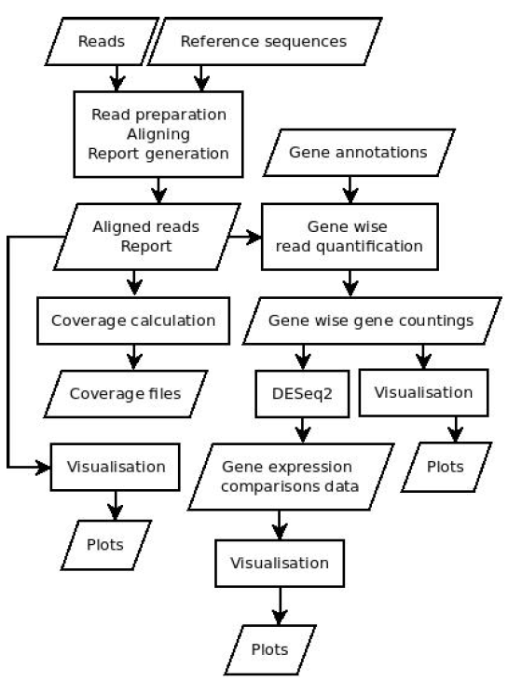
READemption
Scientific Discipline: Natural Science, Biological Sciences, Bioinformatics
Status: Production (hightroughputseq.egi.eu VO)
Sites: GoeGrid, IFCA (Nov-Dec 2014)
Next Generation Sequencing
Implemented in Python 3
Needs:
Third-Party libraries (numpy, scipy, matplotlib, pysam)
Short Read mapper segemehl
R
Usual runtime on a multi-core machine several hours to some days
Implementation on EGI Federated Cloud
VO supported by GWDG, IFCA and CESNET sites
VM with 24 cores and 128 GB of RAM
Block storage up to 3TB
To serve peak loads
Source: Konrad U. Förstner

Slide 20
READemption - Requirements
‘Big’ VMs
>20 cores, >70 GB of RAM, >1TB of disk space
hard to find fedcloud sites able to satisfy these requirements
VM reserved for limited time periods (to manage peaks)
short notice (few weeks)
Clear rules and well defined procedures to access the EGI FedCloud
For free? Pay-for-Use? Which pricing schemes?

Slide 21
WLCG use cases
Scientific Discipline: Natural Science, Phisical sciences, High energy physics
Status: Pre-production (ATLAS, LHCb and CMS VOs)
Sites: BIFI, CESNET-METACLOUD, FZJ, IISAS-FEDCLOUD, INFN-PADOVA-STACK, MK-04-FINKICLOUD, PRISMA-INFN-BARI
Run ATLAS/LHCb/CMS jobs on the EGI FedCloud through Vac/Vcycle
Vac/Vcycle PaaS: self managing system to control virtual machines (developed by the Univ. of Manchester)
Implementation of the vacuum model
CERN developed an OCCI connector for Vcycle to access the EGI Federated Cloud resources
Vcycle can be re-used by other FedCloud use cases (see presentation in the brokering session)

Slide 22
WLCG use cases & Slipstream
Slipstream
PaaS for automating deployments
Helix Nebula
Slipstream OCCI connector
basic deployment of virtual machine (create/delete/status)
direct usage of the FedCloud contextualisation system
dynamic attachment of block storage to the VM
authentication by using proxy uploaded by the users or MyProxy as credential store and VOMS to user retrieve attributes
Alternative to rOCCI client

Slide 23
WLCG use cases - requirements
Running a big amount of small VMs in parallel
how many resources as possible
CERNVM image
CERNVM-FS
Reliable accounting system
happy with the FedCloud and OCCI interface
they have to validate the accounting

Slide 24
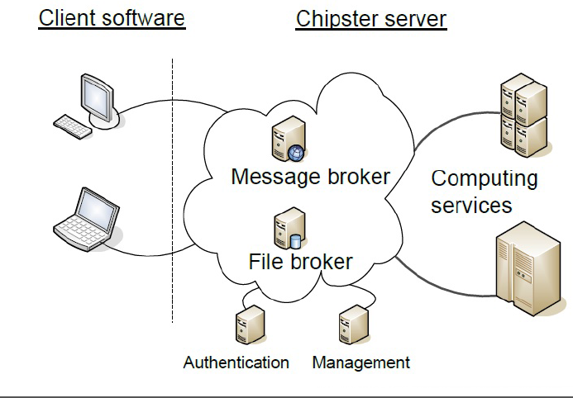
Chipster
Scientific Discipline: Natural Science, Biological Sciences, Bioinformatics
Status: Test & Integration (fedcloud.egi.eu VO)
Sites: PRISMA-INFN-Bari
ELIXIR Pilot Action Proposal:
Using virtual machines and clouds in bioinformatics training
User-friendly analysis software for high-throughput data:
NGS
Microarray
Proteomics
sequence data
Chipster in the EGI FedCloud:
‘light’ VM (datasets removed)
Chipster VM configured through contextualisation
shared block storage exported as NFS for tools (500 GB)
block storage for output (500 GB)

Slide 25
Chipster – Next steps
Test the current Chipster deployment at PRISMA-INFN-Bari site (Jan/Feb)
Evaluate CERNVM-FS to store datasets
Evolve contextualisation to configure Chipster VM at start-up
Test FedCloud object storage when available

Slide 26
Chipster – Requirements
Storage
CERNVM-FS on the EGI Federated Cloud
Object storage
Clear rules and well defined procedures to access the EGI FedCloud
For free? Pay-for-Use? Which pricing schemes?

Slide 27
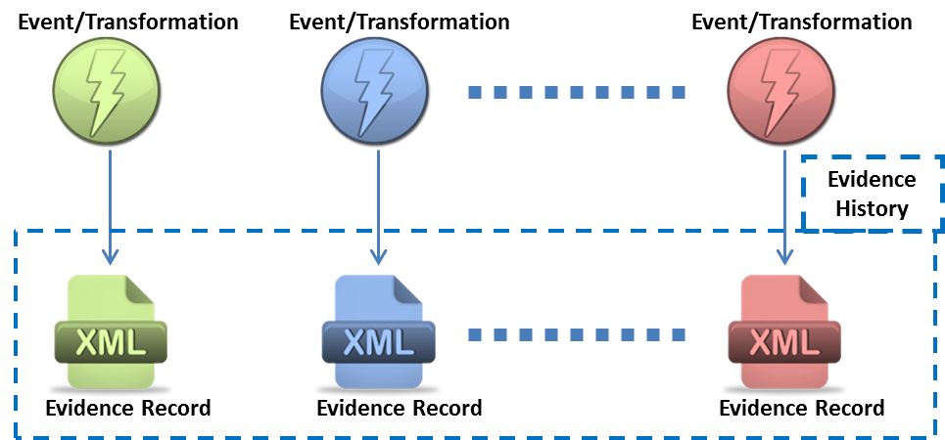
Engineering - HAPPI
Scientific Discipline: Support activities, Digital archives
Status: Test & Integration (fedcloud.egi.eu VO)
Sites: PRISMA-INFN-Bari
HAPPI toolkit:
supports the archive manager and curator to capture and manage part of the Preservation Descriptive Information (PDI)
Platform offered to the DCH-RP community
HAPPI in the EGI FedCloud:
VM: 2 cores, 4 GB of RAM
Block storage (size according to the amount of data stored)
Instance available at this URL

Slide 28
HAPPI in the EGI FedCloud
Presented at:
Final Plenary Meeting of SCIDIP-ES. 9 September 2014 – Heraklion
“Preservation as an e-infrastructure service: a Roadmap for digital cultural heritage” - Final Conference of DCH-RP. 22 September 2014 – Rome
“APA APARSEN SCIDIP-ES Conference 2014”. 22 October 2014 – Brussels
“Digital Preservation in Earth-Science Missions” - Final Workshop of SCIDIP-ES. 26 November 2014 – Rome
Will be presented at
SCIDIP-ES Final Review – March 2015

Slide 29
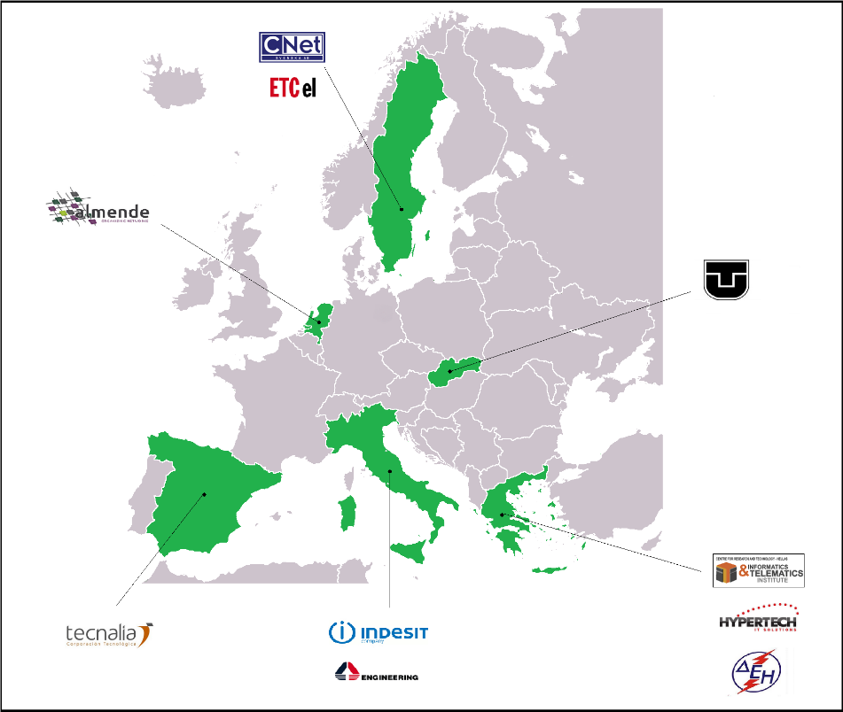
Engineering - INERTIA
Engineering and technology, Environmental engineering, Energy and fuels
Status: Test & Integration (fedcloud.egi.eu VO)
Sites: CESNET-METACLOUD
INERTIA:
address the "structural inertia" of existing Distribution Grids by introducing more active elements combined with the necessary control and distributed coordination mechanisms
Adoption of Internet of Things/Services
Application (backend + iOS App): retrieve energetic data of final-occupant of tertiary building
http://www.inertia-project.eu
INERTIA in the EGI FedCloud:
Backend services hosted in the fedcloud
VM: 2 cores, 4 GB of RAM
Tomcat App server, Block storage
Presented in the project meetings

Slide 30
HAPPI & INERTIA - Requirements
The Research and Innovation Dept. of ENG is interested to maintain these “use cases”, in order to evaluate their exploitation and enhancement in other research activities.
Clear rules and well defined procedures to access the EGI FedCloud
For free? Pay-for-Use? Which pricing schemes?

Slide 31
DRIHM
Scientific Discipline: Natural Science, Earth sciences, Hydrology
Status: Test & Integration (drihm.eu VO)
Sites: PRISMA-INFN-Bari
DRIHM:
project funded by EC aiming at providing an open, fully integrated workflow platform for predicting, managing and mitigating the risks related to extreme weather phenomena.
DRIHM in the EGI FedCloud:
Running various hydrological models in the EGI Federated Cloud
1 VM: 1 cores, 4/8 GB of RAM
few GB of storage
Windows OS
Contextualisation for Windows OS VM image
Licence issue
Current status:
Image registered in the AppDB
Contextualisation tool installed in the image
Context. tested in OpenStack site: update on OCCI-OS needed
To be tested in other CMFs
Tenant configured to start only 1 instance of the VM image

Slide 32
DRIHM - Requirements
Contextualisation for Windows os images
Working in all the EGI Federated Cloud CMFs

Slide 33
BILS Use Cases
Scientific Discipline: Natural Science, Biological Sciences, Bioinformatics
Status: Preparatory (fedcloud.egi.eu VO)
Sites: N. A.
BILS:
distributed national research infrastructure supported by the Swedish Research Council (Vetenskapsrådet) providing bioinformatics support to life science researchers in Sweden
Swedish Elixir node
3 use cases:
BILS portal: front-end to biological tools for not IT skilled users
PConsC2: tools for protein structure prediction
Genome Annotation service: genome brower to run genome annotation pipeline
Current status & next steps:
BILS developers completed the configuration of the environment to execute tests
VM images to be:
adapted for the fedcloud env
registered in the AppDB

Slide 34
BILS Use Cases - Requirements
Production quality Object Storage
Hundreds of GB to be shared between different VMs
Tools to exploit cloud elasticity
JAVA OCCI API
to make easier the integration in the FedCloud of their applications
Clear rules and well defined procedures to access the EGI FedCloud
For free? Pay-for-Use? Which pricing schemes?

Slide 35
Requirements for the FedCloud TF
Requirements | Description
Reliable service management | Well-defined procedures, rules and policies to access the EGI Federated Cloud resources (for free, for pay, how much to pay and with which rules)
Big Data Platform | official solution should be offered by the EGI Federated Cloud to copy and replicate the big data sets used by the use cases open a new FedCloud-TF scenario to analyse this complex and important topic
image format (OVA, handlers, etc...) | the VMCatcher handlers should be able to accept as input N different image formats and properly convert them for the underlying CMF

Slide 36
Requirements for the FedCloud TF
Requirements | Description
Contextualisation tool(s) for Windows OS | offer a contextualization solution for Windows OS virtual machines too
Extend the EGI Federated Cloud OCCI client to get information about the cloud site configuration | a user should be able to query a EGI Federated Cloud site to know its policy about IP management, ports, etc. The OCCI client should allow users to create new security rules (e.g. open port 22) during for their virtual machines
Offer a Virtual Machine image with the EGI Federated Cloud CLI environment pre-installed for the most common OSs (Ubuntu 14, Mac OSx, etc.) | to speed-up the use case preparatory work

Slide 37
Requirements for the FedCloud TF
Requirements | Description
Reliable storage solutions | offer production quality block and object storage solutions
Automatic scalability to exploit cloud elasticity | Offer tools allowing users to exploit horizontal (start/stop new virtual machines when needed) and vertical cloud scalability (change characteristics of already started virtual machines, e.g. increase the number of cores, the amount of memory, etc.).
Custom DNSs | Users should be able to create custom DNS configurations
Java API for OCCI | useful to easily integrate user applications to the EGI Federated Cloud

Slide 38
Conclusions
EGI Federated Cloud is attracting many communities belonging to various scientific domains
Conditions to fully ‘engage’ them in EGI are:
the definition of clear rules and procedures to access the EGI FedCloud (for free, for pay, pricing schemes, etc.)
the improvement of the reliability of the current services
the extension of the current service portfolio including PaaS and reliable storage solutions

Slide 39
Have a new use case? Contact support@egi.eu
Thank you!

