Slide 1


Support to user communities in EGI with COMPSs
Federated Cloud F2F
Jan 19 2014, Amsterdam
Daniele Lezzi – Barcelona Supercomputing Center

Slide 2

Outline
COMPSs programming model
COMPSs tools
COMPSs supported use cases
Conclusions

Slide 3
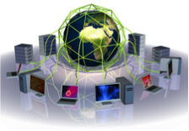

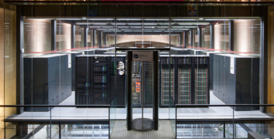
BSC vision on programming models
Program logic
independent of computing platform
Applications
PM: High-level, clean, abstract interface
General purpose
Task based
Single address space
Power to the runtime
“Reuse” architectural ideas under
new constraints
API

Slide 4
Advantages and drawbacks of COMPSs
✔ More flexible and with more expressivity
  The potential of the programming language
  Enables to express complex problems
✔ Data independent
  Different data inputs may generate different task graphs
✔ Powerful runtime
  Platform unaware
  Exploits inherent parallelism
✗ Less explicit than graphical workflows
  Although this can be partially compensated with the COMPSs monitor
✗ Large degree of flexibility may prevent some programmers to be efficient
  Schemas such as MapReduce are sometimes more appreciated by programmers
  Can be improved through training and support

Slide 5
Programming objectives
Reduce the development complexity of Grid/Cluster/Cloud applications to the minimum
  Writing an application for a computational distributed infrastructure may be as easy as writing a sequential application
Target applications: composed of tasks, called several times
  Granularity of the tasks or programs
  Data: files, objects, arrays and primitive types
Programming languages support
  Java (native)
  Python
  C/C++

Slide 6
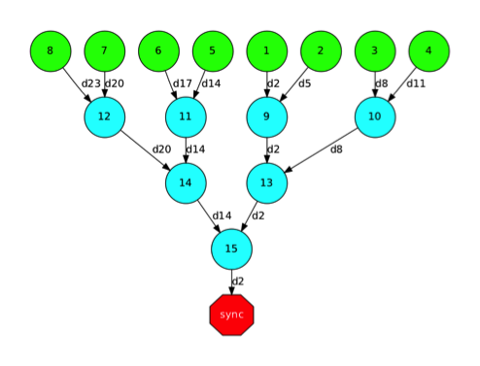
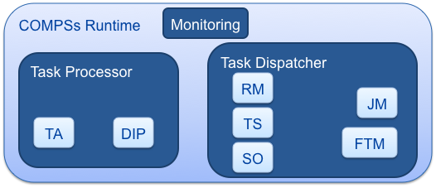
COMPSs Infrastructure
User code
+ annotations
Python
C/C++
Java
TDG
Grids
Clusters
Clouds
Language
bindings
Custom Loader
Tasks
Task
interception
Files, objects

Slide 7
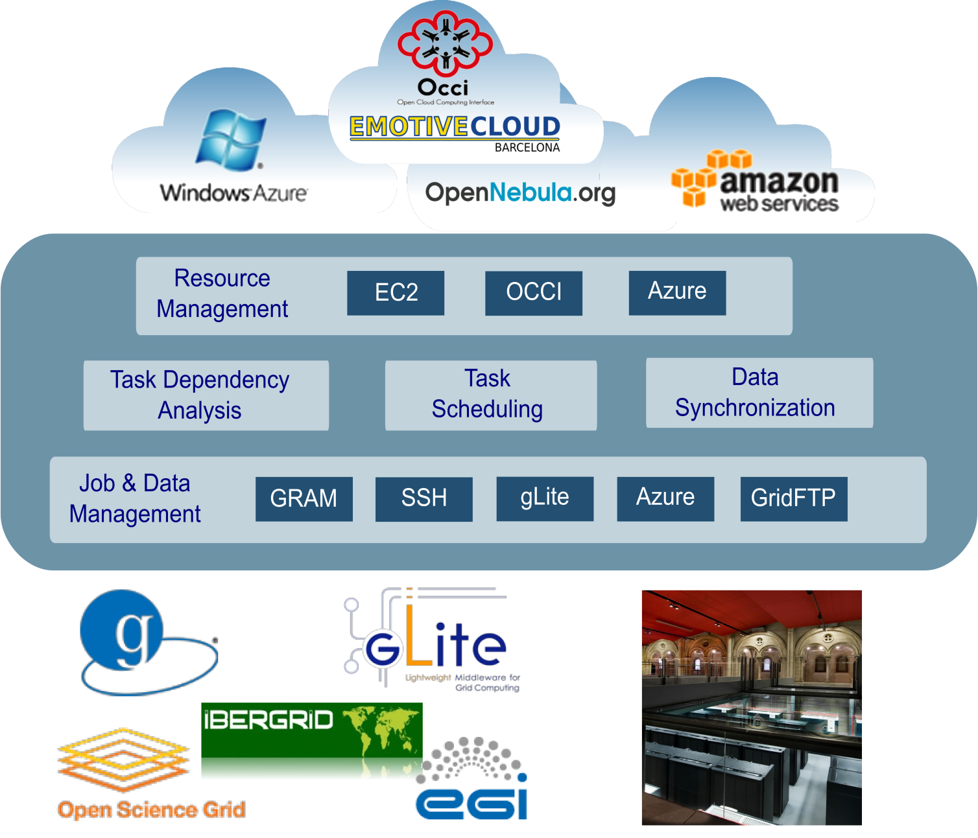
Runtime System
Task handling
  Task graph
  Scheduling
  Data transfers
Resource management
  Cloud elasticity
Support for federated heterogeneous clouds
  i.e. openstack + Amazon
OpenStack

Slide 8
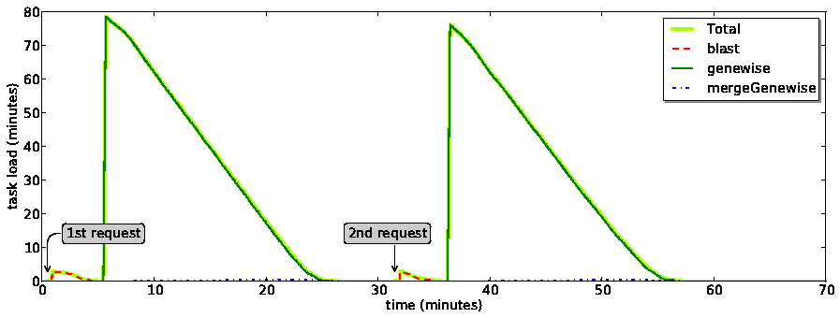
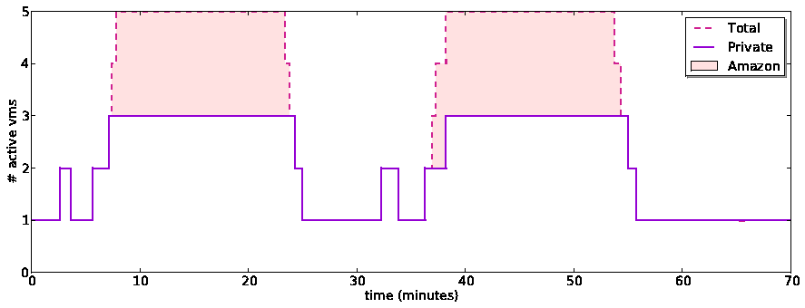
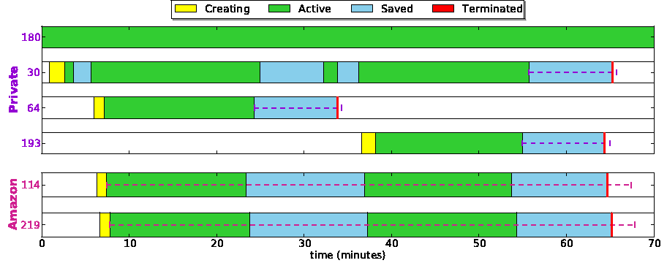
COMPSs in the Cloud
Dynamic creation / destruction of VMs
  Depending on task load
Bursting to meet peak demands
  Private Cloud (OCCI based, ONE, OS)
  Public Cloud (EC2, Azure..)
Save VMs for later use
  Amazon: use the whole hour slot
Reuse of VMs
VM deadlines
8

Slide 9
What is available to users

Slide 10
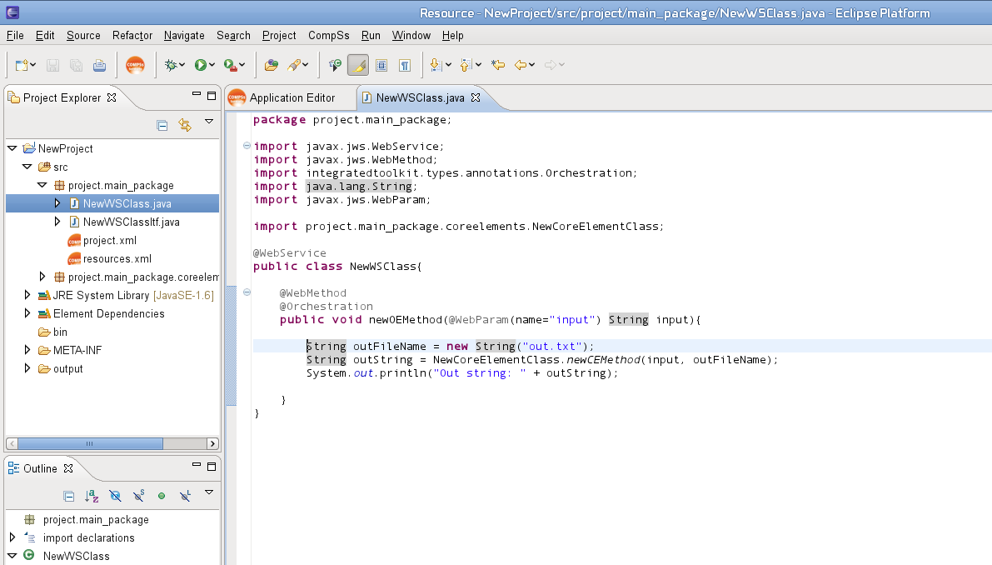
COMPSs IDE
Graphical interface to help developers with COMPSs applications
  Annotation of main program and tasks
  Generation of configurations
  Deployment in the infrastructure (through the PMES)
Developed as Eclipse plugin
  Available in the Eclipse marketplace

Slide 11
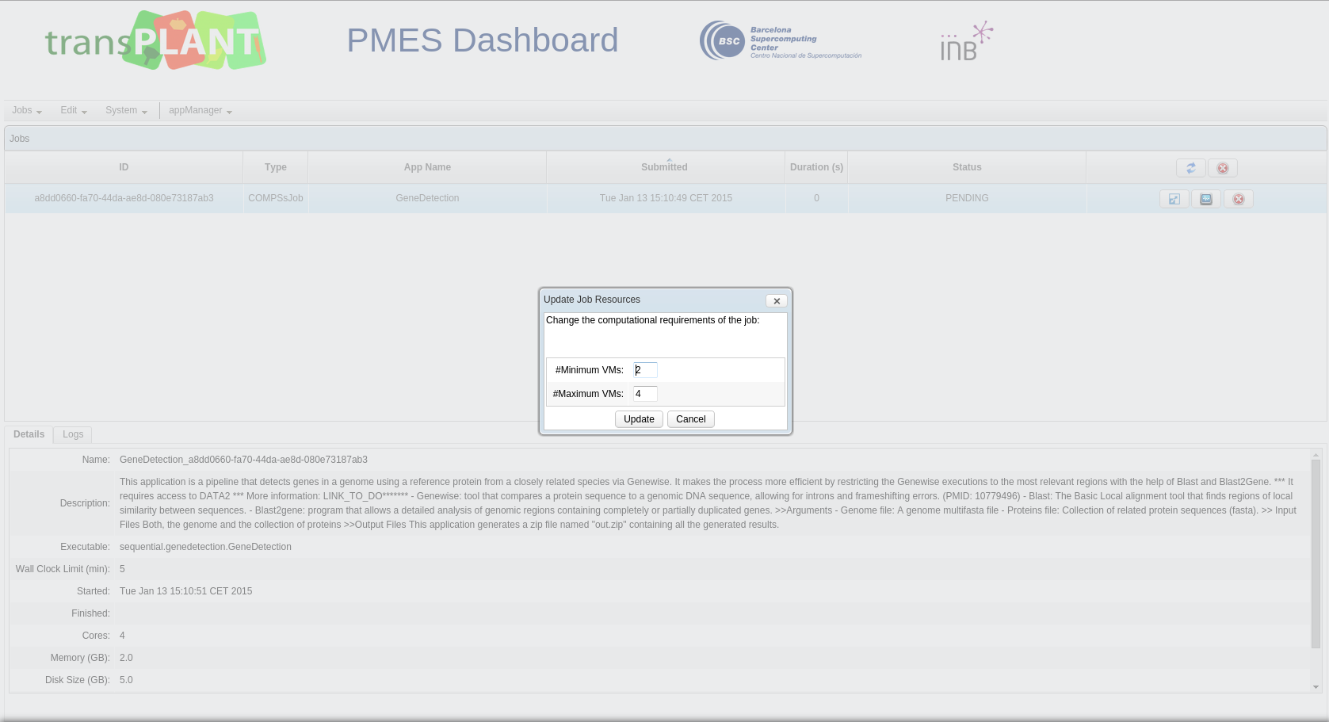
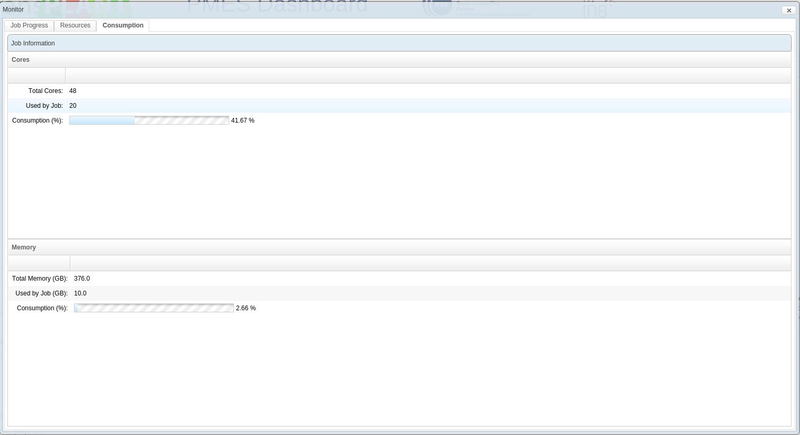
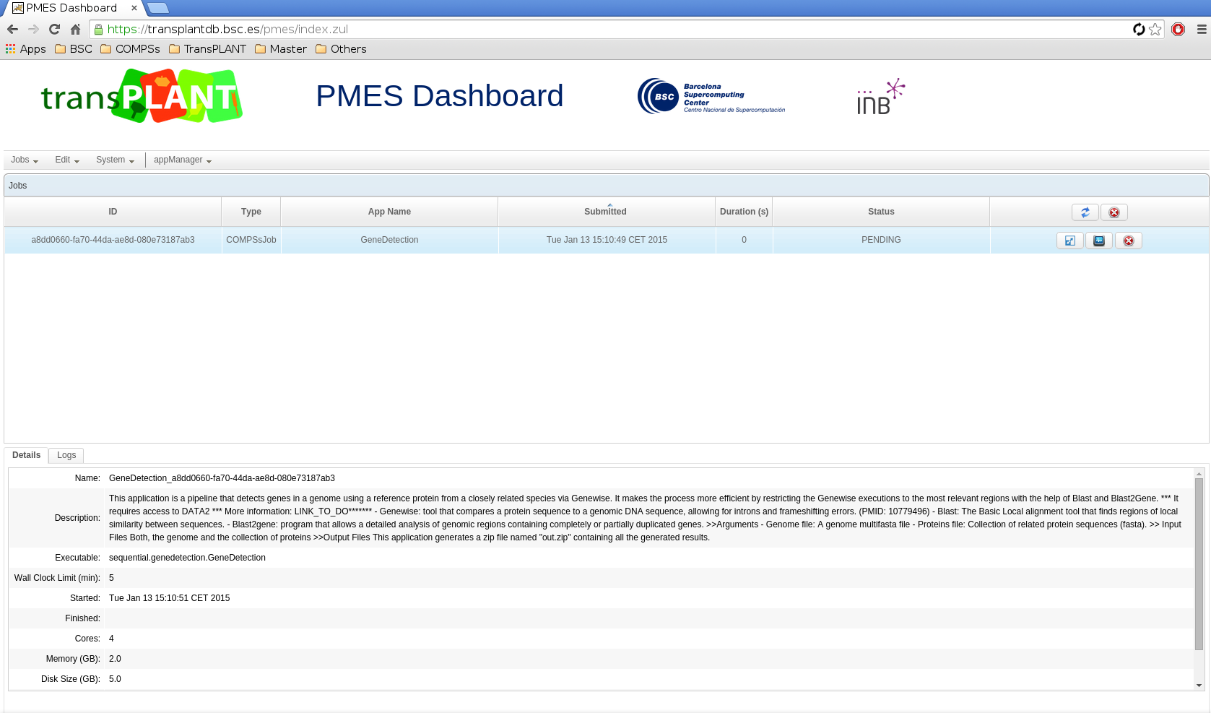
PMES – Transparent deployment and execution
Programmatic interface to execute the applications
  OGSA-BES SOAP API
  Support to OCCI and CDMI
  Multiple cloud providers
Web Dashboard
  Management of applications, jobs, storage and users in the PMES
  Monitoring of execution

Slide 12
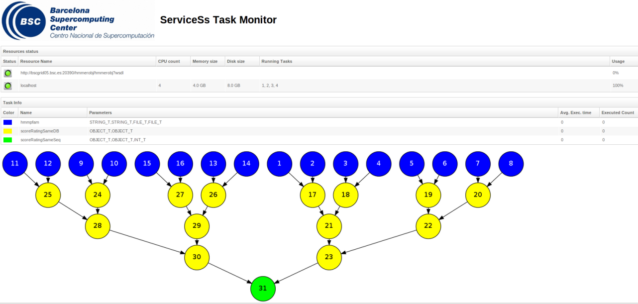
Runtime Monitoring
The runtime of COMPSs provides some information at execution time so the user can follow the progress of the application:
  Real-time monitoring information (http://<IP>:8080/compss-monitor/ )
    # tasks
    Resources usage information
    Execution time per task
    Real-time execution graph
    …
12
Notes:
12
12
12

Slide 13
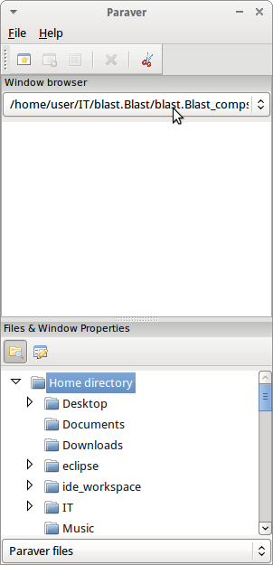
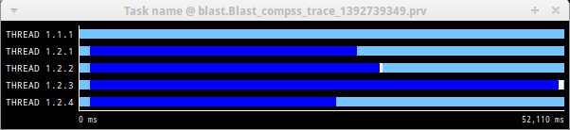
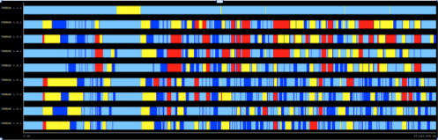
Tracing and performance analysis
Paraver is the BSC tool for trace visualization
  Trace events are encoding in Paraver (.prv) format by Extrae
  Paraver is a powerful tool for performance analysis
  Paraver enables different views of a trace
13

Slide 14
Big Data support

Slide 15
Supported communities in EGI

Slide 16

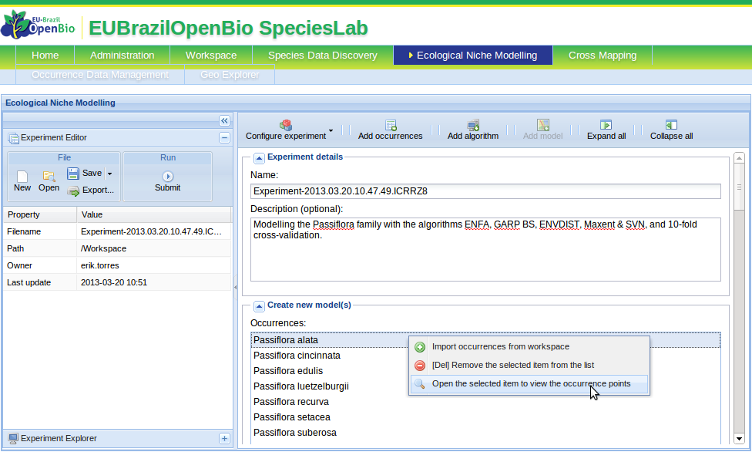
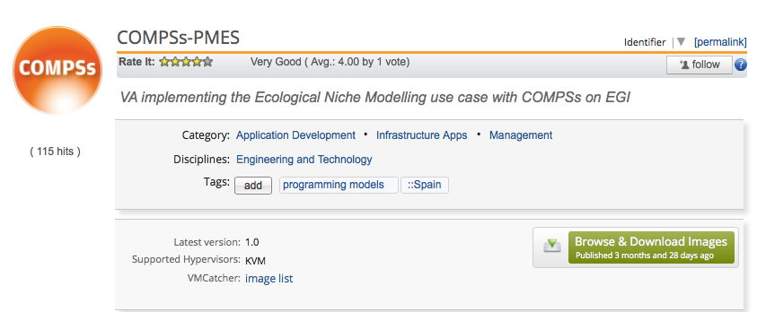

COMPSs and OpenModeller: BioVeL/EUBrazil OpenBio
ENM Service: the OpenBio Ecological Niche Modelling service receives requests for the generation of multiple models, balancing them between different RPs supporting the use case.
COMPSs Enactment Service: deployed at each site, delegates the execution to the COMPSs runtime.
COMPSs Orchestrator: executes (in parallel) the different parts of the complex wf to dynamically created VMs.
ENM Service (OMWS2)
RP1
RP2
Virtual appliance available in the AppDB
COMPSs Execution Service RP1
COMPSs Execution Service RP2
COMPSs Workflow Orchestrator
COMPSs Workflow Orchestrator
VM1
VMn
VM1
VMn

Slide 17
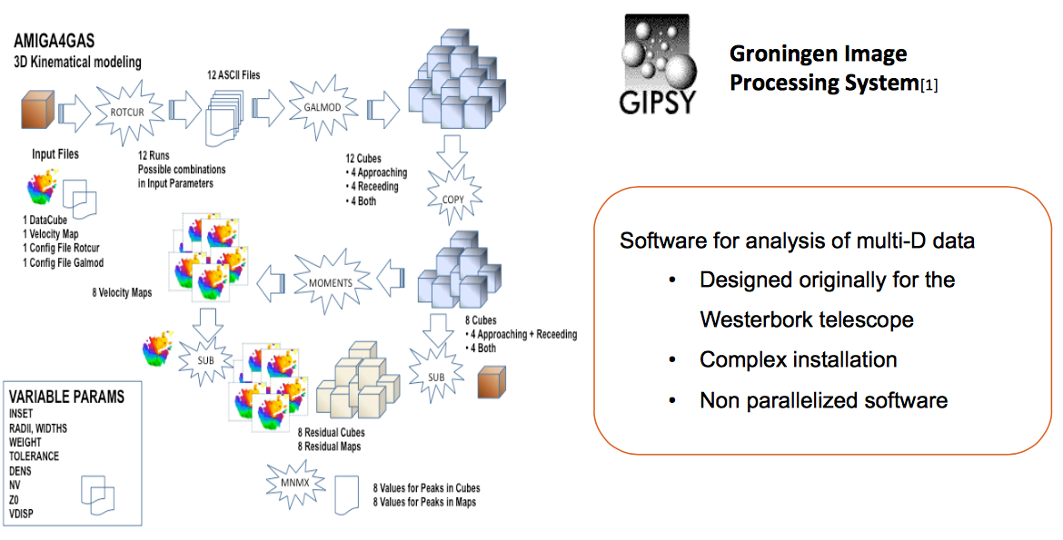
COMPSs and Gipsy
Modelling of the kinematic of galaxies in the AMIGA4GAS project
Set of analysis web services, based in tasks of that can be used as modules in workflows for modelling galaxies
Currently, some of the web services launch the GIPSY tasks to Ibergrid and others to a Supercomputer cluster using COMPSs
Now moving to Cloud
Storage | Memory | Instances/cores
120GB each run. Each model generates 200MB | >1GB (size of 1 cube) | Calculate 600 models. Each instance calculates 10 models

Slide 18

COMPSs and Lofar
Development of a calibration pipeline for LOFAR data in the AMIGA4GAS project
Several configurations of virtual clusters will be used to run and profile different calibration pipelines
The community would like to adopt the COMPSs high-level tool (PyCOMPSs) to port the application on the EGI Federated Cloud
Storage | Memory | Instances/cores
3TB for tests | ~64GB | 1 control + 2 working nodes (2 cores at least)
Storage problem, need to share large volumes of data
The quality of the final image depends on the available memory
Control/working nodes can be modelled in COMPSs, thus the number of instances will depend on the level of parallelism that can be managed by COMPSs

Slide 19
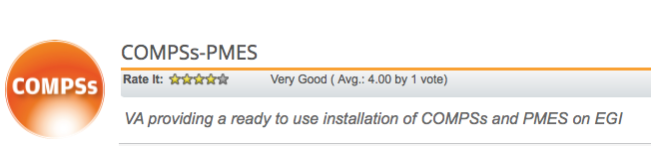
Usage of COMPSs in the FedCloud sites/VO
Installation packages available in the Software Marketplace and VA in Cloud Marketplace
One image provides both COMPSs and PMES (to be started manually if needed)
Endorsed by:
VO | Sites
biomed | CESNET-METACLOUD(CZ)
fedcloud.egi.eu | FZJ(DE) HG-09-OKEANOS-CLOUD(GR) IFCA-LCG2(ES) CESNET-METACLOUD(CZ) BIFI(ES) IISAS-FEDCLOUD(SK) SZTAKI(HU) MK-04-FINKICLOUD(MK) INFN-PADOVA-STACK(IT) BIFI(ES) CETA-GRID(ES) UPV-GRYCAP(ES) PRISMA-INFN-BARI(IT)
Succesfully tested on CESNET (ONE) and INFN Bari (OS) during London interop demo
IFCA has the image but the format (OVA) is not compatible with their OS (raw+qcow2)
Need for a shared storage, custom solution: the image can mount (cloud-init) a NFS space, that has to be previously created

Slide 20








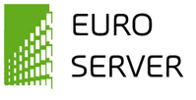





Previous and current projects

Slide 21
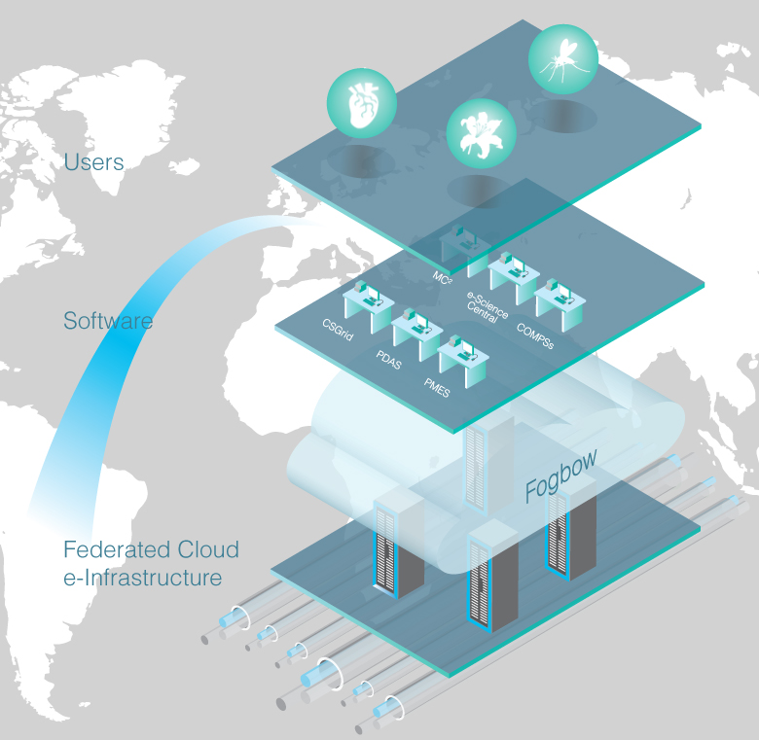
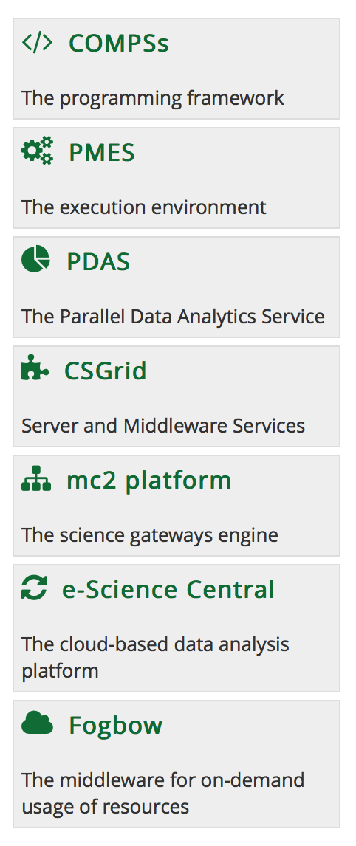
EUBrazil Cloud Connect – A federated environment
Thanks to the collaboration between European and Brazilian research centres the project leverages a set of components for the use of supercomputing, private cloud and cloud opportunistic resources

Slide 22
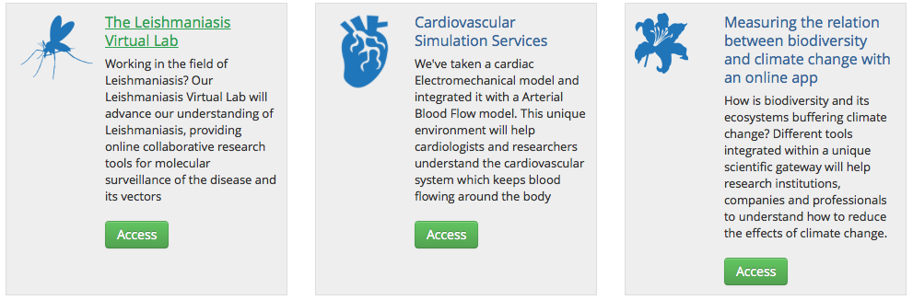
EUBrazil Cloud Connect – Use Cases
The project is aiming at using appDB as image repository
  Integrate VMCatcher in Fogbow
The implemented use cases, and related tools, will be published in the Cloud Marketplace

Slide 23
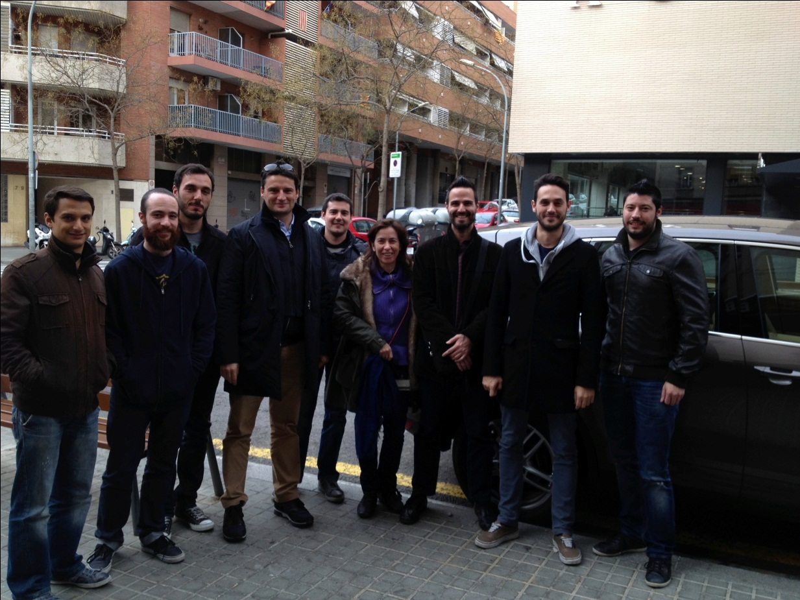
The COMPSs team
Rosa M Badia
Pedro Benedicte (part time)
Carlos Diaz
Jorge Ejarque
Fredy Juarez
Daniele Lezzi
Francesc Lordan
Roger Rafanell
Cristian Ramon (part time)
Raul Sirvent
Enric Tejedor

Slide 24
Thank you! http://compss.bsc.es
http://www.eubrazilcloudconnect.eu

