Slide 2
WLCG Use Case
Luis Esteban

Slide 3
Cloud Services
SaaS
PaaS
VMs on demand
IaaS

Slide 4
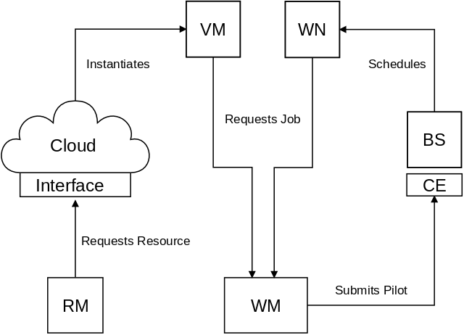
High Level View

Slide 5
Areas
Image Management
Capacity Management
Monitoring
Accounting
Pilot Job Framework
Data Access and Networking
Quota Management
Supporting Services

Slide 6
Image Management
Provides the job environment
Software
Application via CVMFS
PilotJob
Configuration
Contextualization
Balance pre- and post-instantiation operations
Simplicity, Complexity, Update Frequency, Network
Transient Machines
No updates of running machines
Destroy (gracefully) and create new instance

Slide 7
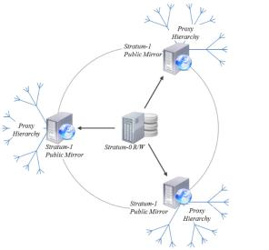
CVMFS
Network file system based on HTTP
Optimized to be fast, scalable and reliable
Files and metadata are downloaded on demand
And aggressively cached
Decouples software life cycle management
From host life cycle management
Uses multiple caching layers
Squids
Stratums
Core technology for WLCG

Slide 8
CernVM Image
The OS via CVMFS
Replicate via HTTP a reference file system
Why?
Because CVMFS is already a requirement
Reduces the overhead of distributed image management
Manage version control centrally
CernVM as a common requirement
Availability becomes an infrastructure issue
Recipe to contextualize
Responsibility of the VO
The goal is to start a CernVM-based instance
Which needs minimal contextualization

Slide 9
Capacity Management
Managing the VM life cycle isn’t the focus
It is about ensuring the is enough resources (capacity)
Requires a specific component with some intelligence
Do I need to start of VM and if so where?
Do I need to stop a VM and if so where?
Are the VMs that I started OK?
Existing solutions focus on deploying applications
Difference components, one cloud
May manage load balancing and failover
Is ensuring capacity a load balancing problem?
One configuration, many places, enough instances?
Developing our own solutions
Exploring Vcycle use for the EGI Federated Cloud
See separate talk on Vcycle

Slide 10
Monitoring
Fabric management
The responsibility of the VO
Basic monitoring is required
The objective is to triage the machines
Invoke a restart operation if it not ok
Detection of the not ok state maybe non-trivial
Other metrics may be of interest
Spotting dark resources
Deployed but not usable
Can help to identify issues in other systems
Discovering inconsistent information through cross-checks
A common requirement for all VOs
Pilot jobs monitoring is VO specific

Slide 11
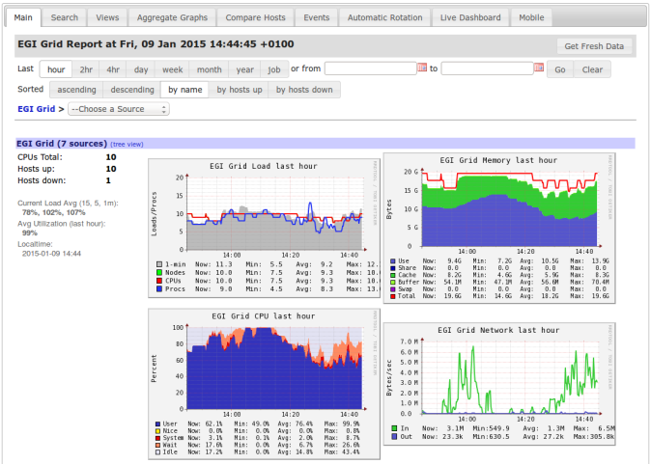
Ganglia

Slide 12
Provider Accounting
Helix Nebula
Pathfinder project
Development and exploitation
Cloud computing infrastructure
Divided into supply and demand
Three flagship applications
CERN (ATLAS simulation)
EMBL
ESA
FW: New Invoice!
Can you please confirm that these are legit?
Need to method to record usage to cross-check invoices
Dark resources
Billed for x machines but not delivered (controllable)

Slide 13
Consumer Accounting
Monitor resource usage
Course granularity acceptable
No need to accurately measure
What, where, when for resources
Basic infrastructure level
VM instances and whatever else is billed for
Report generation
Mirror invoices
Use same metrics as charged for
Needs a uniform approach
Should work for all VOs
Deliver same information to the budget holder

Slide 14
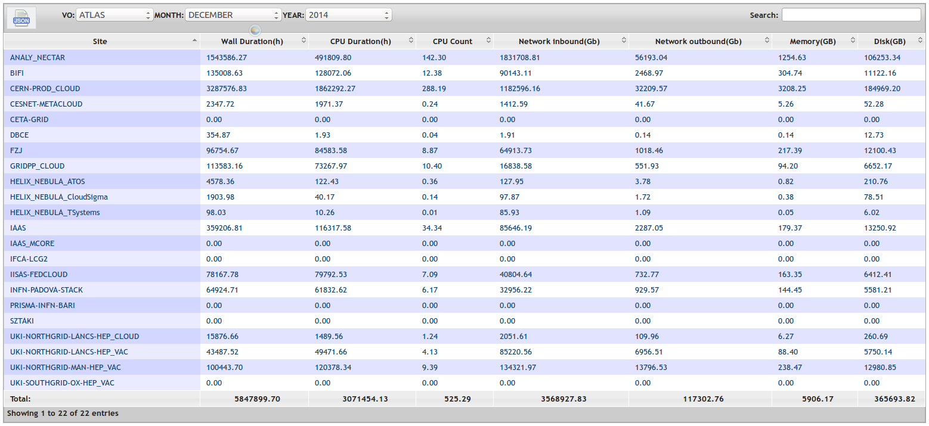
Consumer Accounting

Slide 15
Accounting in WLCG
Sites are the suppliers
Site accounting generates invoices
For resources used
Need to monitor the resource usage
We trust sites and hence their invoices
Comparison can detect issues and inefficiencies
No abstraction of job concept in IaaS layer
Job activities are in the domain of the VO
A job is the VOs measurement of work done
i.e. value for money
Job information is not included in cloud accounting
The experiment dashboard
A common approach to provide job information for WLCG

Slide 16
Accounting Comparison

Slide 17
Other Areas
Data access and networking
Have so far focus on non-data intensive workloads
Quota Management
Currently have fixed limits
Leading the partitioning of resources between VOs
How can the sharing of resources be implemented?
Supporting Services
What else is required?
Eg squid caches in the provider
How are these managed and by who?

Slide 18
Summary
It is all about starting a CernVM image
And running a job agent
Similar to a pilot job
Different options are being explored
To manage the VM life cycle
For delivering elastic capacity
Piloting the use of the EGI Federated Cloud
ATLAS, LHCb and CMS
Accounting is a key aspect for WLCG
Used to compare delivery against the pledged resources

Slide 19
Questions?

