Slide 1
Services for the long tail of science
Peter Solagna
Gergely Sipos

Slide 2
Needs of the long tail: User requirements
Availability of resources – primarily for computing (HTC & cloud), short and mid-term storage
Long-term, dedicated resource access will still require separate community VOs
Zero-barrier access: any user who carries out relevant research can get a start-up resource allocation
We can decide what relevant means (e.g. any non-for profit)
No need for specialised relationship with an NREN, a CA
No need to establish an RA at user’s institute
User-centric: User support for platform users is available through the NGIs
Not necessarily everywhere – but we need teams who can help anyone

Slide 3
Needs of the long tail: EGI requirements
Realistic: Reuse existing technology building blocks as much as possible, require minimal new development
Secure: Provide acceptable level of tracking of users and user activities (Not necessarily f2f vetting)
Scalable: Can scale up to support large number resource providers, technology providers, use cases and users
Valuable: Result tangible outcomes
Traceable scientific publications from the long tail – with EGI acknowledgements
User stories from the long-tail (for the NGIs who participate in the platform)
Opportunities for direct engagement with users → to nurture members from the long tail into e-science communities

Slide 4
Addressing the requirements
We propose a new, ‘long-tail platform’ for EGI
A set of infrastructure services + access processes and policies + user environments + user support resources and teams – all working together in a way fitting the needs of the long tail
Pilot ‘sandbox’ platform
Voluntary resource providers
A different access policies than other VOs of EGI
Start with an approximate solution and refine it along the way
E.g. The business model will have to be fine-tuned during operation
Developments started in PY5 currently ongoing
Operate, fine-tune and evolve the platform in EGI-Engage
Based on feedback from users, providers and collaborating projects

Slide 5
Long-tail platform proposal
Login (EduGAIN, OpenID, Local ID)
Request resources (define capacity)
Justify request (describe science use case – short text!)
Provide means for identification (e.g. URL of staff site with phone number, ResearchGate or LinkedIn reference)
Grant/deny access (Automatic/manual)
Portal OR Review committee
Provide training and app. Integration support
A few NGI User Support Teams
Access resources
User management portal
National/domain/app. specific VREs (e.g. SCI-BUS, DIRAC, CSGF, etc.)
User DB
Collect and analyse usage stats. – watch exceeds
Surveys for publications and feedback
User-specific X509 proxies from robot certificates (New policy to allow robot proxy for job submission too!)
Monitor activity & Suspend users in portal
Long-tail VO (grid + cloud sites)
Security team
Join voluntarily
Certified EGI resource providers

Slide 6
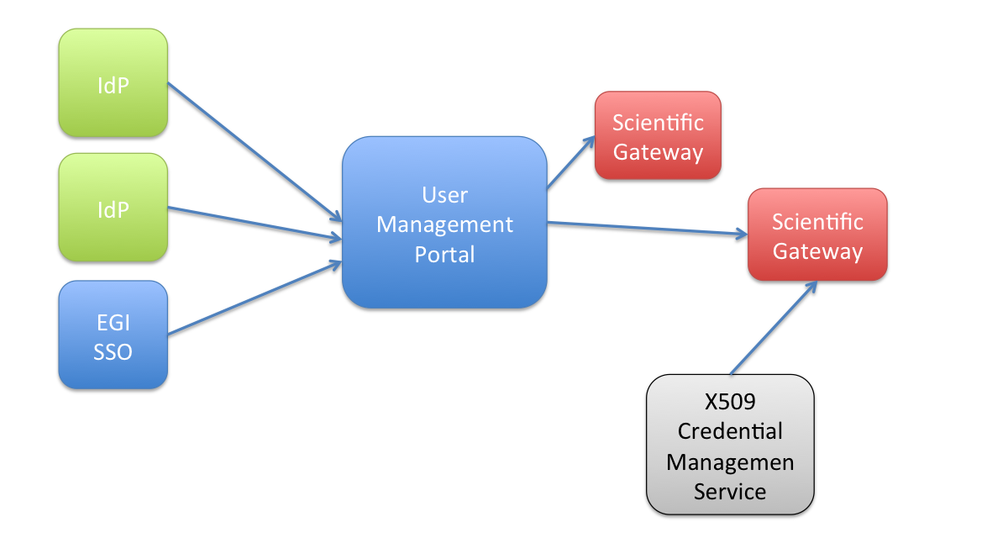
User management portal
Key service in the platform
Manages users authorization
All the services of the LTOS platform must check with the UMP the status of user’s request
Easy to suspend/revoke authorization when needed

Slide 7
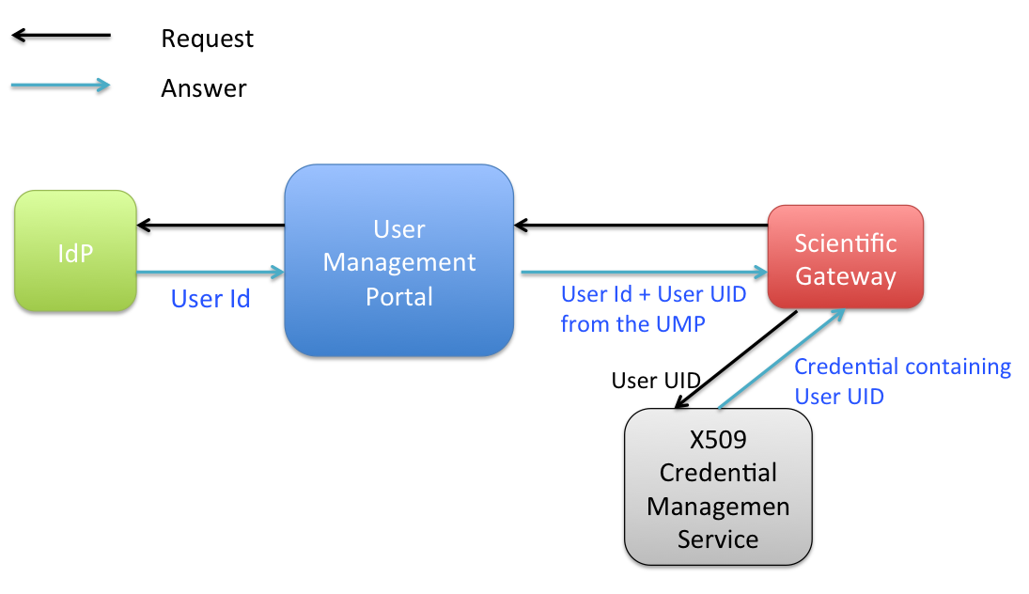
Workflow
User accesses the Scienge Gateway (SG).
The SG redirect the request to the UMP.
The UMP redirect the request to the IdP that holds the credentials of the user (e.g. EGI SSO).
The User authenticate on his/her IdP.
The IdP provides the assertion with some attributes about the user to the UMP (e.g. the user email address).
The UMP answers to the SG adding more attributes including the Unique Identifier that identifies the user in the UMP registry, and that is unique for every user using the LTOS platform.
The SG uses the UID to ask a credentials that can be univocally associated to the individual user.
The credential is used to access EGI resources.

Slide 8
Other activities
Long tail of Science security policy.
Draft produced by David Groep
Long tail of Science VO AUP
Early draft

Slide 9
Robot certificates and per-user subproxies
Given a robot certificate with DN: /C=IT/O=INFN/OU=Robot/L=Catania/CN=Robot: <Application & robot owner>
A proxy (RFC compliant) created from this robot has a DN like: /C=IT/O=INFN/OU=Robot/L=Catania/CN=Robot: <Application & robot owner>/CN=1388930209
A per-user subproxy created from this robot has a DN like this:
Given the user JohnDoe authenticated by the FederationA, the DN of the per-user subproxy will be: /C=IT/O=INFN/OU=Robot/L=Catania/CN=Robot: <Application & robot owner>/CN=FederationA-IdPX:JohnDoe/CN=1388930209

Slide 10
Per-user subproxies and accounting
DN of the per-user subproxies forwarded to APEL instead of the robot certificate DN
Minor update needed in CREAM: available in the next CREAM release (by end of January)
Cloud: update for OpenNebula and OpenStack accounting probes (under development)
No changes needed for APEL and Accounting Portal
Unique robot certificate entries in APEL will be split in one entry for each user behind the robot
Additional views can be created in the Accounting Portal (e.g. view for robot certificate)
Important improvement of the EGI accounting system
We could know the real number of EGI users including all the user hidden behind robots

Slide 11
Impact of the use of per-user subproxies in the EGI Security Policy
Users authenticated by trusted sources can be granted with a full access to the infrastructure (jobs + storage)
Each user behind a robot mapped to a ‘private’ account
No unwanted interactions between users behind a unique robot
Deny access to individual users in case of misuse instead of having to ban the entire robot (full traceability)
VO Portal Policy can be reviewed
Portals/Science Gateways working with robot certificates could allow to run arbitrary executable
Other minor changes (logging) can be introduced considering the evolution of the EGI accounting system

Slide 12
Thank you.
Further information: https://wiki.egi.eu/wiki/Long-tail_of_science_pilot

