Slide 1
FedCloud Accounting
EGI FedCloud F2F Amsterdam, 21/1/2015

Slide 2
Outline
Operations
Usage Record Revision
Future Developments

Slide 3
Operations
Sites Publishing
New Publishing Scripts
Monitoring
Portal Update

Slide 4
Publishing
Most sites publishing
Mal has opened tickets against those not.
Still need to do some verification of the published data.

Slide 5
Sites/Types/Latest
mysql> select SiteName,CloudType,max(LatestStartTime),count(*),sum(NumberOfVMs) from VCloudSummaries group by 1,2;
+---------------------+------------+----------------------+----------+------------------+
| SiteName | CloudType | max(LatestStartTime) | count(*) | sum(NumberOfVMs) |
+---------------------+------------+----------------------+----------+------------------+
| 100IT | Openstack | 2015-01-13 12:01:27 | 30 | 10639 |
| BIFI | Openstack | 2015-01-12 15:17:18 | 144 | 8349 |
| CERN-PROD | None | 1970-01-01 00:00:00 | 1 | 6 |
| CERN-PROD | OpenStack | 2015-01-11 16:48:43 | 982 | 172573 |
| CESGA | OpenNebula | 2014-12-24 19:26:32 | 478 | 36632 |
| CESNET | OpenNebula | 2014-04-01 14:39:04 | 307 | 44789 |
| CESNET-MetaCloud | OpenNebula | 2015-01-12 22:34:44 | 274 | 11837 |
| CETA-GRID | Openstack | 2015-01-12 19:14:09 | 27 | 2593 |
| CYFRONET-CLOUD | Openstack | 2014-11-10 09:39:31 | 14 | 1694 |
| FZJ | Openstack | 2015-01-13 08:11:11 | 213 | 25332 |
| GoeGrid | OpenNebula | 2015-01-13 10:47:04 | 374 | 48649 |
| GRIF | StratusLab | 2013-02-08 09:36:20 | 5 | 47 |
| GWDG | OpenNebula | 2014-05-11 07:28:01 | 46 | 2923 |
| HG-09-Okeanos-Cloud | Synnefo | 2015-01-13 10:39:58 | 58 | 3210 |
| IFCA-LCG2 | OpenStack | 2015-01-13 09:58:11 | 402 | 35658 |
| IISAS-Bratislava | Openstack | 2013-04-09 07:22:22 | 11 | 46 |
| IISAS-FedCloud | Openstack | 2015-01-13 11:43:39 | 89 | 12800 |
| IN2P3-CC | Openstack | 2013-03-19 12:46:04 | 2 | 11 |
| INFN-CATANIA-NEBULA | OpenNebula | 2015-01-13 12:49:42 | 185 | 15390 |
| INFN-CATANIA-STACK | Openstack | 2015-01-08 09:45:22 | 96 | 6317 |
| INFN-PADOVA-STACK | Openstack | 2015-01-12 21:18:10 | 102 | 14780 |
| KISTI | Openstack | 2014-11-26 22:42:14 | 13 | 41 |
| KTH CLOUD | OpenNebula | 2013-09-09 09:41:11 | 50 | 340 |
| KTH-CLOUD | OpenNebula | 2014-12-01 09:08:43 | 116 | 12732 |
| MK-04-FINKICLOUD | OpenNebula | 2015-01-08 10:15:31 | 17 | 5458 |
| NCG-INGRID-PT | Openstack | 2015-01-13 07:23:35 | 10 | 1551 |
| PRISMA-INFN-BARI | Openstack | 2015-01-13 02:44:01 | 155 | 15760 |
| SZTAKI | None | 2015-01-11 05:11:26 | 1 | 1 |
| SZTAKI | OpenNebula | 2015-01-12 06:11:27 | 51 | 8153 |
| TR-FC1-ULAKBIM | Openstack | 2015-01-09 11:13:48 | 42 | 4011 |
| TW-EMI-PPS | OpenStack | 2013-09-12 10:15:36 | 1 | 213 |
| UPV-GRyCAP | OpenNebula | 2015-01-07 16:19:54 | 48 | 3492 |
+---------------------+------------+----------------------+----------+------------------+
32 rows in set (0.01 sec)

Slide 6
Anomalies and Moribund Sites
mysql> select SiteName,CloudType,max(LatestStartTime),count(*),sum(NumberOfVMs) from VCloudSummaries group by 1,2;
+---------------------+------------+----------------------+----------+------------------+
| SiteName | CloudType | max(LatestStartTime) | count(*) | sum(NumberOfVMs) |
+---------------------+------------+----------------------+----------+------------------+
| 100IT | Openstack | 2015-01-13 12:01:27 | 30 | 10639 |
| BIFI | Openstack | 2015-01-12 15:17:18 | 144 | 8349 |
| CERN-PROD | None | 1970-01-01 00:00:00 | 1 | 6 |
| CERN-PROD | OpenStack | 2015-01-11 16:48:43 | 982 | 172573 |
| CESGA | OpenNebula | 2014-12-24 19:26:32 | 478 | 36632 |
| CESNET | OpenNebula | 2014-04-01 14:39:04 | 307 | 44789 |
| CESNET-MetaCloud | OpenNebula | 2015-01-12 22:34:44 | 274 | 11837 |
| CETA-GRID | Openstack | 2015-01-12 19:14:09 | 27 | 2593 |
| CYFRONET-CLOUD | Openstack | 2014-11-10 09:39:31 | 14 | 1694 |
| FZJ | Openstack | 2015-01-13 08:11:11 | 213 | 25332 |
| GoeGrid | OpenNebula | 2015-01-13 10:47:04 | 374 | 48649 |
| GRIF | StratusLab | 2013-02-08 09:36:20 | 5 | 47 |
| GWDG | OpenNebula | 2014-05-11 07:28:01 | 46 | 2923 |
| HG-09-Okeanos-Cloud | Synnefo | 2015-01-13 10:39:58 | 58 | 3210 |
| IFCA-LCG2 | OpenStack | 2015-01-13 09:58:11 | 402 | 35658 |
| IISAS-Bratislava | Openstack | 2013-04-09 07:22:22 | 11 | 46 |
| IISAS-FedCloud | Openstack | 2015-01-13 11:43:39 | 89 | 12800 |
| IN2P3-CC | Openstack | 2013-03-19 12:46:04 | 2 | 11 |
| INFN-CATANIA-NEBULA | OpenNebula | 2015-01-13 12:49:42 | 185 | 15390 |
| INFN-CATANIA-STACK | Openstack | 2015-01-08 09:45:22 | 96 | 6317 |
| INFN-PADOVA-STACK | Openstack | 2015-01-12 21:18:10 | 102 | 14780 |
| KISTI | Openstack | 2014-11-26 22:42:14 | 13 | 41 |
| KTH CLOUD | OpenNebula | 2013-09-09 09:41:11 | 50 | 340 |
| KTH-CLOUD | OpenNebula | 2014-12-01 09:08:43 | 116 | 12732 |
| MK-04-FINKICLOUD | OpenNebula | 2015-01-08 10:15:31 | 17 | 5458 |
| NCG-INGRID-PT | Openstack | 2015-01-13 07:23:35 | 10 | 1551 |
| PRISMA-INFN-BARI | Openstack | 2015-01-13 02:44:01 | 155 | 15760 |
| SZTAKI | None | 2015-01-11 05:11:26 | 1 | 1 |
| SZTAKI | OpenNebula | 2015-01-12 06:11:27 | 51 | 8153 |
| TR-FC1-ULAKBIM | Openstack | 2015-01-09 11:13:48 | 42 | 4011 |
| TW-EMI-PPS | OpenStack | 2013-09-12 10:15:36 | 1 | 213 |
| UPV-GRyCAP | OpenNebula | 2015-01-07 16:19:54 | 48 | 3492 |
+---------------------+------------+----------------------+----------+------------------+
32 rows in set (0.01 sec)
Notes:
A couple of obviously bad entries – CERN-PROD, KTH CLOUD
Some sites haven’t published for a long time.

Slide 7
A couple of obviously bad entries
CERN-PROD, KTH CLOUD, SZTAKI
Some sites haven’t published for a long time:
CESNET, GRIF, GWD, IN2P3-CC, TW-EMI-PPS
If you want this cleaned up, raise a ticket.
If the site is closed and the data is good then leave it.

Slide 8
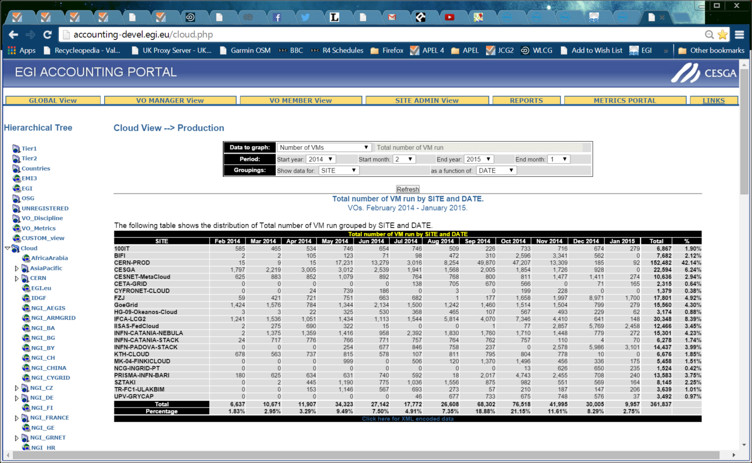

Slide 9
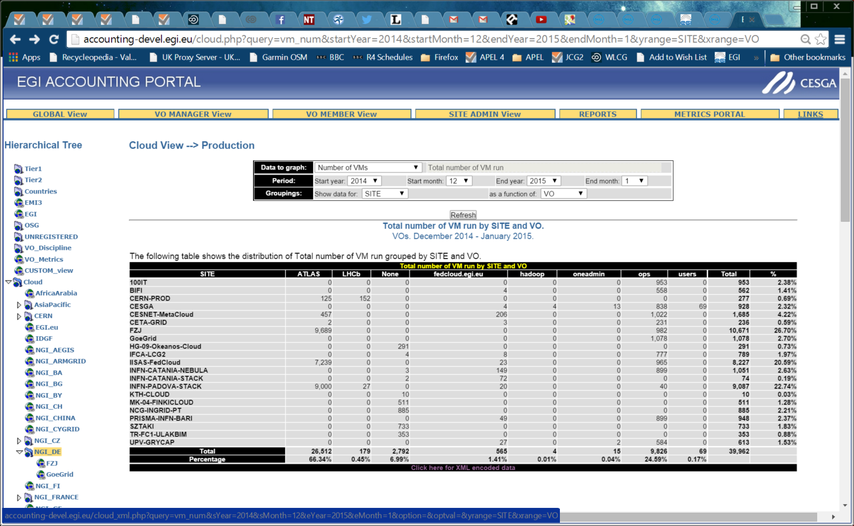

Slide 10
Sum of vm_num | Column Labels
Row Labels | ATLAS | fedcloud.egi.eu | hadoop | LHCb | None | oneadmin | ops | users | Grand Total
100IT |  |  |  |  |  |  | 953 |  | 953
BIFI |  | 4 |  |  |  |  | 558 |  | 562
CERN-PROD | 125 |  |  | 152 |  |  |  |  | 277
CESGA |  | 4 | 4 |  |  | 13 | 838 | 69 | 928
CESNET-MetaCloud | 457 | 206 |  |  |  |  | 1022 |  | 1685
CETA-GRID | 2 | 3 |  |  |  |  | 231 |  | 236
FZJ | 9689 |  |  |  |  |  | 982 |  | 10671
GoeGrid |  |  |  |  |  |  | 1078 |  | 1078
HG-09-Okeanos-Cloud |  |  |  |  | 291 |  |  |  | 291
IFCA-LCG2 |  | 8 |  |  | 4 |  | 777 |  | 789
IISAS-FedCloud | 7239 | 23 |  |  |  |  | 965 |  | 8227
INFN-CATANIA-NEBULA |  | 149 |  |  | 3 |  | 899 |  | 1051
INFN-CATANIA-STACK |  | 72 |  |  | 2 |  |  |  | 74
INFN-PADOVA-STACK | 9000 | 20 |  | 27 |  |  | 40 |  | 9087
KTH-CLOUD |  |  |  |  | 10 |  |  |  | 10
MK-04-FINKICLOUD |  |  |  |  | 511 |  |  |  | 511
NCG-INGRID-PT |  |  |  |  | 885 |  |  |  | 885
PRISMA-INFN-BARI |  | 49 |  |  |  |  | 899 |  | 948
SZTAKI |  |  |  |  | 733 |  |  |  | 733
TR-FC1-ULAKBIM |  |  |  |  | 353 |  |  |  | 353
UPV-GRYCAP |  | 27 |  |  |  | 2 | 584 |  | 613
Grand Total | 26512 | 565 | 4 | 179 | 2792 | 15 | 9826 | 69 | 39962
No VO published

Slide 11
Sum of vm_num | Column Labels
Row Labels | ATLAS | fedcloud.egi.eu | hadoop | LHCb | None | oneadmin | ops | users | Grand Total
100IT |  |  |  |  |  |  | 953 |  | 953
BIFI |  | 4 |  |  |  |  | 558 |  | 562
CERN-PROD | 125 |  |  | 152 |  |  |  |  | 277
CESGA |  | 4 | 4 |  |  | 13 | 838 | 69 | 928
CESNET-MetaCloud | 457 | 206 |  |  |  |  | 1022 |  | 1685
CETA-GRID | 2 | 3 |  |  |  |  | 231 |  | 236
FZJ | 9689 |  |  |  |  |  | 982 |  | 10671
GoeGrid |  |  |  |  |  |  | 1078 |  | 1078
HG-09-Okeanos-Cloud |  |  |  |  | 291 |  |  |  | 291
IFCA-LCG2 |  | 8 |  |  | 4 |  | 777 |  | 789
IISAS-FedCloud | 7239 | 23 |  |  |  |  | 965 |  | 8227
INFN-CATANIA-NEBULA |  | 149 |  |  | 3 |  | 899 |  | 1051
INFN-CATANIA-STACK |  | 72 |  |  | 2 |  |  |  | 74
INFN-PADOVA-STACK | 9000 | 20 |  | 27 |  |  | 40 |  | 9087
KTH-CLOUD |  |  |  |  | 10 |  |  |  | 10
MK-04-FINKICLOUD |  |  |  |  | 511 |  |  |  | 511
NCG-INGRID-PT |  |  |  |  | 885 |  |  |  | 885
PRISMA-INFN-BARI |  | 49 |  |  |  |  | 899 |  | 948
SZTAKI |  |  |  |  | 733 |  |  |  | 733
TR-FC1-ULAKBIM |  |  |  |  | 353 |  |  |  | 353
UPV-GRYCAP |  | 27 |  |  |  | 2 | 584 |  | 613
Grand Total | 26512 | 565 | 4 | 179 | 2792 | 15 | 9826 | 69 | 39962
Ops VMs only
No VO and no CPU
Notes:
The other sites with No VO do publish CPU

Slide 12
Monitoring
Currently write latest update time for each site to a web page which SAM(Argo) reads and sets status of site nagios probe.
How can we improve?
Sanity check of data?
Sync Test?

Slide 13
Portal News
In December we found a bug in the summarising we do in the repository which meant the portal was not receiving all the data that we did.
This was fixed and the portal started showing more VMs.
Still no definition of a production fedcloud site so reports show all sites. WLCG is ramping up cloud use so we need this or we risk being overshadowed

Slide 14
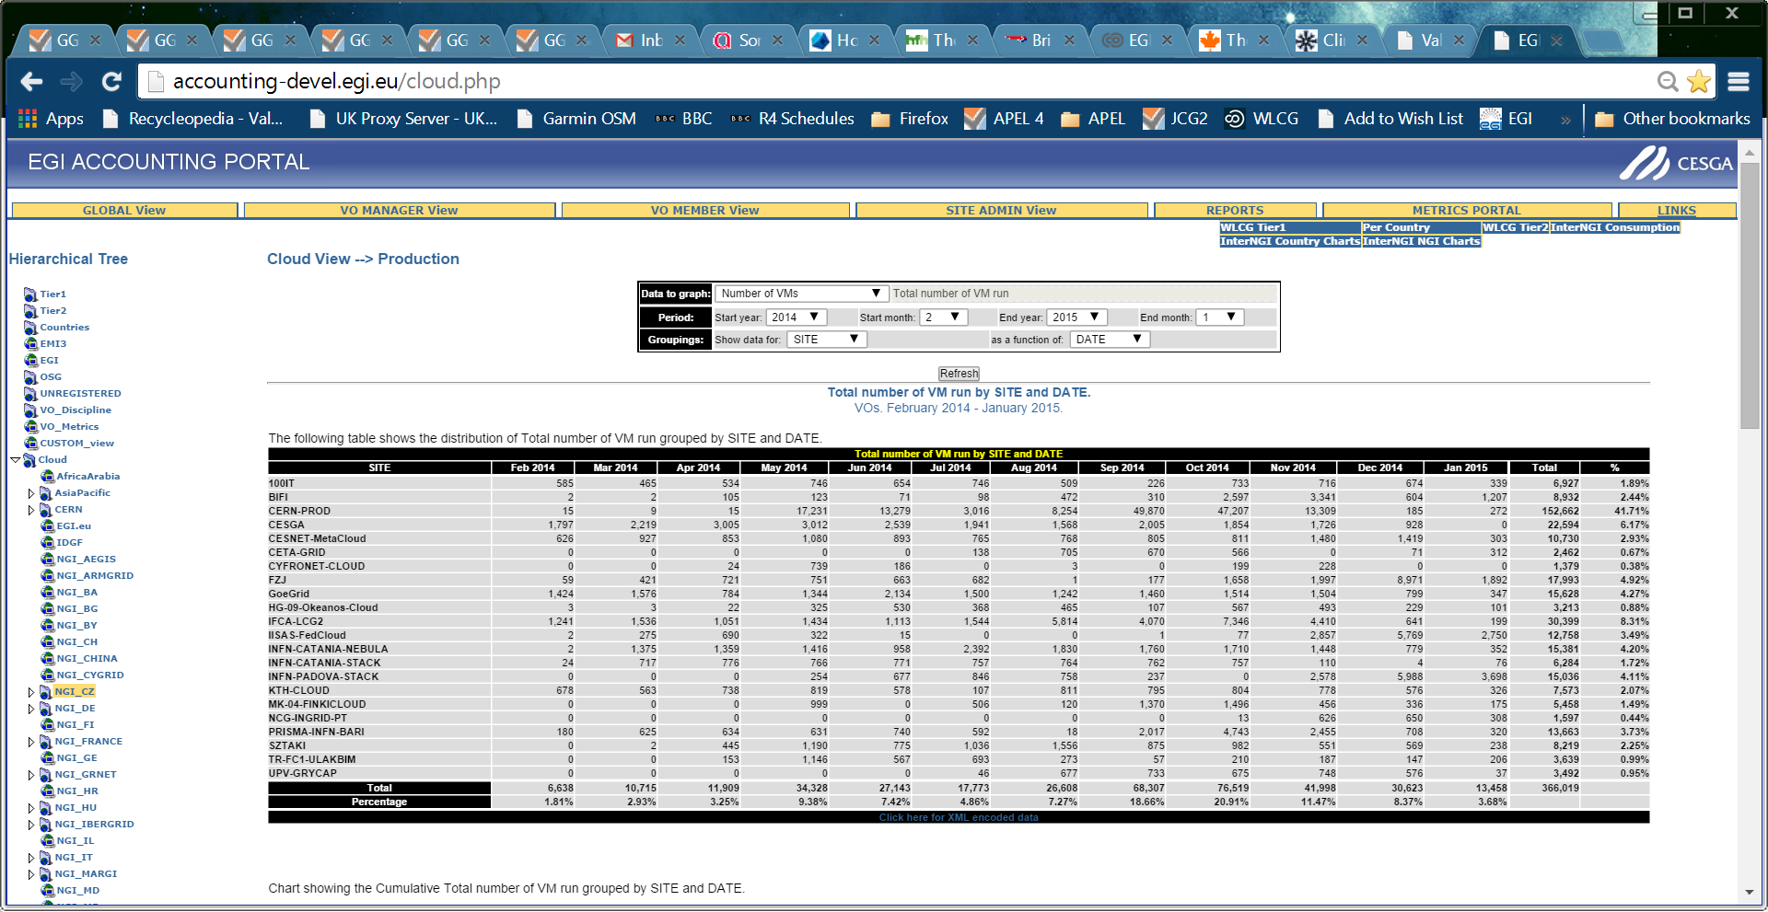
Portal News
The Cloud Tree is now active

Slide 15
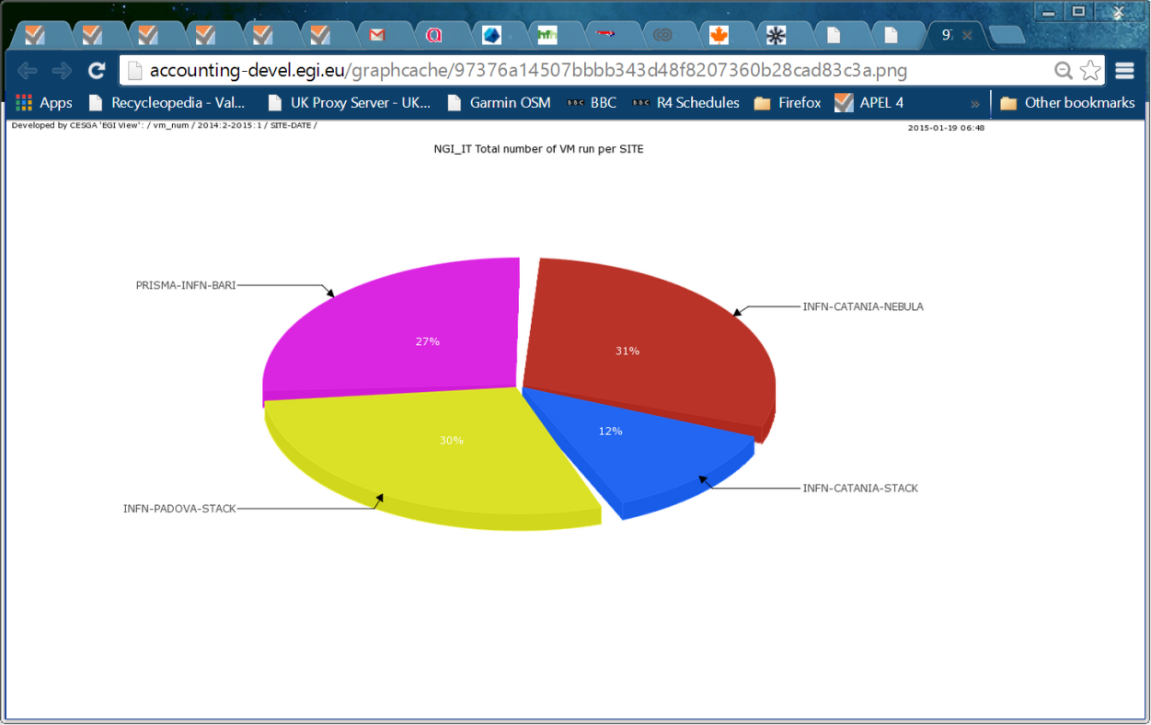
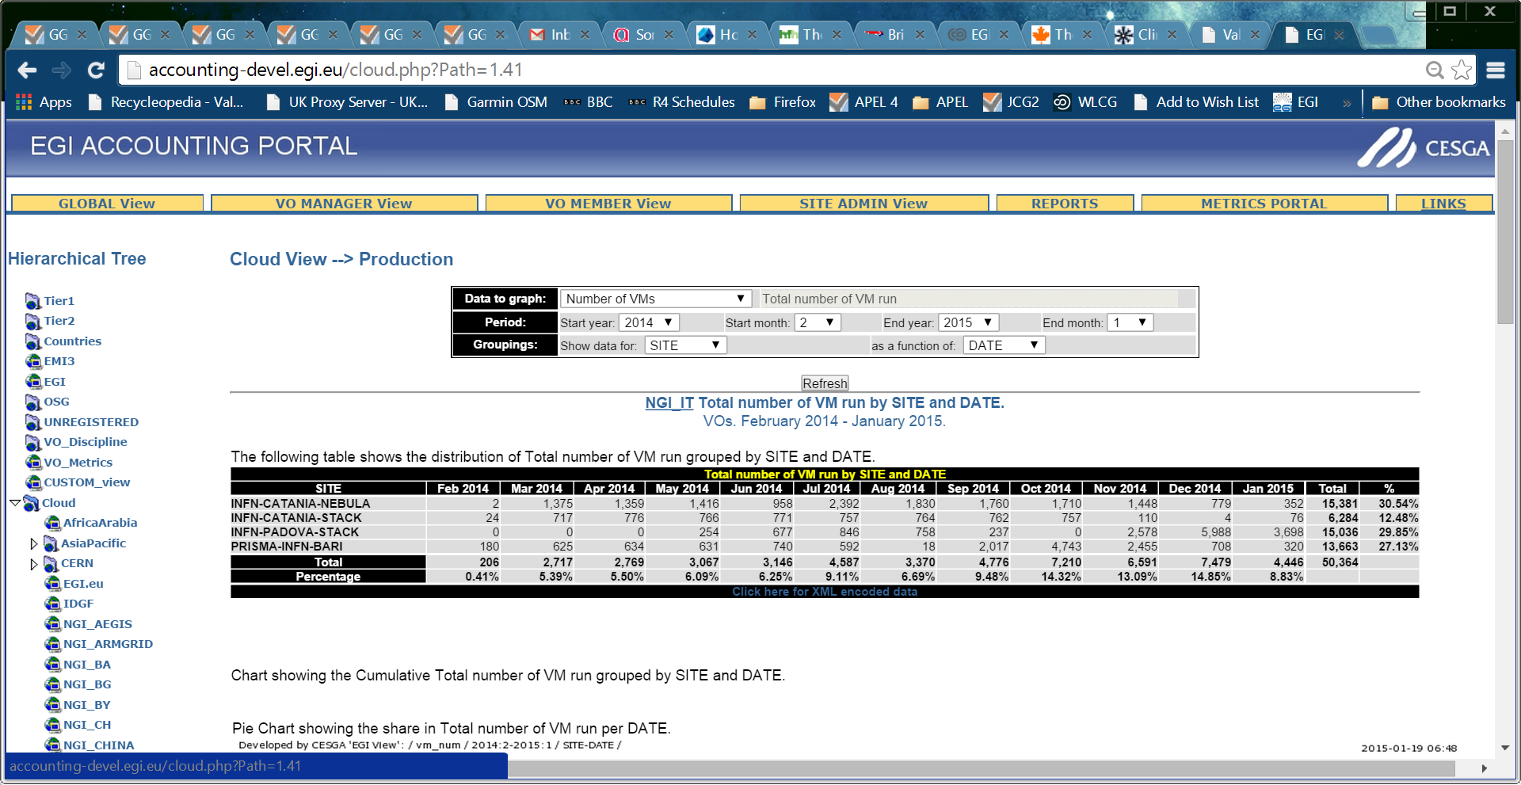
Select NGI_IT

Slide 16
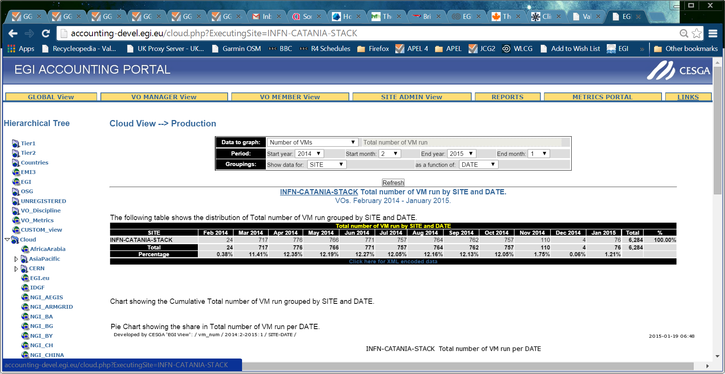
Select a site

Slide 17
VO Manager View

Slide 18
Images
New scripts should be publishing the image used
Portal will give a view of this, possibly with a link back to AppDB or other marketplace.
Probably at site level first

Slide 19
New Versions of the publishing scripts
OpenNebula
https://appdb.egi.eu/store/software/oneacct.export
Boris emailed fedcloud
OpenStack
https://github.com/IFCA/caso
https://caso.readthedocs.org/en/latest/
https://pypi.python.org/pypi/caso/0.1
https://github.com/IFCA/caso/issues
Enol emailed fedcloud
Sites should upgrade and republish old VMs
APEL will have a memory of old records and/or summaries that will need cleaning up. Open a GGUS ticket.
Useful to compare old with new to check what has been republished.

Slide 20
Repo to Portal Sync
Currently send all data twice per day
Portal UPDATEs its data
Deletions on repo not mirrored on portal
Need to come up with a sync method/protocol
Currently refreshing grid Pub/Sync code
Pub/Sync for Cloud as well?

Slide 21
Usage Record Revision
I have circulated a few versions of my proposals for versions 0.4 – draft 3.
I would like to agree this today so that we can implement in database and publishing scripts be updated.

Slide 22
New Fields
CloudComputeService | varchar(255) | Name identifying cloud resource within the site. Allows multiple cloud resources within a site. i.e. a level of granularity.
PublicIPCount | int | Number of public IP addresses assigned to VM
BenchmarkType | varchar(255) | Name of benchmark used for normalization of times (eg HEPSPEC06)
Benchmark | Decimal | Value of benchmark of VM using ServiceLevelType benchmark’

Slide 23
Clarifications
VMUUID | varchar(255) | Virtual Machine's Universally Unique Identifier concatenation of CurrentTime, SiteName and MachineName
Needs to be unique.
OpenNebula followed this definition
OpenStack claim that the internal name is universally unique
ImageId | varchar(255) | Every image has a unique ID associated with it. - For images from the EGI FedCloud AppDB this should be VMCATCHER_EVENT_AD_MPURI - for images from other repositories it should be a vmcatcher equivalent For local images - os_tpl mixin
Implemented in new scripts

Slide 24
Unresolved Uncertainties
NetworkType | varchar(255) |  | Needs clarifying
Possible values?
What do management systems tell us?
What might one charge for?
StorageRecordId | varchar(255) | Link to other associated storage record
Originally thought that we could define a StAR record for storage used.
This would need to be done before the UR could be cut.
Is this relevant for remote traditional storage (No); remote cloud storage (??); storage internal to the VM (Yes)

Slide 25
Cloud UR v0.4
Can we park the uncertainties and agree this today?

Slide 26
Future Revisions
Main requirement not addressed by v0.4 is assigning usage across time.
Current reporting assigns all usage to the EndTime point.
Intermediate records are cut but each one replaces the previous one and builds up the usage of the VM until it ends, when the final values are taken.
For long-running VMs this distorts the record of usage patterns. Can we assign usage to specific time periods during the lifetime of the VM?

Slide 27
Current Thoughts
Propose multiple records for a defined timeslot, say since the last record, could be daily but doesn’t have to be. We can then summarise all records with record EndTime in a month to get a monthly summary.
There will be end effects for records which span a month boundary but with daily publishing the effect is small.
What happens if records go missing?
We already have a StartTime and EndTime – do we reuse them or add new fields? We want records to be unique, not overwriting the previous record for the same VM. Currently VMUUID is primary key. We would need to add one of the timestamps.
We could also postprocess to provide a VM-level summary by aggregating all records for a VM. This might be needed for charging if one wants to produce a list of VMs charged for. This could always be done on demand.
If we reuse the Start/EndTime fields do we need some other flag in order to know how they are being used? Or is it enough to have a different record version which we know to process differently?

Slide 28
Conclusions?
Most sites publishing reliably
New scripts should improve the quality of the data
Sites should upgrade.
Portal now allows drilling down to a site or VO
Agree revision 0.4 of UR
Feedback on monthly accounting.

