Slide 1


Cloud interoperability and elasticity with COMPSs
Federated Cloud F2F
Jan 20 2014, Amsterdam
Daniele Lezzi – Barcelona Supercomputing Center

Slide 2

Outline
COMPSs Framework
COMPSs tools
COMPSs interoperability
Conclusions

Slide 3
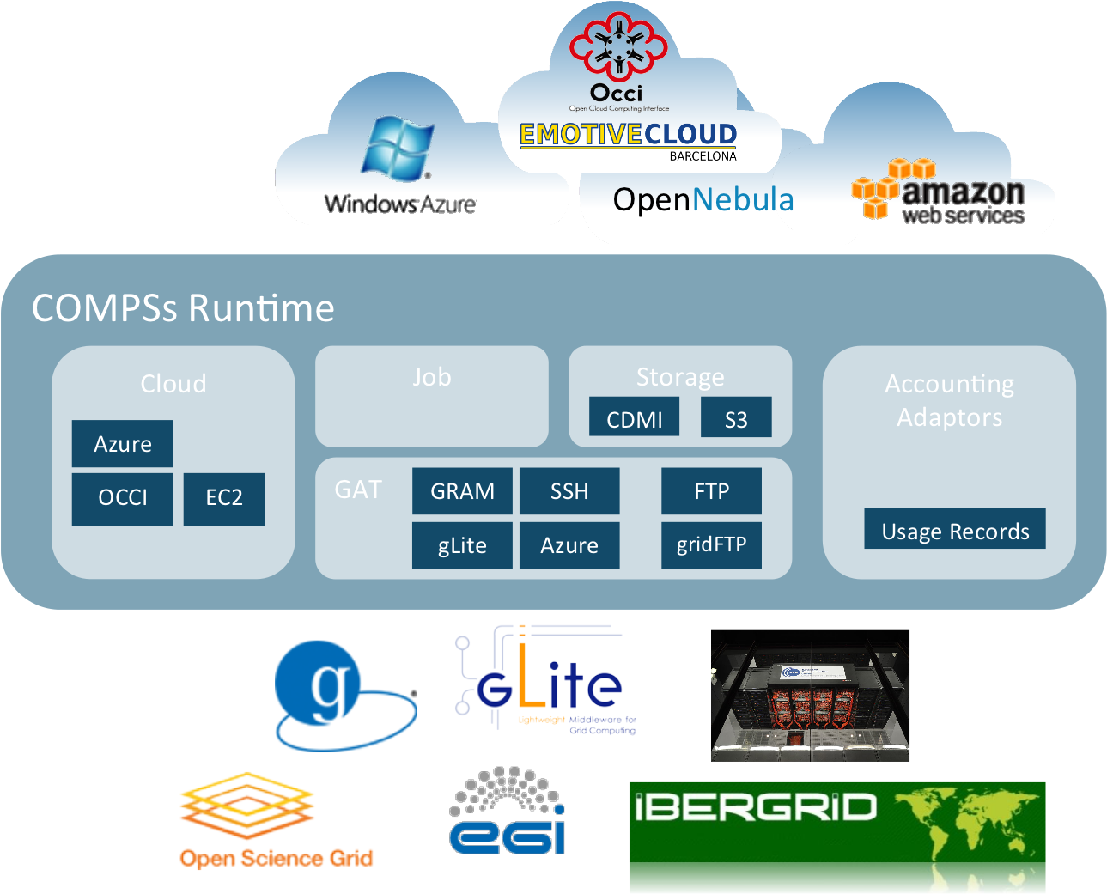

COMPSs Framework
Programming framework for automatic parallelization and orchestration of applications and services.
Automatic brokering of the resources depending on the load.
Transparent support of different infrastructures (grids, clouds, clusters).
Same source code runs on any platform
rOCCI server and OCCI+OVF support.
Interoperability with Azure, EC2, ONE.
Workload auto-scaling.
Automatic selection of VM templates
depending on the task.
OGF BES interface to manage the
execution of COMPSs applications
Use cases: BioVel/EUBrazilOpenBio,
Gipsy, Lofar. New use cases from the ongoing
EUBrazilCloudConnect initiative
3

Slide 4
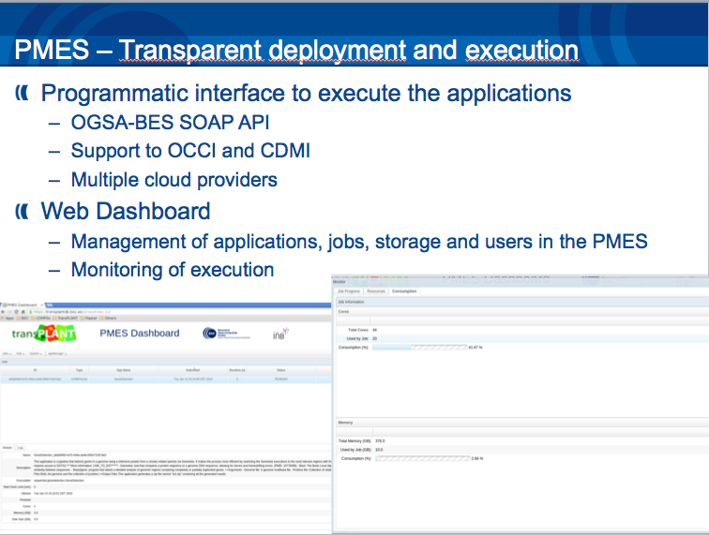
COMPSs development environment
IDE graphical interface
Deployment and execution
Runtime monitor
Performance traces

Slide 5
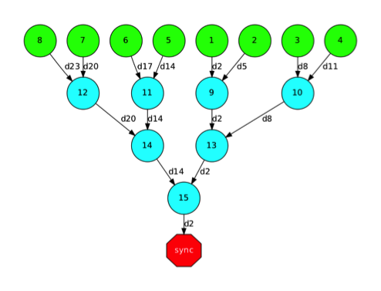
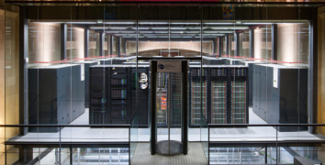
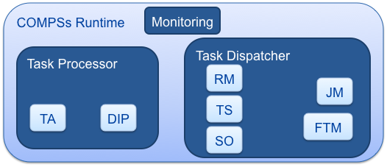
COMPSs Infrastructure
User code
+ annotations
Python
C/C++
Java
TDG
Grids
Clusters
Clouds
Language
bindings
Custom Loader
Tasks
Task
interception
Files, objects

Slide 6
PMES – Deploying applications and services
Resource Manager: controls a pool of usable resources notifying the scheduler of their availability for a particular deployment request.
Scheduler: checks with the Resource Manager the availability of the required resources to deploy the application or service and forwards the request to the Dispatcher component
Dispatcher: handles the deployment cycle interacting with the following components:
  Cloud Broker: requests virtual machines to a cloud provider and deploys the (COMPSs) application package as well as the needed applications/libraries.
  Data Stager: deals with service/ application data transfers (CDMI, FTP, etc.)
  Executor: initialize the application once it has been deployed in the VMs.
  JavaSAGA: interface to different communication pro- tocols. In PMES, persistent SSH connections are established with every deployed virtual machine.
Notes:
6
6
6

Slide 7
PMES Features
Multiple job types suppport: COMP Superscalar job & Single execution job.
Static pool of resources: The static pool is useful to serve those requests that don't involve complex computational runs (BioVeL calls). In the client a parameter is used to specify if the run is simple or complex.
Available as VA in EGI AppDB: https://appdb.egi.eu/store/vappliance/compss.pmes
X509 WS interface:
Java API bindings: A Java API is available for the development of clients to execute COMPSs applications through the PMES service. The Java Doc is available at bscgrid06.bsc.es/~lezzi/pmes/doc/api/
Support for tracing feature on COMPSs jobs.
Support for service resources definition on COMPSs jobs.
Support for VM architecture specification on job description.
Possibility to set periodically updatable output files/directories (staged-out periodically).
Possibility generate zipped output files/directories on stage-out phase.
Support for abstract paths on job arguments description for: SHAREDDISK, WORKINGDIR & DEPLOYPATH.
Cloud adaptors, compatibility with OCCI standard through rOCCI and with ONE native API (OCA).
Support for multiple cloud providers (the list of providers is passed to COMPSs)
Added a sqlite database backend + dashboard (GUI).
In order to provide BioVeL with a cloud enabled openModeller endpoint, the EUBrazilOpenBio ENM service is exposed through an extended openModeller Web Service interface (OMWS+ in the picture).
Such interface in EUBrazilOpenBio supports multi-staging and multiparametric experiments implemented through COMPSs and the openModeller software and managed through a Virtual Research Environment (VRE) portal.
The OMWS extensions are backwards compatible with the original specification, allowing existing clients, as the Taverna Workflow Management System in BioVeL, to be fully supported in the new implementation.
An Experiment Orchestrator Service acts as dispatcher of user’s requests towards different infrastructures. In the case of the EGI Federated Cloud, the VENUS-C middleware is used to instantiate openModeller workflows on cloud resources.
The COMPSs Workflow Orchestrator receives the execution requests and takes care of the execution of the openModeller pipelines on dynamically deployed virtual machines.
An rOCCI connector is used for the VMs management while data management supports CDMI endpoints.
Notes:
7
7
7

Slide 8
Deployment of COMPSs and PMES on EGI
Browser
  PMES allows deployment of COMPSs apps and services
  Contextualization of applications at deployment time
  Pre-allocation of static pool of VMs to save virtualization startup time
  Use of additional provider (Prisma) to execute additional tasks
  COMPSs and PMES are available in the appDB through a single Virtual Appliance
CESNET (OpenNebula)
BSC Storage
User Data
PMES Dashboard
User Data
PMES Service VM
COMPSs Static VM
COMPSs app package
COMPSs Runtime
COMPSs app package
Job
Mgmt
(BES)
COMPSs app package
OCCI
OCCI
Prisma INFN Bari(OpenStack)
PMES Service
OCCI
COMPSs Worker VM
Providers Configuration
COMPSs libraries
COMPSs Worker VM
COMPSs Worker VM
COMPSs libraries
COMPSs libraries
COMPSs Worker VM
COMPSs app package
COMPSs libraries
COMPSs app package
COMPSs app package
COMPSs app package
Input files
Input files
Input files
Input files

Slide 9
Runtime behavior: scheduling and resource management
Task Scheduler
  Assigns tasks to VMs or physical resources
  Each VM or resource has its own task queue
Scheduling Optimizer
  Checks status of workers
  Can decide
    To perform load balancing
    Create/destroy new VMs
Resource Manager: elasticity
  Manages all cloud middleware related features
  Holds information about all workers and about cloud providers
  Scheduler Optimizer sends to the RM requirements about new VM characteristics
  Resource Manager, evaluates the cloud providers alternatives and chooses the best option
    More economic
    The decision can be to open a new private or public VM
  For each Cloud provider, a data structure stores the different available instances (with its features) and the connector that should be used

Slide 10
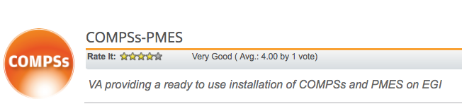
COMPSs
Project page: http://www.bsc.es/compss
Direct downloads page:
http://www.bsc.es/computer-sciences/grid-computing/comp-superscalar/download
  Source code
  Sample applications & development virtual appliances
  Tutorials
  Red-Hat & Debian based installation packages
EGI Cloud Marketplace
  VA: https://appdb.egi.eu/store/vappliance/compss.pmes

Slide 11
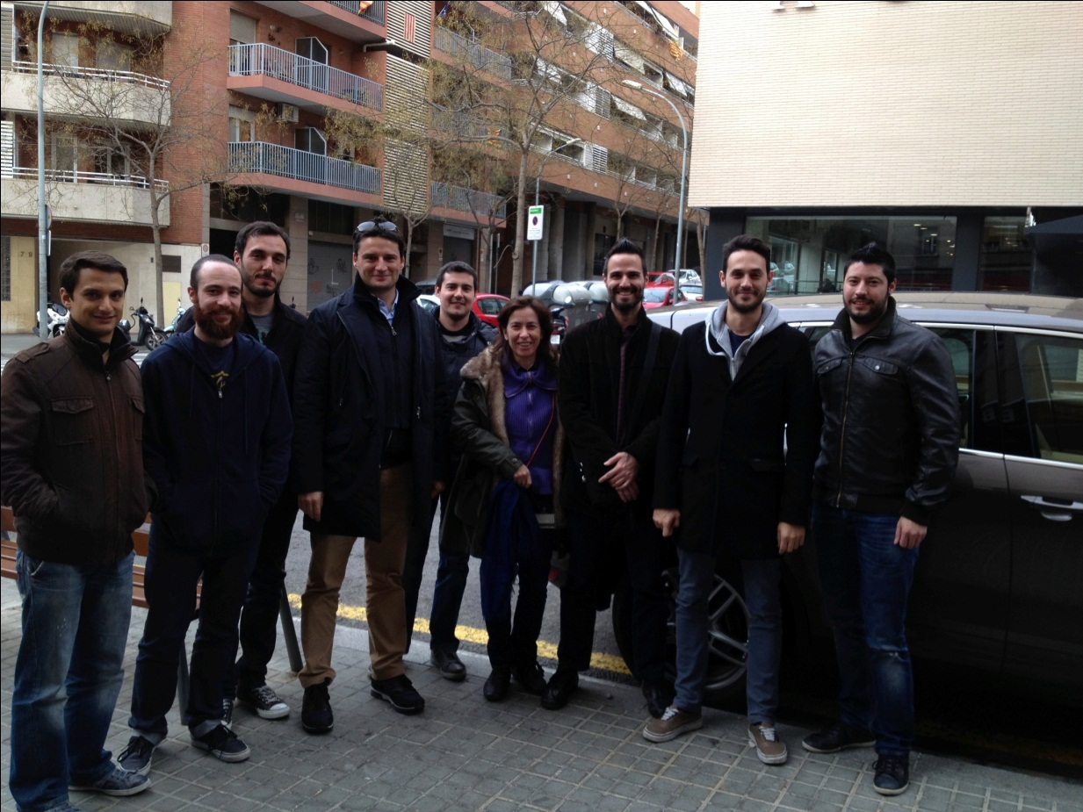
The COMPSs team
Rosa M Badia
Pedro Benedicte (part time)
Carlos Diaz
Jorge Ejarque
Fredy Juarez
Daniele Lezzi
Francesc Lordan
Roger Rafanell
Cristian Ramon (part time)
Raul Sirvent
Enric Tejedor

Slide 12
Thank you!
http://www.eubrazilcloudconnect.eu

