Slide 1
Operations Management Board February 26
Agenda:
https://indico.egi.eu/indico/conferenceDisplay.py?confId=2373
Start: 1o:oo CET

Slide 2
Agenda

Slide 3
Operations Update February
Cristina Aiftimiei, Małgorzata Krakowian, Peter Solagna, Vincenzo Spinoso

Slide 4
Assessment of the operational core activities
1st EGI Core activities bidding result
https://wiki.egi.eu/wiki/Core_EGI_Activities
1 May 2014 - 1 May 2016
Reporting on performance
every 6 month against the OLA targets
yearly against SLA targets
In the Summer 2nd bidding process will start to define the critical services needed from Spring 2016
Need to assess the NGIs requirements
Survey under preparation to gather feedback from NGIs about the core services
Feedback on the criticality of the services for NGI operations
Feedback on the quality of the service (suggestions to improve)

Slide 5
NGI Certification Authorities status
NGIs need to provide access to X509 certificates to their users and their site administrator through a Certification Authority and distributed Registration Authorities
EGI provides a catch-all CA to fill the gaps
Users with no access to a CA/RA
NGIs under establishment
In principle not a long-term solution
Need feedback about any sustainability issue with NGI CAs to plan the future of catch-all CA
And as an input for the EGI AAI strategy

Slide 6
ROD
Issues:
In small NGIs (eg. 1 RC) often ROD and Site admin is the same person
Proposal: To stop ROD performance index monitoring
EGI Operations will stop look at expired ROD tickets and old alarms for 6 month trial period
If no impact on Ava/Rel NGIs will propose change to make optional for ROD teams to open tickets on Ops Portal dashboard based on alarms.
Any comments?

Slide 7
Accouting
Multicore:
At December OMB, EGI asked NGIs to encourage sites to start publishing of multicore accounting https://indico.egi.eu/indico/getFile.py/access?contribId=1&resId=0&materialId=slides&confId=2284

Slide 8
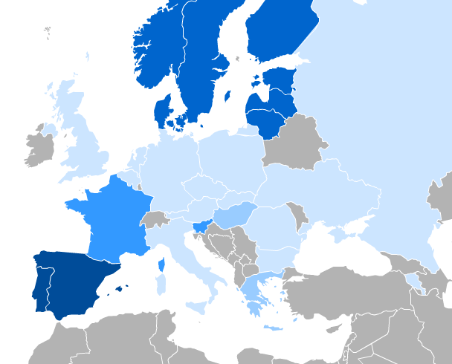
Accouting
User DN - Inter-usage across countries

Slide 9
Cloud Accouting
FedCloud sites must upgrade to the latest releases of accounting probes for their cloud management framework and republish their records once the upgrade is done. (OpenStack, OpenNebula)
GGUS ticket created for all NGIs with FedCloud sites

Slide 10
iRODs
Please register iRODS end-points in GOC DB. We already have a service type in GOCDB:
org.irods.irods
https://goc.egi.eu/portal/index.php?Page_Type=Services&serviceType=org.irods.irods3&ngi=&searchTerm=&production=TRUE&monitored=TRUE&scope=EGI&certificationStatus=Certified&servKeyNames=

Slide 11
New Global VOs
eubrazilcc.eu
Climate research, Biodiversity conservation, Communication engineering and systems, Cardiac and Cardiovascular systems, Epidemiology, Parasitology, Tropical medicine, Infrastructure Development
http://www.eubrazilcloudconnect.eu
EUBrazil Cloud Connect is a project funded under the second Eu-Brazil coordinated call under the topic Cloud computing for Science. Its aim is to create an intercontinental federated e-Infrastructure for scientific usage. This e-Infrastructure will join resources from different frameworks, like private clouds, supercomputing and opportunistic desktop resources to offer the community high level scientific gateways and programming

Slide 12
Operations Portal TAG
Mailing list
ops-portal-atb@mailman.egi.eu
Release schedule
https://wiki.egi.eu/wiki/Operations_Portal_Release_Schedule
Upcoming Release 3.1.2
16.03.2015
http://operations-portal.egi.eu/home/tasksList/release_id/10
Testing 2.03-13.03.2015
Focus of next release (3.1.3)
Security dashboard, small visual changes – improve usability

Slide 13
Accounting Portal
1. Modern look and feel of the portal with the adoption of recent technologies easier to maintain
2. Simplify access to some basic functionality. Eliminate the use of complex forms for common statistics. Direct link to get accounting information for some common queries. Better documentation
3. A complete API to get accounting data directly from the accounting portal.
4. As a lower priority, a map of accounting data to give a user a distribution of jobs in the map

Slide 14
Accounting Portal TAG
Leader:
Malgorzata Krakowian
Mailing list:
acc-portal-atb@mailman.egi.eu
Meetings
Indico page (slides and minutes from meetings)
Acc Portal ATB meetings are scheduled monthly

Slide 15
Documentation
New documentation:
Service Level Targets description:
Quality of Support
https://wiki.egi.eu/wiki/Service_Level_Target_-_Quality_of_Support
ROD performance Index
https://wiki.egi.eu/wiki/Service_Level_Target_-_ROD_performance_index
(in preparation) Availability/Reliability
https://wiki.egi.eu/wiki/Service_Level_Target_-_Availability_Reliability
Links under: https://wiki.egi.eu/wiki/Performance

Slide 16
EGI Survey tool
LimeSurvey for EGI
https://survey.egi.eu/
EGI SSO authentication but there is a need to be in special SSO group.
Contact:
it-support@egi.eu
operations@egi.eu

Slide 17
EGI Conference 2015
EGI.eu and IBERGRID, a partnership between the Portuguese National Distributed Computing Infrastructure (INCD) and the Spanish National Grid Initiative (NGI-ES), are pleased to announce that the EGI Conference 2015 will take place in Lisbon, between 18-22 May.
Registration for the EGI Conference 2015 is open http://go.egi.eu/reg2015
http://conf2015.egi.eu/
Interest in NGI day?

Slide 18
Adobe connect
Federated authentication login is now available our Adobe Connect instance (including EGI SSO)

Slide 19
Next OMBs
Please suggest presentations and topics for OMB meetings
Next OMB is March 26th
Suggest topics by March15th

