Slide 1
VO SLA update
Małgorzata Krakowian
EGI.eu

Slide 2
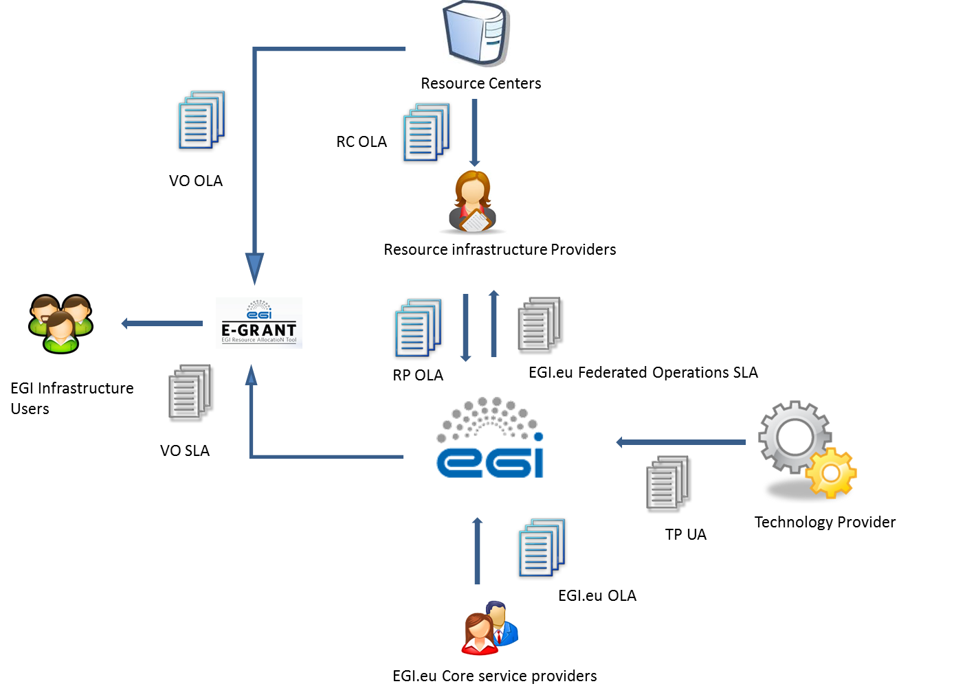
OLA/SLA framework

Slide 3
EGI VO SLA between EGI and VO
Template:
https://documents.egi.eu/document/2371
It is all about expectations clarity!
Not a legal contract
Negotiated and agreed via e-GRANT
Supported by VO OLA
between EGI and RPs
subset of what is offered to VO

Slide 4
Content
Scope: HTC, Cloud
Service hours and exceptions
Support
Service level targets and limitations
Communications
Data protection and data integrity
Responsibility for the providers and the users
Review period

Slide 5
Workflow in e-grant
VO Managers submit the request for resources to e-grant
RC or NGIs submit an offer (pool) of resources
Negotiation and Agreement process
E-grant generates SLA between VO and EGI (1 document for request), based on the template and result of negotiation
Including the additional requirements agreed between VO and RC
Generates the underpinning OLAs between EGI and RC
First pilot phase will be implemented for the Cloud use cases
Smaller communities, less resource provider: easier to spot problems and tune the process (if any)
After the first pilots, extended also to HTC

Slide 6
SLA with existing VOs
SLAs are useful also for long-term collaboration not necessarily linked to a specific resource allocation.
E.g. VOs accessing opportunistic usage of resources
For the VO to clarify the requirements and the type of services they want to access
For NGIs/RC to get recognition of their support to the research community
SLA with already integrated user communities will start with a initial discussion between EGI.eu and the VO
The plan is to have the SLA technically supported by E-grant
To evaluate how to implement the process if many sites should be involved
In the SLA negotiation process VO will also share their plans for resources usage
Is opportunistic usage enough to fulfill the requirements? Should the VO go for other types of resource allocations?
Communities who will be contacted for the initial discussion: BioVel, Biomed, Computational Chemistry, Astronomy Astrophysics..

Slide 7
VO SLA for Federated Operations service
Federated operations are used also by users:
E.g. Accounting and helpdesk
VO SLA will contain also the operational services relevant for the community
Or a separate SLA will be negotiated

