Slide 1
OMB Meeting: May 2015 Operations topics
Peter Solagna – EGI.eu

Slide 2
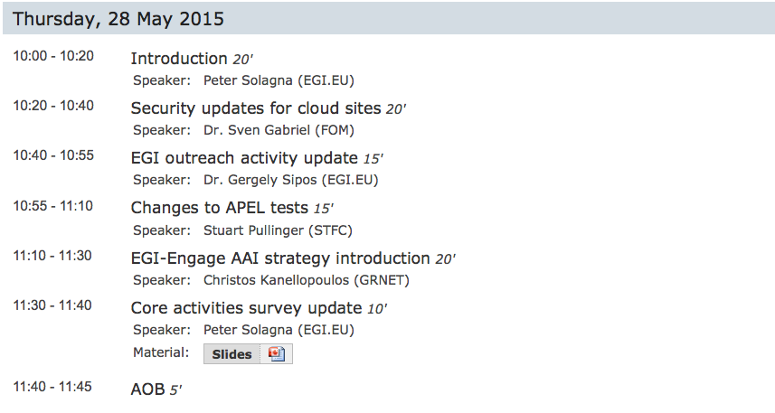
Agenda

Slide 3
New VOs
There are three new VOs created during May:
geohazards.terradue.com and hydrology.terradue.com
VOs that will support the ESA Exploitation platform use case on the federated cloud
long-tail.egi.eu
VO created (not yet in production) to support the long tail of science platform
Thanks to the sites/ngis who offered, and will offer, resources to support the VO!

Slide 4
LTOS: PUSP production 1/2
LCMAPS support for the PUSP
Installation of a dedicated plugin needed
Instructions provided from NIKHEF http://wiki.nikhef.nl/grid/Lcmaps-plugins-robot
Test has been made on a CREAM CE in production at INFN-BARI
the plugin has been working in production for more than 48h without problems, PUSP mixed with usual VOMS/standard AuthN/AuthZ patterns
The resulting guide can be found here: https://wiki.egi.eu/wiki/MAN12
(full CREAM CE configuration example)
EGI Conference 2015, Lisbon (PT), 18-22 May 2015

Slide 5
LTOS: PUSP production 1/2
Examples for mapping
Original robot cert: /C=IT/O=INFN/OU=Robot/L=Catania/CN=Robot: CTS
Enabling all users using that common robot certificate in gridmap-file: "/C=IT/O=INFN/OU=Robot/L=Catania/CN=Robot: CTS/CN=user:*" .testvo
Enabling a single user “test” in gridmap-file: "/C=IT/O=INFN/OU=Robot/L=Catania/CN=Robot: CTS/CN=user:test" testvo001
EGI Conference 2015, Lisbon (PT), 18-22 May 2015

Slide 6
SLAs under discussion
EGI Operations are discussing with the following communities a potential SLA with EGI for the support of their use cases:
DRIHM
WeNMR
Life Sciences
New communities interested:
BILS

Slide 7
A/R statistic of April follow up
Due to the EGI Conference the follow up of the April’s A/R tables have been delayed
EGI Operations will open tickets starting from June directly using the May stats

Slide 8
New procedure under definition
Resource centre suspension procedure:
PROC21
Goals of the procedure:
List the potential reasons for suspension of a site
Ensure that all the involved parties are notified in a timely manner about the suspension
Ensure that all the actions are properly recorded and history is kept
Procedure is still draft. Please, discuss it with your teams and provide comments or propose extensions to operations@egi.eu

