Slide 1
OMB Introduction
Peter Solagna – EGI.eu

Slide 2
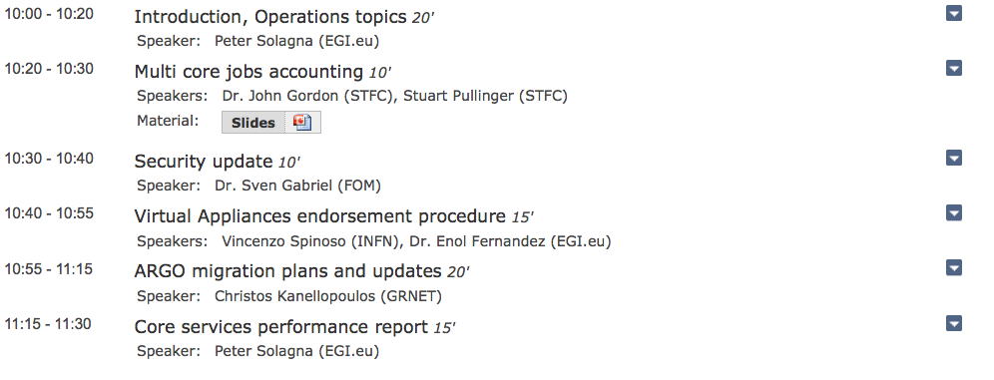
AGENDA

Slide 3
PROC21
For approval
Procedure for the RC suspension, introduced last OMB
Including:
Motivations for suspension
Steps for the suspension: mainly communications to NGI and site
Approved?

Slide 4
UMD updates
UMD-4
Extending the software provisioning infrastructure to support CentOS7 and Ubuntu 14
UMD-4 will support SL6, CentOS7, Ubuntu 14
Need of sites interested in EL7-based distribution for Staged Rollout testing
Contact either operations@egi.eu or João (jpina@lip.pl)
SL5 under decommission
Only security updates of UMD products from September
Decommissioned in March 2016

Slide 5
UMD 3.13.0
RC to be published today, integration testing starting right after OMB
Compute
CREAM 1.16.5 (SL6 only)
Accounting
APEL 1.4.1
Client Tools
srm-ifce 1.22.1
AuthN/AuthZ
gLExec 1.2.3

Slide 6
UMD 3.13.0
Storage
StoRM server 1.11.8
dpm-xroot 3.5.2
XRootD 4.2.0
CVMFS 2.1.20
Frontier Squid 2.7.24
Miscellaneous
fetch-crl 3.0.16
GFAL 2.8.4
GFAL2-PYTHON 1.7.1

Slide 7
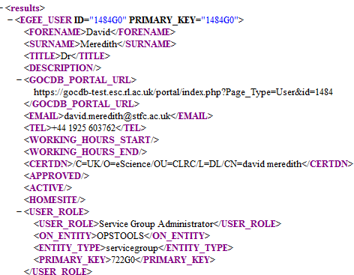
GOCDB: Proposed Changes to PI for IdP Authentication
Replace CertDN with ‘PRINCIPAL’ +/- AUTH_REALM
Dependent systems may need to be ‘AUTH_REALM’ aware?
Request to implement this in production by end July
get_user, get_site_contacts,
get_roc_contacts,
get_project_contacts,
get_service_group_roles
Affected PI methods
becomes
A separate account from a different AuthRealm (EGI SSO IdP)

Slide 8
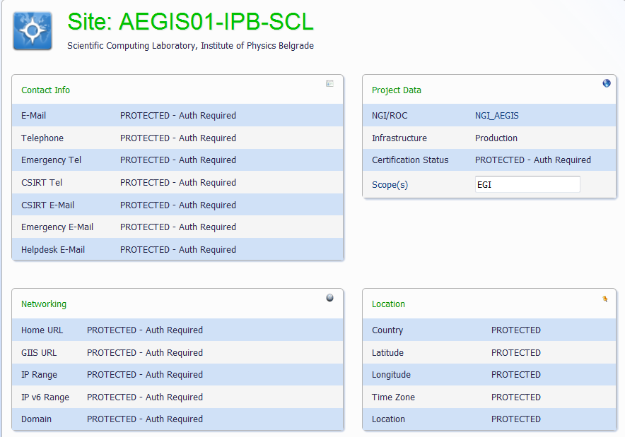
Public/PermitAll access to selected read only pages:
E.g. view Project/NGI/Sites/Service/Downtime can be configured for no authentication
All data regarded as sensitive is obscured (replaced with ‘PROTECTED’)
Does EGI want this functionality to be enabled?

Slide 9
APEL monitoring
For approval
Presented last OMB by Stuart (APEL)
Summary:
GOCDB changes
Rename services
gLite-APEL becomes grid.accounting.publisher
APEL becomes grid.accounting.submithost
Or maybe remove completely
Behaviour changes
Pub test
Per publisher not per site
Sync test
Per submit host/CE not per site
Approved?

