Slide 1
Multicore Accounting
John Gordon
OMB, June 2015

Slide 2
Outline
History
Recent Work
Plan

Slide 3
History
I first raised the issue of sites publishing details of the cores used per job at the OMB last December with an update in January.
There was some initial improvement but then progress flattened off.
WLCG have been pushing the issue as they are now running many more multicore jobs and wish to see this reflected in accounting.
Knowing the number of cores used is important in calculating the effective wallclock time and thus the overall occupancy of a cluster.

Slide 4
Recent Progress
At the June meeting of the WLCG Grid Deployment Board I reported that 87% of LHC CPU use was now reported as coming from Sites/CEs which reported the number of cores per job.
Since there were some obvious omissions from important sites and countries I was asked to address this.
I raised tickets against all NGIs and gave them a link to the publishing of cores for June by their sites which run LHC work.
This has mainly been successful. Once sites actively working on the issue start publishing we will have 97% of cpu reported with cores.
There are 48 sites still publishing 0 cores but for some it is only one or two CEs and a small number of jobs.
This excluded sites which didn't run any LHC work in June
I estimate that there are a further 29 EGI sites not publishing cores and a further 30% of jobs and cpu.

Slide 5
Plan
For NGIs which still have tickets open, I shall point out that there are more sites to be addressed (if there are).
For NGIs which have closed their previous tickets and for NGIs which were not affected by the WLCG campaign, I shall open new tickets if there are sites still to be addressed.
I plan to start in early July as the portal view only shows months so viewing today includes all sites who have recently started publishing cores..

Slide 6
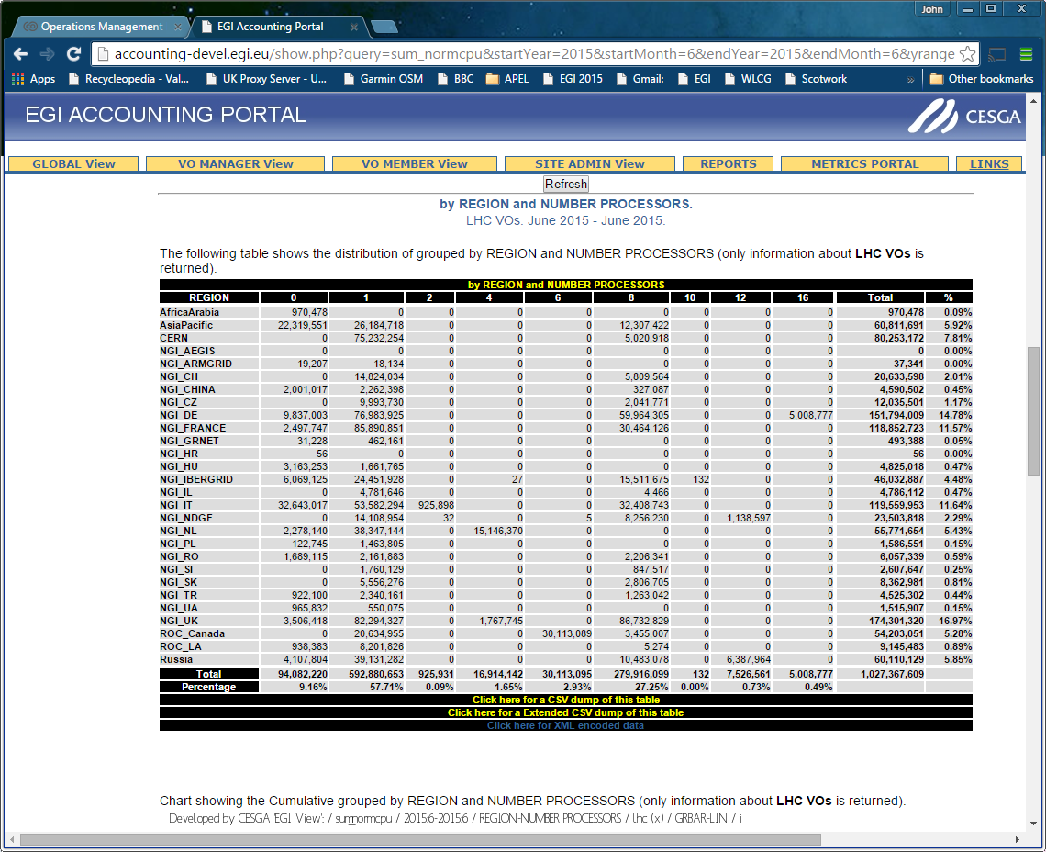
Background
WLCG View

Slide 7
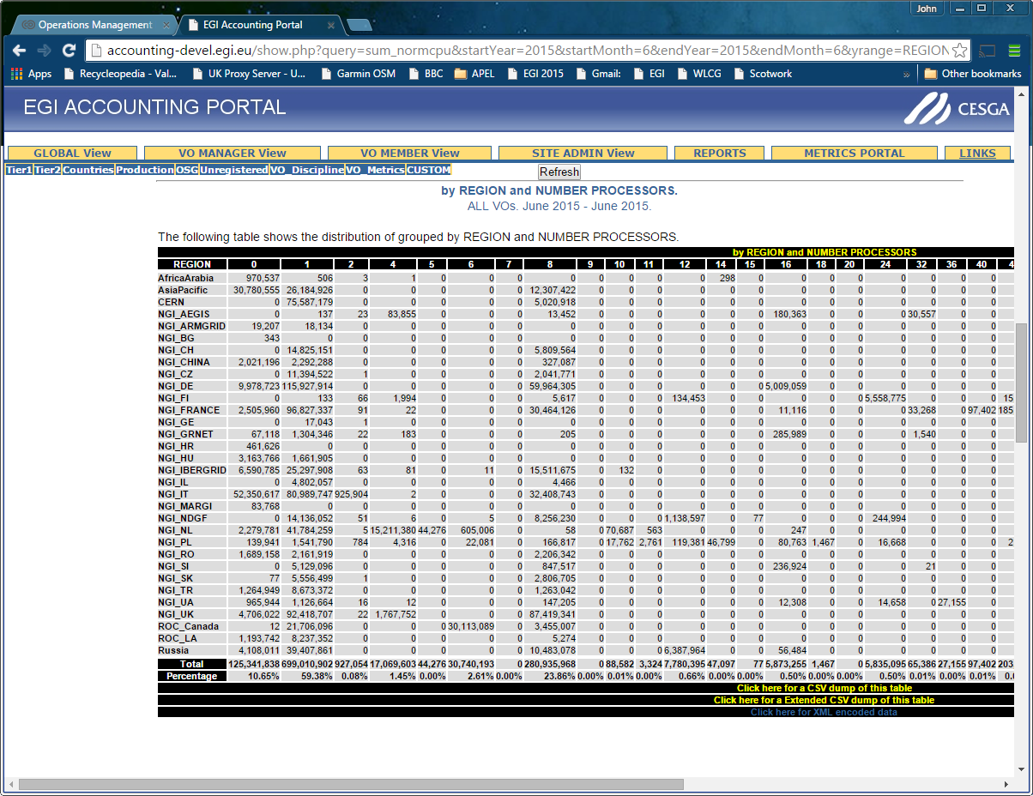
Notes:
June for all VOs

Slide 8
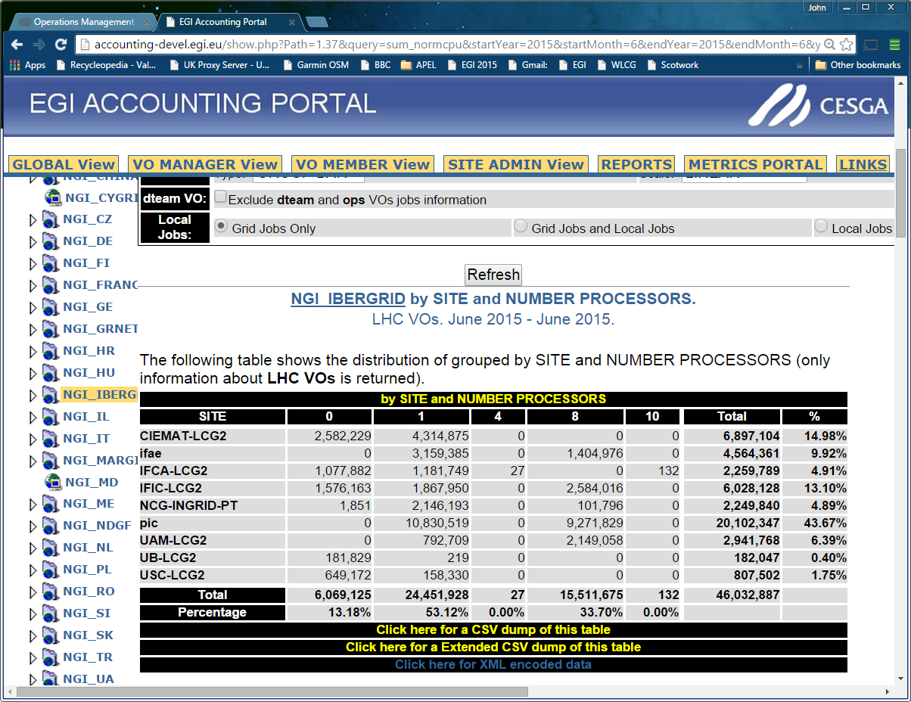
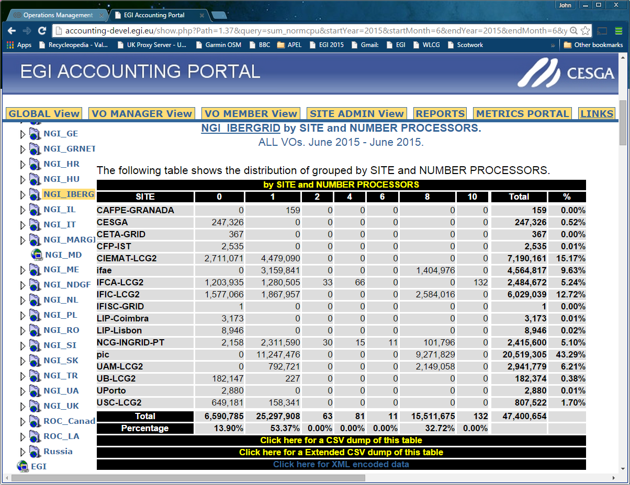
Affected by new campaign
When viewing all VOs I only see: Bulgaria and MARGI who were not in the WLCG Campaign.
But within an NGI there are changes:
Notes:
In general when a site has both 0 and non-0 cores it means either they have started publishing during this month or they are publishing some but not all CEs.

Slide 9
Within a Site
Notes:
Not naming and shaming DESY. They have a problem with ARC CE and their batch system.

Slide 10
Summary
Many sites have not yet started publishing multicore accounting.
Campaign will start in early July
Solution for APEL is simple
Set parallel=true in parser.cfg for parsers parsing batch logs
For other accounting systems, ask advice.
Just start publishing from now, don’t backdate.
Good luck!

