Slide 1
OMB December 2015
Peter Solagna
EGI.eu

Slide 2
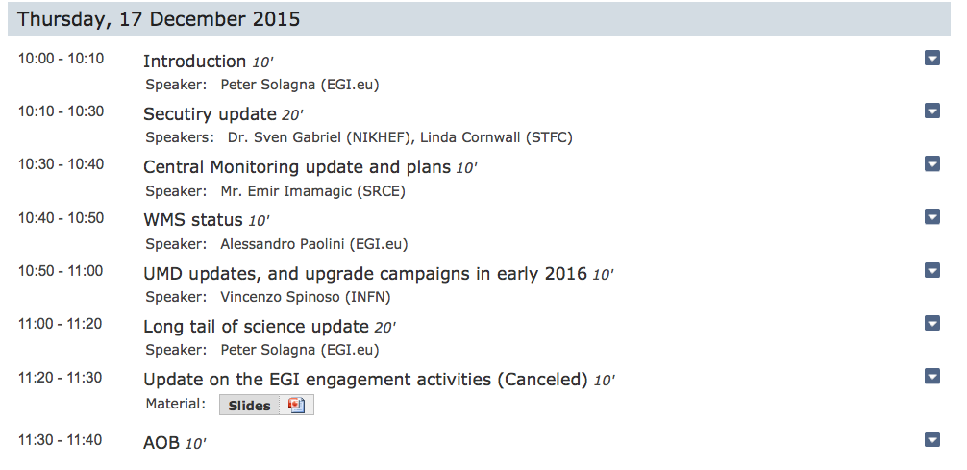
Agenda
The speaker could not attend due to a last minute obligation. Please, find some info in the attached slides

Slide 3
Approved: EGI SVG issue handling procedure
Presented at the September 2015 OMB
Linda Cornwall asked for comments in the NOC Managers ML on Sep 28th 2015
No comments provided
OMB Approves the procedure

Slide 4
Approved: CSIRT critical vulnerability handling procedure
Reminder: Procedure discussed and approved during last OMB (October 2015)

Slide 5
For approval: EGI AUP
Presented at the October OMB by D.Kelsey
Generalise to include all EGI service offerings (Grids, Clouds, Long Tail of Science, etc.)
Add policy requirement to acknowledge support in publications
Address liability issues
Circulated for comments to various boards, including NOC Managers on Oct 15th
No substantial comments
Proposal: OMB Approves the EGI AUP

Slide 6
New Operations portal release under testing
Release 3.3 available for testing
Security dashboard - Notification about security issues: A new page summarising the issues (tickets or nagios alarms )
Metrics
The reports for the Nagios issues is now available
VO ID cards
New section in the VO ID Card for Portal/Web Service Robot
Dashboard
Alarms in the ROD dashboard : a;arms about not production services in will not be visible
The template of the ticket has been improved
NGIs/ROD teams interested in testing are welcome to contact cic-information@in2p3.fr or operations@egi.eu

Slide 7
OpenStack integration
OpenStack native interfaces are now monitored directly by Nagios
Not generating alarms and not generating A/R data
Next steps:
EGI Operations to perform additional validation on the probes (see PROC06)
Add probe to the Operations profile
PROC06
Add probe to the A/R profile
PROC08

Slide 8
2016 OMBs
2016 OMB Meetings available on indico

