Slide 1
VO Services Activities NA3 F2F Meeting (3/03/2011)
I. Blanquer, D. Arce - UPV
G. Borges, J. Gomes - LIP

Slide 2
Activity scope
1 VO Management Support:
Documentation
Consultancy
Requirements gathering
Tools
2 Promote VO activities:
VO Productions
VO User analysis
VO services
3 VO Infrastructure
Monitoring:
Possibility to check which resources are available
Possibility to check if resources are correctly configured
4 VO Infrastructure Usage
Possibility to check their community usage

Slide 3
1. VO Management Support
Documentation
Central documentation point now available and acting as the main source of information for this activity:
https://wiki.egi.eu/wiki/VO_Services
VO Management FAQ Wiki addressing answers to VO Administrators questions collected from different sources:
https://wiki.egi.eu/wiki/VO_Managment_FAQS
Operation of the VO Services Support Unit
Assumes mandates for obsolete support units (VO Management, ...).
Gather requirements from VO managers.
Tries to answers VO managers doubts.
Consultancy on tools / installations / services.
https://wiki.egi.eu/wiki/VO_Services#Complementary_documentation
1 Frequently Asked Questions
1.1 General Information
1.1.1 Do I need a VO?
1.1.2 How to set up a VO?
1.1.3 Which services does a VO need?
1.1.4 What is the effort to operate VO services?
1.1.5 How to apply for the VO support in an EGI catch-all server?
1.1.6 How to register the VO in EGI Operational Portal?
1.1.7 What is the VO Acceptable User Policy (AUP)?
1.1.8 When can a VO start to operate in EGI?
1.1.9 What are the VO Manager responsibilities?
1.1.10 Which users should be accepted in the VO?
1.1.11 How to get computing resources for the VO?
1.1.12 How to include VO Support in GGUS?
1.2 VO Operations
1.2.1 How to install a VOMS service and other VO services?
1.2.2 How to install other VO services?
1.2.3 How to manage VO registration requests in the VOMS server?
1.2.4 How to install VO specific software in a remote site?
1.2.5 Who can install VO software in a remote site?
1.2.6 Where can the VO software be installed in a remote site?
1.2.7 How to access VO activity history?
1.2.8 How to get information about VO resources?
2 Documentation for reference
3 Instalation / Administration guides
4 Operational Links
5 Revision history
3

Slide 4
2. Promote VO activities
Tools to support usage of the VO
High-Level classification and critical analysis for existing software environments, including documentation.
User-friendly submission tools.
Ganga + Diane.
Other execution engines (such as workflows).
User-friendly consoles
E.g. the VBrowser, migrating desktop.
Highly connected to the Tools Database.

Slide 5
2. Promote VO activities
Ganga + Diane + Mini-dashboard framework
The mini-Dashboard monitoring service provides a web-based interface to monitor jobs with the GANGA job submission framework.
The framework can be setup centrally for one or multiple VOs to provide an overview of the jobs that were submitted by members of the VO through GANGA.
Pros & Cons
Ganga GUI contributing to decrease the learning curve for users.
Diane+Ganga represents an easy framework to start VO production jobs, and increase the success rate.
Pilot framework has to be agreed by the infrastructure providers.
Full analysis and evaluation, it will include an example use case:
https://wiki.egi.eu/w/images/1/15/Diane_Ganga_Evaluation_v2.pdf

Slide 6
3. VO infrastrucure monitoring
VO members should be able to access the status of the VO infrastructure
Tools are needed to run VO specific tests
on a regular basis
making the results visible for VO and VRC members.
r-Nagios does similar job for operations
Topology centred in region
Only supports the ops VO
NGI-1
r-Nagios
NGI-2
r-Nagios
NGI-3
r-Nagios
NGI-4
r-Nagios

Slide 7
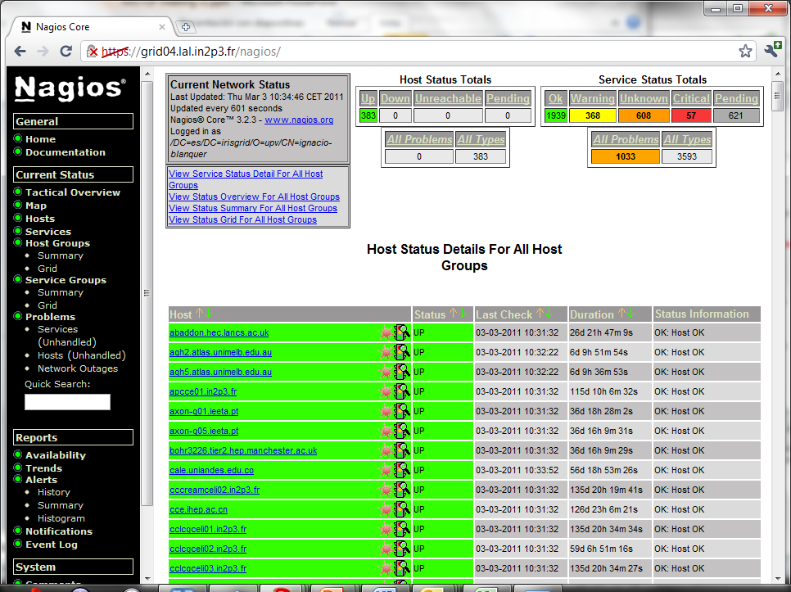
3. VO infrastrucure monitoring
LSVRC Nagios: http://wiki.healthgrid.org/Biomed-Shifts:Index

Slide 8
3. VO infrastrucure monitoring
Adapt r-Nagios to execute tests on a VO perspective:
Understand if multiple VOs can be monitored.
Understand how to generate the VO infrastructure topology.
Deployment of a test box supporting two simultaneous test VO.
Start to document the overall changes and process.
https://nagios01.ncg.ingrid.pt/nagios
NGI-2
NGI-3
VO(1-n)
Nagios
NGI-1
NGI-4
8

Slide 9
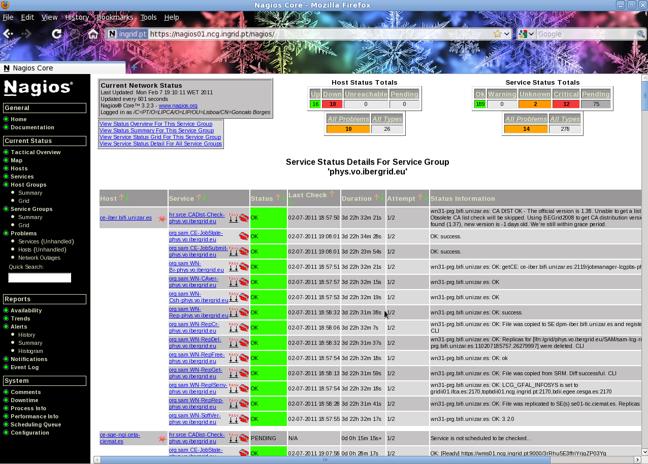
3. VO infrastrucure monitoring

Slide 10
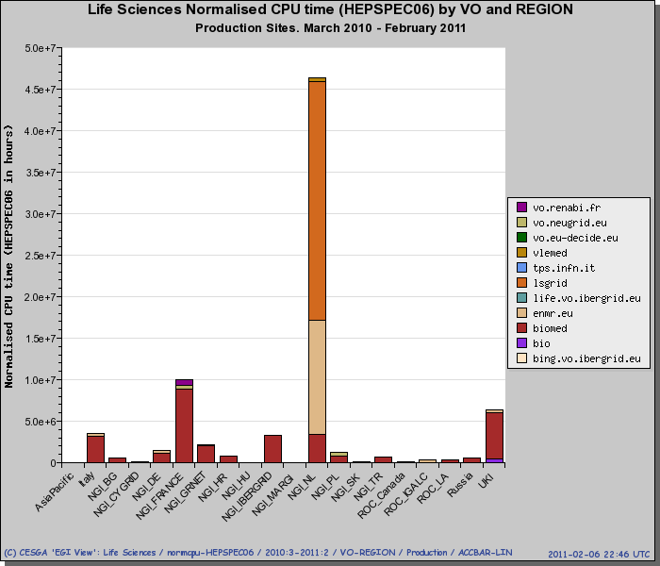
4. VO Infrastructure Usage
Promote available accounting system (Accounting Portal):
http://www3.egee.cesga.es/gridsite/accounting/CESGA/egee_view.php
Promote the views aimed for VO activities:
VO Discipline View
VO Manager View
VO Member View
Gather enhancement requirements

Slide 11
4. VO Infrastructure Usage
Gathering of Requirements for the Accouting
Do we follow the general procedure or transmit them directly?
https://wiki.egi.eu/wiki/Requirements_gathering_details
Requirements for the accounting portal
Accounting is oriented to sites, VOs or VO Disciplines.
Grouping of VOs is performed manually
There is a need to group VOs from the VRC perspective.
Use cases:
Metrics for the whole production infrastructure.
Metrics for a specific region / NGI.
Similar to VO Groups, rather than VO disciplines.
In contact with Accounting developers.

Slide 12
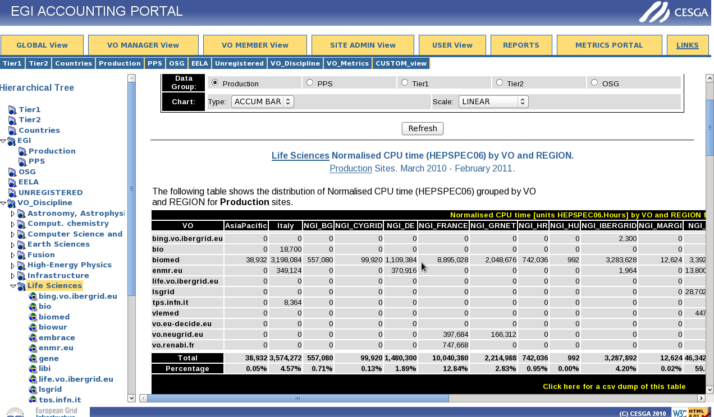
4. VO Infrastructure Usage

Slide 13
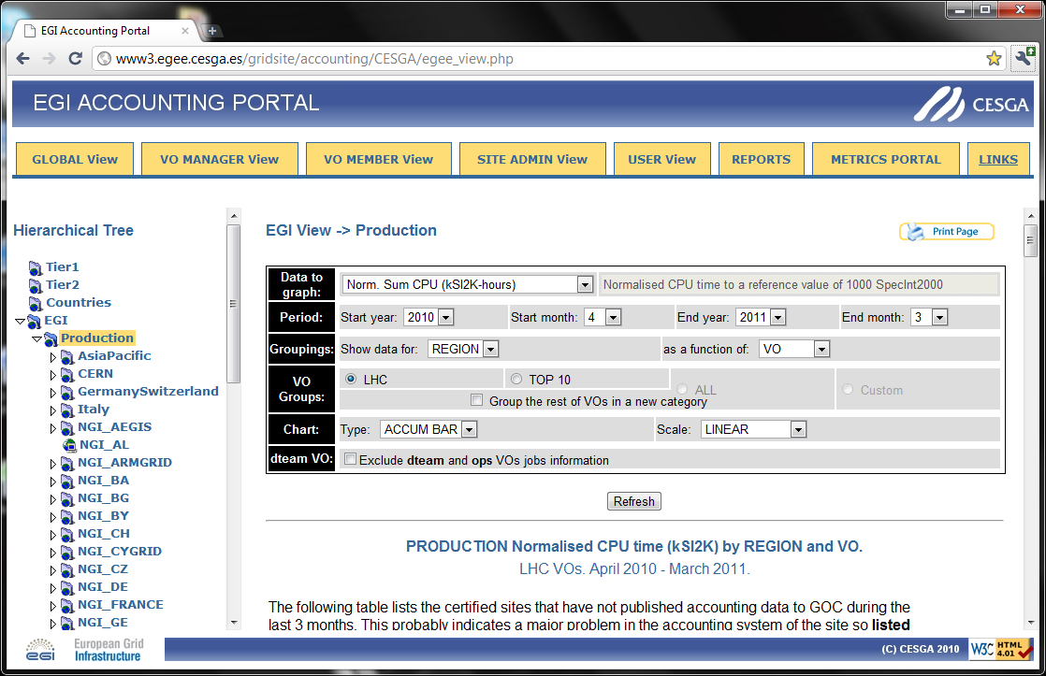
4. VO Infrastructure Usage

Slide 14
VO Services web site
Objective
Gather links to all the documentation and tools required for setting up and operating a VO.
Increase visibility of the subtask.
Content
Links to documents, downloadable tools, test services and operation services.
Planning
Definition of contents and structure (1st quarter of March).
Mock-up and first compilation of contents (April).

Slide 15
VO Services web site
VO Services Page
VO Management Section
Documentation.
VO Infrastructure monitoring and accounting tools.
VO Usage Section
VO Production tools
Coordinated with the software repository, rising important tools for operation.
VO Usage
VRC / VO / User consolidated views.

Slide 16
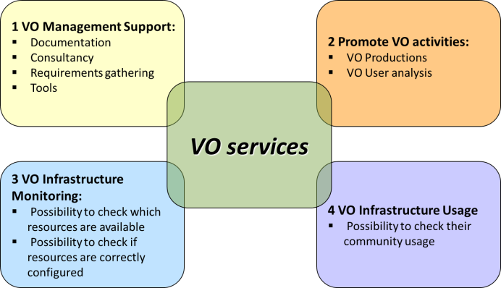
Home
VO Management
VO Production
EGI VO Services
Setting up and operating a VO is a complex task that requires an important effort for ensuring a high quality of services. Many tools and services are available in EGI that rely on the VO information, and sometimes, procedures are neither easily available nor complete. The EGI VO Services subtask aims at supporting VOs in the whole process of start-up, management and operation, pointing out to tools, services, documentation and procedural guidelines to maximize the usage of the resources.
The VO services activity is carried out by LIP in Portugal and UPV in Spain. The activities are summarized in four main points:
VO Infrastructure
VO Usage
Contact
VO Management Support. To set up a central point with procedures, FAQs and a single contact point.
Promote VO activities. To ease the access to tools and services to foster production quality by the users of a VO.
VO Infrastructure Monitoring. To aid setting up tools for monitoring the resources under the VO.
VO Infrastructure Usage. To support the monitoring on the usage of the resources by the users from a VO or a VRC.

Slide 17
Home
VO Management
Promote VO activities. To ease the access to tools and services to foster production quality by the users of a VO.
VO Infrastructure Monitoring. To aid setting up tools for monitoring the resources under the VO.
VO Infrastructure Usage. To support the monitoring on the usage of the resources by the users from a VO or a VRC.
VO Production
VO Infrastructure
Services Offered
Documentation and consultancy for the process of starting and operating a VO, such as where should a VO register, which should be the policies to manage users, what are the main services to set-up, how to evaluate the effort required, etc.
Tools for maximizing the usage of the resources, such as tools for easing the execution of jobs, data management, etc.
Tools for evaluating the status of the resources in terms of failures, updates, abnormal behaviours, etc.
Tools for monitoring the usage of the resources, such as consumption of hours, jobs executed, data transfers, storage used.
Communication channels to retrieve information, ask for advice, etc, in the form of a GGUS Support Unit.
VO Usage
Contact

Slide 18
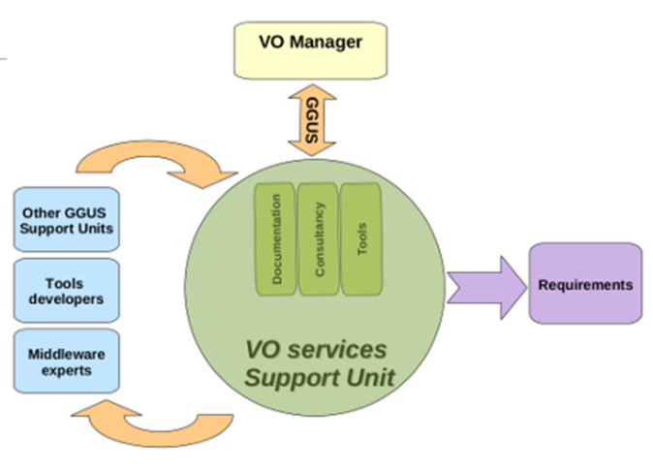
Home
VO Management
VO Production
Consultancy and Support
The GGUS VO Services Support Unit is one of the official communication channel at VO Managers diposal to receive support regarding procedures, services and tools they operate in their daily work. It has been established to provide a closer link with the technical services staff so that VO managers can:
VO Infrastructure
VO Usage
Contact
ask for consultancy services regarding tools and services
ask for support while operating their VO
ask for clarification of procedures or documentation improvements
provide feedback regarding specific tools and/or services
The established workflow assumes that, while interacting with the VO managers, VO Services staff can involve different experts in the discussions, and bridge VO managers requests with the appropriate support units.
Through the interactions with the VO managers, different requirements can emerge. In this case, it is the VO Services Support Unit responsibility to summarize the discussion into a requirement, and insert it in EGI Request Tracker. USCT is then responsible for the requirement follow up.

Slide 19
Home
VO Management
VO Production
Documentation for VO Management
VO Registration Process in EGI
VO Management Frequently Asked Questions
VO Infrastructure
VO Usage
Contact

Slide 20
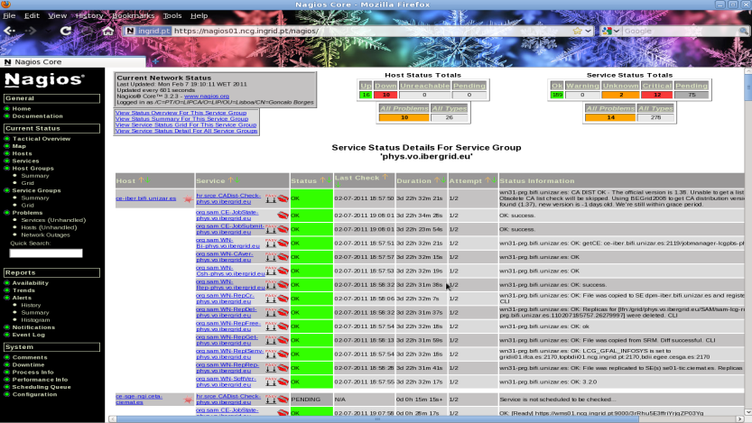
Home
VO Management
VO Production
VO Infrastructure Monitoring
Members of VRCs and VOs should be able to access how reliable their production infrastructure is. VRCs and VO members should be able to use integrated tools that run VO specific tests on their infrastructure on a regular basis, and make the results visible for VO and VRC members. Such tools typically consist of multiple modules:
VO Infrastructure
VO Usage
Contact
An infrastructure testing framework: A component that can host VO/VRC specific tests and run these tests on a regular basis on the infrastructure
A monitor system: A system that collects test results and makes them visible for VO/VRC members
An alarm system: A component that can raise alarms whenever a site/service/resource fails a VO-specific test staff so that VO managers can:

Slide 21
Home
VO Management
VO Production
VO Infrastructure Usage
VO-centric view of the consumption of resources.
VO Infrastructure
VO Usage
Contact

Slide 22
Home
VO Management
VO Production
Contacting and Getting Support
The GGUS VO Services Support Unit.
Direct Contact.
VO Infrastructure
VO Usage
Contact

Slide 23
Issues
Dashboard context
"To simplify access to the infrastructure and to promote collaboration within the VO, EGI.eu will (...) operate access to dashboard infrastructure where the status of the resource fabric being used by a particular VO will be reported upon. Both the portal and dashboard offered by this activity will be basic, but they will provide a core framework around which the particular community can, through their own work, customize their web presence and VO specific monitoring of the infrastructure. The dashboard infrastructure will be based on the work being undertaken in Section 1.3.3.4.3.1: TSA3.2.1 Dashboards."
Dashboard deployment
HUC Dashboards are developed using ORACLE, which represents a showstopper for its use for new emerging communities.
Several meetings and discussions were held with the dashboard teams which proposed alternative solutions.
Alternative solutions were evaluated but still no pragmatic decision was taken.

Slide 24
Future planned Work
Increase the visibility of the VO Services Unit activity
A Web page was created for the User Support Pages
https://www.egi.eu/user-support/ucst.html
Develop a web platform that could give a consolidated view of all the tools / services / documentation that the VO administrator, and VO support collaborators must access.
Finalize the documentation of the VO NAGIOS
Start research on how VOs could develop, deploy and use their own specific probes
A general purpose test will be exemplified.
Start documentation on the analyzed job submission frameworks that VOs could offer to their users.
Extend to other user-friendly frameworks.
Provide a mechanism to inventory available components.
Plans for Y2
Push on the adoption of the VO r-nagios.
Offer VO production tools as services.

Slide 25
Conclusion
Activity scope is now properly defined:
VO Management Support.
VO Infrastructure Monitoring.
Promote VO activities.
VO infrastructure usage.
VO Services has explored a pack of tools that could be offered as services to New Emerging Communities.
Check the status of this work in the next EGI User Forum
Abstract (“EGI VO Services activities“) already accepted for presentation
Plan is to have a first version of the VO Services web site.

