Slide 1
NA3 Task and sub-task leaders f2f meeting
EGI, Amsterdam, 3 March 2011
Steve Brewer

Slide 2
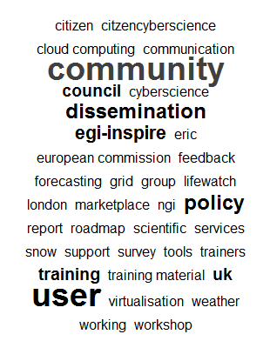
NA3 Task leaders
Programme for the day (09:00 – 15:30)
Status update on NA3, goals for the day
Status reports on NA3 Technical Services
Report on Open AMB
User Forum
Summary of actions and next steps

Slide 3
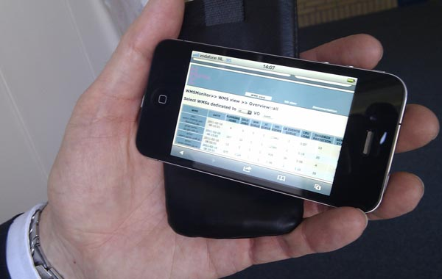
Status update on NA3, goals for the day
NA3 global update
UCST update
NGI support status update
Technical services context
Website update
VRC status update
Goals for the day
The 12 month plan

Slide 4
NA3 global update
TNA3.2 – User and Community Support Team
Team now up to full strength
Requirement Tracking System in place
Key topics identified and investigations underway
USAG, UCB and TCB meetings underway
1 VRC agreed and 4 more close
So-called HUCs proving illusive
New are communities emerging
NGIs, VOs and App Developers to nominate their key communities
Good mix of sessions at UF11 – event needs to be promoted
Blog emerging as good dissemination channel
Weekly metrics and statistics being compiled and circulated
User and developer workshops planned – discussion at UF11

Slide 5
NA3 global update
TNA3.3 – NGI User Support Teams
Consulting for New Communities
AppDb – contribute info on behalf of users
Documentation – to be provided
Training – coordinate communication
Portals and Science Gateways
Dashboard configuration for VOs
App porting support
Resource allocation

Slide 6
NA3 global update
TNA3.4 – Technical Services
Training ‘Marketplace’
Repackages the Calendar & Digital Library
Applications Database
‘A catalogue of ported applications’ for EGI users
VO Services
Services for VO managers and Community leaders (no development work involved)
‘A basic portal and dashboard’
Software Repository for community s/w

Slide 7
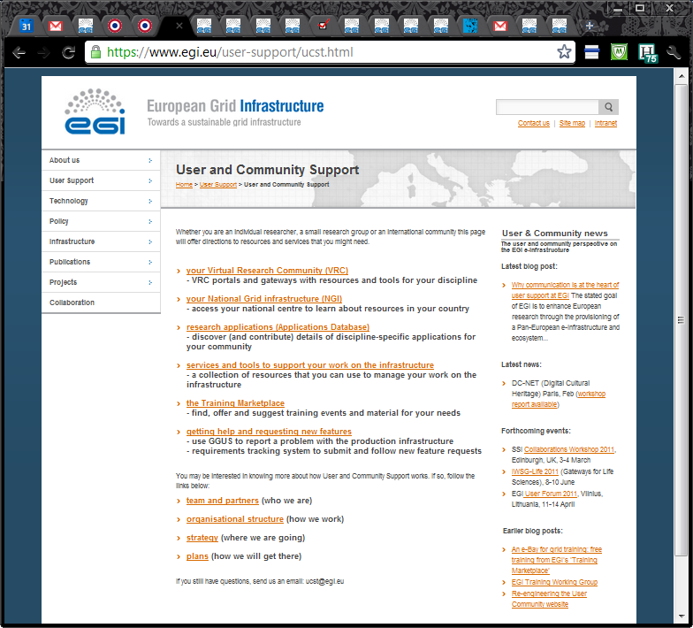
Entry point
For:
Users
NGIs
VOs
VRCs
Policy
Developers
Partners
M/W devs
Non-users

Slide 8
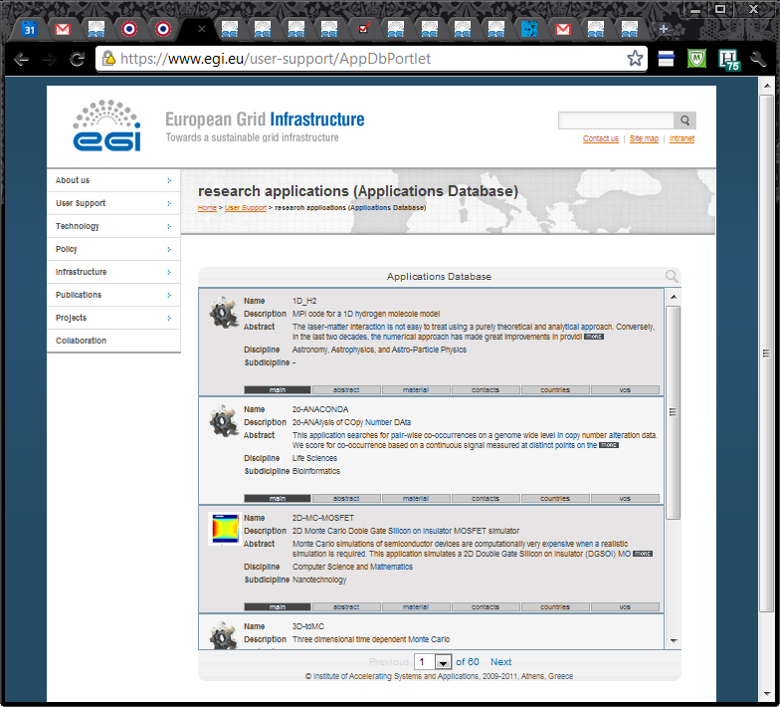
AppDb
‘Gadget’
Example of an ‘App’
embedded within a page
Note:
right hand column also available

Slide 9
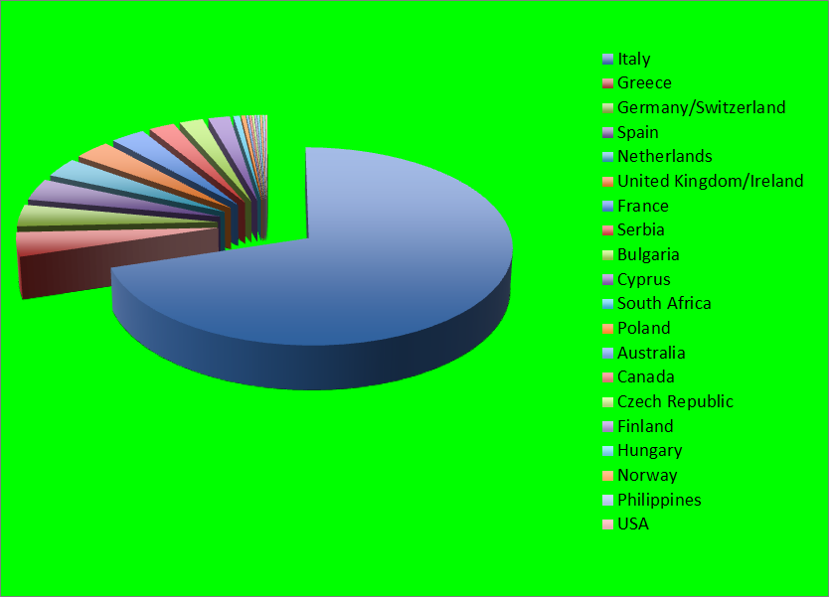
AppDb: developers (521)

Slide 10
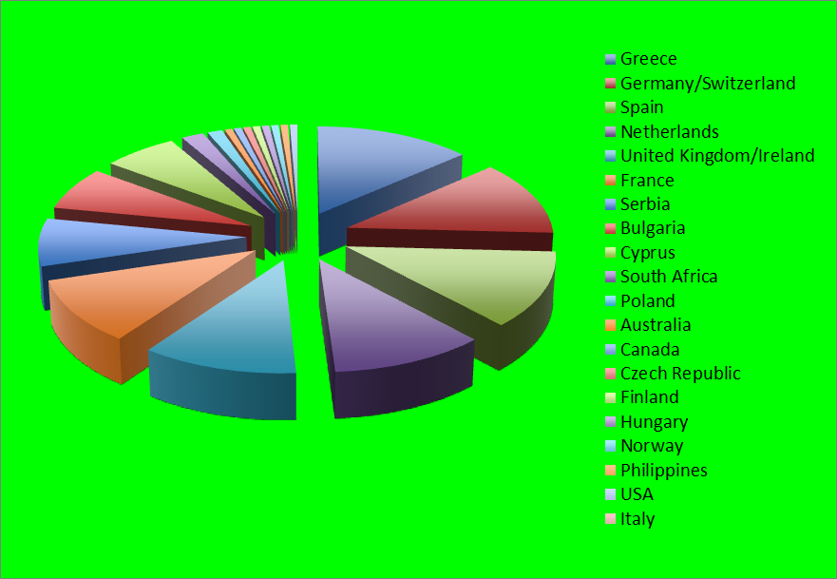
AppDb Developers (exc. Italy, 155)

Slide 11
VRC status update
Virtual Research Communities
WeNMR – have signed
Hydro-meteorology, WLCG, Humanities (comprising DARIAH & CLARIN ESFRIs)
Earth Sci., Astro and Comp Chem. slow
Digital Cultural Heritage Network also interested (DC-NET)
MAPPER: scalable computing have users

Slide 12
Goals for the day
Agree plan for next project year
Detailed (iterative) steps, with dates
Articulate TF11 deliverables
Scope UF12 goals
Plans for UF11
Understand and agree prep. for Review
8 June (phone), 15 June (dress rehearsal)
30 June/1 July) EGI - Review (Amsterdam)

Slide 13
NA3 – Project Year 2
Goal: stimulate the emergence of VRCs
Website to draw in all categories of users (www.egi.eu/user-support)
Gather intelligence: metrics, data, trends, knowledge, geo-spatial
Investigate key reqs. – share knowledge with users/dev’s/m’ware
Blog – post updates on all aspects of NA3 to stimulate discussion
Meet the Application Developers – workshops to support key topics
EGI Community Roadshow – in conjunction with NGIs (after NGS)
Training ‘marketplace’ – combined Training Calendar & Digital Library
Video material & online courses for training – supply tools & support
Key figures: identify influential figures in communities & support them
Tech. Services: APIs, portlets & apps for gateways & smart phones

