Slide 1
http://climate4impact.eu/ Bridging CMIP5 and CORDEX data infrastructure to impact users CERFACS, KNMI, University of Cantabria, SMHI, Wageningen University, CMCC, STFC, IPSL Maarten Plieger, Wim Som de Cerff, Ernst de Vreede, Christian Pagé, Natalia Tatarinova,
Antonio Cofiño, Manuel Vega Saldarriaga,
Ronald Hutjes, Fokke de Jong, Lars Bärring, Elin Sjokvist

Slide 2
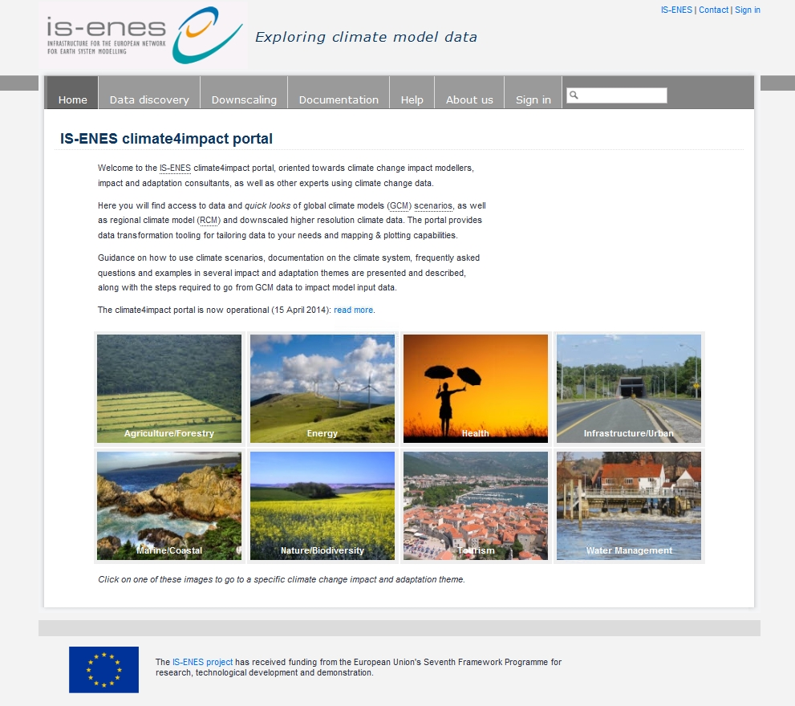
IS-ENES2 climate4impact.eu
http://climate4impact.eu/
Dedicated to the climate impact community: based on 21 use cases from e.g, Deltares, Alterra, UvA.
Dissemination of model results from both global and regional model experiments
Extensive documentation for impact modelers: guidelines, warnings, do’s and don’ts
Facilitates interaction between climate modelers, companies and climate services
Search, visualize and compute: from Petabyte to megabyte size reduction, drill down to the information needed, downscaling and indices
Builds on and contributes to ESGF global infrastructure:

Slide 3
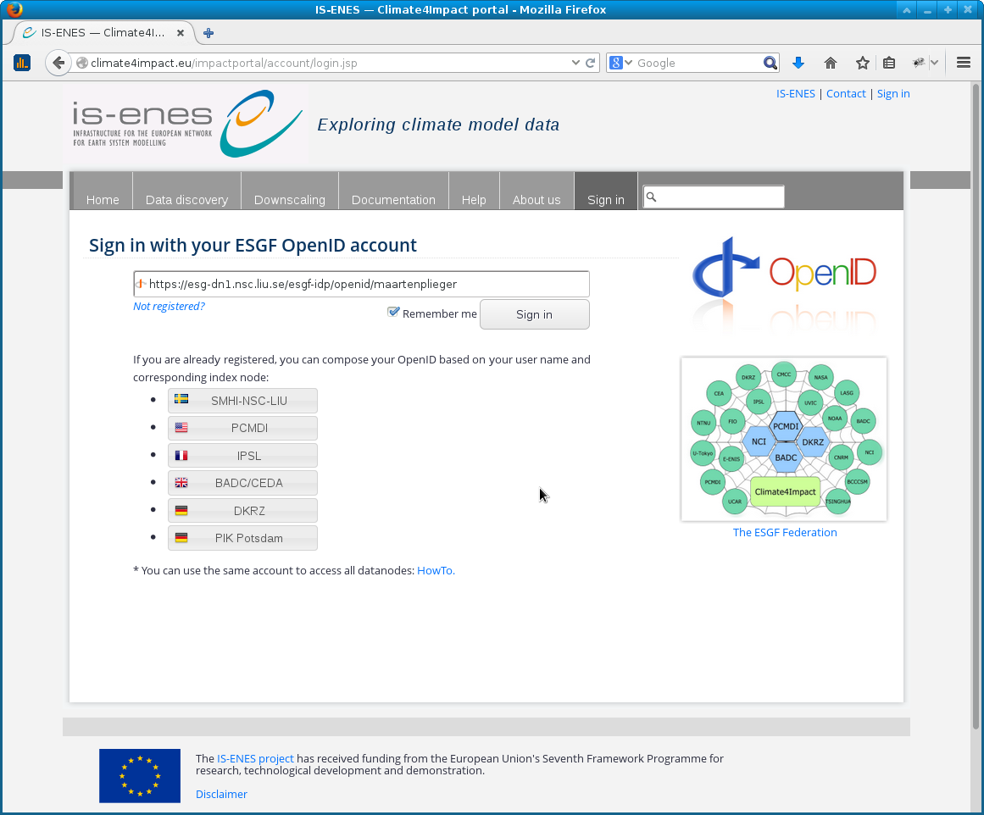
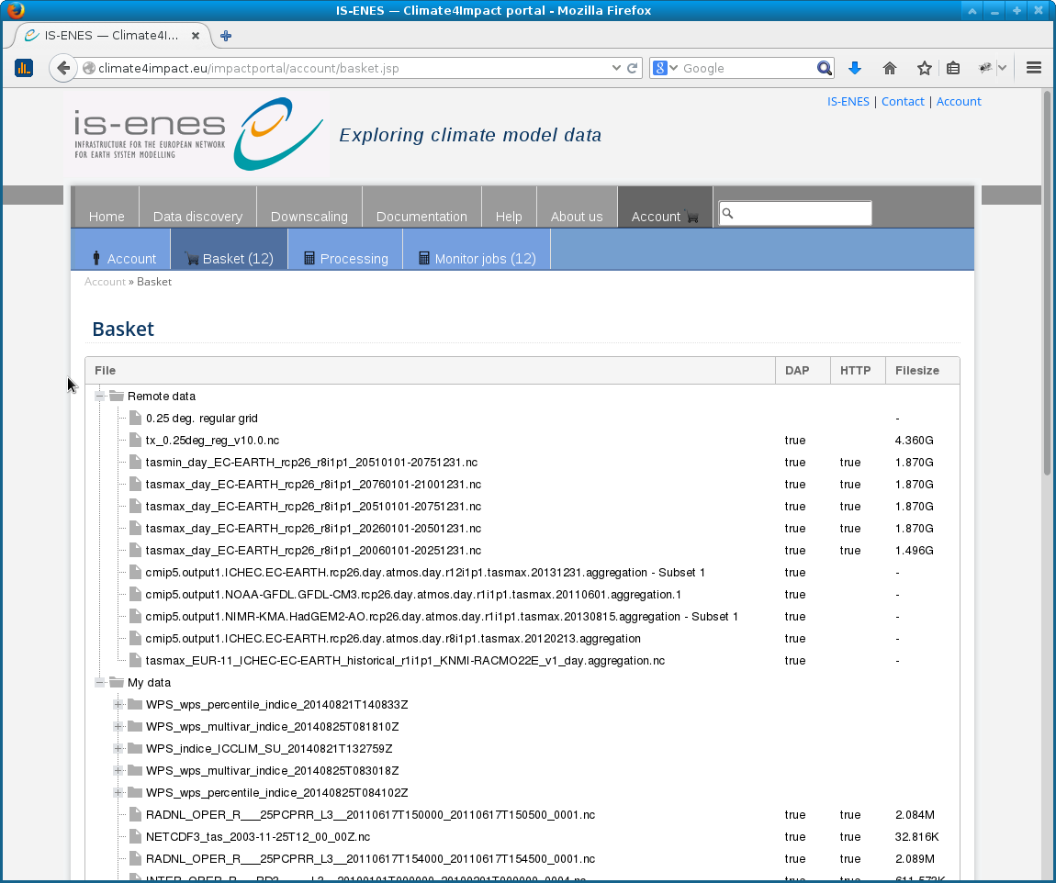
Climate4Impact overview (IS-ENES2)
Features and developments
Login with ESGF open id identifier, system helps with OpenID composition
Uses x509 client certificates for server side data access
Search ESGF infrastructure for CMIP5 / CORDEX
Visualize ESGF data using ADAGUC WMS
WPS processing can be done on files in basket
ICCLIM indices calculation and time series
Processing results are put in your basket
Everyone who logs in has a personal basket
Upload and store your own data
Data served again via OPeNDAP
Visualize your own data online!

Slide 4
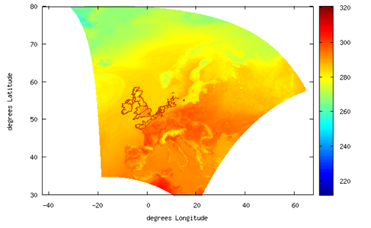
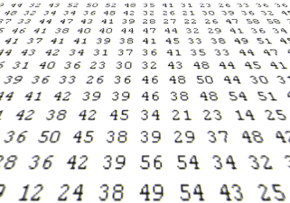
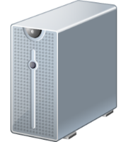
Data → OPeNDAP → WCS → WMS
Work done on client
Graphics
Referenced data
WMS
Array based data
WCS
Data files
HTTP / FTP
01001010010
01010010010
10010100100
10010011000
Work done on server
(de Boer & Plieger, 2014)

Slide 5
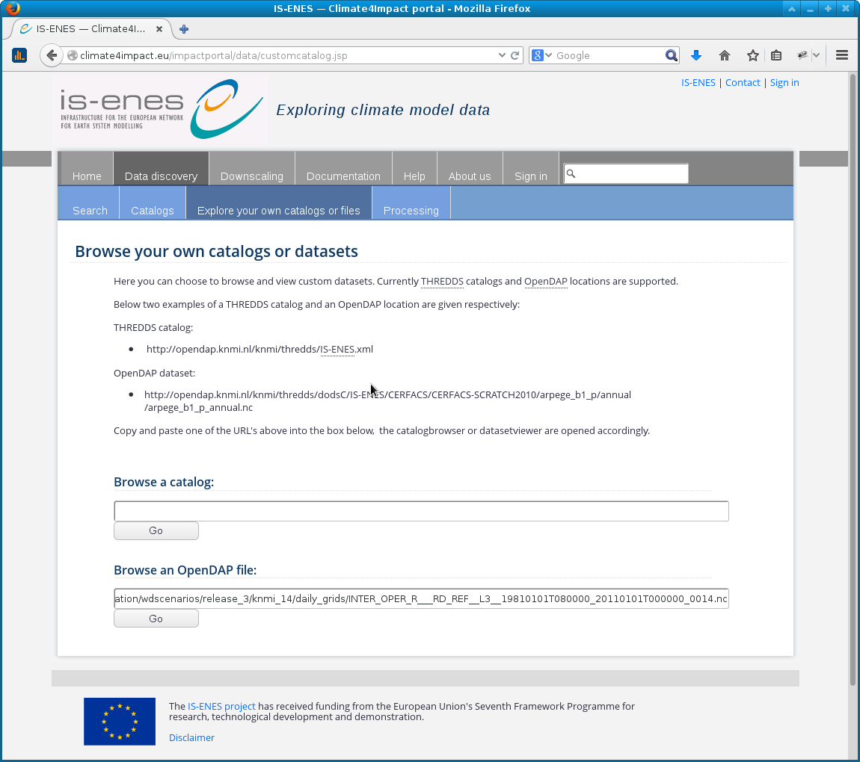
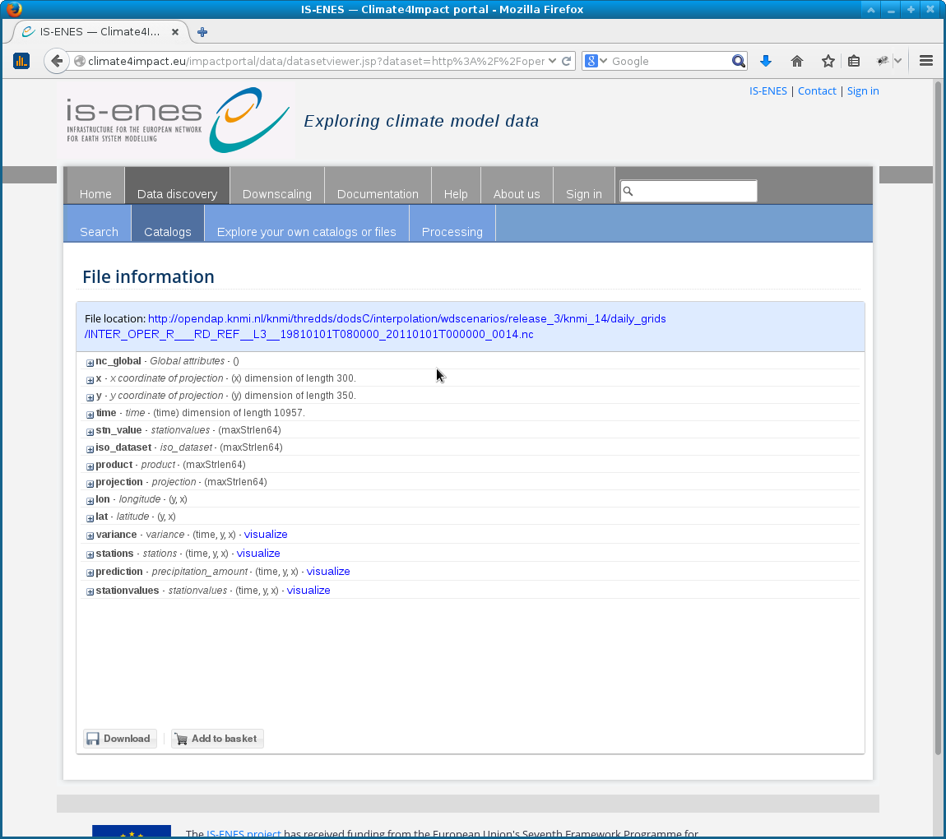
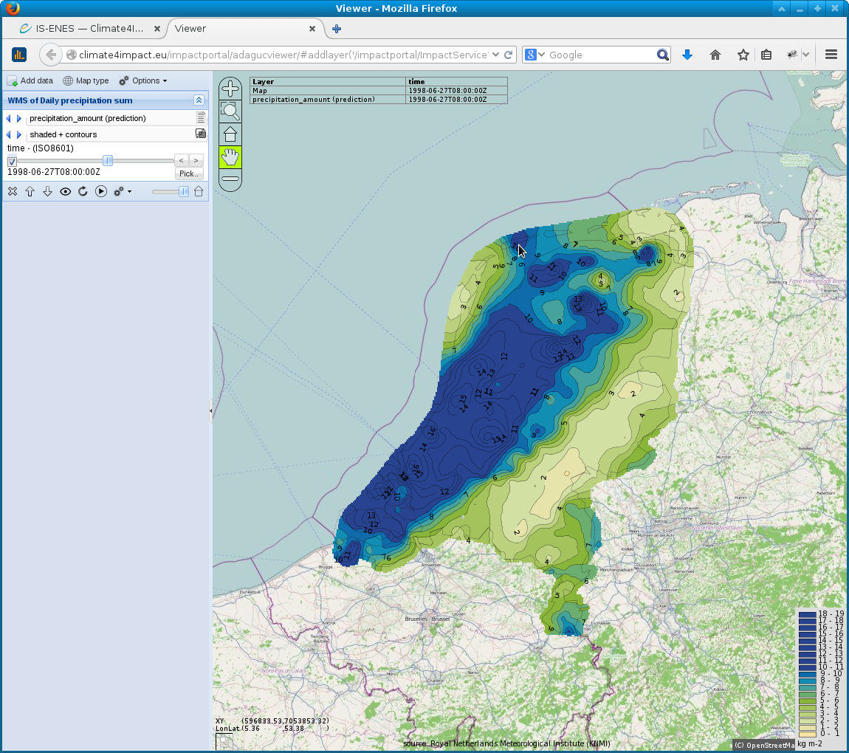
Web Map Services based on OPeNDAP resources
Climate4impact.eu allows for creation of WMS on OPeNDAP endpoints:
Go to “Data discovery” → “Explore your own catalogs or files”
Metadata with variables to be visualized is displayed
ADAGUC viewer displaying the WMS

Slide 6
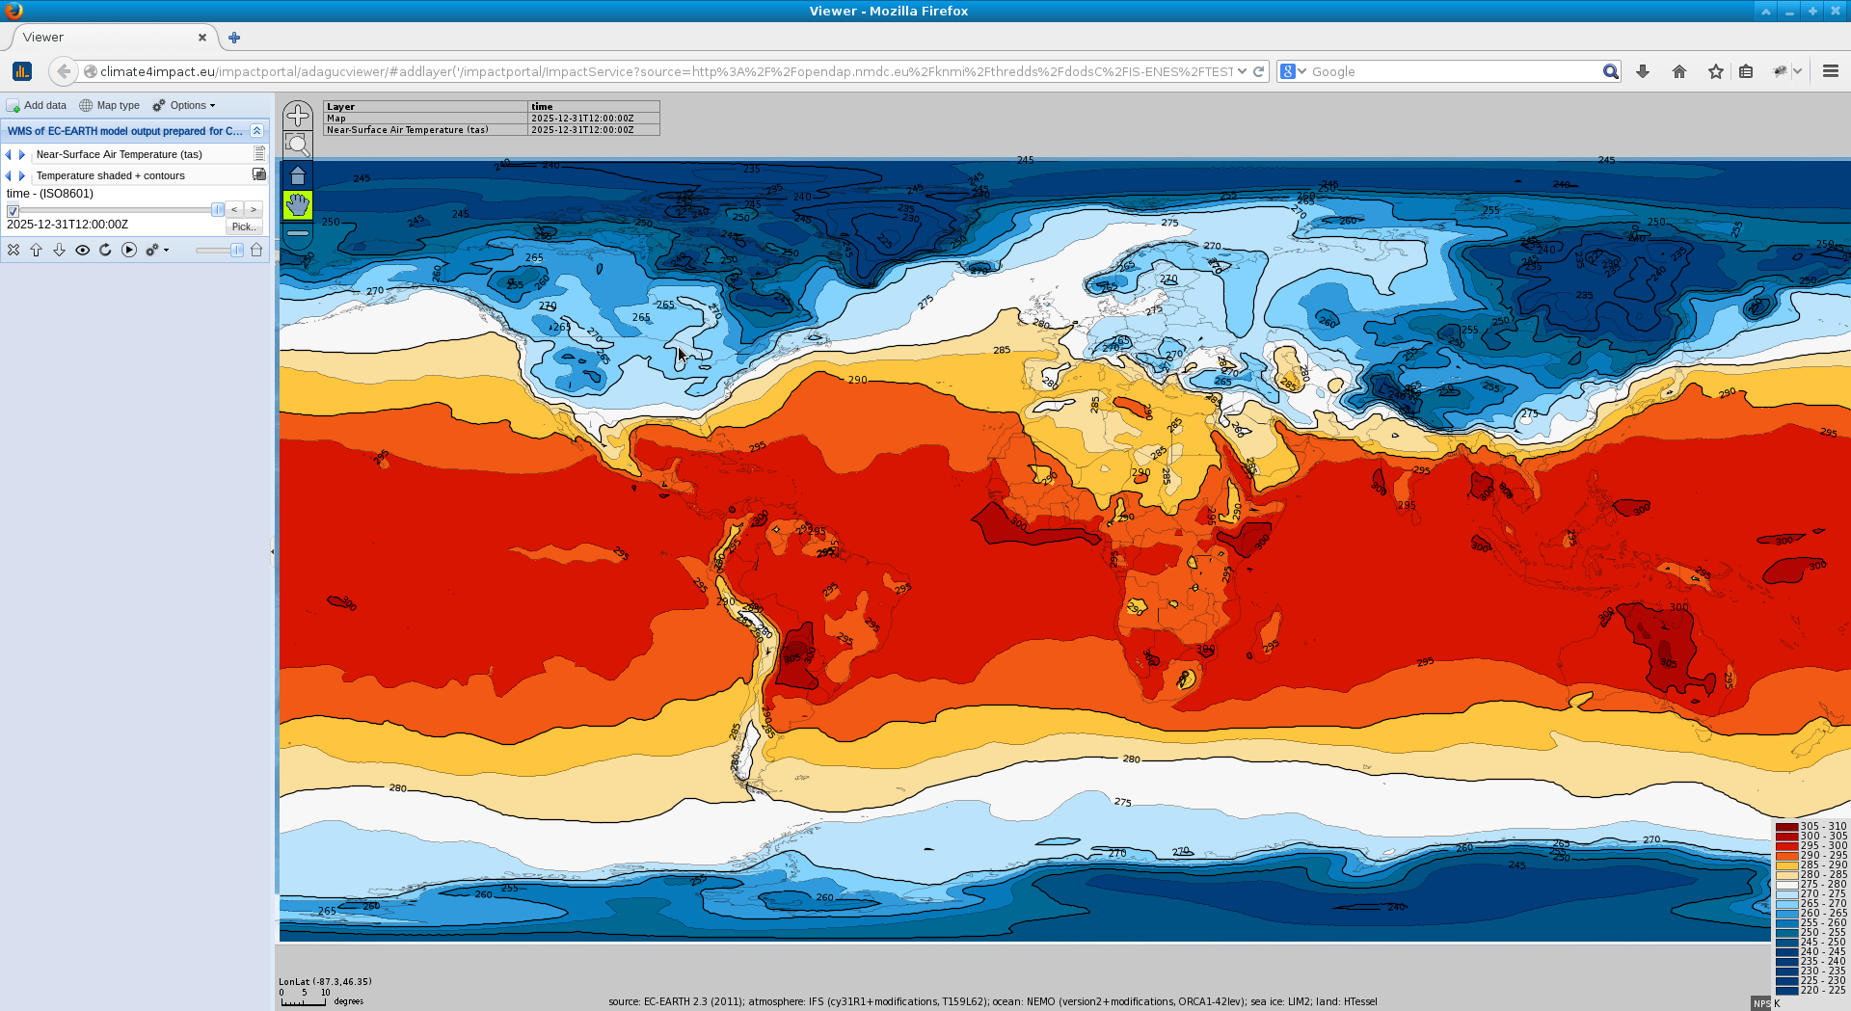
How to create WMS services on OpenDAP at C4I
No additional configuration required!
Provide your opendap URL as source parameter to the WMS service:
http://climate4impact.eu/impactportal/ImpactService?source=<urlencoded opendap endpoint>&
For the rest, the service remains a standard WMS which works in many WMS clients!
Graphical styling is based on standard names and units of the netCDF variable

Slide 7
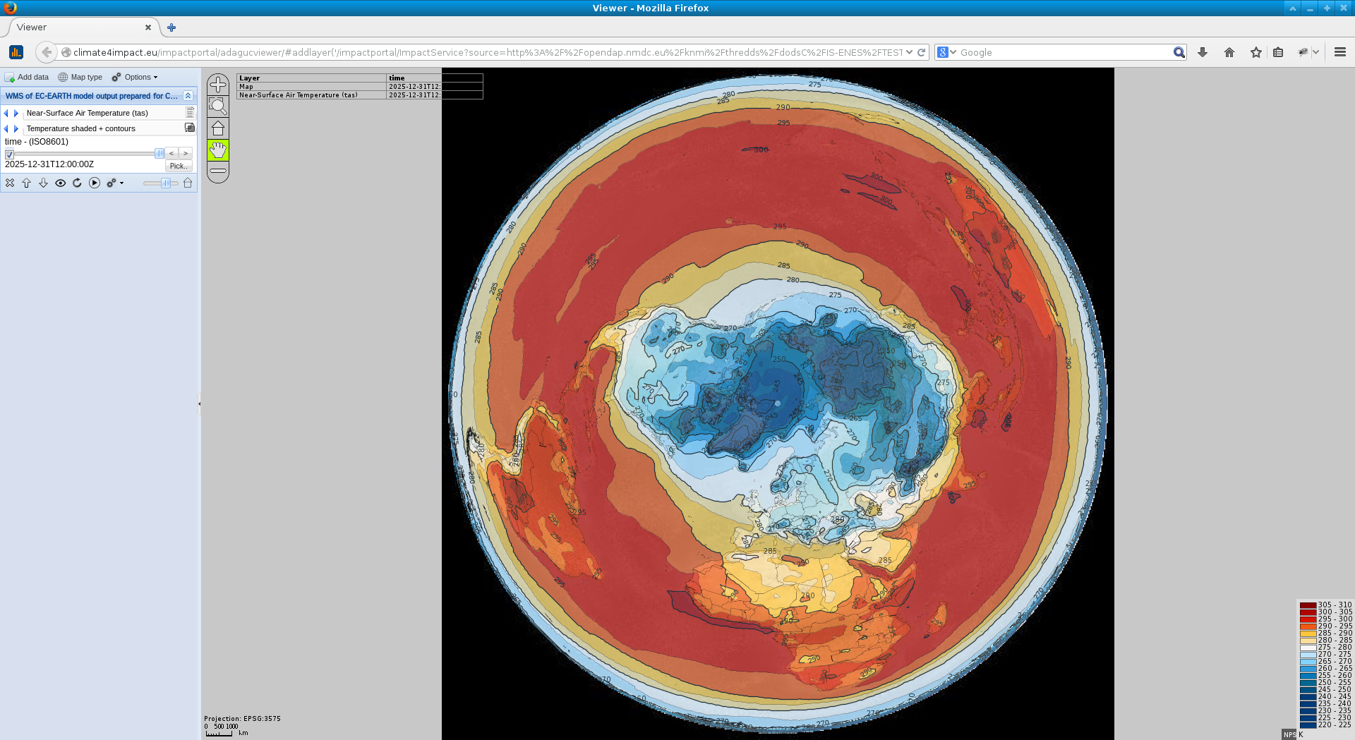
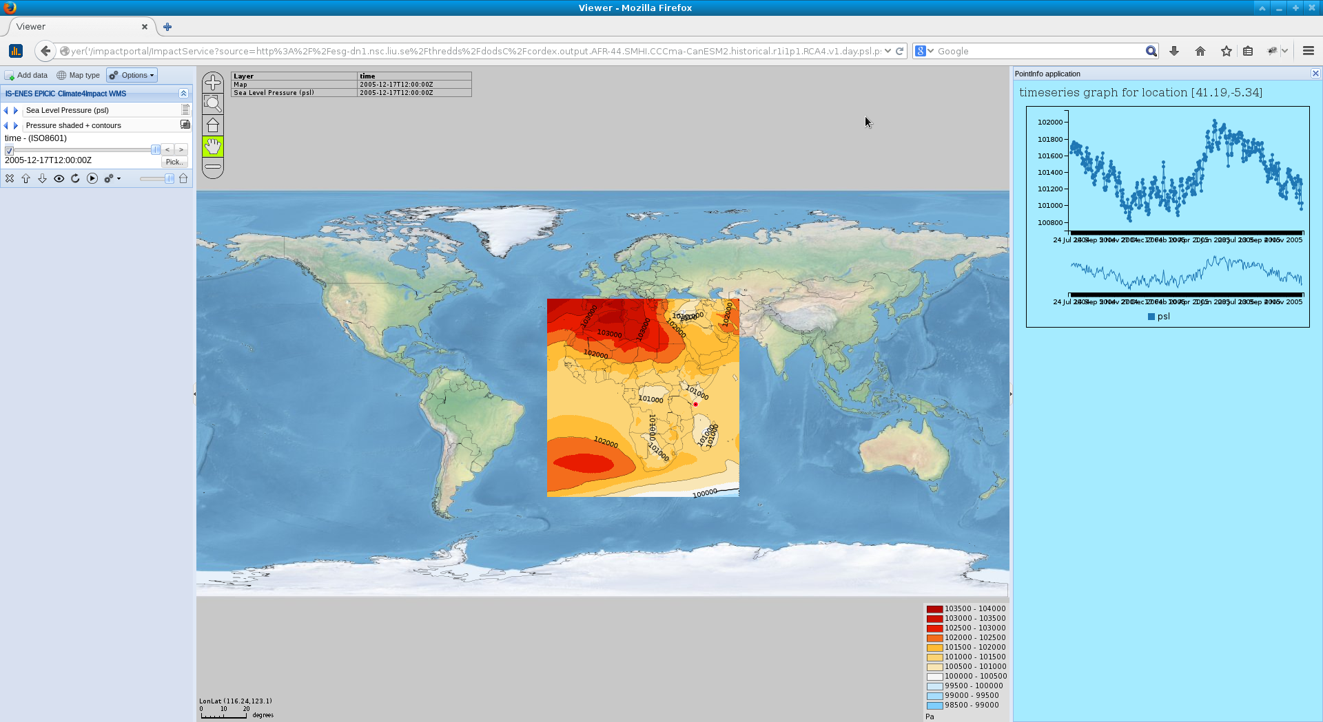
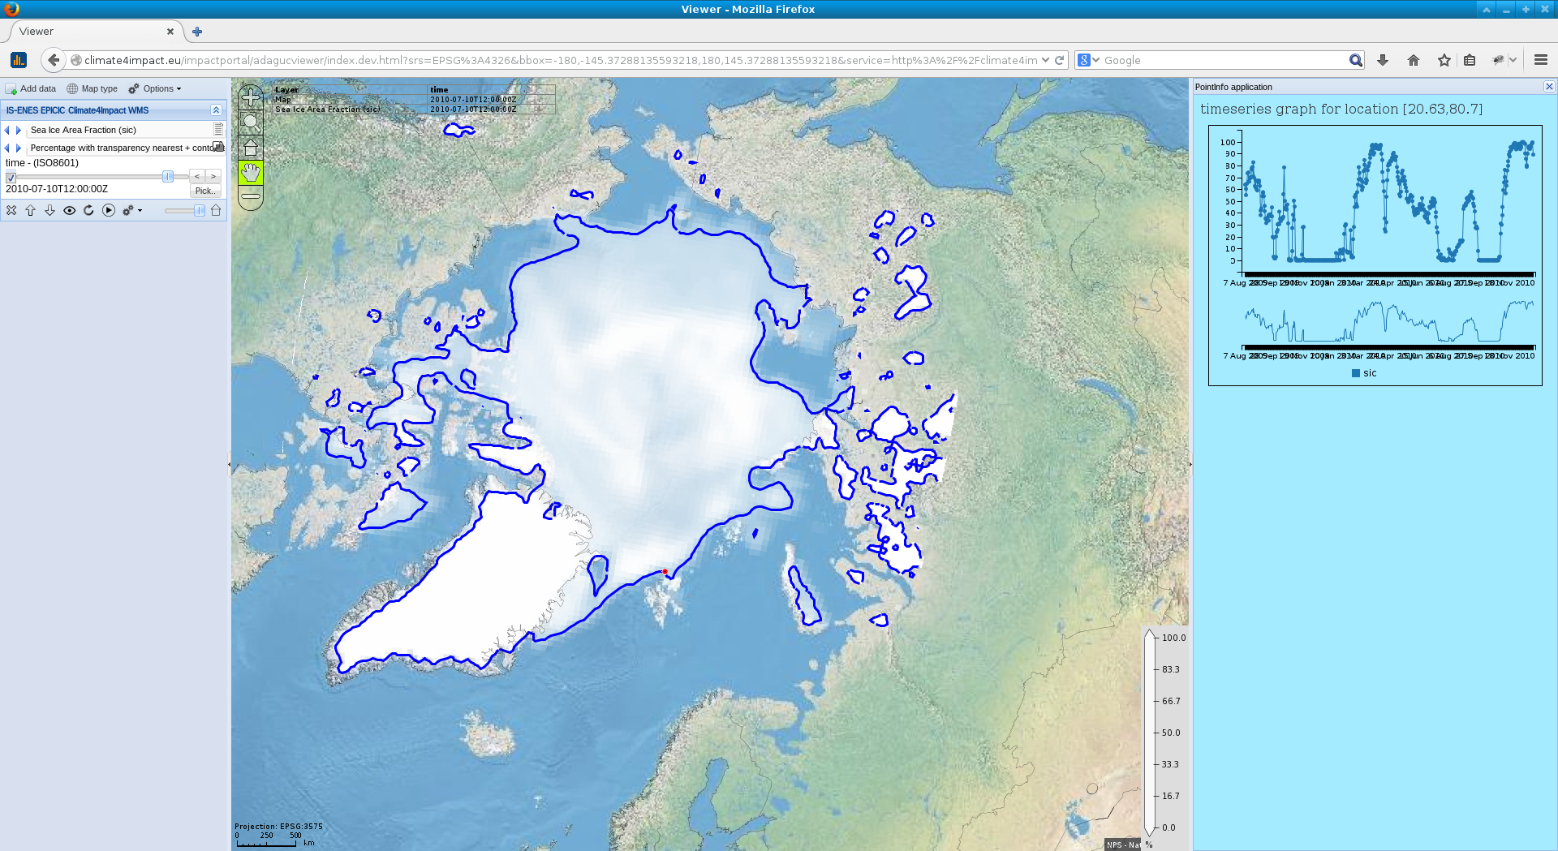
CMIP5
CORDEX

Slide 8
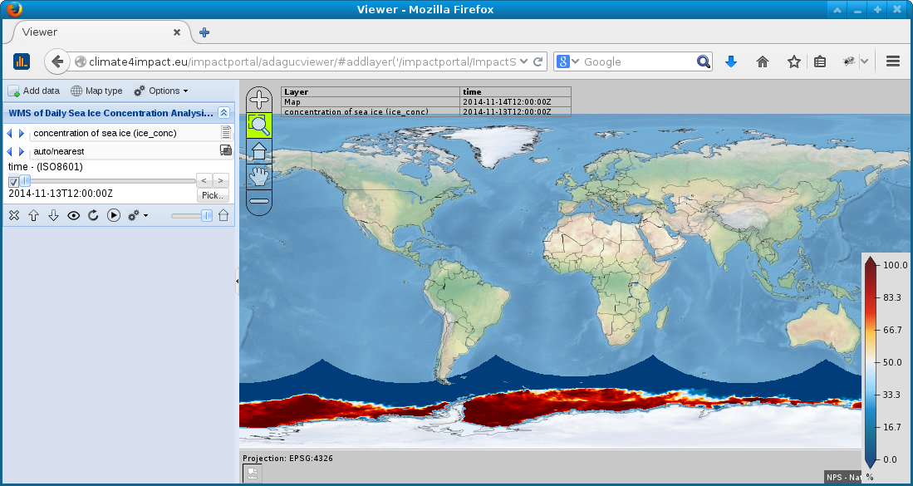
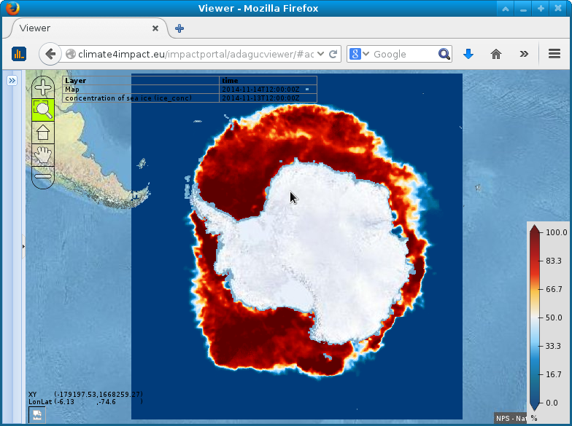
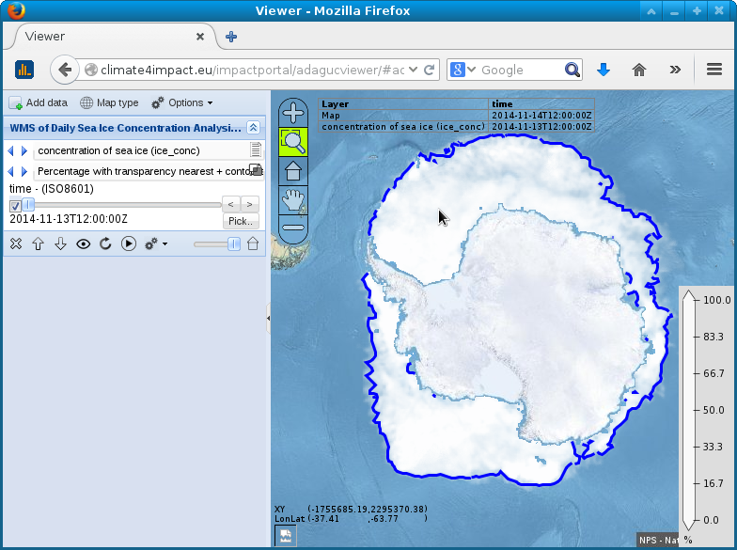
EUMETSAT Ocean and Sea ICE SAF from Norwegian Meteorological Institute:
http://met.no/Hav_og_is/English/Access_to_data/
http://thredds.met.no/thredds/catalog/osisaf/met.no/ice/conc/catalog.html
http://thredds.met.no/thredds/dodsC/osisaf/met.no/ice/conc/2014/11/ice_conc_sh_polstere-100_multi_201411131200.nc
Concentration of sea ice for 2014-11-13

Slide 9
Web Processing Service
Calculating Climate Indices
Uses PyWPS and ICCLIM
User interface is build automatically based on DescribeProcess XML file.
Interface supports:
Link to basket
Boolean elements
Comboboxes / select from list
Strings/text elements
IS-ENES2 is working on an indices wizard for user friendly indices calculation
Climate4impact WPS can be interfaced to other processing packages

Slide 10
Web Processing Service
Processing job list (asynchronous), can be viewed from everywhere

Slide 11
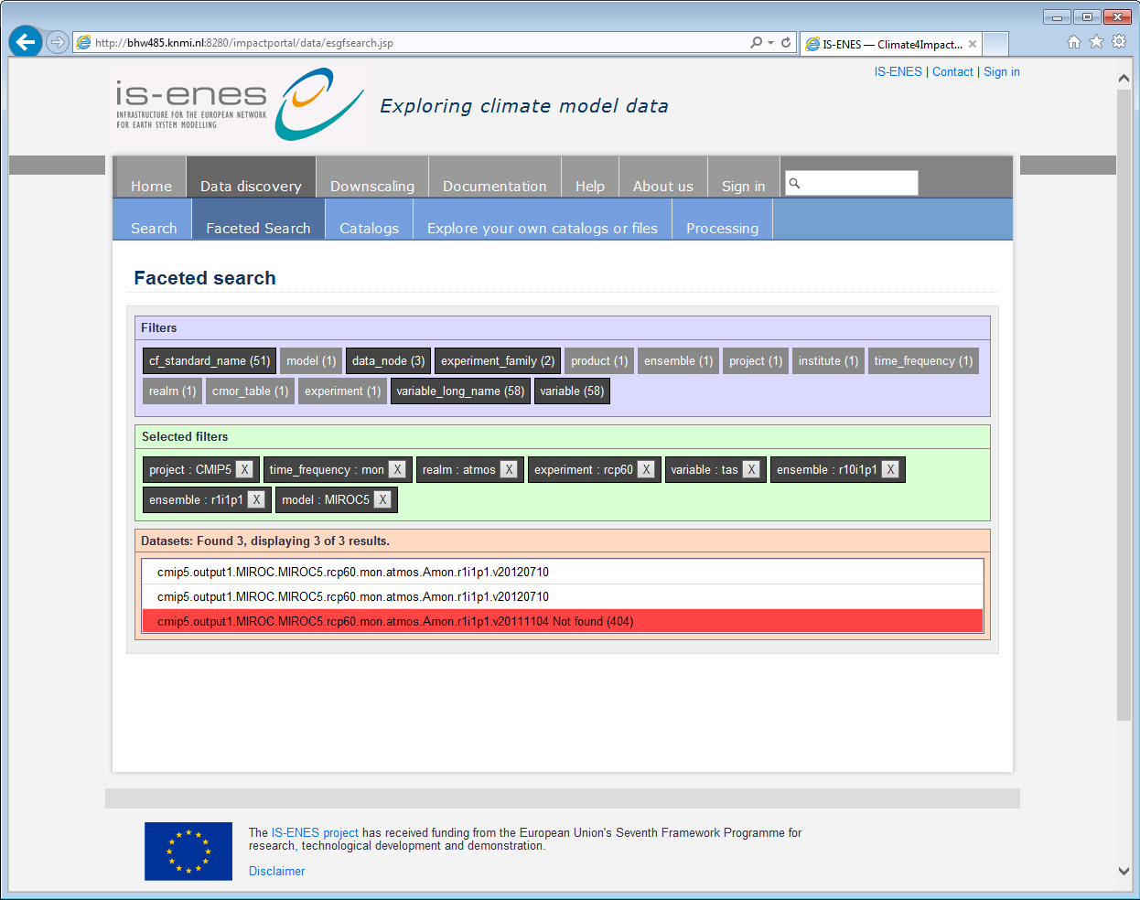
New faceted search
Built in modular way, can be easily re-used at other sites

Slide 12
Conclusion and next steps
Conclusion
ESGF is a great tool for distributed data access
Search works great
But security is complex (OpenID, MyProxy, SSL, ports, delegation issues, etc…)
Climate4Impact makes extensive use of ESGF services
Search, OPeNDAP, Security
Climate4impact is flexible due to applied technologies
Web Processing Service (PyWPS), Web Map Service (ADAGUC), OPeNDAP (THREDDS)
ADAGUC WMS can be used to visualize local and remote files
PyWPS with ICCLIM is suitable as generic processing framework for climate indices
OPeNDAP can be used to access small bits of large files over the internet quickly
Next steps:
Improve user interface → make more user friendly
Finalize the connection to the University of Cantabria downscaling portal
Climate indices calculation wizard
… see the roadmap!

Slide 13
THANK YOU !!!
(For detailed information please take a look at the backup slides
at the end of this presentation or contact maarten.plieger@knmi.nl)

Slide 14
(END)

Slide 15
OPeNDAP
What is it and what can it do?
OPeNDAP is the name of the organization and the name of the protocol
Open-source Project for a Network Data Access Protocol
Data is stored at remote server
Data model is similar to NetCDF’s data model (with differences)
N-dimensional array container, with variables, dimensions and attributes
Only requested pieces of data are sent
Accessing small pieces of large files on a remote server can still be quick
Data is requested based on sub-setting along dimensions
OPeNDAP resources can be opened locally on your computer as if it were local files using the NetCDF library
Local files versus remote files is transparent
The concept of a file is gone, an OPeNDAP endpoint can represent thousands of files aggregated along a dimension
E.g. Usually concatenate a large time series observation to one endpoint using the time dimension

Slide 16
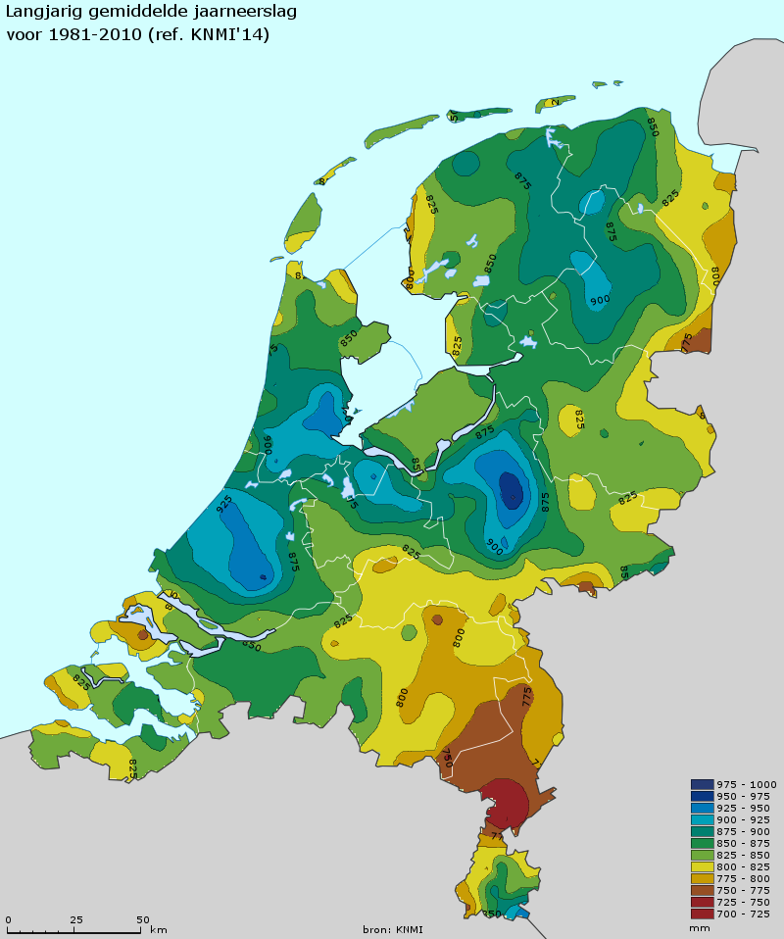
Web Map Service
What is it and what can it do?
Generates visualizations of geospatial data in the form of 2D images, suitable for transfer over the internet (JPG/PNG/GIF)
REST based:
Compose an URL with key value pairs,
and you will get an image!
Standard is developed and maintained by the Open Geospatial Consortium
Generated images are geo-referenced
Images from several sources can be easily combined
Images have dimensions
Time, elevation, member
WMS services can be viewed in many web based clients
OpenLayers, Leaflet, GoogleMaps, ADAGUC viewer, …

Slide 17
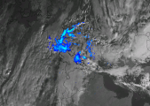
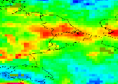
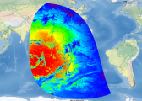
ADAGUC Web Map and Web Coverage server
Geographical visualization framework using open standards and formats
DATA
WMS/WCS
Images
Time series
GIS
Climate and Forecast Conventions
Data
Server
Users
e.g.:
WMS

Slide 18
ADAGUC software
Server details:
C++
NetCDF CF datafiles: grids / RGBA images / point data / swath vector data
Multidimensional (time, elevation, ensemble members, etc): 4D, 5D, 6D
Aggregate files by any dimension, supporting many files (100000+)
Implements MetOcean best practices reference_time and elevation
Preconfigurable styling (based on standard_name attribute)
Autoconfigurable for example for visualization of WPS output
Fast reprojection / regridding of large files
Extensions:
GetReferenceTimes request
GetFeatureInfo/GetPointValue
Can also return timeseries data in JSON/JSONP
Multiple dimension values (e.g. elevation=* returns data for all elevations)
The GetMap extensions found in ncWMS
Showlegend, showscalebar, title and subtitle options

Slide 19
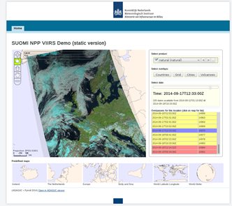
ADAGUC software
Viewer details:
Supports WMS 1.1.1 and WMS 1.3.0
Tested with geoserver, ncwms, mapserver and adaguc
Display legends, select styles, select dimensions
Enables download/manipulation from WCS services
Mapping component is embeddable in other web pages
Mapping component is plain JavaScript,
Rich interface uses ExtJS
Portals main purpose:
A simple way of combining layers from various WMS
In space and time
Visible via http://adaguc.knmi.nl, with demonstration data
Released as open source in June 2013

Slide 20
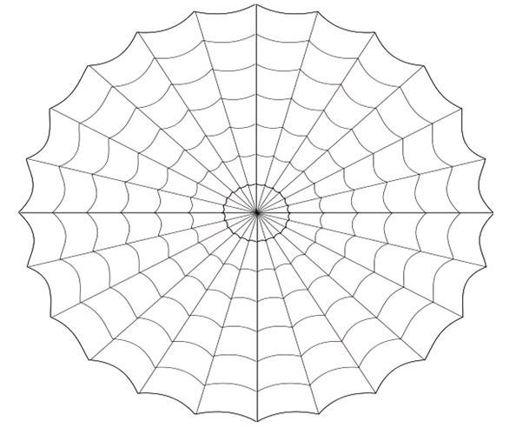
DKRZ
CMCC
NASA
CEA
LASG
Robust
Distributed
Data and processing
IdP + Index nodes (blue)
Data nodes (green)
Climate4impact builds on and contributes to this global infrastructure
IPSL
UVIC
NTNU
FIO
NOAA
BADC
PCMDI
NCI
DKRZ
U-Tokyo
BADC
NCI
E-ENIS
CNRM
PCMDI
BCCCSM
Climate4Impact
UCAR
TSINGHUA

