Slide 1
EPOS-S use case
Luca Trani and the EIDA Team
Acknowledgements to SURFsara and the B2SAFE team

Slide 2
Why B2SAFE
Goal:
“Provide safe, persistent and long term archival and preservation of high quality waveform data”
It matches perfectly with the features offered by B2SAFE
Moreover it allows full control on the choice of data replication facility vs generic cloud service => very important for computation
Possibility to implement customised rules and data workflows

Slide 3
Solution: overview
Main components:
- iRODS: micro services utilised to create customisable replication rules
- EPIC handle system: PID minting and management
PID
Seismic acquisition
system
iRODS
iRODS
dCache
NFS share
NFS mount
HPSS
ODC
ODC
DMF

Slide 4
Solution: workflow
1) Register dataset in iRODS (locally at KNMI): ireg…
2) Generate PID at KNMI
3) Replicate dataset to SURFsara
4) Generate PID of the replica at SURFsara
5) Update parent PID with replica information at KNMI

Slide 5
Solution: some numbers
- Replication of the ODC archive from 1988 to Dec 2013 completed ~ 6.6 M files
- Registration of the first 6 months of 2014 into iRODS at KNMI ~800.000 files
- Registration rate in iRODS ~100.000 files per day
- Replication rate ~ 80.000 files per day
(Typical file size range: from a few KB up to 20-30MB)
Planned actions:
- Finalise replication up to current day
- Set up an automatic procedure to register and replicate new files

Slide 6
Open issues
- PID assigned only to archived datasets: no real time yet
Datasets are assumed as frozen at a certain point in time
- Replication applied to continuous waveforms but it could be extended also to other products. E.g.: stations, qc, …
- PID granularity
- Replication mainly for backup purposes
- The current system does not support data provenance
Impossible to trace the history of changes on a specific dataset: related to Dynamic Data
- PID not coupled with domain specific metadata

Slide 7
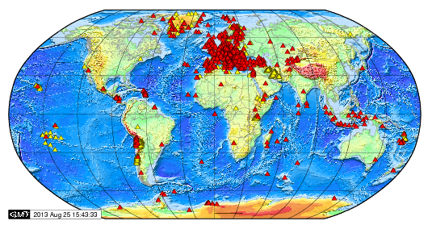
LMU
B2?
…
BGR
ETH/SED
GFZ
Data Discovery
Data Access
Data Computation
AAI
Citation
Workflows
…
B2?
…
Users: Geoscientists etc…
New node
B2?
…
INGV
ODC
…
B2?
IPGP
EIDA
3rd EUDAT Conference, Amsterdam,The Netherlands | 24-25 Sep 2014

Slide 8
Seismic continuous waveform
Seismic stations continuously record ground
motion and send their data in real time to data
centers which collect them
Each station is equipped with different sensors: typically targeting different spatial and frequency components
Data are usually stored as binary files encoded in a standard format called SEED (Standard for the Exchange of Earthquake Data) or better MSEED (its compact version)
A common convention is to arrange data in daily files divided per network,station,channel, location code
E.g.: SABA.HHE.NA.2014.001, SABA.HHN.NA.2014.001, SABA.HHZ.NA.2014.001

Slide 9
Solution: PIDs
3rd EUDAT Conference, Amsterdam,The Netherlands | 24-25 Sep 2014

Slide 10
3rd EUDAT Conference, Amsterdam,The Netherlands | 24-25 Sep 2014

Slide 11
EIDA/EPOS-S plans within EUDAT2020
- Set up a robust, scalable, reliable and secure infrastructure to support the federation of datacenters
- Enrich data streams with PIDs and detailed metadata
- Enable reproducibility and provenance
- Automatic safe replication of datasets on external data resources
- Effective exploitation of replicas: reliability, failover, disaster recovery, computation, optimisation
- Federated Discovery and Access
- Federated Identity Management (in discussion with eduGAIN/GEANT)

