Slide 1
B2SERVICES
www.eudat.eu
European Data Infrastructure
Earth Sciences Workshop
22-23rd of January 2015, Amsterdam
Mark van de Sanden, SURFsara

Slide 2
Research Data Life Cycle
CREATING DATA: designing, planning consent, collection and management, capturing and creating metadata
Creat-ing
data
Processing data
Analy-zing
data
Preserving data
Giving access to data
Re-using data
PROCESSING DATA: entering, transcribing, checking & validating, anonymising and describing
RE-USING DATA: for follow-ups, new research, research reviews, scrutinising, teaching & learning
ANALYSING DATA: interpreting, deriving, producing outputs & publishing, preparing for sharing
ACCESS TO DATA: distributing, sharing, controlling access, promoting
PRESERVING DATA: migrating, backing-up, storing, creating metadata and documentation, archiving
Ref: UK Data Archive: http://www.data-archive.ac.uk/create-manage/life-cycle

Slide 3
Who can use EUDAT service
Single researcher
Team
Community
Upload and download
Upload, add metadata, share
Periodic transfers, quality checks …
Different strategies for different usage scenarios

Slide 4
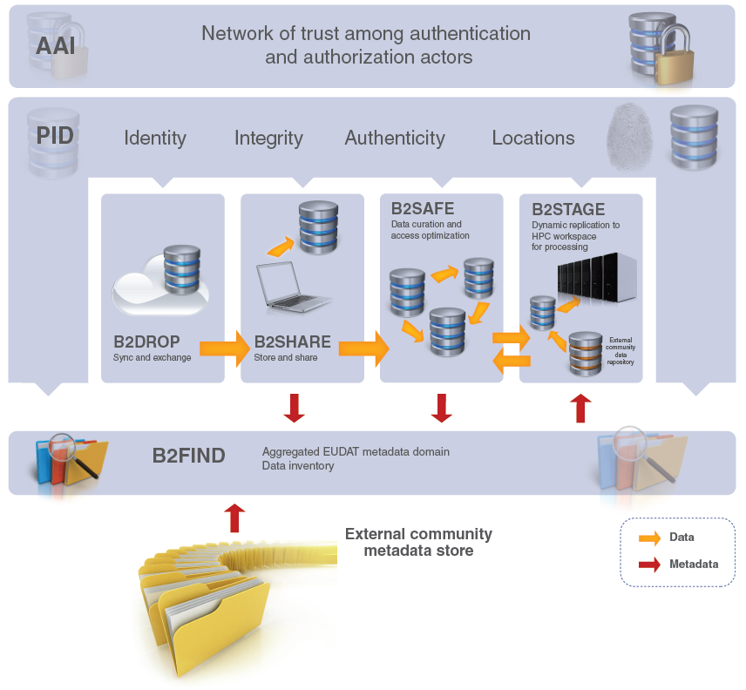

Slide 5
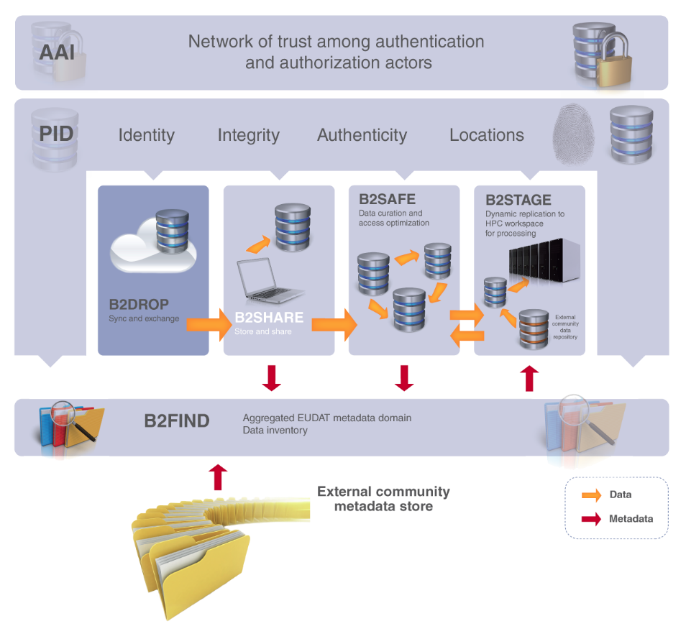
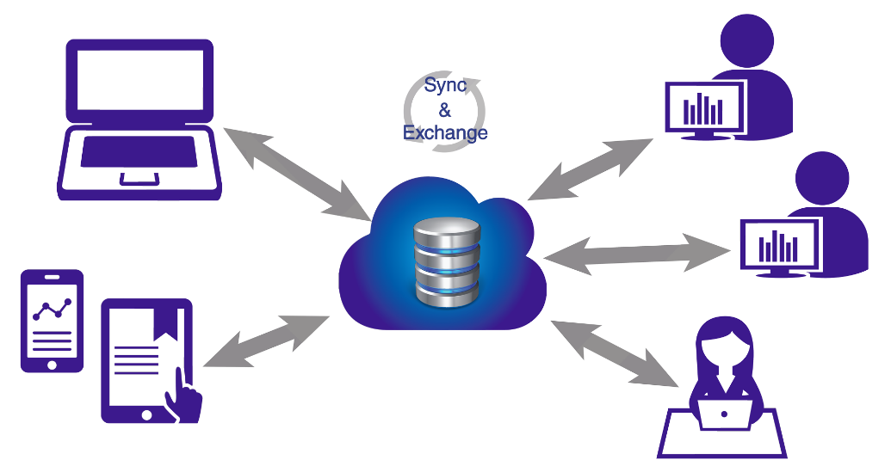
B2DROP is a secure and trusted data exchange service for researchers and scientists to keep their research data synchronized and up-to-date and to exchange with other researchers.
An ideal solution to:
b2drop.eudat.eu
Store and exchange data with colleagues and team
Synchronize multiple versions of data
Ensure automatic desktop synchronization of large files

Slide 6
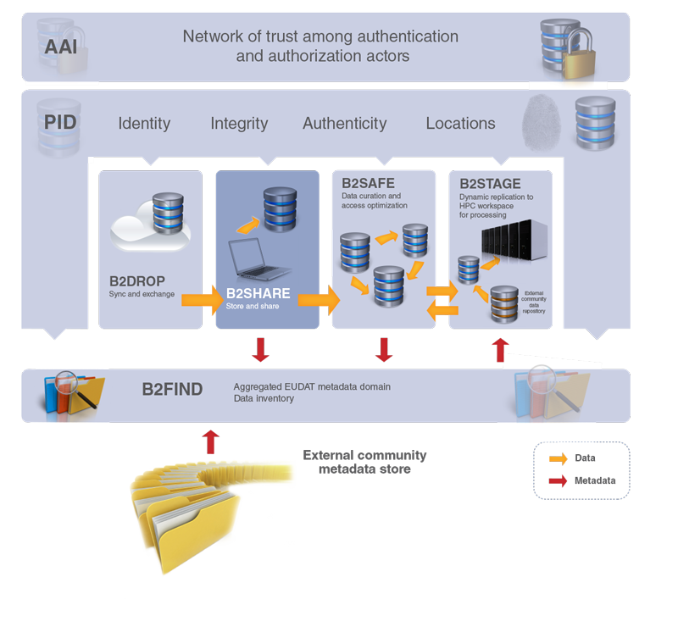
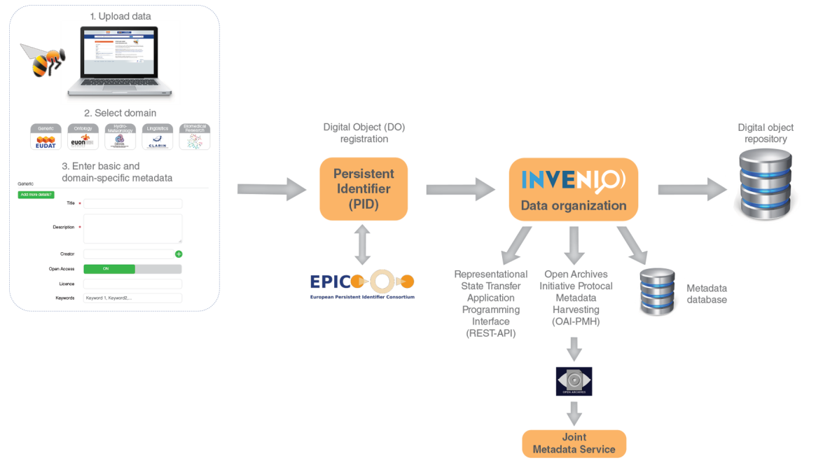
B2SHARE is a user-friendly, reliable and trustworthy way for researchers, scientific communities and citizen scientists to store and share small-scale research data from diverse contexts.
A winning solution to:
b2share.eudat.eu
Store: facilitates research data storage
Preserve: guarantees long-term persistence of data
Share: allows data, results or ideas to be shared worldwide

Slide 7
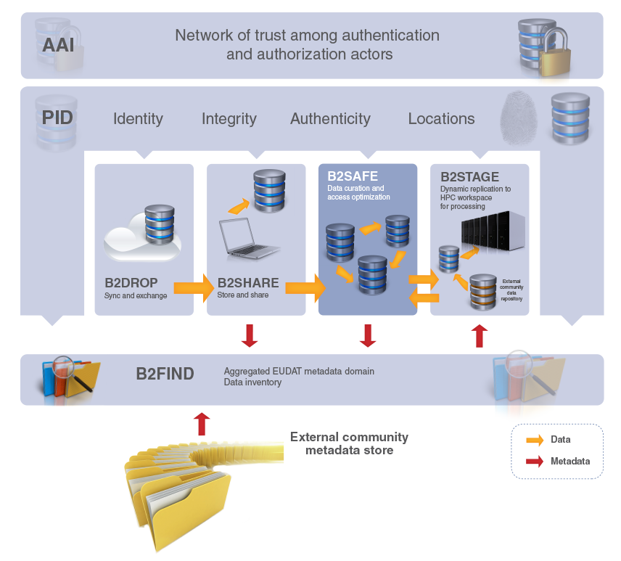
B2SAFE is a robust, safe and highly available service which allows community and departmental repositories to implement data management policies on their research data across multiple administrative domains in a trustworthy manner.
A solution to:
eudat.eu/b2safe
Provide an abstraction layer which virtualizes large-scale data resources
Guard against data loss in long-term archiving and preservation
Optimize access for users from different regions
Bring data closer to powerful computers for compute-intensive analysis

Slide 8
B2SAFE features
eudat.eu/b2safe
based on the execution of auditable data policy rules and the use of persistent identifiers (PIDs)
respects the rights of the data owners to define the access rights for their data and to decide how and when it is made publicly referenceable
data policies are centrally managed via a Data Policy Manager, and the policy rules are implemented and enforced by site-local rule engines
able to aggregate data from different disciplines into a storage system of trustworthy and capable data service providers
support for repository packages (e.g. DSPACE, FEDORA) and a lightweight HTTP-based solution

Slide 9
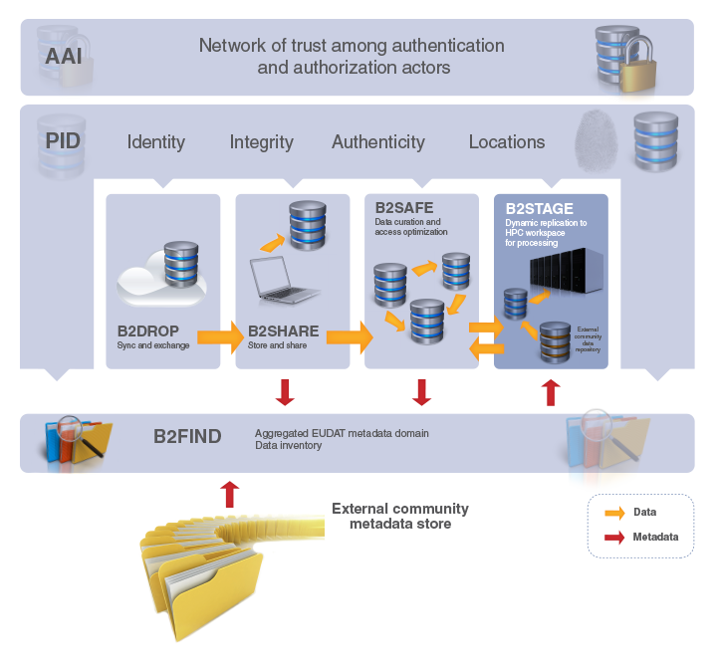
B2STAGE is a reliable, efficient, light-weight and easy-to-use service to transfer research data sets between EUDAT storage resources and high-performance computing (HPC) workspaces.
The service allows users to:
eudat.eu/b2stage
Transfer large data collections from EUDAT storage facilities to external HPC facilities for processing
In conjunction with B2SAFE, replicate community data sets, ingesting them onto EUDAT storage resources for long-term preservation
Ingest computation results into the EUDAT infrastructure
Access data through a RESTful HTTP interface (in progress)

Slide 10
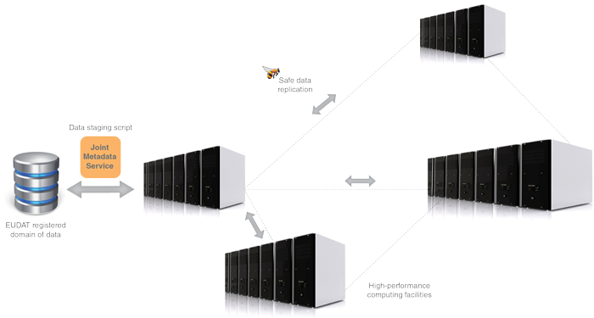
B2STAGE features
an extension of the B2SAFE and B2FIND services, which allow users to store, preserve and find data
data-staging script facilitates staging, ingestion and retrieval of persistent identifier (PID) information of transferred data
service available to all registered researchers and interested communities
eudat.eu/b2stage
users negotiate access to remote HPC services in parallel
collaboration with other infrastructures, such as the European Grid Infrastructure (EGI) and Partnership for Advanced Computing in Europe (PRACE)
documentation, educational material and service helpdesk available to support users

Slide 11
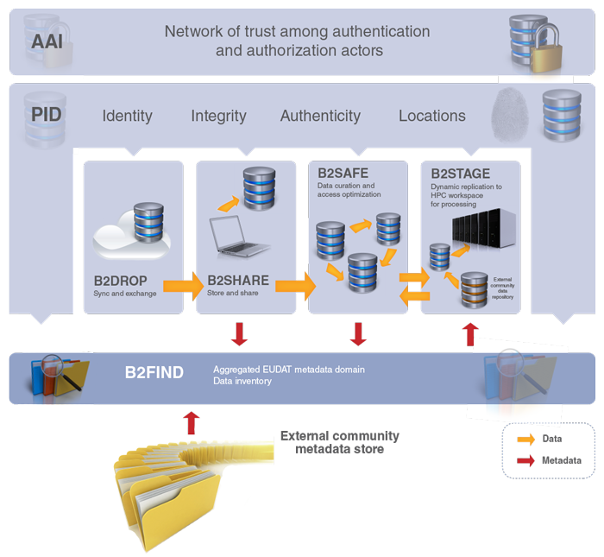
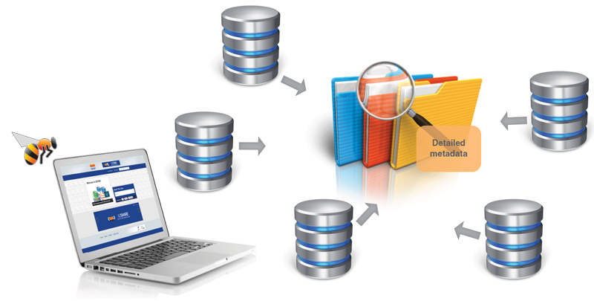
B2FIND is a simple, user-friendly metadata catalogue of research data collections stored in EUDAT data centres and other repositories.
A service which allows users to:
b2find.eudat.eu
Find collections of scientific data quickly and easily, irrespective of their origin, discipline or community
Get quick overviews of available data
Browse through collections using standardized facets

Slide 12
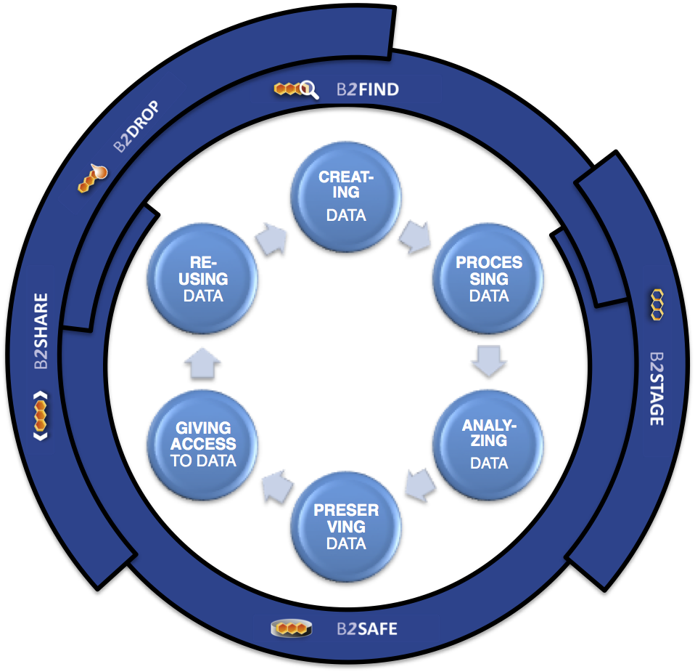
Research Data Life Cycle
Ref: UK Data Archive: http://www.data-archive.ac.uk/create-manage/life-cycle

Slide 13
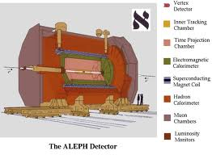
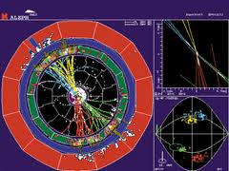
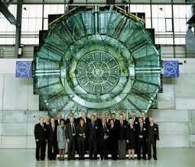
The ALEPH use case
The ALEPH Experiment took data from the CERN e⁺e⁻ collider LEP from 1989 to 2000
Collaboration of ~500 scientists from all over the world
More than 300 papers were published by the ALEPH Collaboration

Slide 14
The ALEPH Picture
HPC
GRID
CLOUD
LOCAL
BATCH
(OPEN?)
Access
Experiment
VM
Digital
Library
(oa reps)
Data
Discovery
Fetch data &
environment
B2STAGE
B2FIND
B2SHARE
Data Infrastructure (Ingestion, PID, Trust, Integrity, Replica, Sharing,…)
Data Curation
Storage
Storage
Bit
Preservation
Knowledge
Preservation
B2SAFE
Network Infrastruture
Disaster
Recovery

Slide 15
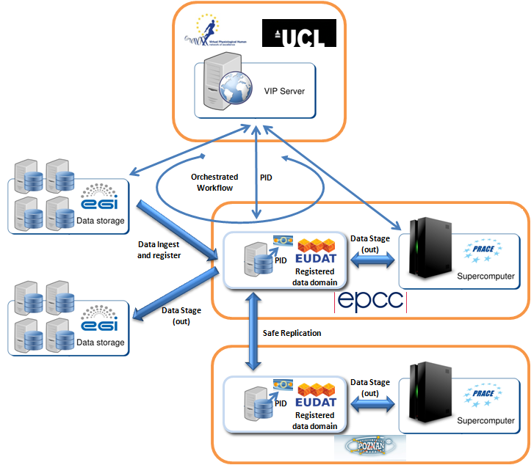
VPH use case

Slide 16
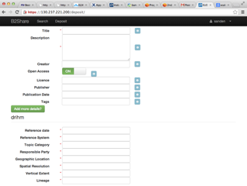
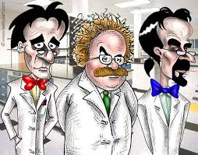
DRIHM Bridge between citizen and community scientists
Community Domain
Specific Metadata
Describe
Citizens
Notes:
DRIHM = Distributed Research Infrastructure for Hydro-Meteorology
Study on natural hazards

Slide 17
EUDAT2020
Further integration of the existing services (B2DROP, B2SHARE, B2SAFE, B2STAGE, B2FIND)
New services for integration with Workflows, Workspaces, Big Data Analytics, Semantic Web
Support more data management policies (e.g. Data Curation and Provenance)

Slide 18
Questions

