Slide 1
Compute and data services in EGI
European Grid Infrastructure
Peter Solagna
Senior Operations Manager peter.solagna@egi.eu

Slide 2
HPC-HTC computing landscape
PRACE (in Europe)
XSEDE (in the US)
Massively parallel (e.g. MPI HPC)
1000+ connected cores
HPC
Massively parallel (e.g. MPI) X times 100s of connected cores
Cluster HTC
EGI
Embarrassingly parallel (HTC) Workflows
Desktop grid
Embarrassingly parallel (HTC)
1000+ individual cores

Slide 3
HTC Compute toolkit
Easy access to shared computing and data services from independent resource providers in a uniform way optimizing usage
Open standard and open source middleware services
Data access based on Virtual Organizations (VO)
Opportunistic usage of unused resources
What do we need to execute computing tasks?
Discovery available resources
Uniform access to heterogeneous clusters
WMSes to target jobs on available resources fulfilling requirements

Slide 4
Computing Element
A CE provides access to the computing resources of a site
Different implementations available in EGI: CREAM, ARC-CE, Unicore/X, Globus GRAM5
Users can submit jobs directly to CE, monitor their status and retrieve outputs
Other CE capabilities
CE publish their capacity and supported Vos in the information system
CEs publish the accounting data into the EGI repository

Slide 5
Workload management services
Workload management service (WMS) acts as brokers for the computing resources
Users submit directly to the WMS their jobs, specifying the requirements
EMI-WMS (the most common WMS in EGI) retrieves from the information system the list of CEs compatible with the job requirements
Jobs are submitted to the CEs that fit with the requirement and with lower workload
Users can monitor their jobs and retrieve the outputs directly through the WMS
WMS can submit to CREAM, ARC-CE and GRAM5

Slide 6
In other words..
Top-BDII
CE
CE
CE
CE

Slide 7
In other words..
Top-BDII
CE
CE
CE
WMS/Science Gateway
CE

Slide 8
The storage toolkit
What do we need in storage?
Storage endpoints
File transfer services
Meta data and location catalogues
Storage Access Federations
All based on
GridFTP for wide area
NFS (4.1 / pNFS) for local access
Http/WebDAV for Web access
SRM/CDMI for storage management

Slide 9
The storage endpoints
Storage
Management
Wide Area Access
High Performance Random Access
Accounting
SRM/CDMI
WebDAV
GridFTP
NFS 4.1 / pNFS
StAR
Standard Abstraction Layer
DPM
GPFS
Lustre
StoRM
dCache
SSD
Spinning
Disks
TSM,HPSS Enstore, DMF, ***
TSM
HPSS
Tape

Slide 10
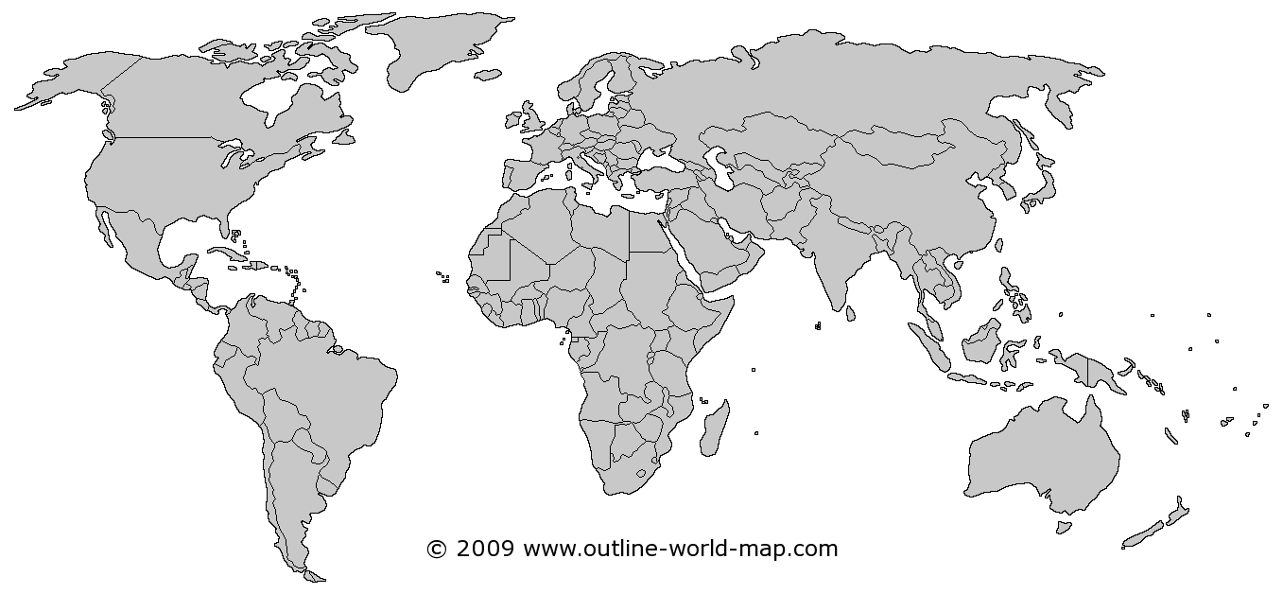
File transfer service
FERMILab
LYON
FTS3
Sydney

Slide 11
Location and Metadata Catalogues
FERMILab
LYON
Taipei
LFC
Logical FN
UUID
Location I
Location II
Sydney

Slide 12
Dynamic federation
Based on http/WebDAV
FERMILab
LYON
Taipei
Dynamic
Federator
Sydney

Slide 13
Thanks!
Questions?
Slides ©: Peter Solagna (EGI.eu), Gergely Sypos (EGI.eu), Patrick Fuhrmann (Desy)

