Slide 1


Slide 2
Computing and Data: Pan-European High Performance Computing Infrastructure and Services
Alison Kennedy, Member of the Board of Directors of PRACE aisbl (and Executive Director of EPCC, University of Edinburgh)
January 23, 2014

Slide 3
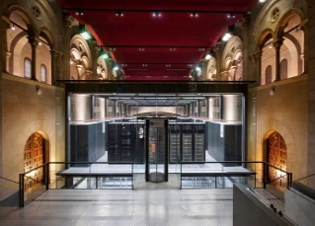




PRACE’s awards in 4 years
346 projects and 9.2 thousand million core-hours awarded
MareNostrum: IBM
BSC, Barcelona, Spain
JUQUEEN: IBM BlueGene/Q
GAUSS/FZJ
Jülich, Germany
SuperMUC: IBM
GAUSS/LRZ Garching, Germany
CURIE: Bull Bullx
GENCI/CEA
Bruyères-le-Châtel, France
HORNET: Cray
GAUSS/HLRS,
Stuttgart, Germany
FERMI: IBM BlueGene/Q
CINECA , Bologna, Italy
Notes:
PRACE’s Achievements in 4 years:
6 supercomputers in 4 hosting countries, 346 projects and a total of 9.2 thousand million core-hours awarded!
PRACE also attracts, trains and retains skilled staff.
Over 360 PATC training days, 2730 participants and 170 enabled applications are the result of this work.

Slide 4




Scientific achievements: example
Academia
FACING THE TEMPEST
A three-year advance in developing new models
IMAGING A WHOLE SEISMIC AREA
1st numerical mapping of the North of Italy
→ Possibility for the UK Meteorology Office to develop worldwide high-resolution climate models (12 km)
Largest allocation ever made on a single PRACE system
UPSCALE Project
Focused on tropical Atlantic storms
→ Estimate the effects of major earthquakes
according to local geological structures,
thus providing better foundations for
decision-making processes
SHAKEIT Project
North of Italy = most active seismic area in Europe
144 million core hours
on Hermit (Germany)
Team: Prof. Pier Luigi Vidale (NCAS-Climate, Dept of Meteorology, Univ. of Reading and UK Met Office, Exeter, UK)
53,4 million core hours
on SuperMUC (Germany)
Team: Dr. Andrea Morelli – Instituto Nazionale di Geofisica e Vulcanologia, Italy
4

Slide 5
Scientific Steering Committee (SSC)
It is composed of European leading researchers that are responsible for advice and guidance on all matters of a scientific and technical nature which may influence the scientific work carried out by the use of the Association’s resources.
The SSC includes scientists from diverse areas:
materials science, universe sciences, environmental science,
particle physics, computational earth sciences, life sciences,
plasma physics, computational physics, mathematics,
astrophysics, chemistry and engineering
Sylvie Joussaume (Climatologist, IPSL) is the new SSC chairperson.

Slide 6
PRACE User Forum
The User Forum was set up in December 2011 through an initiative of PRACE itself.
It is an independent entity where PRACE users can discuss their experiences and express their future needs as well as feedback on the current services and resources of the PRACE HPC Research Infrastructure. The aim is to provide an effective mechanism through which the Tier-0 user community can give feedback to PRACE.
The PRACE User Forum takes the outcomes of these discussions to PRACE on behalf of the User Community – workflows, computational steering etc.

Slide 7
HPC and Data
Current PRACE users are computational scientists/computer modellers
Typically output data is generated BY the PRACE project and is moved elsewhere for analysis.
The typical national HPC service has a large research data facility co-located with it (primarily for long term storage)
Evolution of PRACE calls: Ensemble modelling projects now eligible for PRACE; longer term access offered (up to three years) for eligible projects
Allocation of compute and data resources in one call is the next development to be piloted

Slide 8
PRACE Call for Data Pilot Projects– with EUDAT and EU-T0 confirmed as partners
Call to be issued in February 2015
PRACE is opening a pilot call for projects which have storage and HPC data
storage/services needs. Will be selected via PRACE scientific peer review.
Aim – to explore new models of resource provision and deployment.
Looking for projects from the Earth Sciences and Universe Sciences domains
EUDAT - coupling EUDAT storage capacity and services to PRACE HPC resources.
EU-T0 - reinforcing the links between HPC and HTC at the service of science.
Discussions on-going with other eInfrastructures

Slide 9
Possible PRACE/EUDAT/EGI collaboration
Organize Joint Calls for Accessing PRACE and EUDAT and/or EGI resources
  User applying at the same time for computing and storage resources (pilot call planned)
  Opportunity to assess service interoperability
2. Harmonization of User Support ?
  Some users have access to PRACE HPC systems and EUDAT services.
  PRACE and EUDAT are using the same technology to provide this service
Harmonization of AAI
  Users of PRACE and EUDAT resources (could) have a single identity that is usable on both infrastructures.
Facilitate awareness and access for communities

Slide 10
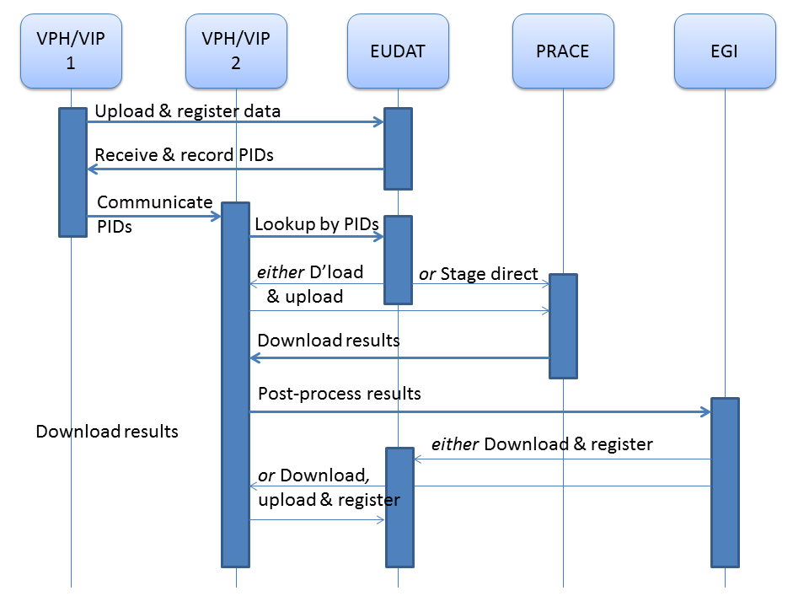
VPH Cross-Infrastructure Pilot (2013) (an EUDAT community)

Slide 11

