Slide 1
EGI for earth science
Tiziana Ferrari
Technical Director, EGI.eu
e-Infrastructures for Earth Sciences - workshop
Amsterdam, 22-23 January 2015

Slide 2
EGI Vision:
Open Science Commons
Researchers from all disciplines have easy and open access to the innovative digital services, data, knowledge and expertise they need for performing collaborative excellent research
Digital services
Data
Knowledge & Expertise
http://go.egi.eu/osc

Slide 3



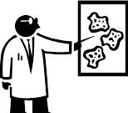
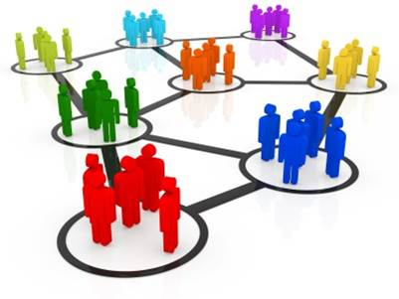


Services for long tail and big science
EGI Solutions
http://www.egi.eu/solutions/
Individual Researchers
& Teams
Federated Operations
High-Throughput Data Analysis
Federated Cloud
Community Driven Innovation & Support
International Research Communities
& Institutions
Individual resource Centres & national e-Infrastructures

Slide 4
High-Throughput Data Analysis
Do you need to manage and analyse large datasets, or to execute thousands of computational tasks?
European federation of publicly-funded clusters
for High-Throughput Computing (HTC)
Grid Compute: run large-scale computational jobs
Grid Storage: store/access/retrieve files
File Transfer: file data movement service
File Metadata Catalogue: metadata catalogue service
Federated Cloud
Community Driven Innovation & Support
High-Throughput Data Analysis
Federated Operations
Based on open standards and open source software
Integrate heterogeneous infrastructure/technologies
Added Value
Uniform access to distributed computing capabilities to run large-scale computational jobs processing big data and preventing single vendor lock-in‏
  Possibility to federate your own resources
  Facilitate collaboration across communities and borders by sharing compute and data

Slide 5
Federated Cloud
Do you need an infrastructure to deploy on-demand IT services for managing and processing your research data?
Federated Cloud
Community Driven Innovation & Support
High-Throughput Data Analysis
Federated Operations
European federation of publicly-funded community clouds
Cloud Compute: deploy/manage virtual machines (VM)
Cloud Storage: store/access/retrieve digital objects
Virtual Appliance Marketplace: marketplace for application developers and users
Based on open standards and open source software
Integrate heterogeneous cloud technologies
OpenStack, OpenNebula, CloudStack,…
Integrate with commercial providers*
  Within EGI or through the Helix Nebula Marketplace
Added Value
  Promotion of open cloud standards for uniform access, no lock-in and on-demand scale out capabilities
  Easy deployment of own/customised services clouds
  Efficiency by co-locating big data + cloud computing

Slide 6
Federated Operations
Do you need operational services and tools to run a distributed IT infrastructure for research?
Technologies, processes and expertise:
To manage operations of heterogeneous distributed infrastructures
To integrate resources from multiple independent providers with lightweight central coordination
Federated Cloud
Community Driven Innovation & Support
High-Throughput Data Analysis
Federated Operations
Relies on the best practices for IT service management (FitSM)
  Operations, Technology, and Security Coordination
  Helpdesk support
  Governance & Project specialised consultancy services
  Technical consultancy and support
  Distributed service registry, accounting, monitoring,
Added Value
  A cost-efficient framework to manage operations within a federated environment, while retaining responsibility of local infrastructure.
  Allows efficient implementation of Best Management Practices for IT services

Slide 7
Community-Driven Innovation
& Support
Do you want to discover and implement the best approach to your data-intensive compute needs?
Federated Cloud
Community Driven Innovation &Support
High-Throughput Data Analysis
Federated Operations
Expert assistance for easy and seamless integration and access to the computing and data services
  European Distributed Competence Centres
  Leveraging expertise of user communities and technology providers
  Partnership with National Grid Initiatives and external competence centres
Support at both national and EU level
Added Value
Avoid duplication of solutions
Leverage expertise from the community
Facilitate collaboration across communities and borders‏
  User-driven innovation

Slide 8
Principles of the federation
Uniform, secure access to multi-disciplinary heterogeneous data management and compute services and capacity provisioning
Federation services of e-Infrastructure services from
  Publicly-funded infrastructures
  Commercial providers
    → Partnership with Helix Nebula
    Free at point of delivery or pay per use
Federation of community-specific services

Slide 9
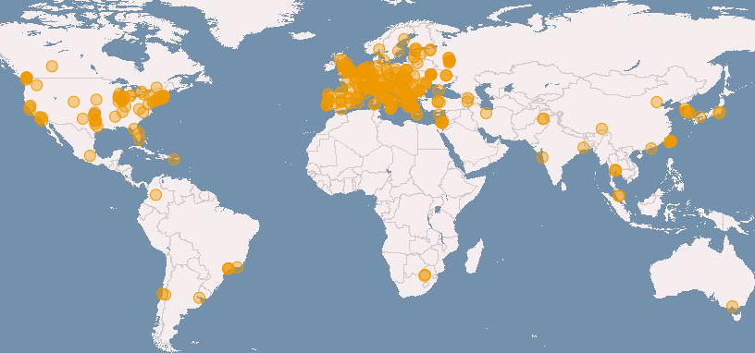
HTP Platform
Distributed and federated data
and computing facilities
HTC and Cloud compute platform
340 data centres in 34 National Grid Initiatives/EIROs
Partnerships with non-EU infrastructures
> 200 International Research Communities
Domains-specific Software & Tools
The HTC federation in numbers:
525,000 cores, 1.5 M jobs/day
300 PB disk capacity
200 PB tape capacity

Slide 10
Federated Cloud Platform
Launch: May 2014
19 cloud providers from 12 countries
  Czech Republic, Germany, Greece, Hungary, Italy, Macedonia, Poland, Slovakia, Spain, Sweden, Turkey, United Kingdom
  Publicly funded and commercial
4 countries currently integrating
  France, Finland, Portugal, South Korea
  Coming: Canada (CANFAR), D4SCIENCE
Worldwide interest
  South Africa (SAGrid)
  United States* (NIST, NSF Centres)
  Australia* (NeCTAR)
* Not shown on map

Slide 11
Resource usage (2008-2014)
  of which 1,000 Million CPU hours for Atmospheric sciences, Biodiversity conservation, Climate research, Earth Sciences, Ecology, Environmental engineering, Geophysics, Hydrology, Space Science

Slide 12
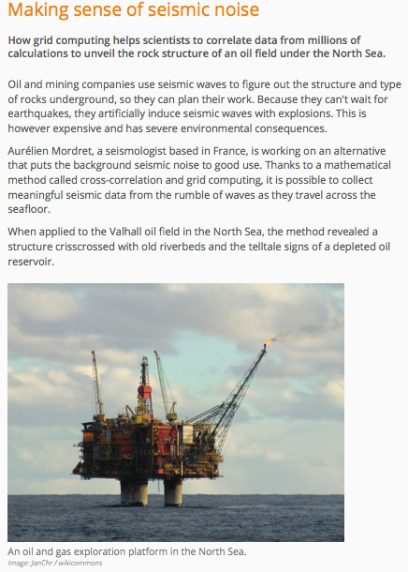
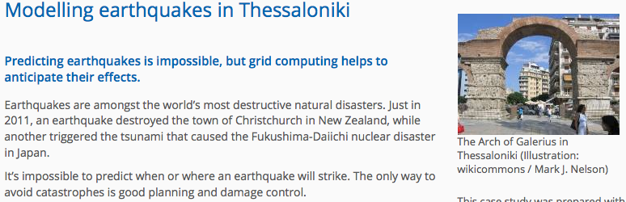
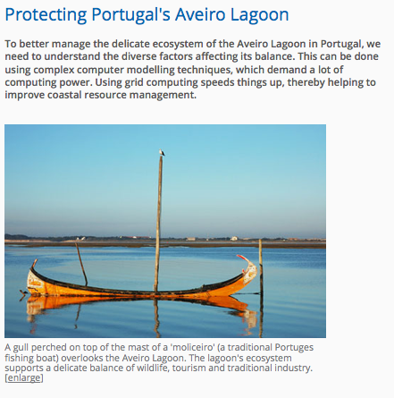
EGI for earth science: the case studies
http://www.egi.eu/case-studies/index.html

Slide 13
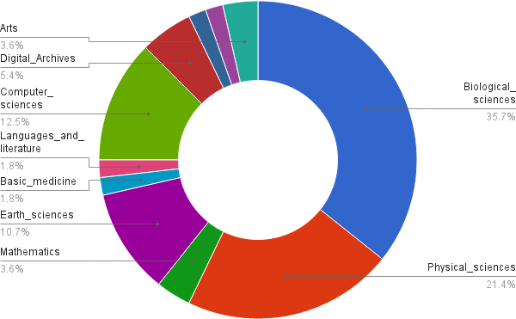
Cloud Use Cases Discipline Classification (2° tier)

Slide 14
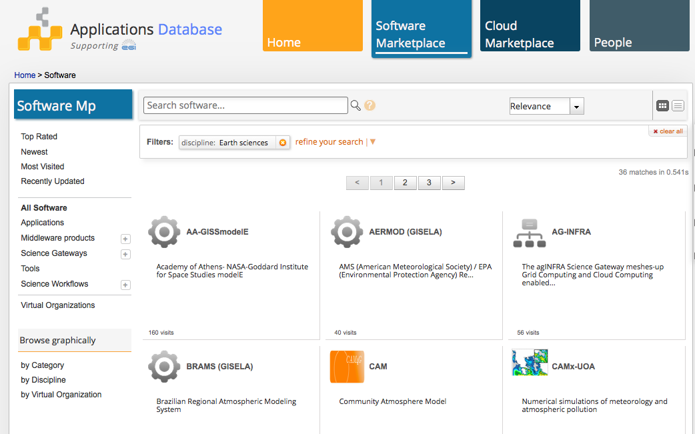
Application Database
Build communities for scientific codes for sharing and reuse of applications and science workflows: 36 for earth science http://go.egi.eu/AppDB-earthscience

Slide 15
Collaborations
DRIHM and VERCE
  E.g. Running various hydrological models in the EGI Federated Cloud
EPOS Competence Centre
  Design of the use of grid and cloud for the integrated solid Earth Sciences research as part of the European Plate Observing System
    Identify and validate authentication and authorisation services for EPOS
    Test cloud resources and usage models
      compute/data resources for applications
      hosting services
    Science gateway (no specific platform yet)
  EGI/EUDAT service interoperability use cases
ESA: e-Collaboration for Earth Observation (e-CEO) platform
  support online contexts where researchers can work collaboratively and compare and evaluation different problem-solving approaches
Centre of Excellence for environmental sciences – HTC/HPC/Cloud (EINFRA-5 project proposal EnCompAS)

