Slide 1
Earth Sciences workshop: GÉANT services 22-23 January 2015
Roberto Sabatino

Slide 2
GÉANT Network

Slide 3
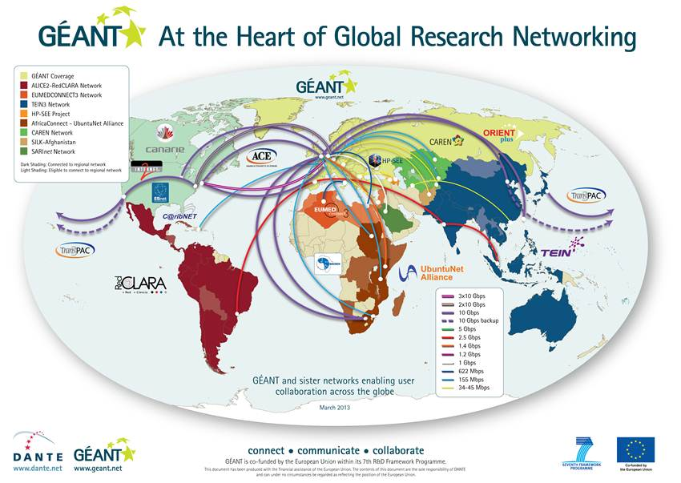
Global Connectivity

Slide 4
Connectivity Services
IP connectivity for NRENs: IP access up to 100Gbps
Point to point circuits (between end sites):
Virtual circuits (L2 VPNS) up to 10Gbps
10Gbps, 100Gbps
VPNs

Slide 5
eduGAIN Authentication & Authorisation World-wide
eduGAIN is an interfederation service that connects national higher education & research identity federations world-wide
can be joined only via existing federations, typically a national identity federation (e.g. SURFconext in the Netherlands, DFN-AAI in Germany, ...)
Identity information comes in form of user attributes (ID, name, mail, affiliation, ...)
User attributes can be used to identify and authorise users on a service
Users can use their institutional login to access federated web services:
within their own organisation
within the same country via the national federation
world-wide via eduGAIN
GÉANT provides assistance to research communities to get their services eduGAIN-enabled.
GÉANT Enabling Users task (talk to Lukas Hämmerle)

Slide 6
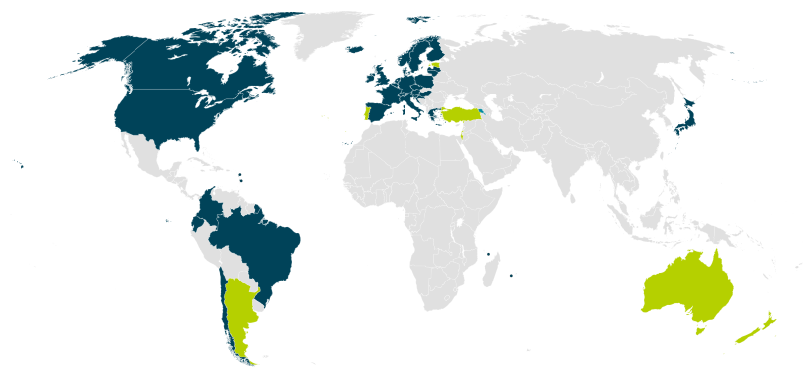
eduGAIN (National) Member Federations
30 eduGAIN Members
6 Joining eduGAIN
3 Candidate Federations
Source: http://edugain.org/technical/status.php (Nov. 2014)
1173 Identity Providers (19.1.2015)
1129 Service Providers (19.1.2015)

Slide 7
Collaboration on Cloud Services
Technical and organisational baseline and joint approach
Definition of suitable standards and requirements
Cloud strategy guide
Provide services to users (choice and safe to use)
Community cloud, MAKE develop, integrate and offer services together
Public cloud, BUY brokerage and procurement: buy, connect and distribute services together
Online service catalogue lists the capabilities of suppliers and allow users to choose the ones they wish to contract with

Slide 8
One stop shop user support: What landscape do (we think) users see ?
Imagine two collaborators in two different countries
Different services, with different T&Cs , in different countries
Which services are available to them end to end ?
What are the business models along the delivery chain ?
Who pays what to whom?
Now imagine having 10 users in 10 countries…
How do users work their way through the labyrinth ?

Slide 9
GEANT user liaison function: making it happen
Co-ordination functions towards the users:
International projects or collaborations
Discuss and understand user requirements
Co-ordinate the formulation of solutions for the user
Technical, organisational, financial
Be “the voice of the customer/user” within GÉANT
Works in tight co-operation with NRENs

Slide 10
Success stories
PRACE network infrastructure
E-VLBI
LHC
Various ESA projects
CONFINE
Belle-II
EU agencies
SMARTFire
SKA
…..many more…

