Slide 1
European Research Data Services, Expertise & Technology Solutions
www.eudat.eu
European Data Infrastructure

Slide 2
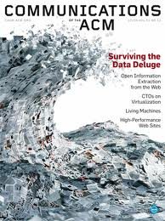
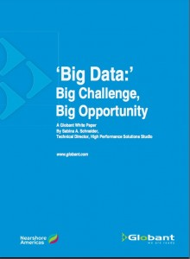
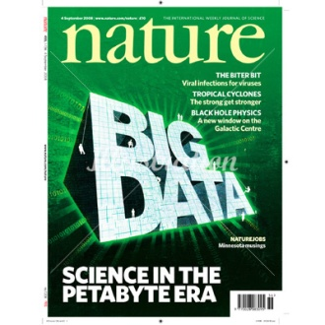
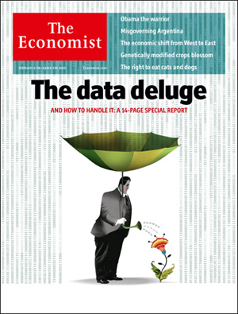
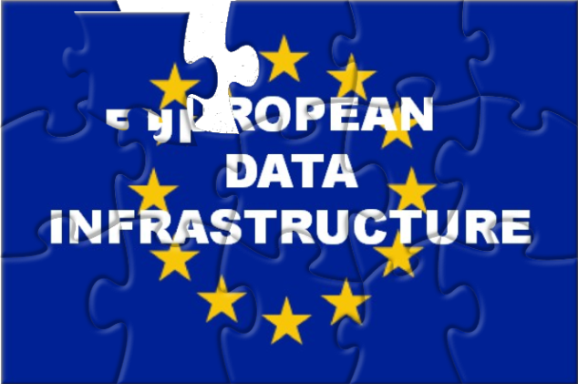
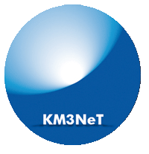
Managing the rising tide of scientific data
Zettabytes
Exabytes
Exponential growth
Petabytes
Where to store it?
How to find it?
How to make the most of it?
Terabytes
Gigabytes
Increasing complexity and variety
www.eudat.eu

Slide 3
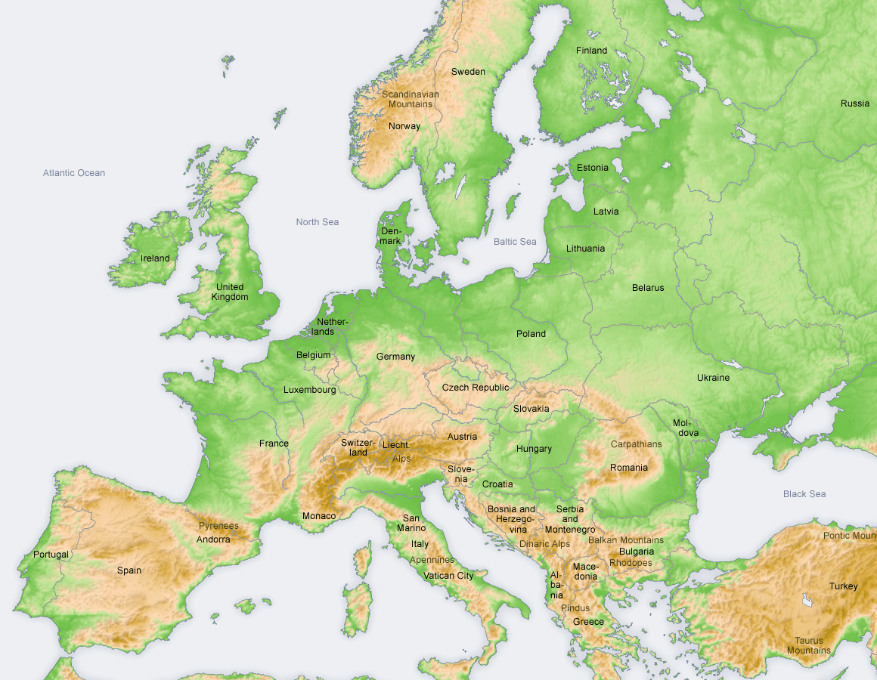
EUDAT is …
a pan-European initiative building a sustainable cross-disciplinary and cross-national data infrastructure providing a set of shared services for accessing and preserving research data
supporting multiple research communities by working closely with them to deliver these technical services as part of the EUDAT Collaborative Data Infrastructure (CDI)
www.eudat.eu

Slide 4
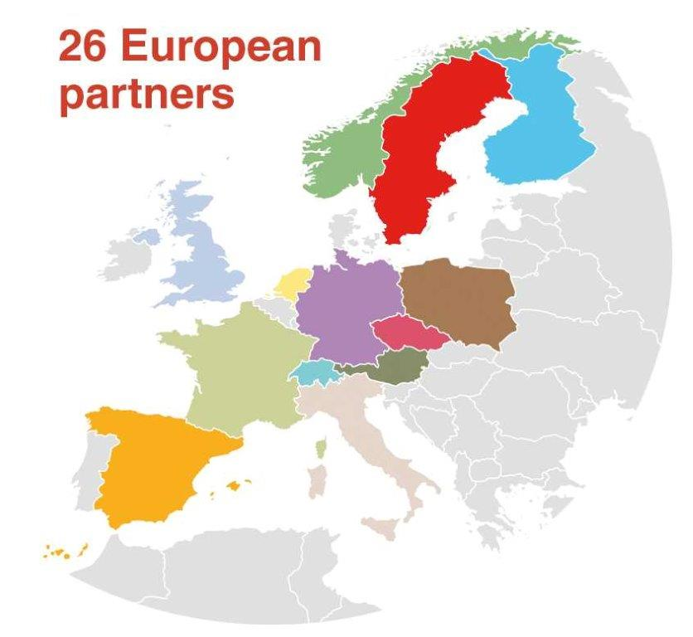
Who is behind EUDAT?
Research Communities
National Data centres
Technology providers

Slide 5
Research communities involved
EPOS: European Plate Observatory System
CLARIN: Common Language Resources and Technology Infrastructure
ENES: Service for Climate Modelling in Europe
LifeWatch: Biodiversity Data and Observatories
VPH: The Virtual Physiological Human
INCF: International Neuroinformatics Coordinating Facility
www.eudat.eu
Notes:
Project partners represent the data scientists in these consortia. EPOS – data and observatories for earthquakes, volcanoes, tectonics – based on sensor data. CLARIN – making language resources and technology usable ENES – simulations of the climate system using HPC Lifewatch – biodiversity research VPH – biomedical modelling and simulation of the human body

Slide 6
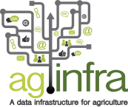
Increasing community involvement + 25 communities
through
Dialogue
User Forums
Open Call for Collaboration

Slide 7
A Network of Trusted Centers
Strong and sustainable generic data centers with existing trusted relationships
Each having specific relationship with research communities
EUDAT is about providing solutions in a federated environment
Generic data
centres
Community
data sites

Slide 8
Infrastructure Pillars
Easy to Use
Services adaptive to communities environments
Open to everyone
User-Driven
Multidisciplinary services
Designed for and by the communities
Sustainable
Funding models
Tools and clear policies to facilitate usage
Partnerships with other national and European infrastructures
Meeting real communities needs
Relying on national centers

Slide 9
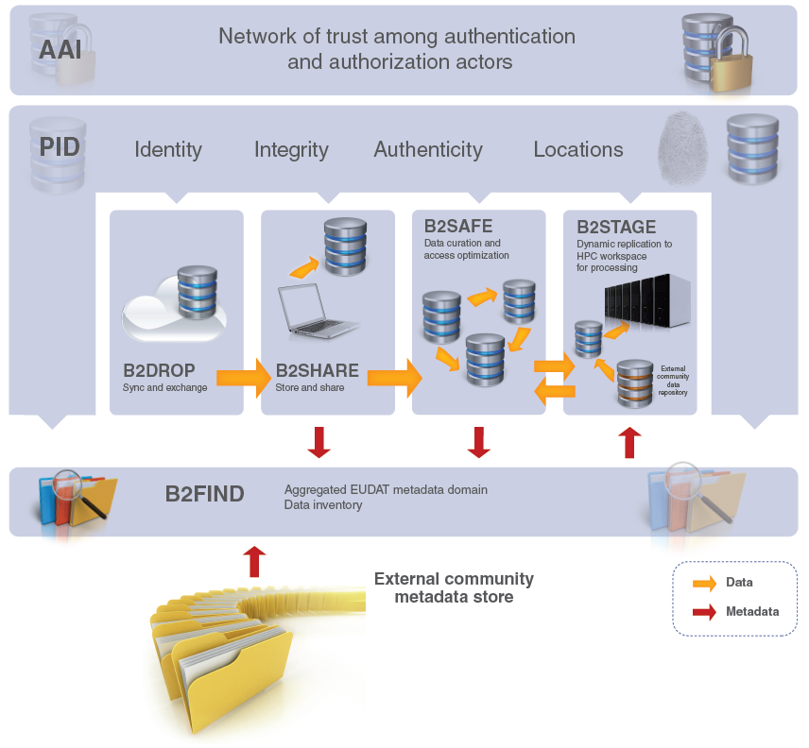
First EUDAT Services

Slide 10
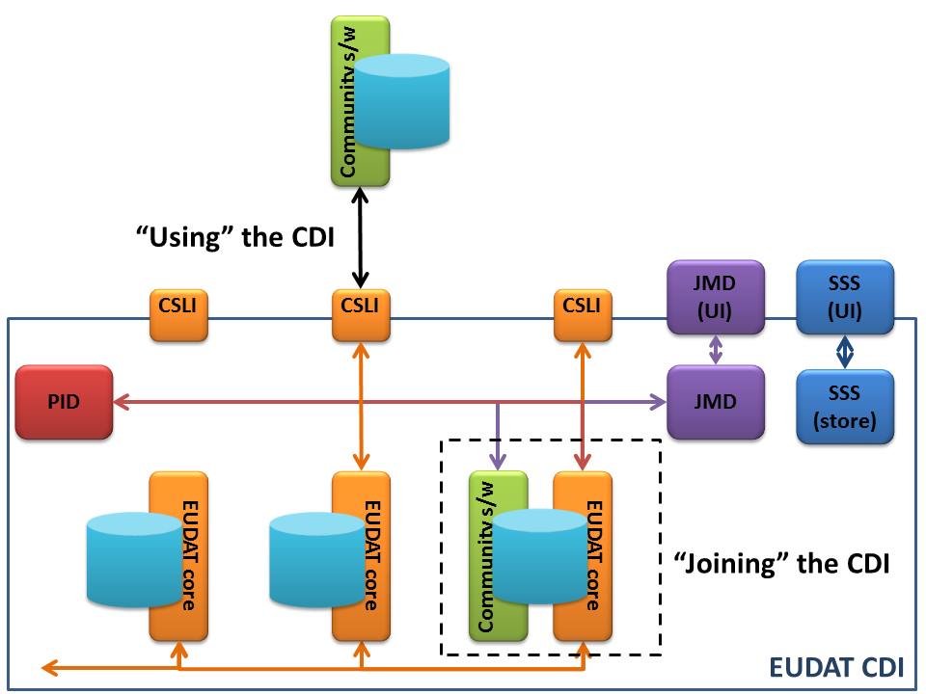
Using versus Joining EUDAT CDI

Slide 11
EUDAT H2020
Proposal accepted by the EC
Preliminary start date is March 1st, 2015
Continue and extend work
On existing services: B2SAFE, B2STAGE, B2FIND, B2SHARE, B2DROP
On new services: workflow integration, workspaces, integration with Big Data analytics
On new policies for Data Curation and Provenance
Further development of the CDI and the integration of the services
Continue collaboration and engagement with Communities
via User Forums, Call for Collaborations and working groups
Joint calls and pilots with PRACE and EGI

Slide 12
Contact Us:

