Slide 2
Intro to PRACE: Pan-European High Performance Computing Infrastructure and Services Alison Kennedy, Member of the Board of Directors of PRACE aisbl and Executive Director of EPCC, University of Edinburgh January 22, 2014

Slide 3
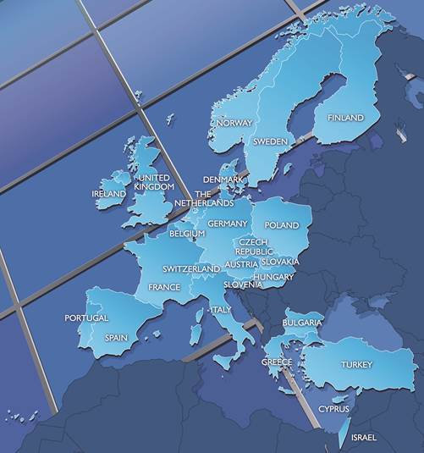
PRACE aisbl, a persistent pan-European supercomputing infrastructure
25 members
4 hosting members: France, Germany, Italy and Spain
Enables world-class science through large scale simulations
Offers HPC services on
leading edge capability systems
Awards its resources through a single and fair pan-European peer review process for open research
Notes:
PRACE (Partnership for Advanced Computing in Europe) is a persistent pan-European supercomputing infrastructure with 25 member countries.
The Mission of PRACE is to enable world-class science through large scale simulations by providing HPC services on leading edge capability systems enable to enhance European competitiveness for the benefit of society.
Preparatory Access : preparation of proposals for Project Access, accepted at any time, cut-off date every 3 months.
Project Access: used by individual researchers and research groups including multi-national research groups, 1 year duration.
Multi-year Access: for major European projects
PRACE peer review process: evaluation of the proposals by leading scientists based on scientific excellence. PRACE leads the integration of a highly effective HPC ecosystem and offers its resources through a single and transparent pan-European peer review process to academia and industry.

Slide 4
PRACE implements a persistent pan-European HPC service portfolio
European researchers access highest capability computers and PRACE supports up-scaling of codes
PRACE trains HPC professionals

Slide 5
PRACE at a glance, HPC services in Europe
530 M€ of funding for the 2010-2015 period
25 member states, including 4 Hosting Members (France, Germany, Italy, Spain)
346 scientific projects enabled
>9 billion core hours awarded since 2010 with peer review , scientific excellence as the main criteria
15 Pflop/s of peak performance on 6 world-class systems
Open R&D access for industrial users
≈3000 people trained by 6 PRACE Advanced Training centers and others events

Slide 6
Project Access
Open Call
for
Proposals
Technical
Peer Review
Scientific
Peer Review
Right to reply
Priorisation
+
Ressouce
Allocation
Project
+
Final
Report
~ 2 Months
~ 3 Months
~ 1 year
Technical experts in PRACE systems and software
Researchers with expertise in scientific
field of proposal
Access Committee
Researcher
6
6
Notes:
6

Slide 7
DECI – now to be run by a PRACE aisbl “Optional Programme”
Operates as a resource exchange programme between national Tier-1 providers who can opt in or out of each call (typically 5-10% of national cycles)
Proposals peer-reviewed nationally then assigned to suitable architectures
Fraction of resources made available to PIs of proposals from countries not participating in the optional programme
Cross-national applications encouraged
Complementary “Tier-1 for Tier-0” services funded from PRACE 4IP project

Slide 8
Scientific achievements: example
Academia
FACING THE TEMPEST
A three-year advance in developing new models
IMAGING A WHOLE SEISMIC AREA
1st numerical mapping of the North of Italy
→ Possibility for the UK Meteorology Office to develop worldwide high-resolution climate models (12 km)
Largest allocation ever made on a single PRACE system
UPSCALE Project
Focused on tropical Atlantic storms
→ Estimate the effects of major earthquakes
according to local geological structures,
thus providing better foundations for
decision-making processes
SHAKEIT Project
North of Italy = most active seismic area in Europe
144 million core hours
on Hermit (Germany)
Team: Prof. Pier Luigi Vidale (NCAS-Climate, Dept of Meteorology, Univ. of Reading and UK Met Office, Exeter, UK)
53,4 million core hours on SuperMUC (Germany)
Team: Dr. Andrea Morelli – Instituto Nazionale di Geofisica e Vulcanologia, Italy
8

Slide 9
PRACE Service Catalogue Three categories of services (by availability not service level): Core (all PRACE Tier 0 and Tier 1 sites) - e.g. GridFTP ( for Tier 1, where the PRACE dedicated network is available), LDAP (user administration) Additional (may be limits caused by technical, legal, financial or policy limitations) e.g. - UNICORE Optional (case by case basis) – e.g. MC-GPFS, Gtransfer (depends on GridFTP)
Notes:
Examples come from the category Data Transfer, Storing and Sharing and Authorisation

Slide 10
HPC and Data
Current PRACE users are computational scientists/computer modellers
Typically output data is generated BY the PRACE project and is moved elsewhere for analysis.
The typical national HPC service has a large research data facility co-located with it (primarily for long term storage)
To date, it has not been customary to request a PRACE allocation for large scale data analysis but we foresee this change: Very large HPC facilities as a tool for data generation AND for data analysis – requests coming from different communities or from different groups within the same community

