Slide 1
Daniele Bailo and the EPOS Consortium
EPOS
European Plate Observing System
Notes:
EPOS is the ESFRI RI for Solid Earth Science.
It participates in ENVRI and COOPEUS

Slide 2
What’s EPOS

Slide 3
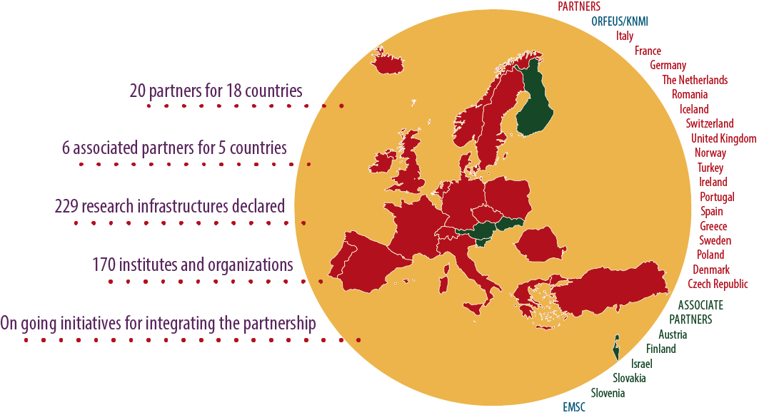
A Plan for solid Earth Science
The European Plate Observing System (EPOS):
scientific vision and approach in which innovative multidisciplinary research is made possible for a better understanding of the Solid Earth Science processes
long-term plan to facilitate integrated use of data, models and facilities from distributed and new research infrastructures
Partnership
Notes:
One of the first result of the interaction between the EPOS PP Management and the Advisory Board has been the definition of a roadmap starting from the EPOS Mission.

Slide 4
Solid Earth Science
Different communities involved
Multidisciplinary contributions
Community building
Services to society
Geo-Hazards
Geo-Resources
Environmental hazards (including anthropogenic hazard)
Notes:
DESCRIBE SOLID EARTH, SPECIFYING THAT:
WE STUDY THE WHOLE SOLID COMPONENT OF OUR PLANET (FROM THE INNER CORE TO THE SURFACE)
WE STUDY PROCESSESS EVOLVING IN VERY DIFFERENT TIME SCALES (from μιχρο−seconds to thousands years)
- WE STUDY PROCESSESS EVOLVING IN VERY DIFFERENT SPATIAL SCALES (from ΝΑΝΟΜΕΤΕΡΣ ΤΟ ΤΗΟΥΣΑΝΔΣ ΚΜ)

Slide 5
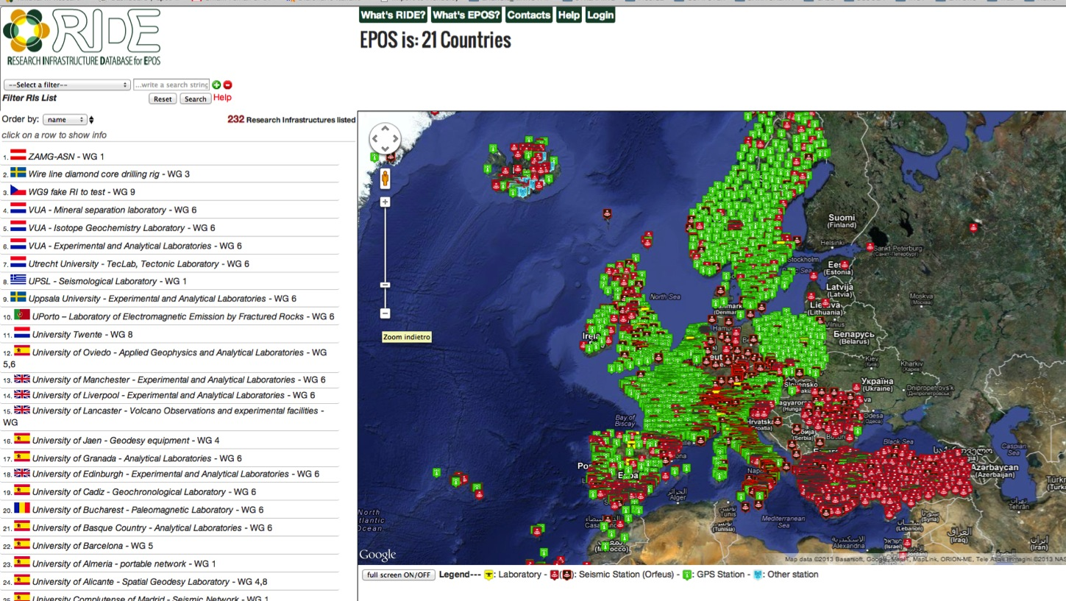
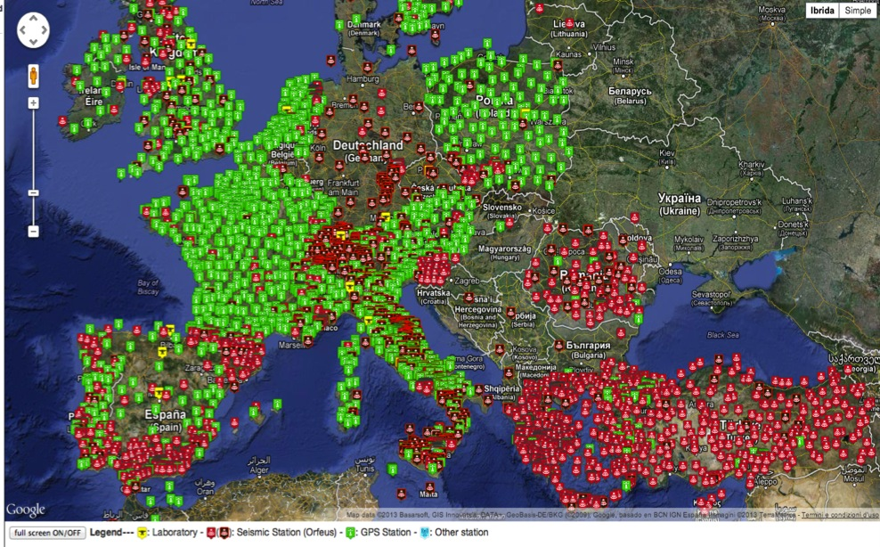
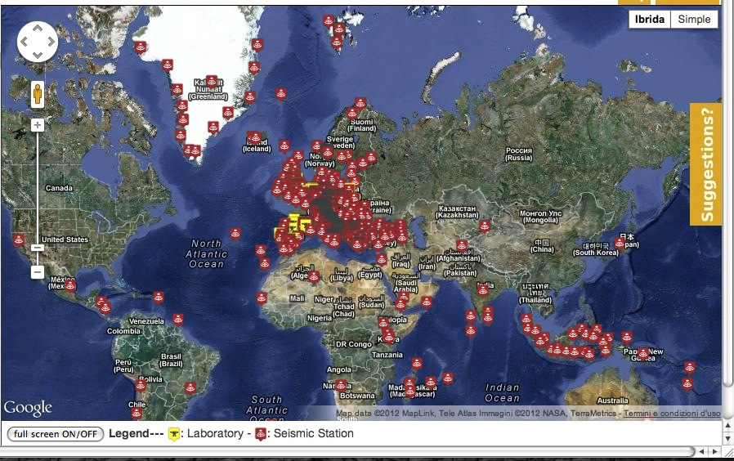
“Numbers” of solid earth science
MAP OF:
- Seismic/GPS stations
Laboratories
- etc….
Diversity in data type and formats
http://www.epos-eu.org/ride/
Research Infrastructure
LIst
244 Research Infrastructures
138 Institutions
22 countries
2272 GPS receivers
4939 seismic stations
464 TB Seismic data
1.095 PB Storage capacity (seismology)
1.240 PB Storage capacity (GNSS DC)
828 instruments in 118 Laboratories

Slide 6
EPOS Framework
Seismological Observatories & Research Infrastructures
Volcano Observations
Geological and Surface Dynamics data
Geodetic data
Other Geosciences data (OBS, Gravity data)
ICT & e-RI Facilities
Analytical and Experimental Laboratories
ICT & e-RI Facilities
Satellite Information data
Geomagnetic Observatories
Infrastructures for Geo-Resources
Notes:
EPOS strongly promotes a community building action. These are the communities
(Describe each layer, INFO about projects contributing at each layer. )
ICT perpendicular to others, because it integrates the different layers.
Also, many projects belong to EPOS constellation.
#Here we focus on the EPOS topics, WORKING GROUPS and the COMMUNITY BUILDING ACTION

Slide 7
Purpose & Challenges

Slide 8
EPOS Purpose
keywords: multidisciplinary, integrated, holistic, comprehensive, efficient, e-Science
This is not just a portal to domain specific (thematic) datasets for download – it is this plus much more
It’s easy and it has everything you need
Overcoming the complexity

Slide 9
Dealing with complexity of users
where does the user go
Too many offerings
User role – can be dynamic
Am I a data provider? A data consumer?
Am I a service provider/manager?
User role authorities and responsibilities
Am I allowed to access software services?
Am I allowed to access laboratory services?
Am I allowed to access computing / detector services?
User role preferences
Device: mobile? Laptop?...
Modality: keyboard/mouse / gesture/ speech…
Simple – one stop shop
Rights
Costs

Slide 10
Dealing with the complexity of usage
Ownership and IP (data, software, publications)
Permissions to use (data, software, facilities/equipment including computing)
Conditions of use: (by class of user) (licence) acknowledgement, citation, payment
Conditions of use: (by class of user) (licence) constraints on further actions

Slide 11
Architecture

Slide 12
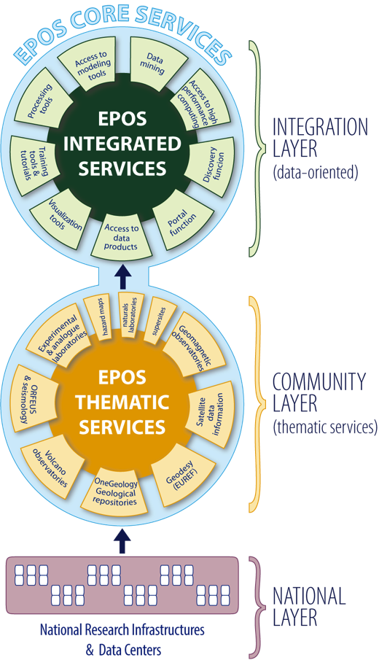
EPOS SERVICES
The EPOS Integrated Core Services will provide access to multidisciplinary data, data products, synthetic data from simulations, processing and visualization tools, .... Not just data access but EPOS means to integrate, analyze, compare, interpret and present data and information about Solid Earth
Thematic Core Services are infrastructures to provide data services to specific communities (they can be international organizations, such as ORFEUS for seismology)
National Research Infrastructures and facilities provide services at national level and send data to the European thematic data infrastructures.
Notes:
FROM THE BOTTOM:
3. National RI, alrady operational, provide services at national level. Some of them send already data to european organization
2. We want to promote a community buliding action to move from this scattered set of Ris to THEMATIC CORE SERVICES, i.e. RI to provide data to specific communities (geodesy, seismology) . They’ll EUROPEAN disciplinary integrated nodes
1. Integration layer, the EPOS infrastructure which will be able to integrate all the data from different THEMATIC. Access … (leggi slide)

Slide 13
Compatibility layer
ICS/TCS comunication
Metadata catalogue+APIs
Web Services
COMPATIBILITY LAYER
Notes:
FROM THE BOTTOM:
3. National RI, alrady operational, provide services at national level. Some of them send already data to european organization
2. We want to promote a community buliding action to move from this scattered set of Ris to THEMATIC CORE SERVICES, i.e. RI to provide data to specific communities (geodesy, seismology) . They’ll EUROPEAN disciplinary integrated nodes
1. Integration layer, the EPOS infrastructure which will be able to integrate all the data from different THEMATIC. Access … (leggi slide)

Slide 14
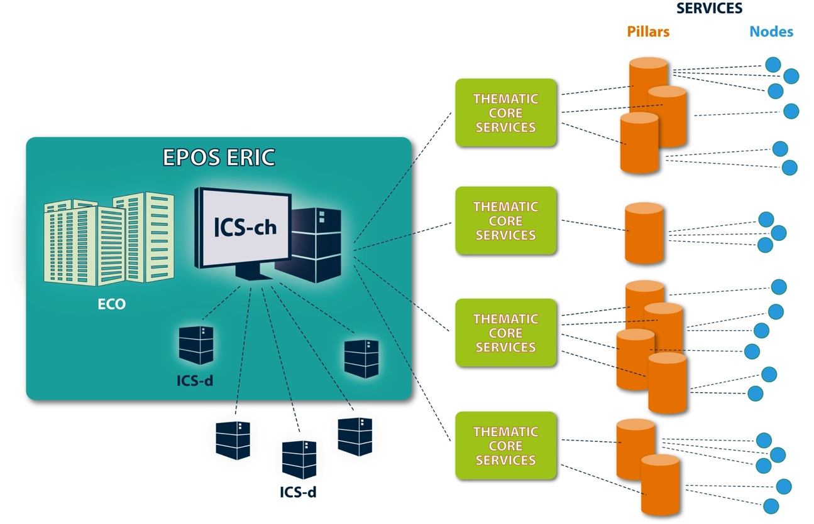
ECO: Executive Coordination Office
ICS-ch: ICS Central Hub
ICS-d: ICS distributed resources
ROTATE
visualization
computing
processing
ICS
TCS

Slide 15
EPOS SERVICES
ECO: Executive Coordination Office
ICS-ch: ICS Central Hub
ICS-d: ICS distributed resources
visualization
computing
processing
ICS
TCS

Slide 16
ICS and metadata

Slide 17
Inside ICS – Integrated Core Services

Slide 18
Metadata
Two dimensions of metadata
3 layers Metadata Model
Discovery and Services
The “bricks”
Objecs of “EPOS ecosystem”

Slide 19
e-Infrastructure Metadata Model
Complete cohort of researchers, research managers, innovators, media
User Model
interaction with data, processing, persons
Processing Model
providing what the user requires
Data Model
representing research
Resource Model
representing ICT
Complete ICT environment for research
Notes:
Resources: 5. data providers, 6. internal to ics, 3. other outside epos delivery framework.
We describe: instruments, data storage resources, data processing and visualization
Data model: 3 layers. Ongoing work: metadata collection, data taxonomy
Processing model: 5.description of the functions available in each processing environment, 6. protocols to connect to them, 3. algorthms which deal with the composing of the processing
User model: how a suer interacts with the system: iaaa, interaction workflow, multilinguality

Slide 20
3-layer metadata model
Anticipates data.gov domains
Discovery (DC) and (CKAN, eGMS)
Web portal, Spatio-Temporal Search
Generate
Contextual (CERIF metadata model)
Search for instruments, software, models...
Point to
Detailed (community specific)
domain-specific data with detailed metadata
domain specific - geographically distributed data

Slide 21
Contextual (CERIF metadata model)
(http://www.eurocris.org/)
Common European Research Information Format
Metadata Entities and Relations
Used as metadata engine at contextual level
CERIF-XML exchange format and APIs

Slide 22
Architecture In summary
Compatibility layer
wrapper
wrapper
wrapper
wrapper

Slide 23
ICS – Integrated Core Services
Challenges to be tackled (other modules)
AAAI (feds?)
Data staging
PIDs
Processing
Visualization
Workflows Engine

Slide 24
OPEN CHALLENGES
Large datasets – sometimes will have to be transported
Generally will try to move software to data and minimise data transport
Nonetheless networking load or mirroring and backup of ICS node

Slide 25
PROTOTYPE

Slide 26
Demo
EPOS GUI & API
CERIF + SYSTEM MANAGER and Other modules
EPOS MD Catalogue
COMPATIBILITY L.
TCS wrapper
NF wrapper
IF wrapper
WEB SERVICES
TCS (WGs)
National Facility
Institutional Facility

Slide 27
SEISMOLOGICAL SERVICES
EPOS GUI & CERIF WS
CERIF+SOFTWARE
EPOS METADATA
Access & Mapping
Compatibility Layer
SEISMOLOGICAL
METADATA
EMSC webservices
ORFEUS
FDSN WS
ORFEUS
Dataselect services
EFEHR
OGC WMS WS
SEISMOLOGICAL
SERVICES
EVENTS
STATIONS
Waveforms (Orfeus)
Hazard & Risk

Slide 28
Architecture improved: metadata mapping
EPOS METADATA CATALOGUE + SOFTWARE
METADATA MAPPING
Compatibility layer
EMSC webservices
ORFEUS/EIDA
FDSN WS
ORFEUS
Dataselect services
EFEHR
OGC WMS WS
GEODESY
GSAC WS
ONEGEOLOGY
WMS WS

Slide 29
Metadata Under the hood (1)
Service Access metadata, to compose the request to the webservice (e.g. FDSN) according to user parameters
Mapping metadata, to map service response metadata into a common set of metadata (fig1) to be presented to the user
ID
Title
Description/keywords
Format/Standard
Bounding Box (spatio coordinates) Start/End time (temporal coords)
UNDER DEVELOPMENT
Fig1. Common metadata example

Slide 30
Request workflow: diagram
REQUEST
RESPONSE
EPOS GUI or APIs
CERIF+SOFTWARE
User
request mapping
1
Compatibility Layer
2
response mapping
EMSC webservices
ORFEUS/EIDA
FDSN WS
ORFEUS
Dataselect services
EFEHR
OGC WMS WS
EVENTS
STATIONS
Waveforms (Orfeus)
Hazard & Risk
SERVICE MAPPING
METADATA MAPPING

Slide 31
Request workflow: example
USER
GUI SOFTWARE
CERIF CATALOGUE + System manager
FDSN Station service
ORFEUS/EIDA
Select a bounding box on a map and search station
Request stations into a
Box with coords: lat-min, lat max, lon-min, lon-max
Knowing that the request is for an FDSN station service: 1. Maps lat-min into minlat etc. 2. Compose the service query (1)
Data represented in internal format is plotted on map and/or rendered on GUI…linked to WF
1. Parse XML 2. Maps metadata key&values into internal representation
Response in FDSNStationXML
format
(1) SERVICE QUERY
http://www.orfeus-eu.org/fdsnws/station/1/query?level=station&nodata=404&&minlon=17.21&minlat=36.43&maxlon=23.21&maxlat=42.43

Slide 32
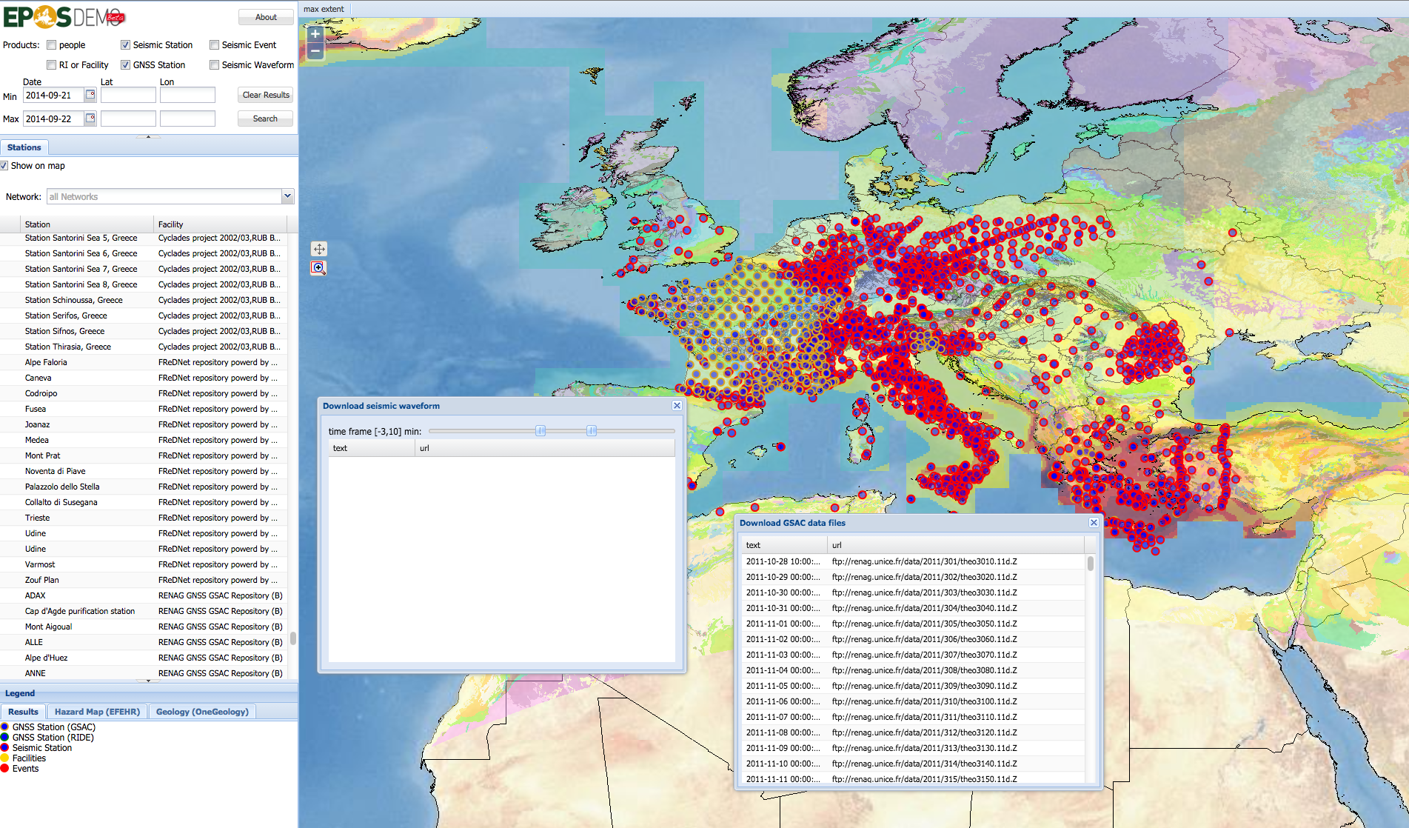
The EPOS Added Value
EPOS prototype for Solid Earth Science
SEISMIC DATA
DOWNLOAD
GPS DATA
DOWNLOAD
http://epos.cineca.it

Slide 33
Who’s in(tegrated)?
ORFEUS/EIDA: Waveform Data, Station Metadata, Orfeus Metadata for Waveforms
SMdB - Waveform Data
EMSC – seismic events
AHEAD - Earthquake Products - Historical Data
EFEHR - Hazard & Risk Maps
OneGeology Europe – geological maps (Images (WMS) , GeoSciML (WFS), and others)
Geodesy – geodetic data GSAC repositories (INGV, Geo Azur ,INOGS (FredNet), Univ Athens, NOA Greece)
And the supersites (e.g. FUTUREVOLC, Iceland)

Slide 34
Acknowledgments
Keith Jeffery - NERC
Frieder Euteneuer - GFZ
Damian Ulbricht - GFZ
Alessandro Spinuso - KNMI
Luca Trani - KNMI

Slide 35
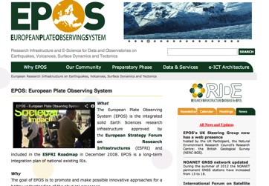
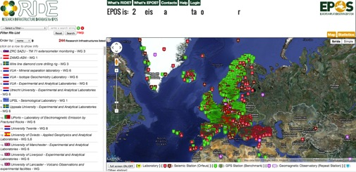
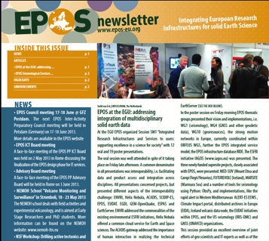
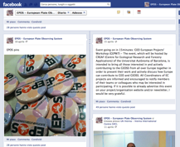
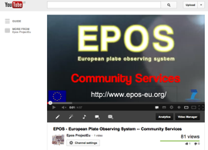
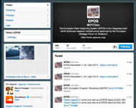
Thank you
WebSite
R.I.D.E. & Demonstrator
www.epos-eu.org
www.epos-eu.org/ride epos.cineca.it
Newsletter
Epos Social
facebook
youtube
twitter
www.epos-eu.org/newsletter

