Slide 1
AAI in EGI
Status and Evolution
European Grid Infrastructure
Peter Solagna
Senior Operations Manager
peter.solagna@egi.eu

Slide 2






Authentication and Authorization in EGI
TRUST
TRUST
Virtual
Organization

Slide 3
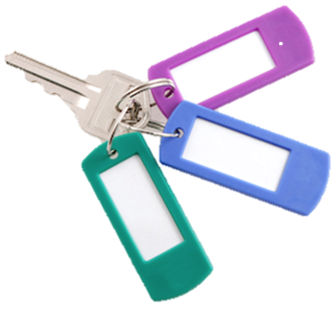
The key is: collaboration
Authentication and Authorization workflows scale with the number of service providers and users
  User identity is verified by the IGTF Certification Authorities who release the X509 certificates
  The certificate enable uniform authentication of the user across resource centres
User communities have the tools to manage the membership of their users and their structure
  Collaborate to the trust chain and to integrate the information provided by the Identity Providers
  Authorization is based on the Virtual Organization membership and attributes not on the single user identity
  The user capabilities based on groups and roles within the VO are reflected into uniform access rights across the sites that support the VO

Slide 4
Federated AuthN in EGI
For some users approaching EGI the X509 mechanism is a barrier
  They do not have easy access to a Certification Authority
  They would prefer to continue using their institutional credentials
  VOs and Resource Providers implement portals to ease the access to the resources
The most effective solution is to bridge other identity federations (eduGAIN, institutional IdP) with the EGI AAI
  Technical bridge: credentials translation, support in the middleware for other AuthN protocols
  Policy bridge: build trust between SP and IdP, enable different level of trust

Slide 5
Extend federated AuthZ
Provide tools to the users to manage their user communities
  Distributed Attribute Authorities connected with the user’s IdPs
  Can be used also within application-specific environments for user authorization
Maintain uniform authorization across multiple service providers
  Based on the attributes provided by the user communities
Apply the collaborative trust approach of EGI to new authentication technologies

Slide 6
Future work
EGI.eu and other EGI partners participate to the EC funded project AARC
  Goal of the project is to define an architecture for a common European AAI, cross-border/cross-einfrastructure
EGI-Engage AAI activities
  Find the best technical solutions to support Federated AuthN/AuthZ in EGI and be aligned with the AARC outcomes
  Deploy the required supporting services and make them available to EGI communities

