Slide 1
EGI Federated Cloud
Diego Scardaci, EGI.eu Technical Outreach Expert
e-Infrastructures for Earth Sciences workshop
22-23 January 2015, Amsterdam (NL)

Slide 2
What is the EGI Federated Cloud
The EGI Federated Cloud is federation of institutional private Clouds, offering Cloud Infrastructure as a Service to scientists in Europe and worldwide.
EGI Federated Cloud is based on:
Standards and validation: federation is based on common Open-Standards – OCCI, CDMI, OVF, GLUE, etc...
Heterogeneous implementation: no mandate on the cloud technology, fostering the adoption of the standard interfaces and services.
* Not shown on map
Supported use cases:

Slide 3
The EGI Federated Cloud
12 countries provide certified resources
Czech Republic, Germany, Greece, Hungary, Italy, Finland, Poland, Slovakia, Spain, Sweden, Turkey, United Kingdom
19 resource providers
4 countries currently integrating
France, Finland, Portugal, South Korea*
5 countries interested
Bulgaria, Denmark, Israel*, The Netherlands, Switzerland
Worldwide interest
South Africa* (SAGrid)
United States* (NIST, NSF Centres)
Australia* (NeCTAR)
Microsoft
January 2015

Slide 4
Cloud Infrastructure Platform
End users
EGI Collaboration Platform
EGI Federated IaaS Cloud Infrastructure
OCCI
CDMI
GLUE2
Cloud Compute
Cloud Storage
Information Discovery
Image Repository
Cloud Management Stacks
(OpenStack, OpenNebula, CloudStack, Stratuslab, …)
OVF
HEPiX
EGI
Application Database
EGI Core Infrastructure Platform
Service
Registry
GLUE2
GSI
SAM
APEL
Information Discovery
Federated AAI
Monitoring
Accounting
System admins

Slide 5
Value proposition
Open standards, open technologies
Use of Open Standards is key to the establishment of an effective, fair and transparent cloud market in Europe
Open Source components raise the barrier for hidden backdoors, thus lead to more trusted services
Firmly rooted in Europe
Strong public sector involvement through NRENs, NGIs, EIROs are EGI’s members
European commercial Cloud resource providers, including SME
A single cross-border market
Reaching out for research, government & business sectors
Level playing field for innovation and services on multi-service tiers

Slide 6
User workflows
Cloud sites
End users:
Access services running in VMs
Site: Supports a research group
Create/destroy/access VMs
Download VM images
AppDB
Cloud Marketplace
EGI Applications Database
Download VM image and use ‘locally’
Publish image
Include image in a research group set
Technical developer: Prepares VM Images
Research group Manager: Endorses suitable VM images

Slide 7
High-level tools to use the EGI Federated Cloud
Easy and powerful way to exploit the EGI Federated Cloud
To manage multiple VMs at a time
To provide high level GUIs
To offer simpler user authentication
To provide automatic scalability
Extend the IaaS capabilities of the EGI cloud
PaaS & SaaS
External contributions, growing
Catania Science Gateway Framework, COMPs, SlipStream, VMDIRAC, WS-PGRADE
JCloud and Vcycle under integration

Slide 8
Federated Cloud service tiers
Tier 4:
Zero ICT
Infrastructures
VRE
VRE
VRE
Virtual
eLaboratory
Secure storage
Tier 3:
Professional research infrastructure platforms
Tier 2:
General-purpose platform services
DB aaS
Hadoop
aaS
Key Mgmt
Encryption
ACL mgmt
Tier 1:
Reliable
Infrastructure Cloud
Federated IaaS and STaaS Cloud

Slide 9
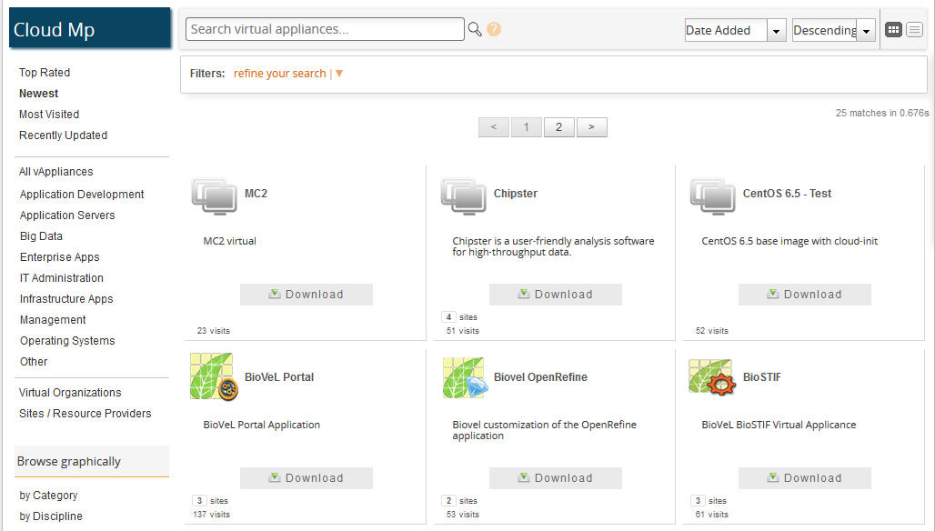
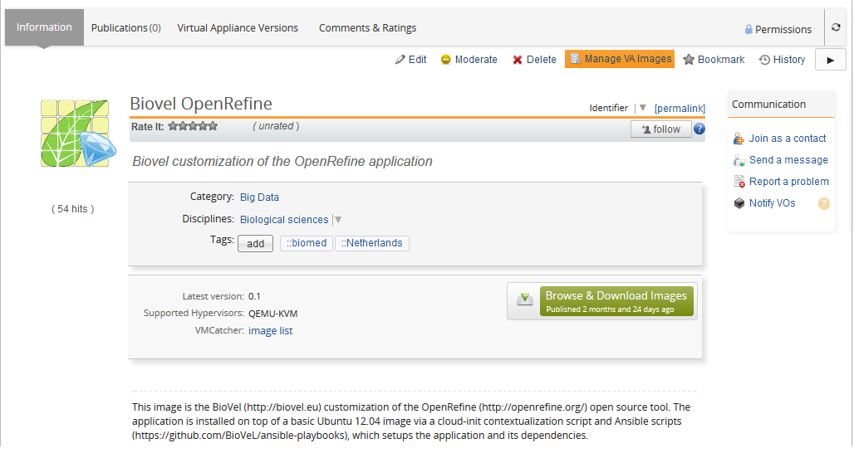
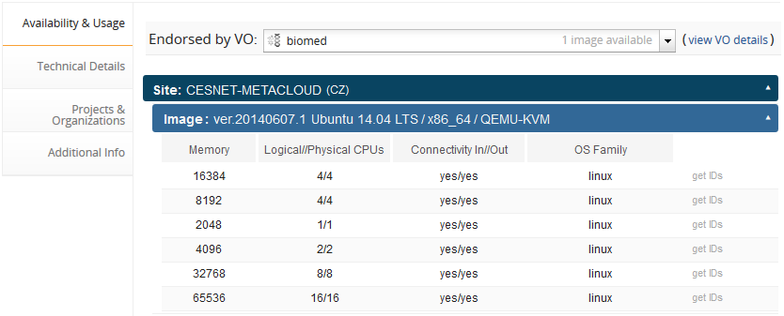
The Cloud Marketplace VM images

Slide 10
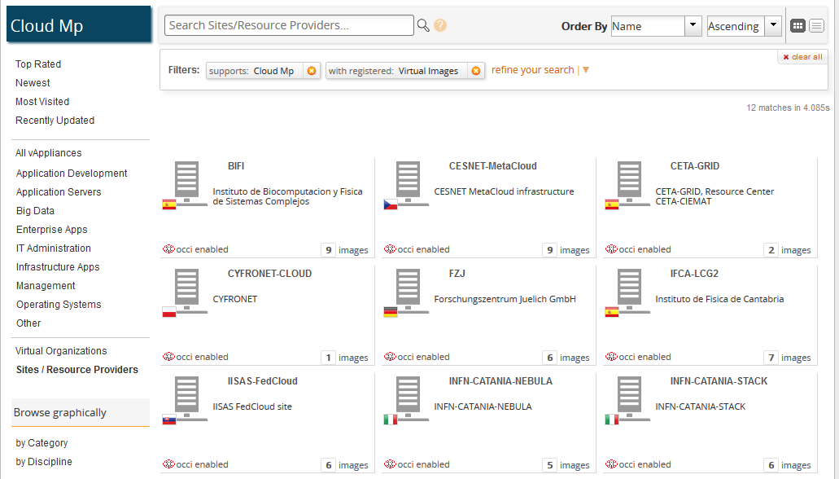
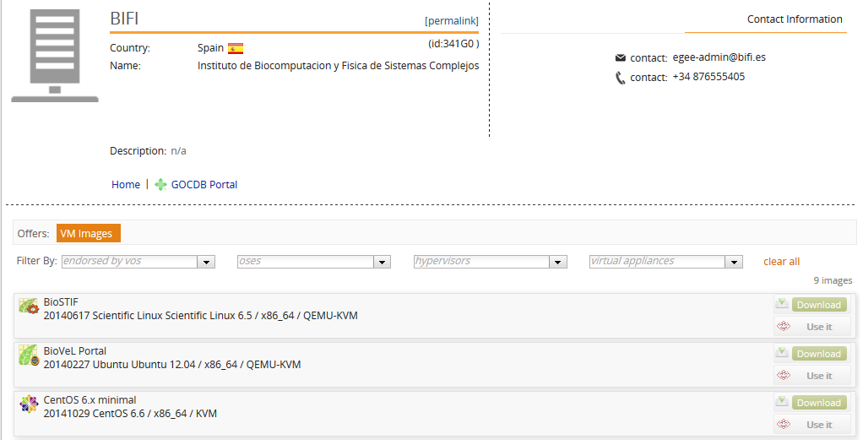
The Cloud Marketplace Resource Providers

Slide 11
EISCAT-3D Metadata discovery
Open Source Geospatial Catalogue (OSGC)
CESNET site (CZ)
Metadata exists in specific section of the file
E.g. Antenna direction
Will be used in Phase 1 for discovery of files
Further metadata have to be extracted from the data
E.g. Number of spikes, Type of spikes
Applications exist that can process the EISCAT files and identify metadata (e.g. with FFT)
These applications should be collected from the EISCAT community and exposed to OSGC as services
Can be done in Phase 2
EISCAT file
Metadata part
Phase 1: In ENVRI
Catalogue
Data part
Visualization service
Pre-processing service N
Phase 2: In EGI-Engage

Slide 12
EISCAT-3D - pilot setup
On-site
Off-site
EGI Federated Cloud
EISCAT archive
Object Storage
Juelich site (DE)
OpenStack SWIFT
Open Source Geospatial Catalogue (OSGC)
CESNET site (CZ)
5m files, ~1TB in total
CDMI with HTTP export
wget
Web browser
Catalogue
Scientific users
Phase 1: In ENVRI
Phase 2: In EGI-Engage
Near Real Time tool to import data automatically from receiving stations
Data administrators
Pre-processing service 1
Pre-processing service N
...
Admin tools
Processing / visualization service 1
Processing / visualization service N
...

Slide 13
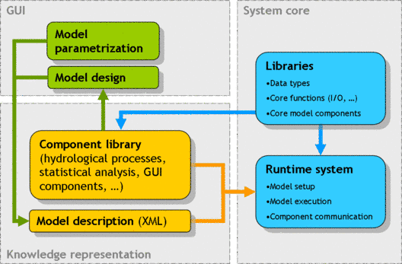
JAMS - Jena Adaptable Modelling System
java-based, open-source software platform to address:
the demands of a process-based hydrological model development
various aspects of model application
applied to simulate hydrological dynamics in catchments with a size of 1km² to 100,000 km² in a temporal time step of hours to months
models calibration process days to weeks in a WS
thread based parallelization
JAMS in the EGI FedCloud:
1 VM: >8 cores, >16 GB of RAM
Successfully integrated
Image available in the EGI cloud marketplace

Slide 14
Summary
EGI: Community of resource providers with long-term tradition in providing federated ICT services for research
EGI Federated Cloud: Paving the way for a federated cloud in Europe
Open standards, open technology
Open membership, open processes
Community of experts in cloud technology and user support
Driver for innovation in Europe
Expanding from IaaS to PaaS and SaaS
International perspective: Although EGI activity, a global federation is in scope, with global concrete interest
Korea, South Africa, Canada, Taiwan, Australia
Commercial Cloud providers

Slide 15
Thank you
EGI Federated Cloud resources
Wiki site: http://go.egi.eu/fedcloud
User support: https://wiki.egi.eu/wiki/Federated_Cloud_user_support
User support e-mail: support@egi.eu
Cloud Marketplace: https://appdb.egi.eu/browse/cloud
GitHub: https://github.com/EGI-FCTF

