Slide 1
GÈANT Cloud Catalogue and EGI Fedclouds participations
Peter Solagna – EGI.eu

Slide 2
What is (will be) the GÈANT Catalogue
A list of cloud service providers that NRENs and their users can use to find where to access resources
It is not a marketplace
It is not a federation
Facilitate the aggregation of demand across GÉANT Members
GÈANT defined a list of requirements for the cloud providers, assessed answering a questionnaire
Non fulfilling some requirements does not prevent to be in the catalogue
The answers are public and are published in the catalogue (a point system will show easily to users how much a provider is fulfilling the requirements.

Slide 3
Type of services expected in the catalogue
Collaboration Suites – bundle of web‐based user collaboration applications that could also be referred as a web‐based Office suite
File storage and synchronisation – applications that allow cloud storage of files, sharing between users, and synchronisation with different devices, etc.
Real‐time communication ‐ web‐based applications offering real‐time videoconferencing, user collaboration, etc.
Infrastructure as a Service – ability to host ones virtual infrastructure with the service provider (public cloud, private cloud, hybrid solutions, or community clouds)
Other cloud‐based services – any other service that is delivered from clouds to users and that is of particular interest for research & education community.

Slide 4
The process
Once a year GEANT will publish a Prior Information Notice to invite the Cloud providers to publish their services in the catalogue
CSP will have to submit the questionnaire with the answers to the specific requirements
GEANT team will evaluate the answers and score the CSP and publish them in the catalogue

Slide 5
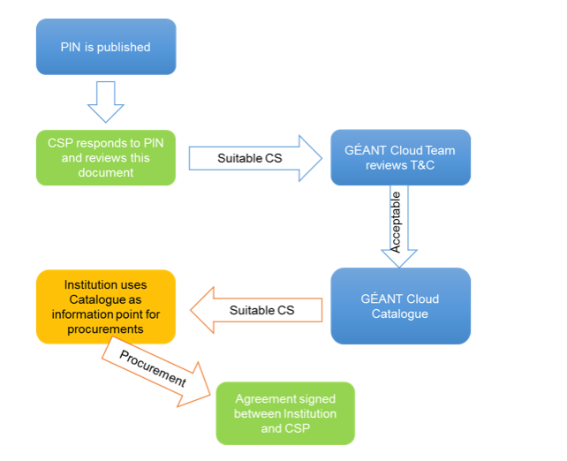
The process (2)

Slide 6
Requirements
The topics for the requirements are:
Intellectual Property Rights and Ownership
Legal aspects
Security
Continuity
Confidentiality
Communications
Peering
Network peering with GEANT
29 requirements in total

Slide 7
Publish EGI Cloud providers in the catalogue
One entry for the EGI Federated cloud IaaS as a whole
Give visibility to the federation capabilities, and the tech outreach coordination
Individual cloud providers will decide if they want to publish themselves
To be discussed with GÈANT the possibility to add a flag to inform that they participate to the Fedcloud
Individual providers will be able to have better score in the survey

Slide 8
Steps
EGI.eu to prepare a first version of the requirements questionnaire
Feedback and comments from the Fedcloud TF
Circulate for comments to the EGI Council
Review the survey
Submit to GÈANT

