Slide 1
Astronomy and Astrophysics
Dr. Giuliano Taffoni & Dr. Claudio Vuerli
Italian National Institute for Astrophysics

Slide 2
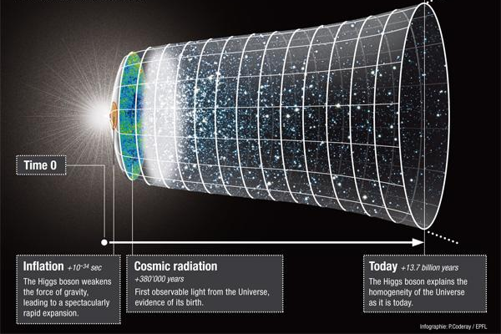
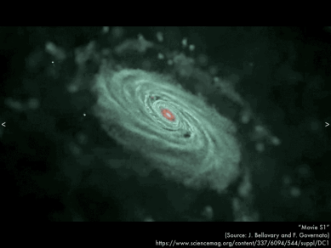
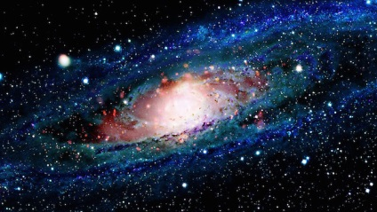
A&A Community
Collection of heterogeneous, distributed, scientific (sub)-communities
Study the different scientific aspects of formation and evolution of the Universe
Commonalities in terms of technological challenges and requirements
Computing (HTC but also HPC)
Demanding in terms of data
Astronomy and Astrophysics
Notes:
encompass both experimental and computational approaches:
Observations (Experiments) Simulations (Computing) visual analytics
Big Data - defined not only as datasets too large to be processed with today's tools and methods but also as datasets too complex to be effectively dealt with
Gruppi scientifici di stribit non hanno esigenze diverse e VRC umbrella international scientific groupus around different

Slide 3
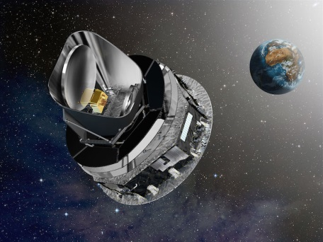
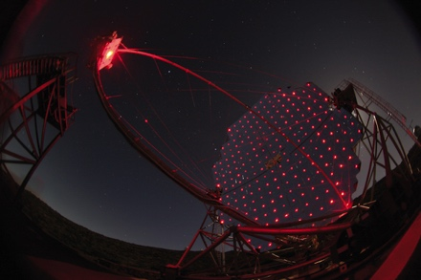
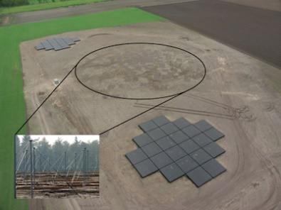
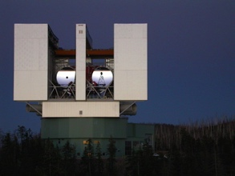
A&A Heavy User Community
Research communities:
Radio Astronomy, Gamma Ray Astronomy, Helio-physics, Stellar Astrophysics, cosmology….
The A&A Virtual Organizations
10 with
about 500 users
about 80000 cores
about 100 TB storage
More in other VOs
A light weight coordination
The A&A Heavy User Community
Identify commonalities and common technical solutions.
Astronomy and Astrophysics
Notes:
Interoperability with Vos
Project oriented:
SSO System
Federated computing and storage facilities
Science Gateways
Heavy use (software tools)

Slide 4
A&A Challenges
Data sharing: Virtual Observatory standard - Astronomical data and service infrastructure;
Integrating infrastructures and resources (HTC, HPC);
Hide complexity of the infrastructures and allow end users to focus on scientific aspects.
eScience approach
federated (virtual) research environments and computational resources
Astronomy and Astrophysics
Notes:
Interoperability with Vos tight the collaboration with the VOs
Project oriented:
SSO System
Federated computing and storage facilities
Science Gateways
Astronomers do not like to interact with infrastrucures
Approach to provide solutions to project and scientists for
Short here community of communities…commonalities (common bits)

Slide 5
A&A in EGI-InSPIRE
Partnership in EGI-InSPIRE to develop and maintain services and tools (WP SA3, Task 5) and prepare their long term sustainability
Visualization tools (VisIVO)
Use of GPUs and Visual Analytics service
Interoperability services of different DCIs (HPC)
Interoperability of DCIs and Data Distributed Infrastructure (Virtual Observatory)
Access and update BaSTI database
the largest archive of Stellar Evolutionary Tracks.
HTC resources impossible to achieve without EGI.
Cherenkov Telescope Array Virtual Team
Challenge simplify access to resources.
Technology study focused on authentication and authorization and Science Gateways.
Astronomy and Astrophysics

Slide 6
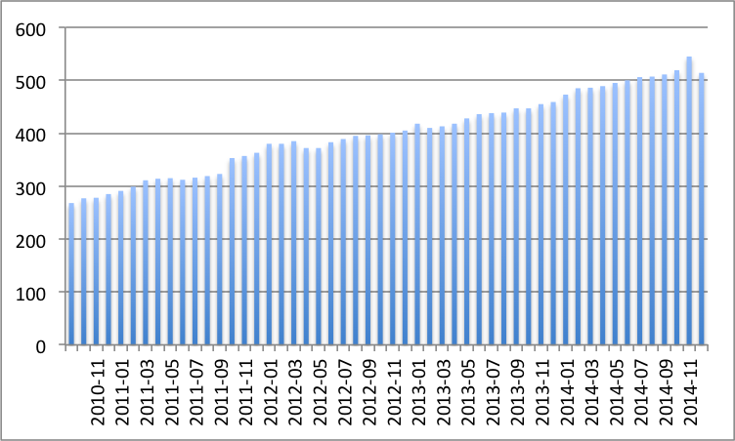
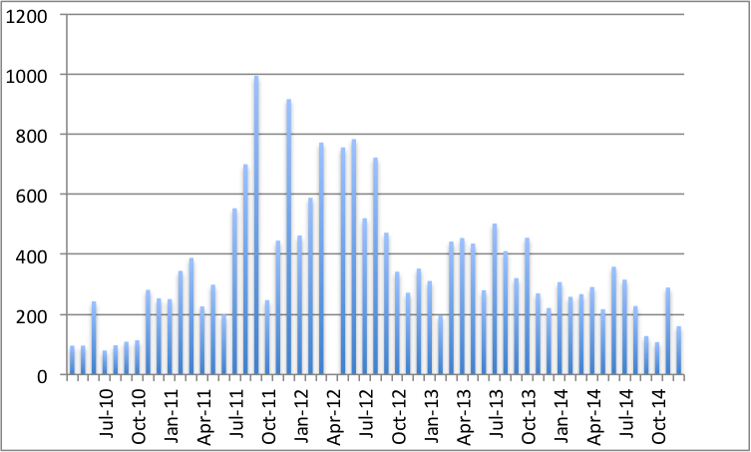
The value of EGI for A&A
Technology
Overall Number A&A users
Interoperability
Community-Driven
Innovation & Support
Overall Number of jobs [K]
EGI
Community
building
High level services
High-throughput
Data Analysis
Astronomy and Astrophysics
Notes:
This leaded to a number of activities that continuous after the end of the funded period where EGI plays different roles
Accountig solutions (portals gateway), computing solutions,

Slide 7
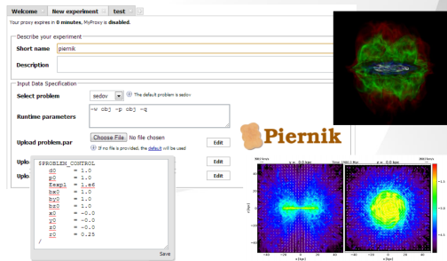
EGI for A&A
Science gateways as a framework to integrate Applications and services for A&A (8 SGW)
SCI-BUS / Science Gateways/ EGI MOU
ER-flow / User Communities Applications/ EGI Partners
AstroGrid-PL: InSilicoLab for Astrophysics (PL NGI)
Trans-national federations and initiatives
STARnet / Trans-national Federation of thematic astronomical Science Gateways (EGI Resources and Services)
Services: Visualization, database access
Interoperability between eInfrastructures: EuroVO data and services cloud.
Astronomy and Astrophysics
Notes:
Other projects in which the community is involved and EGI in involved in all of them we facilitate it’s the hub
A&A is involved in a number of projects (challenges)
Provide

Slide 8
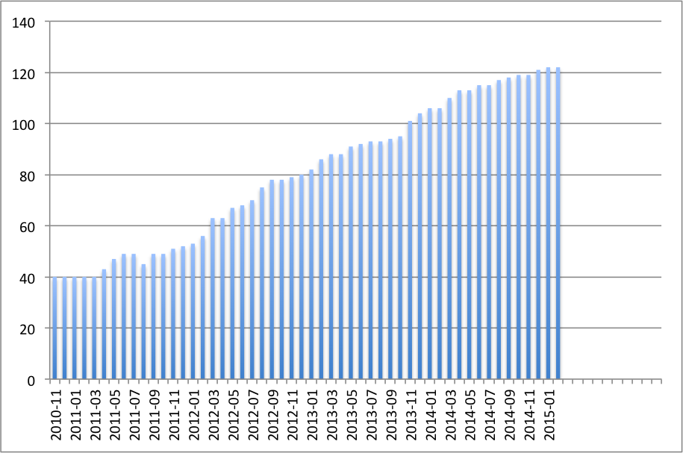
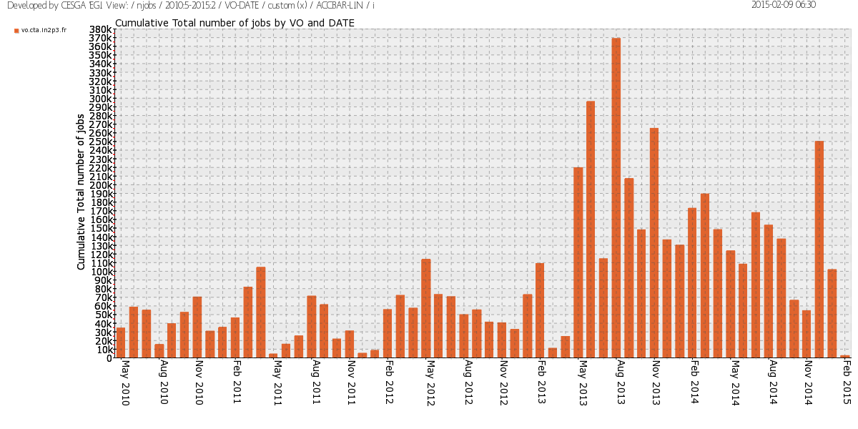
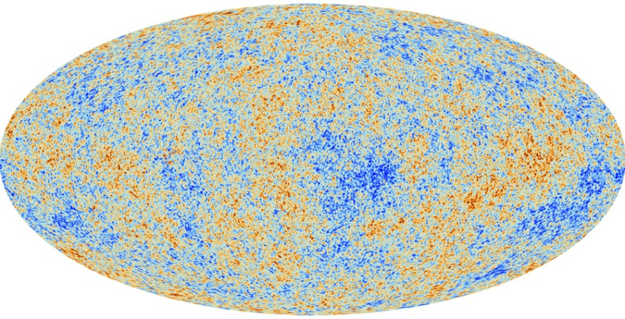
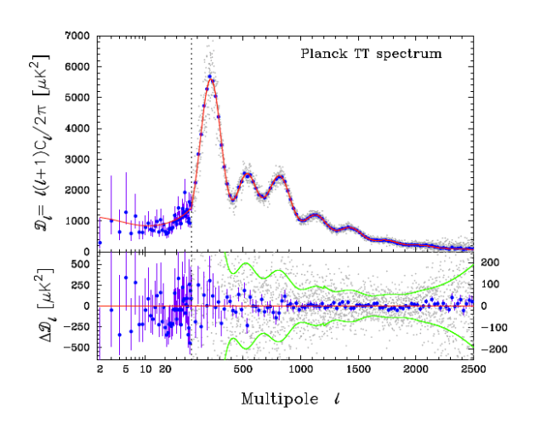
Success Stories
vo.cta number of users
Planck ESA satellite mission: measure the CMB.
EGI used to execute simulations (resources) to estimate the Cosmological Parameters correcting instrumental and observational systematics.
Main experiment in cosmology of the last 10 years (more that 700 papers in the last year)
Planck VO: ~50 users, ~ 20000 Cores, 15TB
CTA:
open observatory to a wide astrophysics community
explore our Universe in depth in Very High Energy
VO
120 users
~ 70K cores
7 EU countries and US
Simulations and testing that requires large HTC facilities
Astronomy and Astrophysics
Notes:
Lofar (Radio Astronomy)

Slide 9
More success stories
CTA portal: prototype by Cyfronet and INAF
SKA pathfinder: Evolutionary Map of the Universe a deep survey of the sky (10mJy/beam) to be carried out at 1.4 GHz with the Australian SKA Pathfinder (ASKAP).
STARnet science gateway federation
A&A services: e.g. AstroGrid-PL or BaSTI
Engagement of A&A Data Centers: science gateways for data services baed on cloud
Interoperability with International Virtual Observatory:
Canadian Data Center federated Cloud for Astronomy
IVOA Grid and Web Services working group
Astro-WG and Astro-CG in OGF
Astro-CG as an international forum where the A&Acommunities and projects
Meet and bring their experiences and advances
Learn about technology advances
Liaison with the Virtual Observatory
Astronomy and Astrophysics
Notes:
Support with tehcnology (cloud) support with framwork integration
Robots certificate for a
Achivements: one VOs

Slide 10
A&A in 2015 and beyond
Federation of science gateway for different projects and services.
Dedicated computing and storage will increase in 2015 (800 cores and 100TB storage, cloud, national funding)
An integrated virtual research environment
solutions for data sharing, visual analytics, data mining and for supporting collaborations
Integrated solutions for data and computing (EGI fed cloud and Virtual observatory cloud interoperability)
Astronomy and Astrophysics
Notes:
Engaging CTA and SKA
Impact on the benefit in therms of improve performance of reduce costs

