Slide 1
EGI-InSPIRE:
Overview, Finance and Results
Tiziana Ferrari
EGI.eu Technical Director
Tiziana.Ferrari@egi.eu
EGI-InSPIRE Final Review
Amsterdam, 13 February 2015

Slide 2
Outline
Project and financial overview
Progress in PY5
Results and impact

Slide 3
Project effort and financial overview
Celine Bitoune
Chief Finance Officer/EGI.eu

Slide 4
PY5 at a glance
PY5 participants: 30
PY5 PMs reported = 417PMs / 52 FTEs
PY5 estimate funding planned: 1,988,800 €
PY5 Provisional Financial status: 1,573,193 € requested
  Missing costs for GRNET (175k), CNRS (71k), CYFRONET (90k), STFC (190k)
Financial session deadline: 28-02-15 (60 days after the end of the project 31-12-14)
Over reporting partners: Proposal for redistribution if funding left
Advance payments:
  95% of advance received has been distributed (20,253,817 €)
  PY4 Payment submitted to EC – Nov 14: 1,000,514 €
  Final payment in 2015: 3,749,778 €
Final deliverable: Final distribution to the grant 30 days after release of final payment

Slide 5
PY5 Consumed Effort
Type | Work Package | Worked PM Funded | Committed PM | Achieved PM%
MGT | WP1-M | 33 | 35 | 93%
COORD | WP9 | 197 | 207 | 95%
COORD | WP10 | 38 | 39 | 96%
OTHER | WP11 | 83 | 116 | 72%
RTD | WP12 | 66 | 59 | 112%
Total: |  | 417 | 456 | 91%
WP1 → NA1 Management
PMs left used for report and costs
preparation
WP9 → NA4 Community management
WP10 → NA5 Strategy, Policy and Business
Development
WP11 → SA5 Federated Cloud
WP12 →JRA2 Tool Development

Slide 6
PY5 funding per activity
Type | Work Package | Worked PM Funded | PY5 Eligible Cost Estimate | PY5 Estimated Funding
MGT | WP1-M | 33 | 293,040 | 293,040
COORD | WP9 | 197 | 1,470,945 | 735,473
COORD | WP10 | 38 | 295,305 | 147,652
OTHER | WP11 | 83 | 599,018 | 299,509
RTD | WP12 | 66 | 505,942 | 252,971
Total: |  | 417 | 3,164,250 | 1,728,645
WP1 → NA1 Management 100%
WP9 → NA4 Community management 50%
WP10 → NA5 Strategy, Policy and Business
Development 50%
WP11 → SA5 Federated Cloud 50%
WP12 → JRA2 Tool Development 50%

Slide 7
PY5 Deviations to plan
EGI.eu: few efforts left for preparation of the reports and FS (Jan-Feb 2015)
For partners who have submitted their Form C the project office has checked the deviation with the efforts declared and has reconciled costs and efforts:
  Task carried out consuming less efforts than planned
  Efforts not declared (new administrator at the partners’ level)
  Additional efforts to the initial plan were not charged in the costs;
  Reasonable overspending.
For inactive partners (no efforts reported), no Form C is expected (EMBL and JINR); payments were released up to PY1-PY3 costs accepted, thus there is no advance payment to reclaim
For two partners not participating in PY5 and underspending in PY4 have been reclaimed funding: UOBL-B&H (BE11) 771 € and ICI-Romania (BE51) 3,337 €

Slide 8
PY1-PY5 use of funding
Participants including JRU members: 141 of which 95 funded
PMs: 9,463 / 168 FTE
Eligible costs: 71,039,803
Funding: 25,000,000 (35%)
PERIOD | FUNDING
PY1 | 5,275,882
PY2 | 6,978,609
PY3 | 6,186,410
PY4 | 4,463,042
PY5 requested | 1,573,193
PY5 missing costs | 522,866

Slide 9
Progress in PY5

Slide 10

Policy
REC 1. Develop and promote the Open Science Commons Vision
Researchers from all disciplines have easy, integrated and open access to the advanced digital services, scientific instruments, data, knowledge and expertise they need to collaborate to achieve excellence in science, research and innovation
www.opensciencecommons.org

Slide 11
A new approach to digital research, tackling policy challenges and coupling the “open science” and the “commons” economy as a new paradigm for knowledge creation and collaboration in research
Requiring the involvement of
  E-Infrastructures
  Data providers
  Research Infrastructures
  Competence Centres
Digital services
Knowledge & Expertise
Data
Instruments

Slide 12
Strategy
REC 2. Continue to develop the EGI Strategy
REC 4. KPI Metrics should be measured and evaluated in a wider context, in order to determine whether the organisation is heading in the right direction
Development of a new EGI strategy in progress
  Based on the Open Science Commons vision
  Participatory leadership
Increase skills among EGI.eu staff
Increase maturity of the strategic planning process
Improve quality of conversation on strategy
Improve communication of strategy
  Both internally and externally

Slide 13
Timeline
EGI strategy development
2.2015
11.2014
Full draft new EGI Strategy based on OSC vision & strategy workshop
4.2014
Full draft new EGI Strategy based on OSC vision and workshop
10.2013
Open Science Commons vision
Update on the EGI strategy:
“Secure, federated data-analysis capability for the European Research Area
4.2012
First EGI Strategy document: “Seeking new Horizons: EGI’s role in 2020”
5.2010
EGI-InSPIRE Kick-start
2.2010
EGI.eu was born

Slide 14
Sustainability 1/3
REC 7. Test business cases in commercial contexts as well as in ESFRI RI contexts
Recommendations from Pay-for-Use initiative
  43 individual participants and observers
    EGI.eu (Lead), Resource Centers, NGIs, Commercial Company
  Publishing Pricing Information
    30 Providers across 12 Countries
1st Business Engagement Programme
EGI and ESFRI RI: cross-border service procurement
  Collaboration with DARIAH, EPOS and LifeWatch

Slide 15
Sustainability 2/3
REC 3. Sustainability planning needs more development, especially in respect of achieving longer-term sustainability
New governance approved in Oct 2014
  Full participant and associate participant
  Revised simpler fee scheme (GDP-based)
  Extended full membership
    Europe and beyond
    ERICs and EIROs

Slide 16
Sustainability 3/4
EGI-InSPIRE
New projects
Core Activities
Plus NGI international tasks (65% NGI funding)
Plus funding of the running of the infrastructure (100% NGI funding)

Slide 17
Sustainability of technical development
EGI-InSPIRE
New projects
EGI.eu-lead project
Non-lead projects (e.g. EMI, IGE, H2020)

Slide 18
Status
NGI International tasks (operations, user engagement)
  no longer funded as of 01 May 2014
  But need of sustained support to human networks, especially user engagement, especially in countries with international user community not yet established
EGI Core Services
  Partly sustainable → Council fees and in-kind contributions
  https://wiki.egi.eu/wiki/Core_EGI_Activities

Slide 19
Strategy
REC 5. Examine the planned Big Data SRIA and its relation to EGI and Open Science
Commons Big Data plans
Big Data Value Association
  (a) strengthening competitiveness and ensuring industrial leadership of providers and end users of BIG DATA VALUE technology
  (b) promoting the widest and best uptake of BIG DATA VALUE technologies and services for professional and private use;
  (c) establishing the excellence of the science base of creation of value from BIG DATA
Membership under evaluation in the context of the strategy being defined

Slide 20
Results and impact

Slide 21
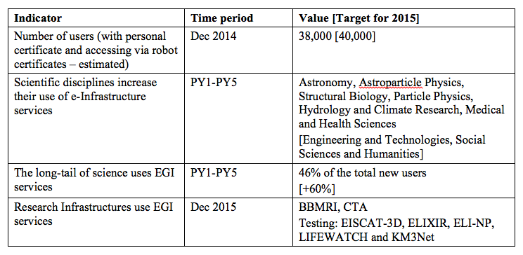
All researchers
All researchers from all disciplines have access to the Commons

Slide 22
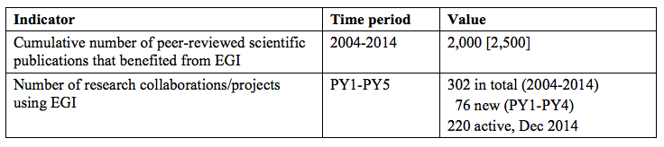
Excellence in science
Collaborate to achieve
excellence in science, research and innovation

Slide 23
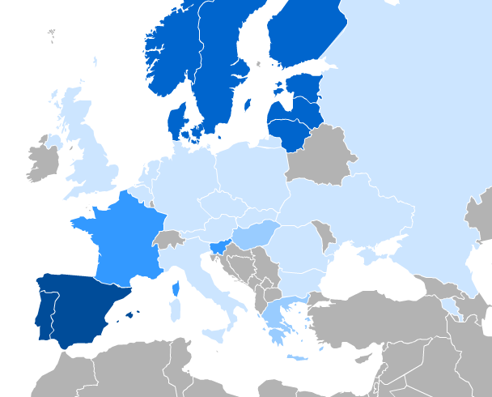
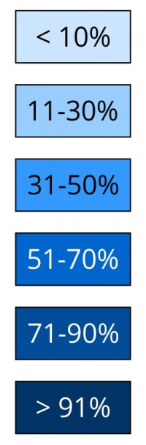
Open access
Researchers from all disciplines have easy, integrated and open access → 24 of transnational access
Percentage of resources used by users from another country
Notes:
Researchers from all disciplines have easy, integrated and open access

Slide 24
Digital services
Open access to the advanced
digital services, scientific instruments, data, knowledge and expertise
3600 service end-points (grid, cloud, storage and data management)
Registered applications → 620
Natural Sciences 353
Medical and Health Sciences 124
Agricultural Sciences 9
Engineering and Technology 9
Other 126

Slide 25
Outlook
The Open Science Commons are not yet a reality
  Technical integration barriers
  Fragmented landscape
    No governance and consistent access models
  Digital divide
  …
EGI-InSPIRE already allowed EGI to advance towards an Open Science Commons

