Slide 1
Software provisioning and HTC Solution
Peter Solagna
Senior Operations Manager
peter.solagna@egi.eu

Slide 2
Software provisioning

Slide 3
Goals of the SW provisioning
Establish agreements with the technology providers
Develop and run a quality control process for the software that has to be deployed in the production infrastructure
Quality criteria definition and verification
Staged rollout
Provide a repository infrastructure to distribute the software among the resource centres
Software provisioning in EGI-InSPIRE
Supported by SA2 task in PY1-4
Supported by EGI.eu fees as core activity in PY5 (and beyond)

Slide 4
Technology coordination
Coordination of the UMD release activities
Collaboration with the software providers
URT meetings
2 meetings per month
Meeting with the product teams contributing to UMD
Updates on release activities of the PTs and UMD schedule dissemination
Supported by TNA1.3

Slide 5
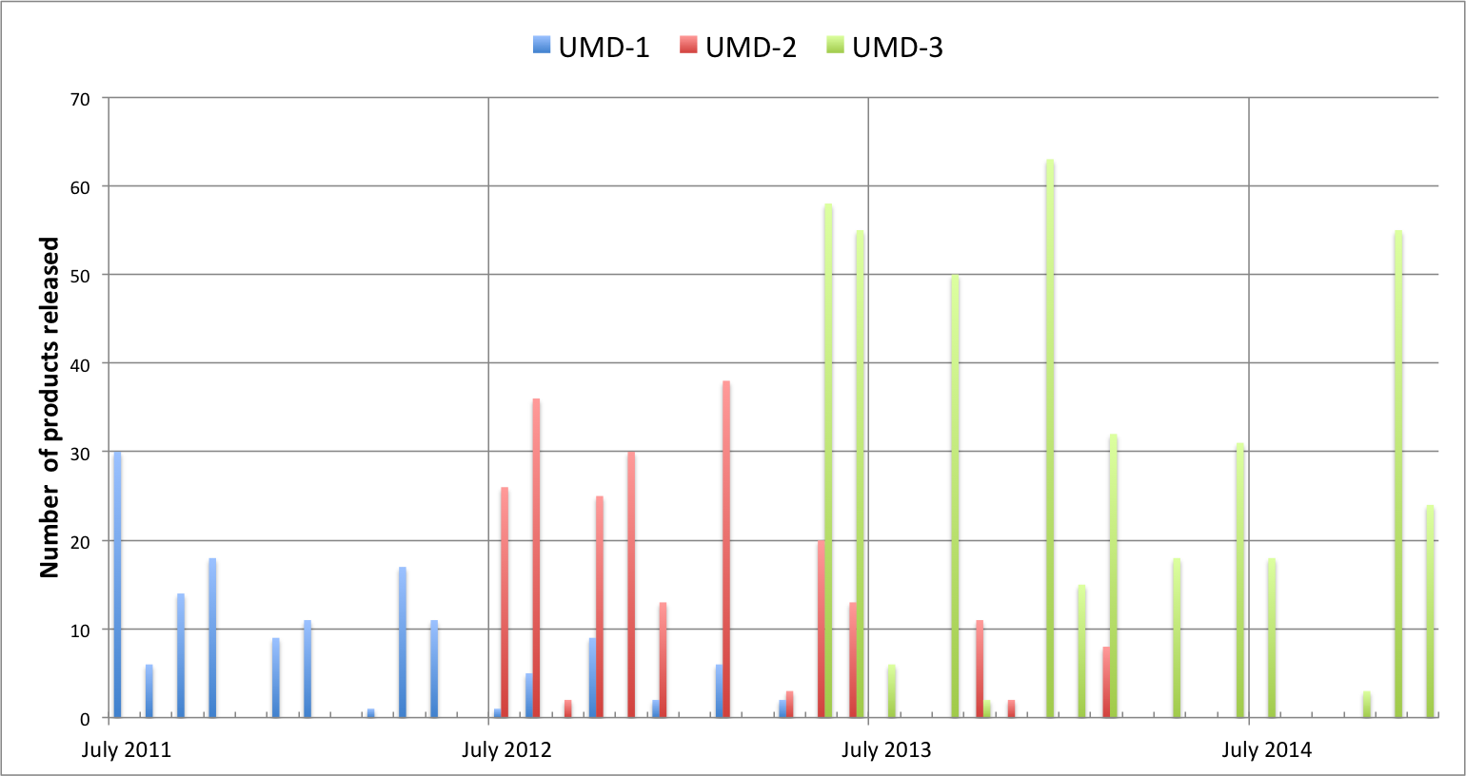
UMD releases
Total number of releases:
UMD-1: 16 releases, 142 product updates
UMD-2: 16 releases, 227 product updates
UMD-3: 15 releases, 430 product updates

Slide 6
UMD releases
During PY5
Total of 7 UMD-3 updates
87product updates (125 including multiple platforms: SL5, SL6, DEBIAN6)
Unified Middleware Distribution | UMD-3 | 0 major release
 |  | 5 minor updates
 |  | 2 revision updates
EGI PKIX trust anchors | 5 releases
SAM | 1 release
New components | FTS3, CVMFS, Frontier-Squid
Total number of releases:
UMD-1: 16 releases, 142 product updates
UMD-2: 16 releases, 227 product updates
UMD-3: 15 releases, 430 product updates

Slide 7
Quality criteria evolution
7 releases of the quality criteria document
Quality requirements for software in UMD
Coverage of all the UMD products
Disseminated among the technology providers
Reduced to a core set of requirements during PY4 to make possible for external verifiers to contribute to the process
Products verification on dedicated cloud resources
Integration with the Federated cloud processes
Increased automation of the processes to reduce overhead
Average time/verification from 14h/product in PY1 to 2.5h/product in PY5
Notes:
Future plans about cloud services: QC for VMI, process of verification of images(?)
Support for the CoE/CC

Slide 8
Software provisioning evolution
EMI yum/apt
UMD-1
Untested
UMD-1
Tested
UMD-1
Production
IGE yum/apt
EMI
IGE
EPEL
UMD-2
Untested
UMD-2
Tested
UMD-2
Production
UMD-3
Untested
UMD-3
Tested
UMD-3
Production
HTTP
PT specific
Community repositories

Slide 9
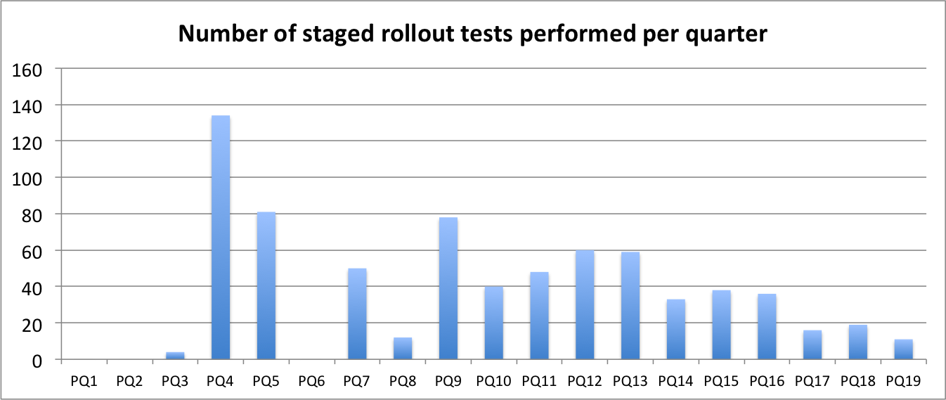
Staged rollout
PY5
Number of early adopter sites | 81
Number of SR test performed during PY3 | 46

Slide 10
Future plans
Continue to support the production infrastructure
Distribute Cloud components to support Fedclouds
Quality criteria
Support software release of the EGI communities and the Centres of Excellence
Virtual Machines Images quality control
Repository infrastructure
Extend the platforms supported to fulfill the stakeholders requirements
Extend UMD to be the main target for the product teams to release

Slide 11
High-throughput data analysis (HTC) solution

Slide 12
High throughput data analysis solution
Overview
Enable researchers to access large scale data management and computational capacity
To analyse or produce large datasets through the execution computational tasks, which can be either single or parallel processes
Research can be performed in an effective, cost-efficient and collaborative way
Uniform access to distributed and federated resources
Support users communities who need to federate their own resources
Support users communities who do not own resources
Target groups
Researchers who work on the same topic, share data or use the same application software.
The groups can be very small, such as individual researchers, or very large international collaborations
Communities that need to access distributed resources or datasets in a collaborative way
Currently there are 38k users who access the HTC solution
Notes:
How the solution was supported by PY5 (additonal slide)

Slide 13
HTC solution architecture
Deploy
Analyse
Retrieve
Science gateways
AAI
Distribute scientific code
Accounting
Monitoring
Workload Management
HTC Compute
Grid Storage
File transfers
Data
management

Slide 14
HTC solution components
Deploy
Analyse
Retrieve
Technical Consultancy
Technology Coordination
Science gateways
AAI
Distribute scientific code
Accounting
Monitoring
Workload Management
HTC Compute
Grid Storage
File transfers
Security Coordination
Data
management
Operations Coordination

Slide 15
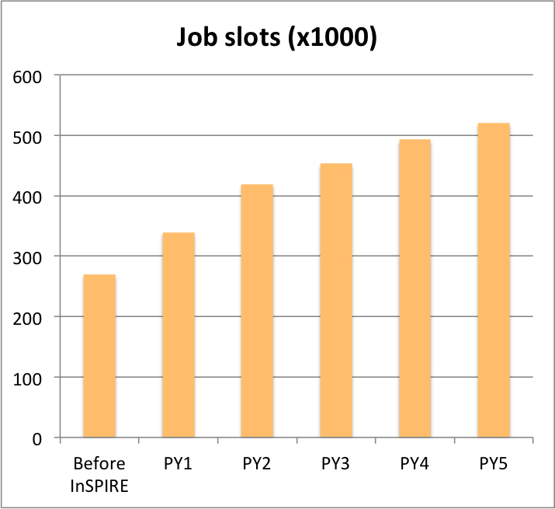
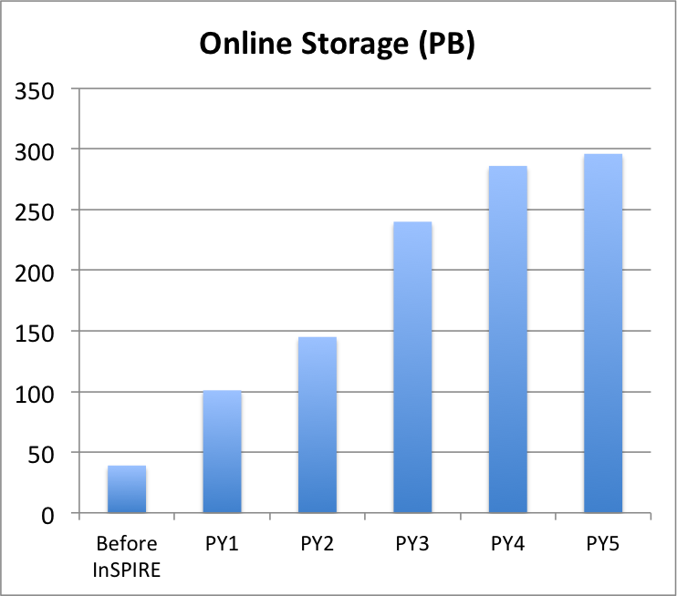
Evolution of the HTC production infrastructure
End of PY5
Job slots council member RPs (Increase from PY4) | 401,200 (+10%)
Job slots including integrated RPs | 531,000
Online storage capacity (Increase from PY4) | 296 PB (+4%)

Slide 16
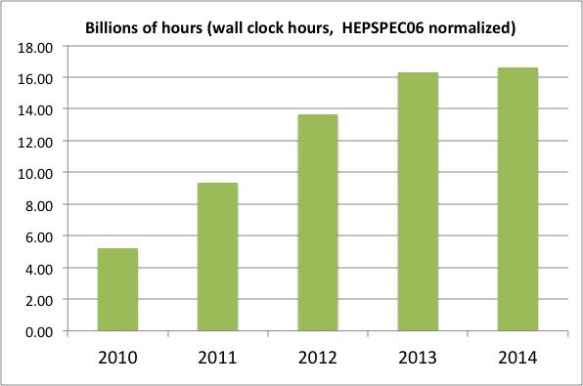
Use of the HTC infrastructure

Slide 17
Use of the HTC infrastructure
PY5 (Increase from same period 2013)
Job executed | 372 Mln (+10%)
Wall clock time [HEPSPEC06 hours] | 12.38 Bln (+15%)

Slide 18
HTC integration
EUDAT
EGI/EUDAT interoperability cookbook to support common use cases
XSEDE
Study of collaborative use examples to identify cross e-infrastructure use cases and identify interoperability requirements
IDGF
Desktop resources part of the production infrastructure since PY5

Slide 19
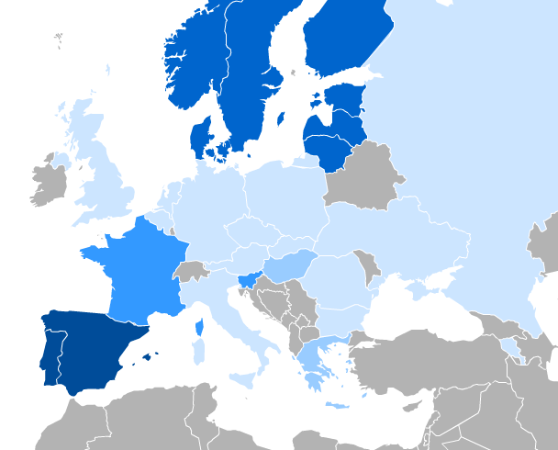
Inter-usage across countries
Percentage of resources used by users from another country
Notes:
RImettere

Slide 20
Inter-usage beyond EGI
TO OSG
More than 6,200 jobs in PY5, excluding HEP
TO IDGF
More than 68,000 jobs in PY5
Notes:
RImettere

Slide 21
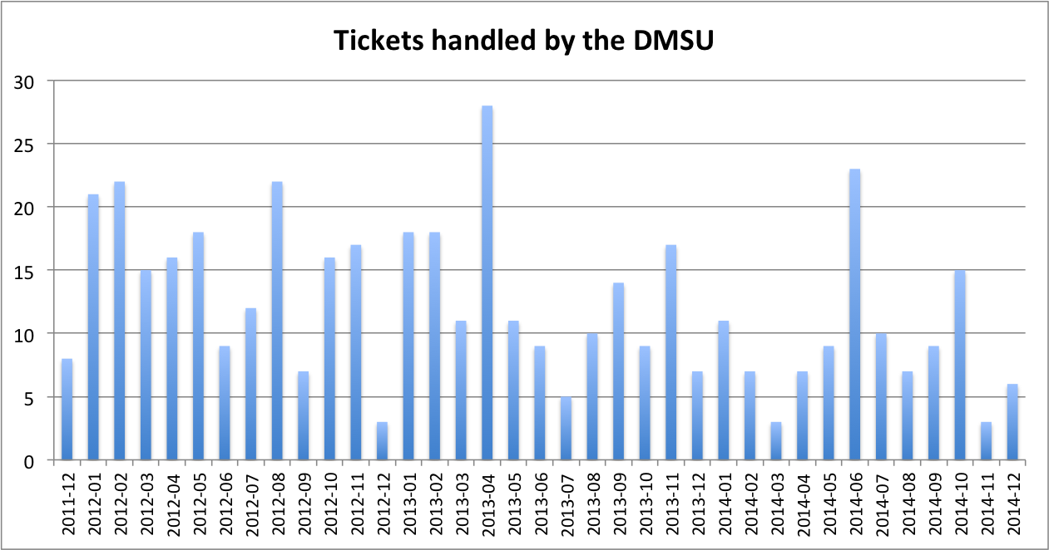
Helpdesk support for the HTC services
Tickets handled by the 2nd level support

Slide 22
Helpdesk support for the HTC services
Tickets handled by the 2nd level support
PY5 (Supported as core activity)
Tickets handled by the 2nd level support | 82
Tickets solved by the 2nd level support | 78

Slide 23
Conclusions
Software provisioning
SA2 Built a software provisioning process and infrastructure to support UMD
Now Supported as core service by the EGI members fees
Releasing
HTC Middleware: gLite, ARC, Globus
HTC/HPC Middleware: UNICORE, QCG
Storage: dCache, Frontier-Squid, CVMFS
Ready to evolve to support the needs of the EGI stakeholders
Additional business models: provided as a service to centres of excellence and EGI user communities
High throughput data analysis
Support for the increased requirements of the user communities
Effective sharing of resources among countries and user communities

Slide 24
Questions
Members of the EGI-InSPIRE collaboration thank the EC for supporting EGI

