Slide 1
Strategy
Sergio Andreozzi
Strategy and Policy Manager, EGI.eu
sergio.andreozzi@egi.eu

Slide 2
Outline
EGI Strategy 2010-2014
Initiative for Developing a new Strategy
EGI Strategy 2015-2020

Slide 3
EGI Strategy 2010-2014

Slide 4
Timeline
EGI strategy development
2.2015
11.2014
Full draft new EGI Strategy based on OSC vision & strategy workshop
4.2014
Open Science Commons policy paper and presentation at e-IRG
10.2013
Open Science Commons vision
Update on the EGI strategy:
“Secure, federated data-analysis capability for the European Research Area
4.2012
First EGI Strategy document: “Seeking new Horizons: EGI’s role in 2020”
5.2010
EGI-InSPIRE Kick-start
2.2010
EGI.eu was born

Slide 5
  EGI Strategy document (2012-2013)
  Major Strategic Shifts
Customers & Users
  From consolidating current user communities to
  proactive outreach with champions/NILs to new user communities
  From teaching the customer to learning from each other
Services
  From Grid of Clusters to “Grid of Clusters & IaaS Clouds”
  until “Cloud First”
  From command line + generic web portals to domain-specific science gateways

Slide 6
  EGI Strategy document (2012-2013)
  Major Strategic Shifts
Federation
  From a single business model to multiple business models
  From loose collaborations among e-infrastructures to
  an e-infrastructure commons
  From federated operations supported by EC projects to sustained by the members
  From internal federated operation to federated operation as a service

Slide 7
Initiative for Developing a new Strategy

Slide 8

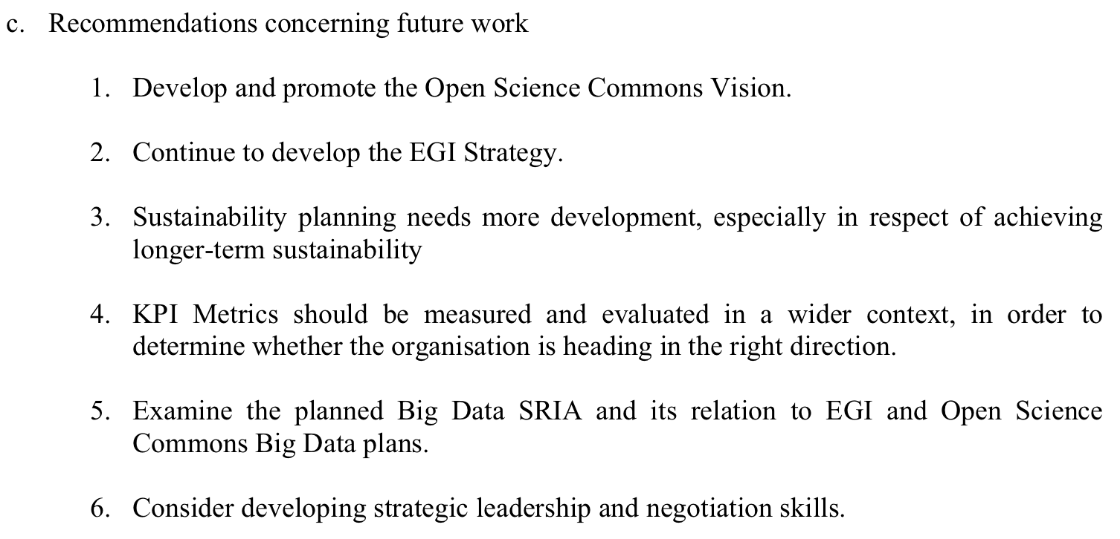
Motivation
From
4th EGI-InSPIRE review report

Slide 9
Goals of the Initiative
Develop a new EGI strategy
  Based on the Open Science Commons vision
  Involving EGI.eu senior managers, the EB and the Council
  Gather the viewpoint of key representatives of user communities
Increase skills among EGI.eu staff
Increase maturity of the strategic planning process
Improve quality of conversation on strategy
Improve communication of strategy
  Both internally and externally

Slide 10

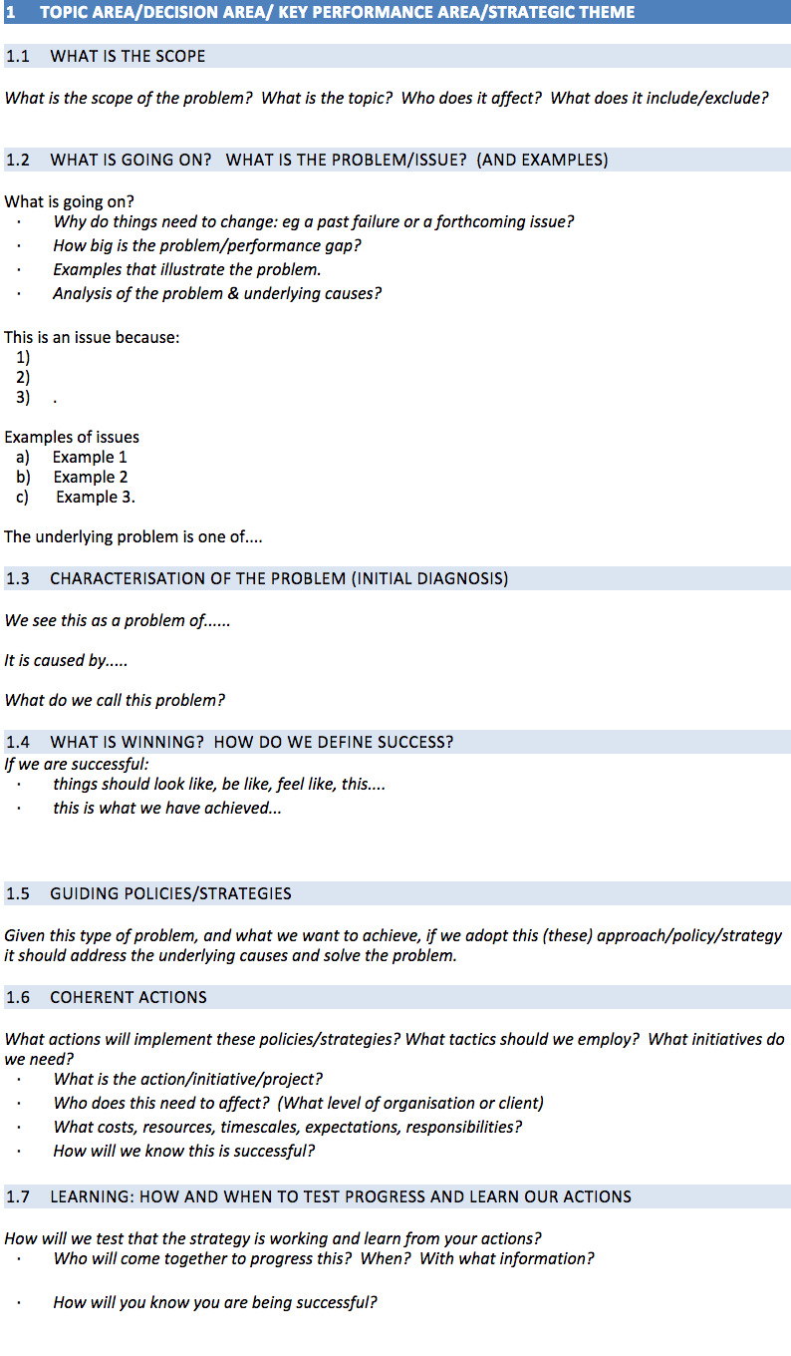
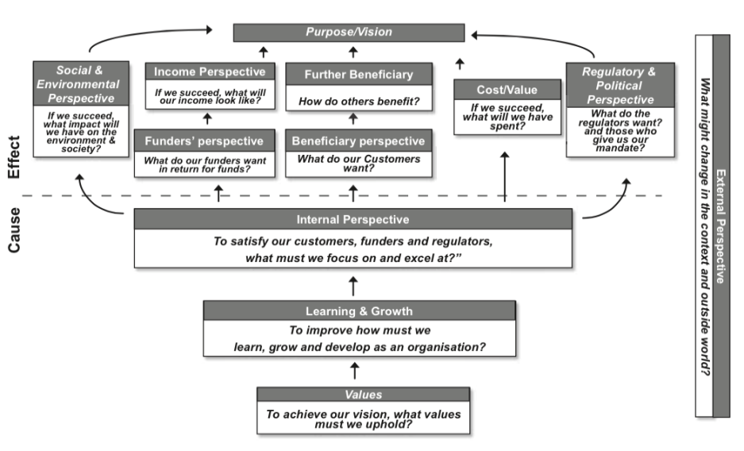

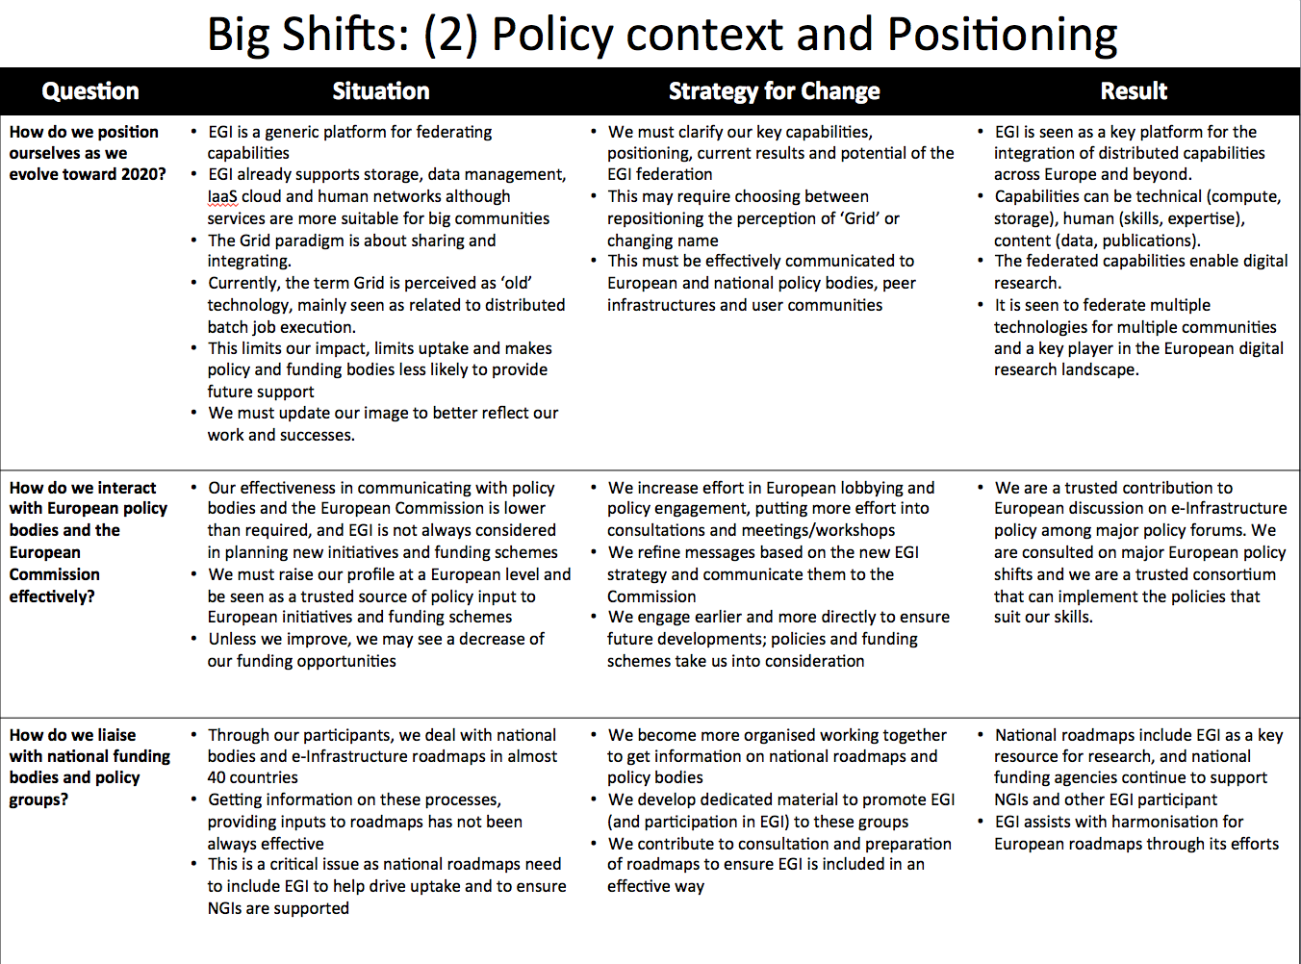

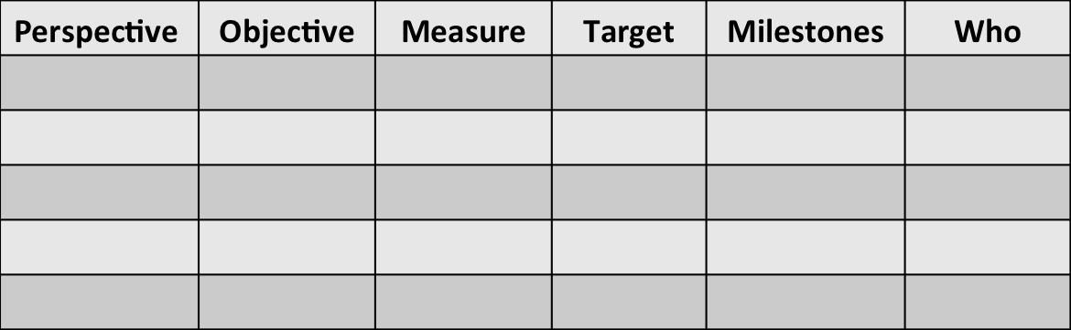
Tools

Slide 11

Work-Plan
Interview EGI.eu staff
Development top level strategy map
Training EGI.eu staff
Develop strategy tablets
Identification big shifts
Sep-Oct 2014
Interview EGI Executive Board
Revise top level strategy map
Revise big shifts
Update strategy tablets
Nov 2014
Survey EGI Council
Revise top level strategy map
Revise big shifts
Update strategy tablets
Survey key user communities
Dec 2014 -Jan 2015
Cascade strategy maps
Develop milestones
Develop KPIs
Write strategy document
Council Strategy workshop
Jan-Feb 2015
Analyse workshop feedback
Analyse EGI-InSPIRE review feedback
Develop new draft strategy doc
Public comment
Adoption EGI Council May 2015
Mar-May 2015

Slide 12
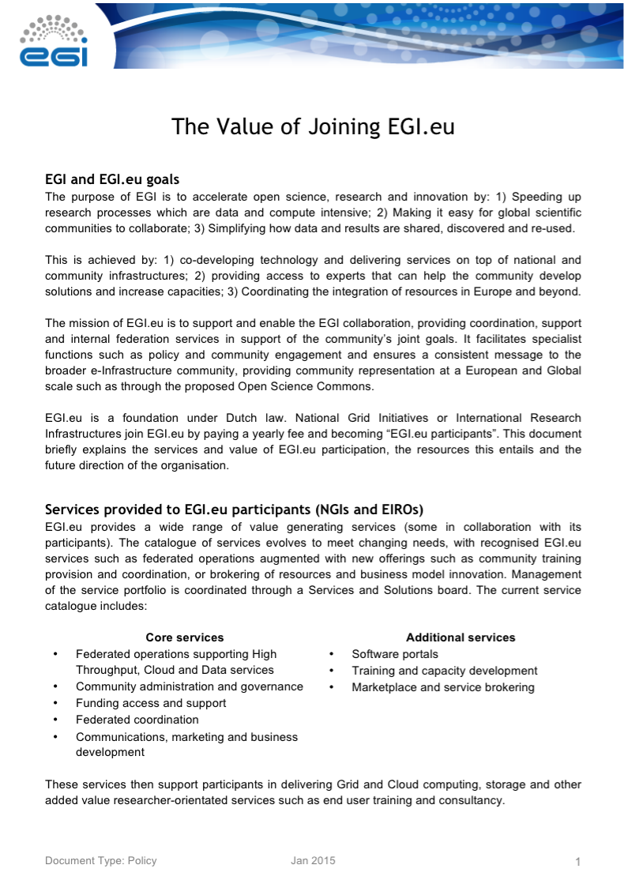
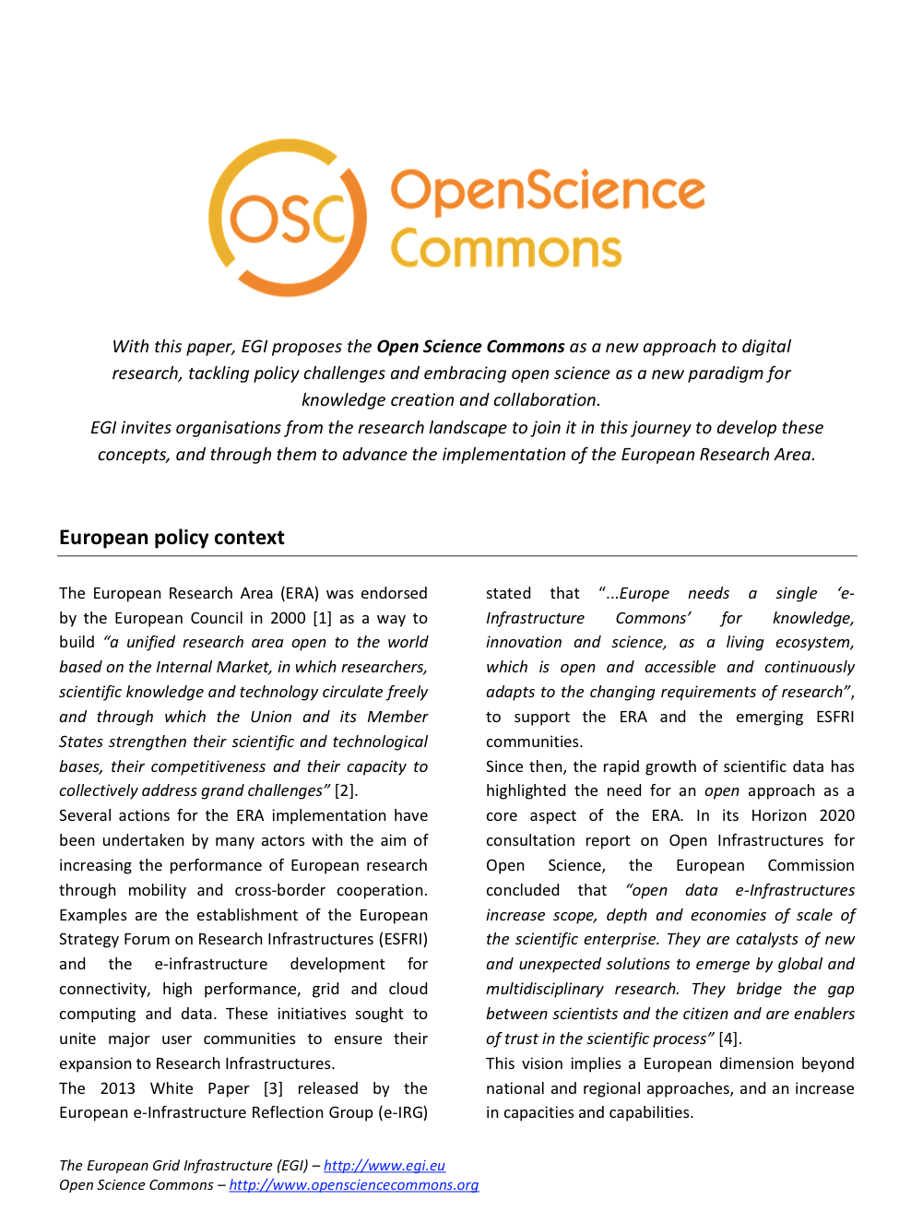
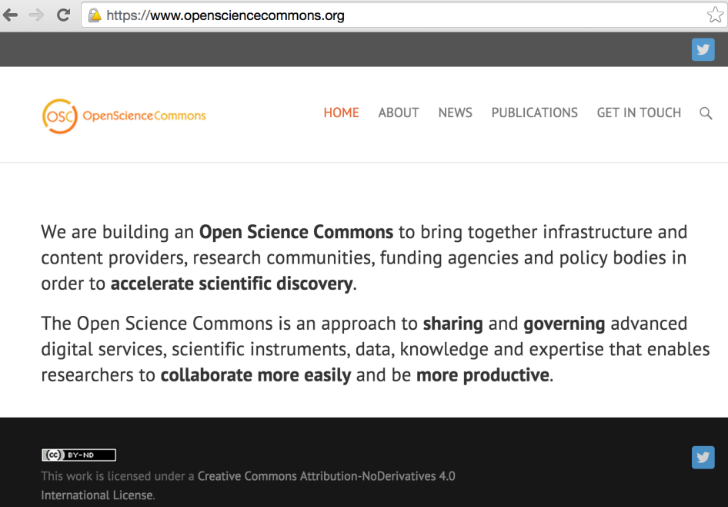
Outputs in PY5

Slide 13
EGI Strategy* 2015-2020
* Work in progress, not yet approved by the EGI Council

Slide 14
Structure of the Strategy Document
Top-level strategy map cascaded into 5 strategic themes
10 big shifts areas in 4 main categories
Summary objectives, milestones for 2015-2018 and related KPIs
Assumptions and risks
Governing the strategy

Slide 15
Overarching Vision
Researchers from all disciplines have easy, integrated and open access to the advanced digital services, scientific instruments, data, knowledge and expertise they need to collaborate to achieve excellence in science, research and innovation
Digital services
Knowledge & Expertise
Data
Instruments
www.opensciencecommons.org

Slide 16
What is a ‘Commons’?
Resource management principle by which a resource is shared within a community
  Non-discriminatory access
    Not depending on user identity or intended use
  Not necessarily free access
    Recover costs
    Avoid congestions/depletion
      “tragedy of the commons”
    Congestions polices (e.g., charging for use, quotas)
    Infrastructure: the Social Value of Shared Resources:
    http://www.amazon.com/Infrastructure-Social-Value-Shared-Resources/dp/0199975507

Slide 17
Principles of the Commons
Principles of the Commons | What it means to the Open Science Commons
Shared community resources | research data, scientific instruments, digital services, software, scientific publications, educational and training, expertise
Community-based rules and procedures in place with built-in incentives for responsible use | Access modes are well defined and non-discriminatory for all members of the ERA Clear points of access and support
Governance: the community is part | Governance model with multiple stakeholders, including research communities, scientific infrastructures, resource providers, national and European infrastructures, etc.
Long-term, persistent care for a given resource for the benefit of oneself and others | Long-term support of funding agencies to allow for infrastructures to take a long-term view and build for a common European future

Slide 18
In the context of European open science, research and innovation…
EGI (the Federation) Mission
to provide solutions for open science, research and innovation by federating digital capabilities, people and knowledge
EGI.eu Mission
to provide services and coordination to our participants enabling them to create value, as a federation, for researchers performing digital collaborative science, research and innovation

Slide 19
Top-Level Strategy Map
Overarching
vision
Researchers have easy/open/integrated access to advanced digital services, data,
knowledge and expertise to collaborate and achieve excellence in science, research and innovation
EU &
National
Governments
I want research that benefits the economy, society & environment:
I want Open Science without borders
Value: make sure
you can show me
this investment
was worth it
Research
Organisations
And Researchers
Allow us to conduct and collaborate in open research,
across Europe & worldwide, efficiently
Our mission
To provide solutions for open science, research and innovation
by federating IT capabilities, people and knowledge
The
contribution
Policy & strategy
Services & solutions
Sustainable services
Policy contribution
OSC
Principles
Aligned policy &
roadmaps
e-Infrastructure
Services
Solutions
The EGI Federation
Influence Policy & develop strategy
Engage, educate and
Help communities to find right solution
Design, Develop
and deploy solutions
Serve and support users.
Provide effective
services & solutions
Prove
& Learn
Leadership
Openness
Reliability
Innovation
Commitment

Slide 20
Big Shifts in the EGI Strategy
Overall vision, policy context and positioning
  From an e-Infrastructure Commons to
  an Open Science Commons
  From following policies to co-creating policies
  From “Grid of Clusters/Clouds” to “Grid of capabilities”

Slide 21
Big Shifts in the EGI Strategy
Customers and Users
  From research only to research and innovation (including SMEs)
  From big communities to big communities and long tail
  From teach our services to co-create solutions
  From provider/customer to joint competence centre
  From high entry barrier to easy sign up and try out

Slide 22
Big Shifts in the EGI Strategy
Services & Solutions
  From Grid of IaaS Cloud to Grid of IaaS/PaaS/SaaS Cloud
  From private data to open data enabling services
  From FedOps to FedOps-as-a-Service
  From some human networks to more human networks

Slide 23
Big Shifts in the EGI Strategy
The Federation
  From central to collaborative strategic planning
  From diverse to standardised service management
  From diverse to standardised project/team management
  From sharing services to creating new opportunities
  From one business model to many business models
  From internal to open innovation

Slide 24
Governing the Strategy
Execution and Revision
EGI Council
High-level review of progress in strategy implementation, project execution, and service delivery
3 months
EGI.eu Executive Board + EGI.eu senior managers
Detailed look at progress towards objectives and blocking issues
4 weeks
EGI.eu Managers Meeting
Policy Boards &
FitSM process owners
weekly
Weekly progress
on projects
Report about operations, user satisfaction, …

Slide 25
Conclusion
Established an open and collaborative strategic planning process
Developed a new vision and high-level policy paper
Developed a new EGI strategy and execution plan
Improved governance for strategy execution and revision

Slide 26


Members of the EGI-InSPIRE collaboration thank the EC for supporting EGI

