Slide 1
Community-Driven Innovation and Support Solution
Gergely Sipos
EGI.eu
gergely.sipos@egi.eu

Slide 2
Outline
Objectives
Structure of activities
Results in PY5
Events and communications
Virtual Teams
Distributed Competence Centre
SME engagement
Federated Cloud
Use of resources
Next steps
Conclusions
Community-Driven Innovation and Support Solution

Slide 3
Objectives
Enabling excellent science through EGI solutions
Raising awareness of EGI
Technical engagement with community representatives
Requirement-driven customisation and extension of EGI solutions
Target groups:
Research Infrastructures
Scientific collaborations (international & national projects)
The ‘long tail’
SMEs and industry
Engagement strategy defined and driven from EGI-InSPIRE
Community-Driven Innovation and Support Solution

Slide 4
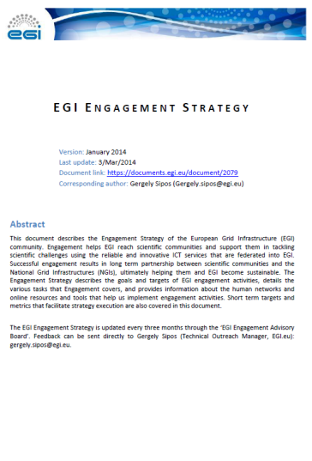
Approach
Engagement strategy
http://go.egi.eu/engagementstrategy
To define what, why, who, how, when
Monthly Engagement meetings
Coordination, implementation and support from EGI-InSPIRE
EGI.eu teams
NA4.1
Coordination
NGI International Liaisons
EGI-InSPIRE
NA4.2
Communication
Champions
NA4.3, SA5.2
Heavy User Communities (User Community Board)
Support
Distributed Competence Centre
Collaborating projects
NEW in PY5
Community-Driven Innovation and Support Solution

Slide 5
From needs to solutions
Technical engagement
Outreach
Implementation
Events and communication
Consultancy and support
Virtual Teams AND Competence Centres
User communities
NEW in PY5
Outcome
Awareness and interest in EGI
Existing solutions
Joint activity plan
Excellent science
Success cases, tools, champions, etc.
Community-Driven Innovation and Support Solution

Slide 6
Results from PY5
Community-Driven Innovation and Support Solution

Slide 7
Results from PY5
Events and communications
Virtual Team projects
Distributed Competence Centre
SME engagement
Federated Cloud
Community-Driven Innovation and Support Solution

Slide 8
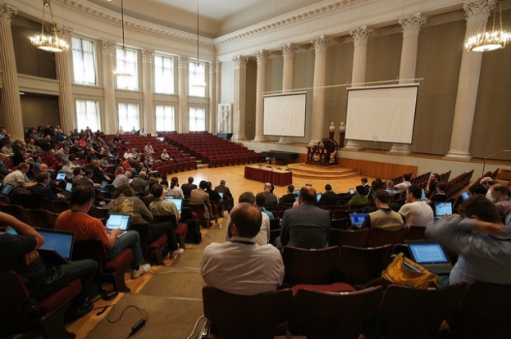
Events
EGI events
EGI Community Forum, Helsinki, May 2014
Ca. 400 participants
Technical tracks, Hackathons, Tutorials, Workshops, …
EGI Conference on Challenges and Solutions for Big Data Processing on Cloud, Amsterdam, Sep 2014.
Ca. 160 participants
Technical sessions on AAI, Data, Storage; EGI-GEANT Symposium
Contributions to external events
Conferences
Bioenergetics, Computational Biology, Climate modelling, Low-frequency Radio Telescopes
ESFRI workshops
BioMedBridges, DASISH, BBMRI, ELIXIR, EPOS, LifeWatch, DARIAH
EC consultation events
E-infrastructures for Mathematics; E-infrastructures for Africa, Research e-infrastructures and innovation clusters
Community-Driven Innovation and Support Solution

Slide 9
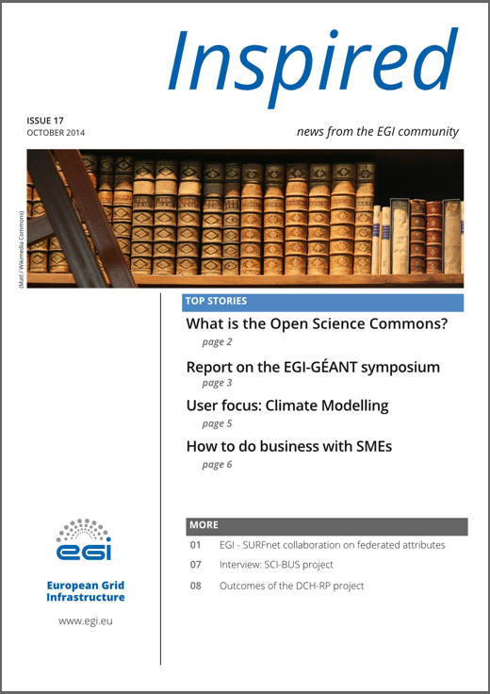
Communications: Publications
Solutions’ brochures
EGI CF2014
Book of Abstracts
Case studies
Six new case studies
Astro-seismology, Crystallography, Environmental science, Physics, Medical, Space science
Case studies booklet http://www.go.egi.eu/cst
Newsletters
2 issues of Inspired
Community-Driven Innovation and Support Solution

Slide 10
Virtual Teams
PROJECT | START DATE | END DATE
Promoting Desktop Grids | Nov 2013 | Feb 2015
Support for genome analysis and protein folding | Apr2014 | Ongoing
Platform for the long-tail of science | Oct 2014 | Ongoing
Integrating ELIXIR Reference Datasets into EGI | Dec 2014 | Ongoing
Community-Driven Innovation and Support Solution

Slide 11
Promoting Desktop Grids VT
Goals/Tasks:
Promote DG technology and support uptake
Members:
Albania, Bulgaria, Hungary (leader), Italy, Malaysia, Netherlands, Serbia, Spain, Taiwan, UK, Ukraine
Achievements:
Integrating 5000 cores from 65 countries
New European DG Operations Centre
New applications from
Structural biology
Biodiversity science
Mathematics (prime numbers; linear algebra)
Community-Driven Innovation and Support Solution

Slide 12
Support for genome analysis and protein folding VT
Goals/Tasks:
1. Identify and integrate relevant tools from the domain
2. Raise awareness about EGI tools and support
Members:
2 EGI Champions
3 NGIs
3 scientific communities
Life sciences
Genomics
Proteomics
Structural Biology
Bioinformatics
Achievements:
1. Integration of 4 tool from the domain with EGI
READemption (DE), Trufa (ES), Chipster (FI), RSTAT (FR)
2. Promotion of 17 applications/tools
1 webinar and 3 face-to-face events
Reaching approx. 100 scientists
Community-Driven Innovation and Support Solution

Slide 13
Platform for the long tail VT
National solutions exist in several countries. But we need
More consistent support across all countries with simplified access
Facilitation of interactions between researchers and NGIs
Lower cost of operation
Long tail platform
User registration portal and science gateways
Dedicated resources in a Global VO (grid and cloud)
New security mechanism: User-specific robot proxies
Development started in October 2014
Release in Spring 2015
Community-Driven Innovation and Support Solution

Slide 14
Integrating ELIXIR Reference Datasets into EGI VT
Goals/Tasks:
Identify and replicate life science datasets into EGI
Extend Applications Database (AppDB) and ELIXIR-BMB Registry towards dataset registries
Propose analysis tools for researchers to work with data replicas
Members:
EGI.eu, EUDAT, ELIXIR Hub + ELIXIR nodes of DK, GR, IT, PT, SI
Project started in December 2014
Expected end in Autumn 2015
Community-Driven Innovation and Support Solution

Slide 15
Distributed Competence Centre
PY5: Distributed Competence Centre
‘Flat’ list of 32 institutes
Technical engagement with local communities
Nanotechnology, Agricultural sciences, Humanities, life sciences, Marine research, etc.
Support for application Integration, gateways, etc.
From 2015: Network of 8 Competence Centres
Each focussed on a specific scientific discipline
Joining effort from NGIs, ESFRI institutes, technology and service providers
Community-specific work plans building on EGI cloud, AAI, Data, GPGPU, etc.
Outreach, support and training
Additional CCs are expected to emerge from recent collaborations,
E.g. CLARIN, ELI, ESS, ICOS, KM3NET, LOFAR
Community-Driven Innovation and Support Solution

Slide 16
SME engagement
Local/project initiatives continued in PY5
Federated Cloud is seen as a facilitator
6 cloud use cases from private companies: Electric grids, Digital archiving, Music score analysis, Virtual screening, Data backup, Water quality prediction
European approach
EGI Business Engagement Programme defined by a Virtual Team
Including an implementation plan
Council requested revision in February
Community-Driven Innovation and Support Solution

Slide 17
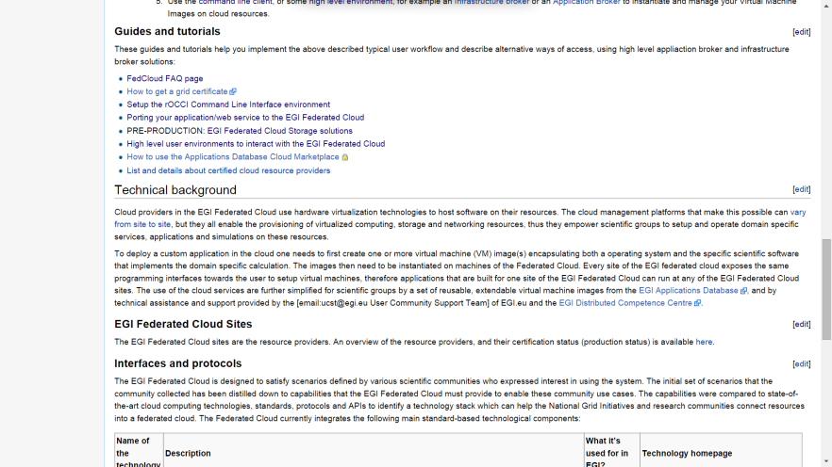
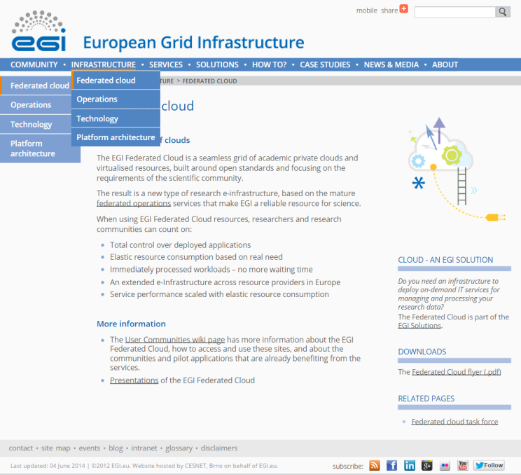
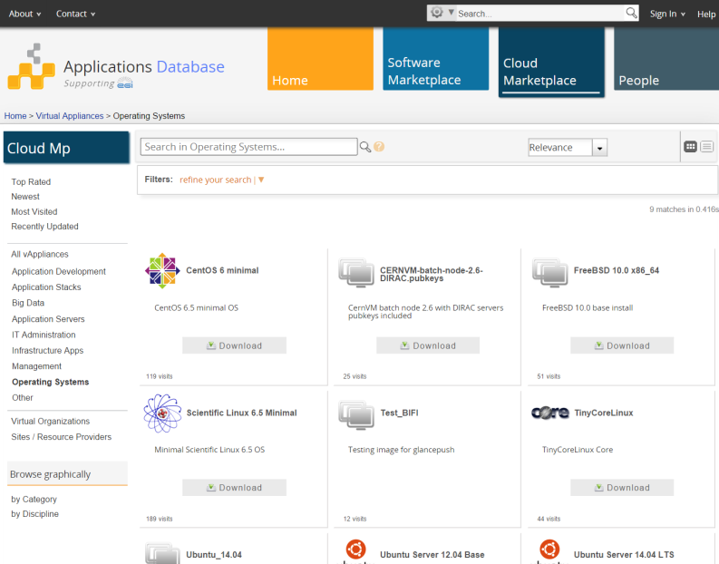
Federated Cloud - Support
A new EGI platform
Production launch in May 2014
Established user support
Online guides, tutorials, guides
Incubator resource pool
Formalised support workflow
Network of cloud user support teams in the NGIs
Community-Driven Innovation and Support Solution

Slide 18
Federated Cloud - Impact
Supported 50 use cases from 26 communities in PY5
Biological sciences – 18
Physical sciences – 11
Earth sciences – 5
+ Computer science, Digital archives, Arts, Language and literature, …
Usage statistics:
11 VOs
31 VM images in AppDB registry
200.000 VM instantiated
Community-Driven Innovation and Support Solution

Slide 19
Use of resources
NA4 (Community engagement)
EGI.eu with 44 PM
28 partners with 162 PM (~6 PM / partner)
Achieved PMs
NA4.1: 90%
NA4.2: 106% (EGI.eu)
NA4.3: 99%
SA5.2 (Cloud use cases)
18 partners with 63 PM
Achieved PMs: 41%
Reason of difference comes from: CESNET, CSIC, GRNET
Activities were covered from other funding sources
Community-Driven Innovation and Support Solution

Slide 20
Key achievements of 5 years
Excellent science
+ >2000 publications with support from EGI
Virtual Research Communities
Community coord.
8 RIs with Competence Centres
6 additional RIs in early engagement
76 science projects supported
82 partners: NILs, UCB, Champions (only ~10 FTE from EGI-InSPIRE)
23 Virtual Team projects
257 software and
31 VM image registration in the Applications Database
Production Infrastructure
49 multi-national + 27 national new VOs
6 ESFRI VOs ELI , CTA, LifeWatch, EISCAT, Km3Net, BBMRI
61 billion CPUh consumed
200.000 Virtual Machine instantiation
Community-Driven Innovation and Support Solution

Slide 21
Next steps
Keeping the diversified engagement approach
Setup service agreements with heavy user communities
Launch Competence Centres with ESFRIs
Roll-out the long-tail platform
Expand support for the Federated Cloud
High level platforms (e.g. Hadoop clusters)
Implement the EGI Business engagement programme
Reinforce the human networks
NILs, Champions, UCB, Operation Managers
E-infrastructure partnerships (joint calls)
Community-Driven Innovation and Support Solution

Slide 22
Summary
Engagement activity at the pan-European scale would not be possible without EGI-InSPIRE
Successfully established framework, tools and human networks
Customised approaches for each user segment
Intensified activities in PY5
Virtual Team projects
Structured Competence Centres
Federated Cloud
To focus and intensify activities in 2015 with RIs and SMEs
Community-Driven Innovation and Support Solution
Notes:
VTs are important

Slide 23
Questions
Members of the EGI-InSPIRE collaboration thank the EC for supporting EGI

